Slide 1
Economic Evaluation of Distribution Modernization Expenditures
Presentation for National Association of State Utility Consumer Advocates
Paul De Martini, Newport Consulting
Contributions by Lisa Schwartz, Berkeley Lab
January 15, 2025

Slide 2
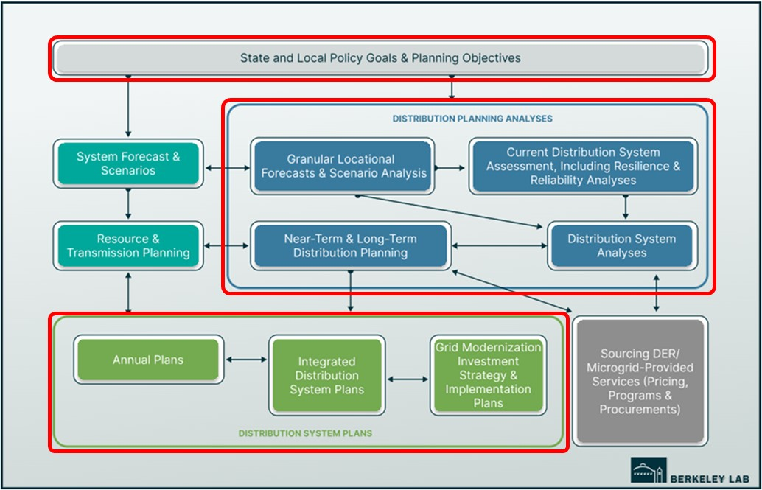
Economic Evaluation of Distribution Grid Modernization Expenditures*
Cost-effectiveness evaluation of distribution modernization expenditures is integral to the distribution planning process.
Planning activities circled in red involve cost-effectiveness process steps:
  State and Local Policy Goals & Planning Objectives
  Distribution Planning Analyses
  Distribution System Plans
*New Berkeley Lab report by De Martini, Ball and Schwartz posted here

Slide 3
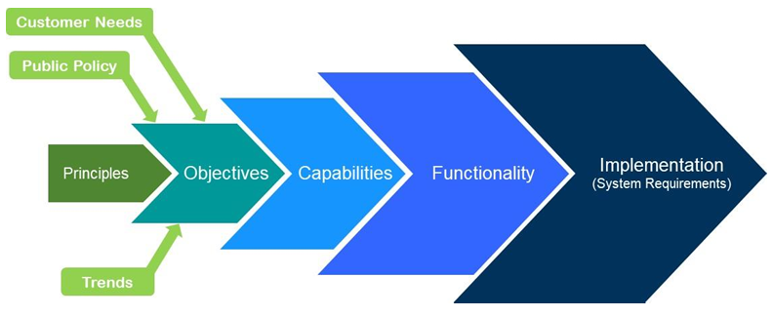
Three core principles
Create transparency and consistency in assessment methods to ensure cost-effectiveness evaluation of alternatives clearly shows the relationship between proposed solutions, identified grid needs, and related objectives.
  Clarity and consistency in underlying assumptions, parameters and values
Use credible, methodologically sound data from independent or balanced sources that reflect a time frame relevant to the analysis.
Conduct a holistic analysis that includes all supporting analyses of grid needs and identifies monetary and non-monetary benefits and costs.
Source: Modern Distribution Grid, Volume I (2019)

Slide 4
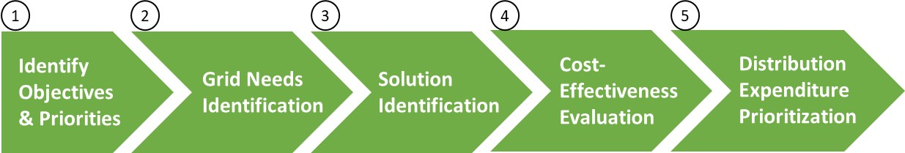
Multi-objective decision-making process

Slide 5
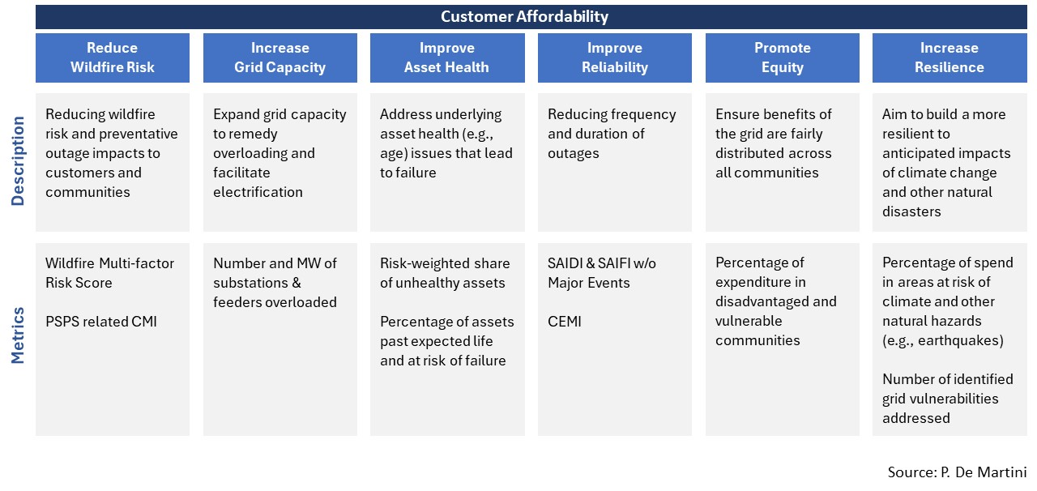
1. Identify objectives and priorities
Establish objectives, metrics and priorities through a stakeholder-engaged process
Example Utility Grid Planning Objectives & Metrics

Slide 6
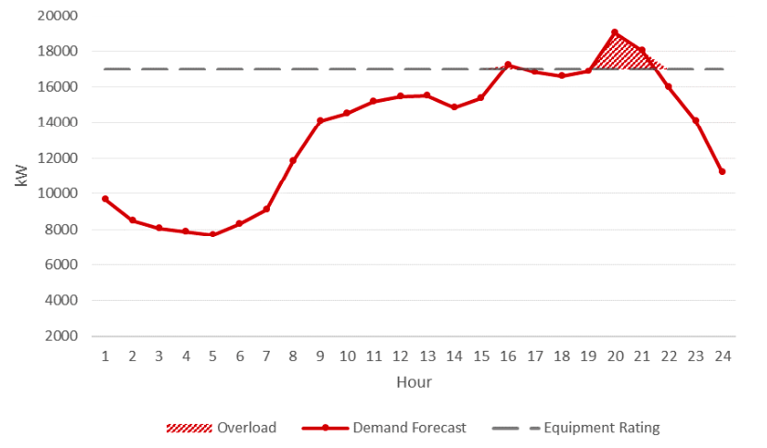
2. Identify grid needs
Clearly describe grid needs in terms of objectives and metrics
Grid needs assessment is the distribution system analysis output that identifies specific grid deficiencies
  Describes each grid need, with engineering characteristics or functional requirements and timing
  Starting point for developing solutions to address each need
Hourly Grid Needs Example
Source: HECO

Slide 7
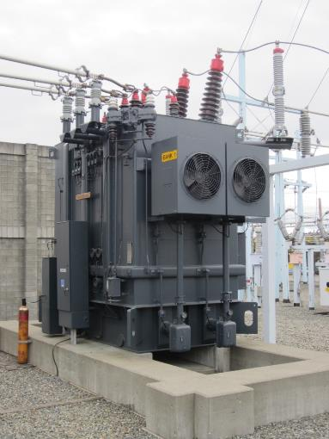
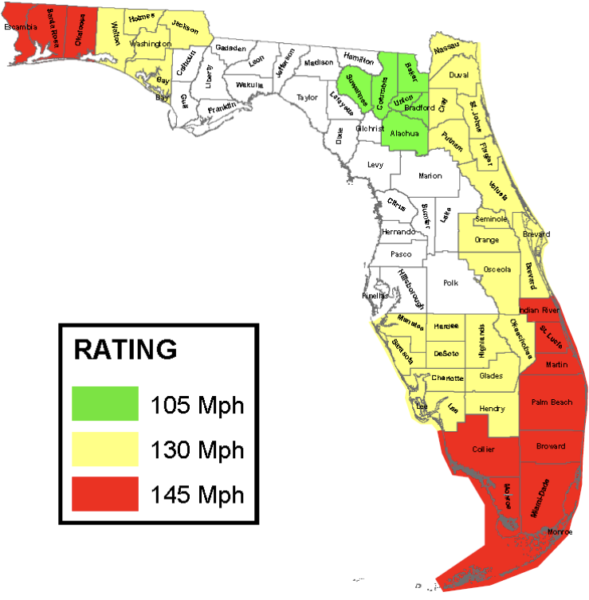
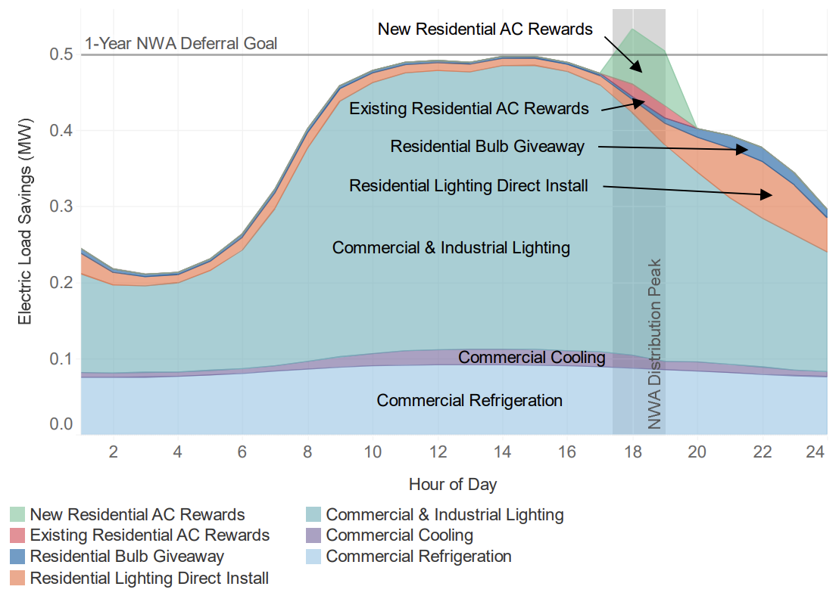
3. Identify potential solutions
System improvements (incremental cost), such as resilience investments, programmatic asset replacement, infrastructure upgrades, and grid technology investments
Operational changes (no incremental cost), such as system reconfiguration and new design standards
Non-wires alternatives, such as time-varying rates (low incremental cost where smart meters are installed), geotargeted demand-side management programs (no or low incremental cost), and procurements for third-party distributed energy resource (DER) services (incremental cost)
Source: CEE
Source: Florida Power & Light

Slide 8
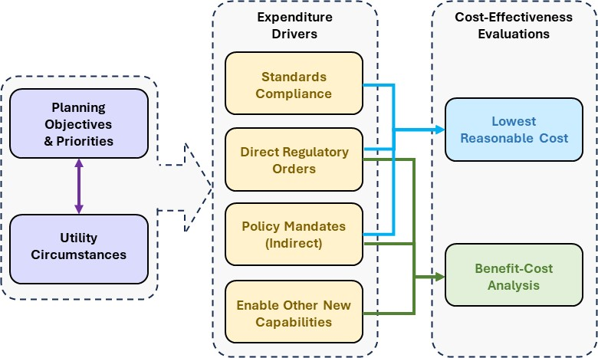
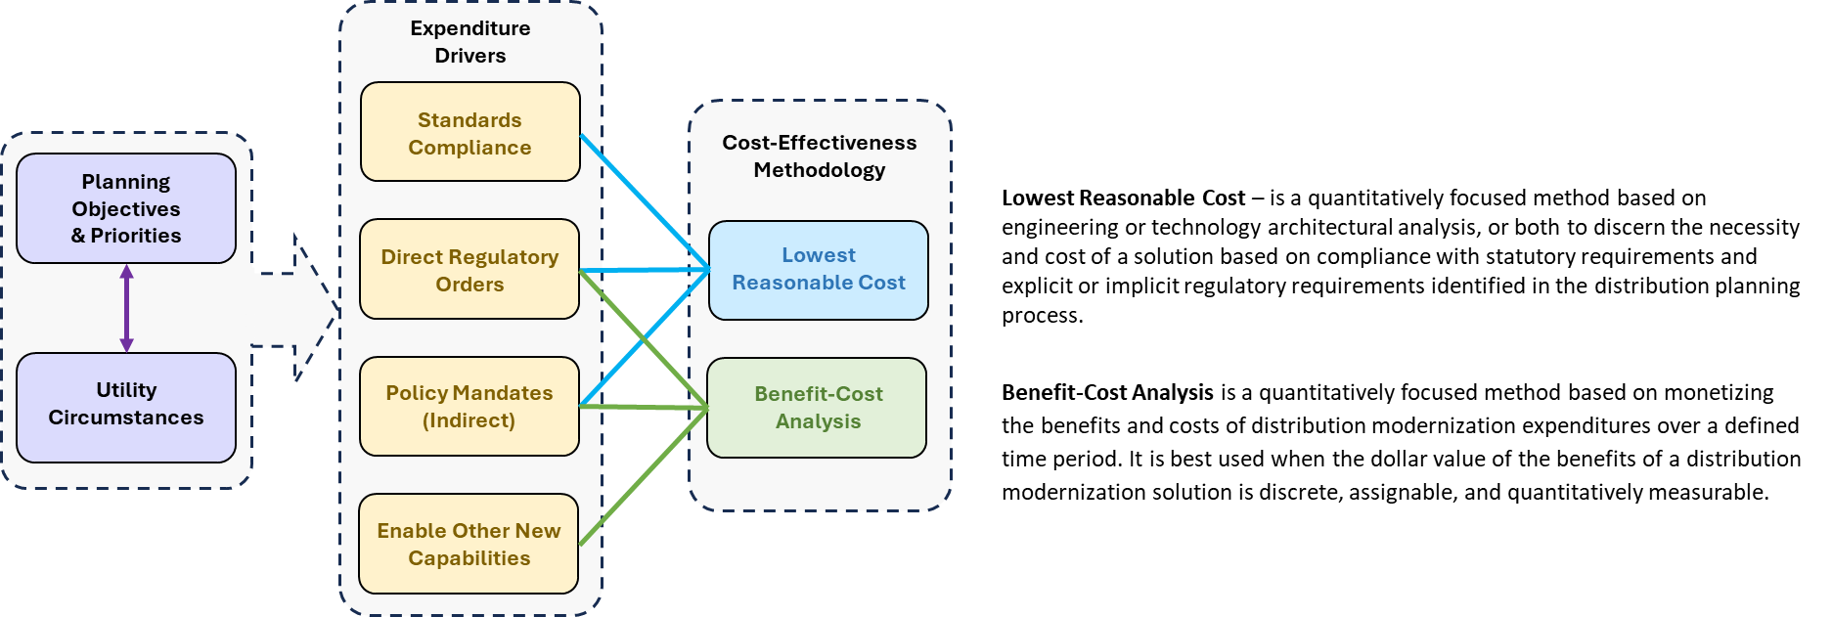
4. Screen for cost-effectiveness
Source: P. De Martini

Slide 9
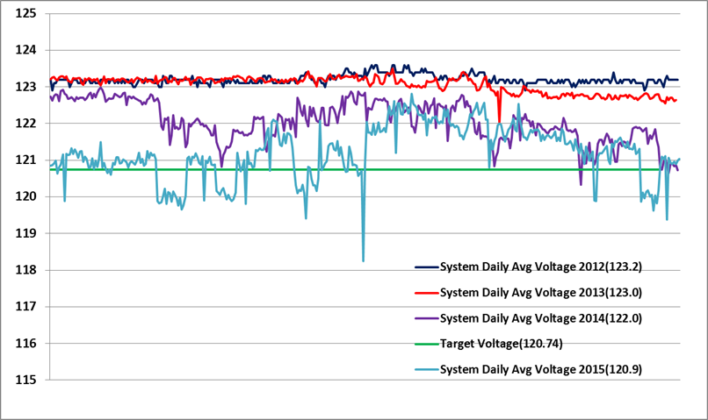
Expenditure drivers
Standards Compliance – Solutions to comply with safety, power quality, and reliability standards are addressed using Lowest Reasonable Cost (LRC).
  Example: Voltage management solution to comply with the national electric service quality standard for voltage (ANSI C84) involving grid devices and integrated volt-var control (IVVC) software to manage inverters (IVVC illustration below).
Direct Regulatory Order – Solutions in response to a PUC order may be addressed using LRC or require a Benefit-Cost Analysis (BCA), depending, for example, on whether the decision and order included a finding that the required capability was in the interest of the public and utility customers. If so, then the LRC method may apply.
  Example: California PUC ordered utilities to implement a specific approach to flexible DER interconnections involving a dynamic curtailment control scheme that will require utility expenditures to implement. The order determined that this new requirement was in the public interest, and the utility must implement the required approach using the lowest reasonable cost solution that conforms to the order.
  Example: A regulatory order in a DER docket requires a distribution grid solution — specifically, flexible demand programs. In this case, the utility conducts a BCA to assess cost-effectiveness of the proposed program in compliance with the order, including program implementation costs. Any necessary grid operational technologies (e.g., DER management system — DERMS) is included in program costs to avoid duplication and align all implementation costs with the flexible demand programs.
Source: Duke Energy

Slide 10
Expenditure drivers (cont.)
Policy Mandates – For instance, legislation requiring commercial fleet and light-duty vehicle sales by a certain date considers societal value and compliance with the statute, which may require new enabling grid capabilities. However, not all policy mandates identify the value from the perspective of utility customers. In these cases, a BCA is used to determine the cost-effectiveness of solutions.
  Example: Wildfire mitigation solutions are evaluated with BCA even in the face of a policy mandate as there is typically a need to prioritize expenditures that have the greatest mitigating impact. For example, this may be done by assessing the risk-spend efficiency of a wildfire mitigation solution. This approach is a derivation of a typical BCA.
Other New Capabilities – Solutions identified by the utility to improve operations (not driven by compliance, regulatory, or policy mandates) are evaluated using BCA.
  Examples: Solutions that create operational savings (e.g., operational control center consolidation) and adoption of technology innovations that increase productivity (e.g., field crew technology)

Slide 11
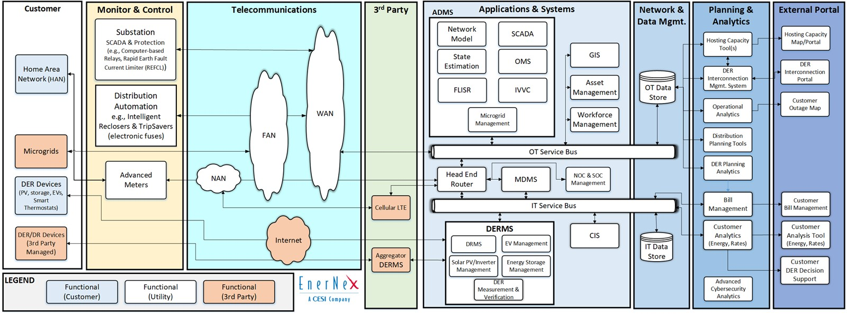
LRC example: Advanced Distribution Management System
A utility requires a better understanding of real-time operational conditions, based on current and forecasted DERs and electric vehicle (EV) charging interconnected to its distribution system. The utility intends to replace its obsolete distribution Supervisory Control and Data Acquisition (SCADA) system. The existing outage management system will be replaced in 4 years. IVVC capability may be needed in 6 years, depending on actual DER and EV adoption rates.

Slide 12
LRC example: Advanced Distribution Management System (cont.)
A BCA involving each current and future option would require determining marginal benefits from new capabilities, current and future software replacements, and potential additional modules based on assumptions of future software enhancements, timing of need, co-dependent field technologies (as in the case of the IVVC module), and any adjustment for the risk of mis-timing a future decision.
This is impractical because the decision is not whether an ADMS platform with an initial Network Model and SCADA is justified – that decision is determined through the needs analysis in the distribution system plan.
The task is to determine which vendor solution is the most cost-effective in terms of capital and ongoing operational and maintenance costs based on a comparative level of functionality — the least-cost, best-fit solution.

Slide 13
Benefit-cost analysis
BCA is a quantitatively focused method for assessing the net value to utility customers of a specific distribution modernization expenditure over a defined time period. The net value is determined by identifying utility, customer, and societal benefits compared to the expenditure's cost. A grid modernization BCA evaluates both:
  Direct utility savings - Financial benefits that accrue directly to the utility in terms of cost savings that are quantifiable in dollar terms, measurable, and auditable. These savings have a tangible impact on a utility's financial performance. They involve a clear cause-and-effect relationship between changes due to the proposed expenditure, as reflected in related metrics, and the resulting financial outcome.
  Indirect (non-utility) savings - Financial benefits that clearly accrue to customers or society or may accrue to utility but cannot be quantified. Indirect benefits may be harder to quantify in dollar terms, measure, or audit financial results. Indirect savings often require estimation or projections of dollar value. Certain grid modernization expenditures involve indirect monetary benefits such as improved customer reliability and societal gains. While not financially auditable, such non-utility benefits are important to assess.

Slide 14
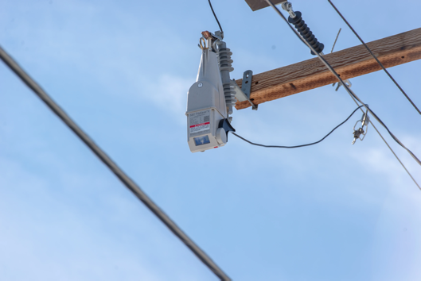
BCA example: Distribution Automation - Reclosers
A utility proposes to deploy five sectionalizing reclosers on each feeder to improve reliability. Standard industry practice is to install at least one mid-point sectionalizing recloser on each feeder for reliability. If all feeders do not have such a recloser, then material improvements in reliability can often be achieved and quantified.
Reliability benefits diminish as more reclosers are added to a circuit. While the cost of reclosers remains the same, the number of customers benefiting and the avoided outage duration decline, given the smaller segments.
Berkeley Lab’s ICE Calculator can be used to determine the optimal number of reclosers to install on an individual feeder to achieve the desired level of reliability cost-effectively.
For reliability improvements, indirect dollar benefits are typically much greater than
direct utility benefits, meaning that the proposed expenditure will be an incremental
cost. That is why it is essential to establish the reference metric for the overall target
level of service reliability based on specific reliability metrics (e.g., CAIDI – Customer
Average Interruption Duration Index) or peer benchmark rankings (e.g., maintaining
2nd quartile ranking), or both.
It is desirable to assess all individual reliability improvement measures holistically
as a program against the overall reliability objective and metric(s) in a distribution
system plan.
“TripSaver” automated recloser
Source: CHELCO

Slide 15
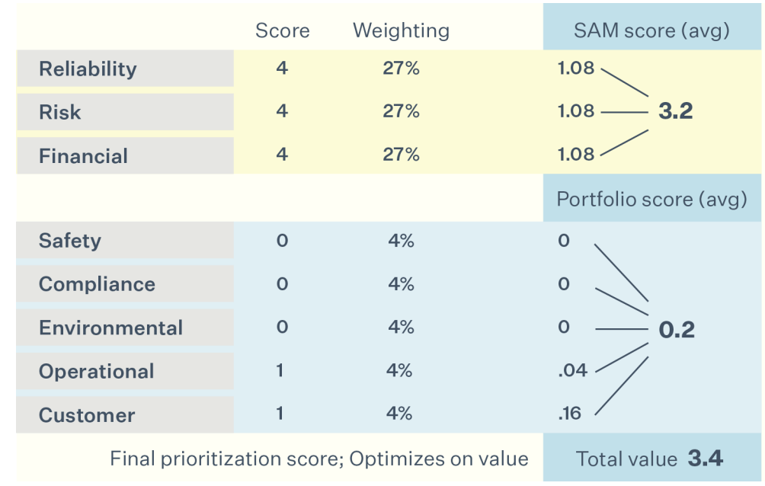
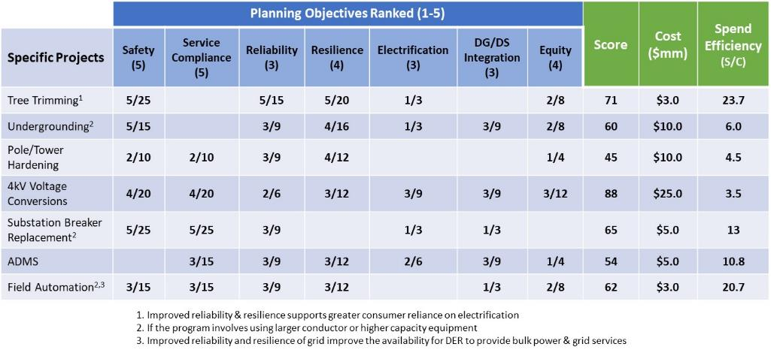
5. Prioritize investments based on multiple objectives
Use multi-objective decision analysis to prioritize grid modernization and all other distribution expenditures to optimize value toward meeting state goals, customer needs, regulatory requirements and other criteria
Identify which solutions materially address the most or highest priority objectives for a given net cost
Goal: A prioritized portfolio of distribution expenditures for a given revenue requirement
  Customer affordability is the global objective, setting the financial constraint for optimizing expenditures to achieve other objectives
Assess each proposed expenditure quantitatively, qualitatively, or both against each objective and metric
  Score each proposed solution based on its contribution to addressing each objective, then apply a weighting factor that reflects the objective's priority ranking (PGE example below). Finally, rank each possible solution using its final score and cost.
Use a value-spend efficiency approach for objectives that do not have a clearly defined methodology for determining the contribution of a grid solution to the desired outcome (illustrative example below)
Source: P. De Martini
Source: Portland General Electric's 2022 Distribution System Plan

Slide 16
Contacts
  Paul De Martini:
  Lisa Schwartz: lcschwartz@lbl.gov; 510-926-1091
For more information
  Download publications from Energy Markets & Policy: https://emp.lbl.gov/publications
  Sign up for our email list: https://emp.lbl.gov/mailing-list
  Follow Energy Markets & Policy on Bluesky: @berkeleylabEMP.bsky.social
Acknowledgements
  This work was funded by the U.S. Department of Energy Office of Electricity under Contract No. DE-AC02-05CH11231.
  The views and opinions of authors expressed herein do not necessarily state or reflect those of the United States Government or any agency thereof, or The Regents of the University of California.

Slide 17
Disclaimer
This document was prepared as an account of work sponsored by the United States Government. While this document is believed to contain correct information, neither the United States Government nor any agency thereof, nor The Regents of the University of California, nor any of their employees, makes any warranty, express or implied, or assumes any legal responsibility for the accuracy, completeness, or usefulness of any information, apparatus, product, or process disclosed, or represents that its use would not infringe privately owned rights. Reference herein to any specific commercial product, process, or service by its trade name, trademark, manufacturer, or otherwise, does not necessarily constitute or imply its endorsement, recommendation, or favoring by the United States Government or any agency thereof, or The Regents of the University of California. The views and opinions of authors expressed herein do not necessarily state or reflect those of the United States Government or any agency thereof, or The Regents of the University of California.
Ernest Orlando Lawrence Berkeley National Laboratory is an equal opportunity employer.
Copyright Notice
This manuscript has been authored by an author at Lawrence Berkeley National Laboratory under Contract No. DE-AC02-05CH11231 with the U.S. Department of Energy. The U.S. Government retains, and the publisher, by accepting the article for publication, acknowledges, that the U.S. Government retains a non-exclusive, paid-up, irrevocable, worldwide license to publish or reproduce the published form of this manuscript, or allow others to do so, for U.S. Government purposes

