Slide 1
EV Load Forecasting
National Association of State Utility Consumer Advocates Webinar
Julieta Giraldez, Director Integrated Planning, Electric Power Engineers
Prepared for Berkeley Lab
January 29, 2025

Slide 2
What Is EV Load Forecasting Used For?
Integrated Resource Planning
Grid Infrastructure Planning
Transmission
Distribution
Financial Utility Planning
Revenue requirement
Rate design
EV Program Design
EVSE Infrastructure Planning
EV Load Forecasting Use-Cases
EVSE – Electric Vehicle Supply Equipment

Slide 3
Key Questions to Ask
What EVs?
For how long?
Scenarios?
Time & budget?
Use-Case / Spatial Granularity?

Slide 4
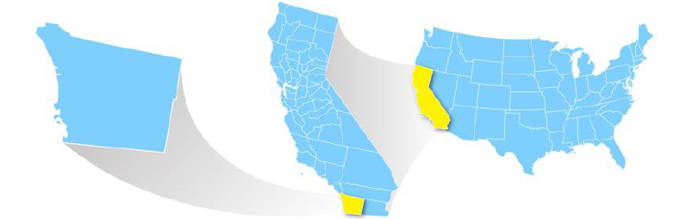
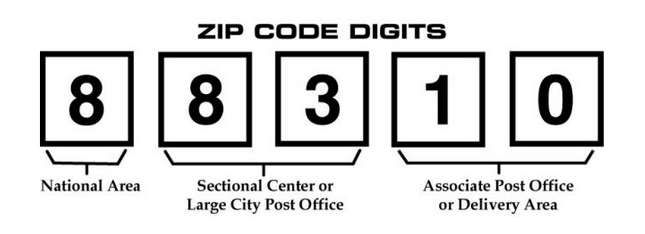
Unit of Adoption & Approach?
Top-Down vs. Bottom-up Methods
House
Zip-code
County
Service Territory / State Zonal
National

Slide 5
Granular and Temporal Resolution by Use-Case
System Level
Transmission Node
Feeder
Location and individual behavior are more important
Location and individual behavior are less important
Traditional Integrated Resource Planning (IRP)
Utility Financial Planning
Transmission Planning
Distribution Planning
EVSE Infrastructure Planning

Slide 6
Forecasting Approach
Top-Down
Start with regional EV/EVSE inventory and scale down to estimate inventory at the local level
Mixed
Integrates aggregate and granular data to model both macro and micro-level interactions.
Bottom-Up
Use only data in the forecast areas to forecast inventory

Slide 7
Adoption Models

Slide 8
Data Sources
Utility and State Databases: Utilities maintain internal databases with customer usage data, grid topology, and historical demand patterns. State databases often track vehicle registrations and travel patterns.
Example: State of California's vehicle registration data for tracking EV adoption across counties
Publicly Available Datasets: National Renewable Energy Laboratory (NREL), the Alternative Fuels Data Center, and other government and nonprofit entities provide free datasets on EV charging, adoption rates, and infrastructure.
Example: NREL’s EV Infrastructure Projection Tool (EVI-Pro) for public charging needs forecasts
Proprietary Industry Data: Companies such as HIS (S&P) Markit or Experian VIO provide proprietary data on vehicle registrations, consumer preferences, and market trends. These datasets can be more granular and up-to-date than public sources but are typically subscription-based and more expensive to access.
Example: HIS (S&P) Markit’s Vehicle Intelligence data for current vehicle registration and market share trends
Data Types
Census Data
Economic & Consumer Data
Vehicle Counts & Telematics
Charging Behavior & Patterns
Existing EVSE
Grid Data
Other Data

Slide 9
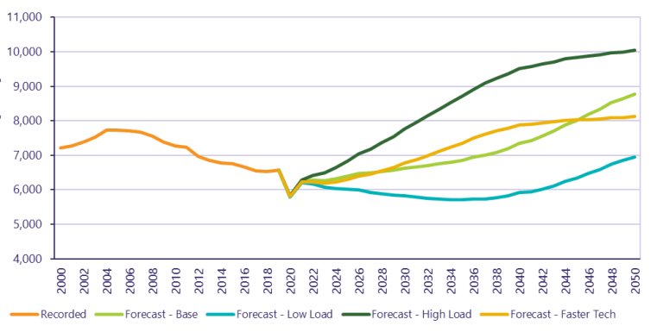
Scenarios and Sensitivities
Scenarios serve as plausible future states that allow stakeholders to evaluate uncertainties and plan for multiple contingencies.
Example scenarios
Baseline: Represents current trends with no significant changes in policy or behavior
High Adoption: Aggressive EV uptake driven by strong policy support and rapid technology improvements
Delayed Adoption: Slower growth due to economic constraints or lack of infrastructure
Managed Charging: Includes assumptions for demand flexibility programs to optimize grid impacts
Sensitivity analysis for a scenario explores a change in outcomes due to a change in a single input.
Example EV Adoption Scenarios in Oahu Island [GWh]
Source: HECO IGP

Slide 10
Inputs and Assumptions for Scenario / Sensitivity Analysis
Vehicle Inventory
EV Vehicle Attributes
Vehicle Adoption
Charging Behavior and Technology
Energy and Load Profiles
Grid Integration and Upgrades
Policy and Economic Factors
Encompasses factors like battery capacity, energy efficiency, and range that influence energy consumption per vehicle and play a role in assessing energy demands​​
Covers projected rate of EV adoption using methods such as diffusion, agent-based, or propensity score models. Adoption assumptions often consider incentives, socio-economic factors, and regional policy impacts​​
Focuses on how and where vehicles are charged (e.g., residential, public, or workplace chargers) and impact of Level 1, Level 2, and DC fast chargers on load distribution; also includes role of managed charging and its ability to optimize grid performance​​
Entails assumptions about energy use patterns, such as daily charging routines, peak demand periods, and seasonal variations in charging behavior, and load shape considerations integrating real-time and aggregate data​​
Evaluates impact of EV load on grid infrastructure, highlighting required upgrades, locational considerations, and scenarios for demand-side management, such as smart charging strategies​​
Includes assumptions for state and federal policies (e.g., incentives, emissions standards) and their impacts on EV adoption rates and infrastructure development are critical; economic considerations also include costs of EV ownership and market trends​​
Includes the current and projected number of EVs, by type, such as light-duty, medium-duty, and heavy-duty vehicles; often incorporates data on market trends, government targets for zero or low emission vehicles, and registration statistics​​

Slide 11
Key Areas of Coordination Between Utilities and States
Aligning state-level forecasts with utility planning
How different policy scenarios (e.g., high renewable energy targets, incentives/rebates) could impact EV integration strategies
Translating state EV targets into utility-specific forecasts
Collaborative planning processes
Engaging various stakeholders (e.g., public utilities, regulators, EV manufacturers, consumers) in the EV infrastructure planning process
Policy frameworks that support utility and state coordination

Slide 12
Contacts
Julieta Giraldez, Electric Power Engineers: jgiraldez@epeconsulting.com Lisa Schwartz, Berkeley Lab: lcschwartz@lbl.gov
For more information
Download publications from the Energy Markets & Policy Department: https://emp.lbl.gov/publications
Sign up for our email list: https://emp.lbl.gov/mailing-list
Follow the Energy Markets & Policy on Bluesky: @berkeleylabEMP.bsky.social
Acknowledgements
This work was funded by the U.S. Department of Energy under Contract No. DE-AC02-05CH11231.
The views and opinions of authors expressed herein do not necessarily state or reflect those of the United States Government or any agency thereof, or The Regents of the University of California.

Slide 13
Disclaimer This document was prepared as an account of work sponsored by the United States Government. While this document is believed to contain correct information, neither the United States Government nor any agency thereof, nor The Regents of the University of California, nor any of their employees, makes any warranty, express or implied, or assumes any legal responsibility for the accuracy, completeness, or usefulness of any information, apparatus, product, or process disclosed, or represents that its use would not infringe privately owned rights. Reference herein to any specific commercial product, process, or service by its trade name, trademark, manufacturer, or otherwise, does not necessarily constitute or imply its endorsement, recommendation, or favoring by the United States Government or any agency thereof, or The Regents of the University of California. The views and opinions of authors expressed herein do not necessarily state or reflect those of the United States Government or any agency thereof, or The Regents of the University of California. Ernest Orlando Lawrence Berkeley National Laboratory is an equal opportunity employer. Copyright Notice This manuscript has been authored by an author at Lawrence Berkeley National Laboratory under Contract No. DE-AC02-05CH11231 with the U.S. Department of Energy. The U.S. Government retains, and the publisher, by accepting the article for publication, acknowledges, that the U.S. Government retains a non-exclusive, paid-up, irrevocable, worldwide license to publish or reproduce the published form of this manuscript, or allow others to do so, for U.S. Government purposes

