Slide 1
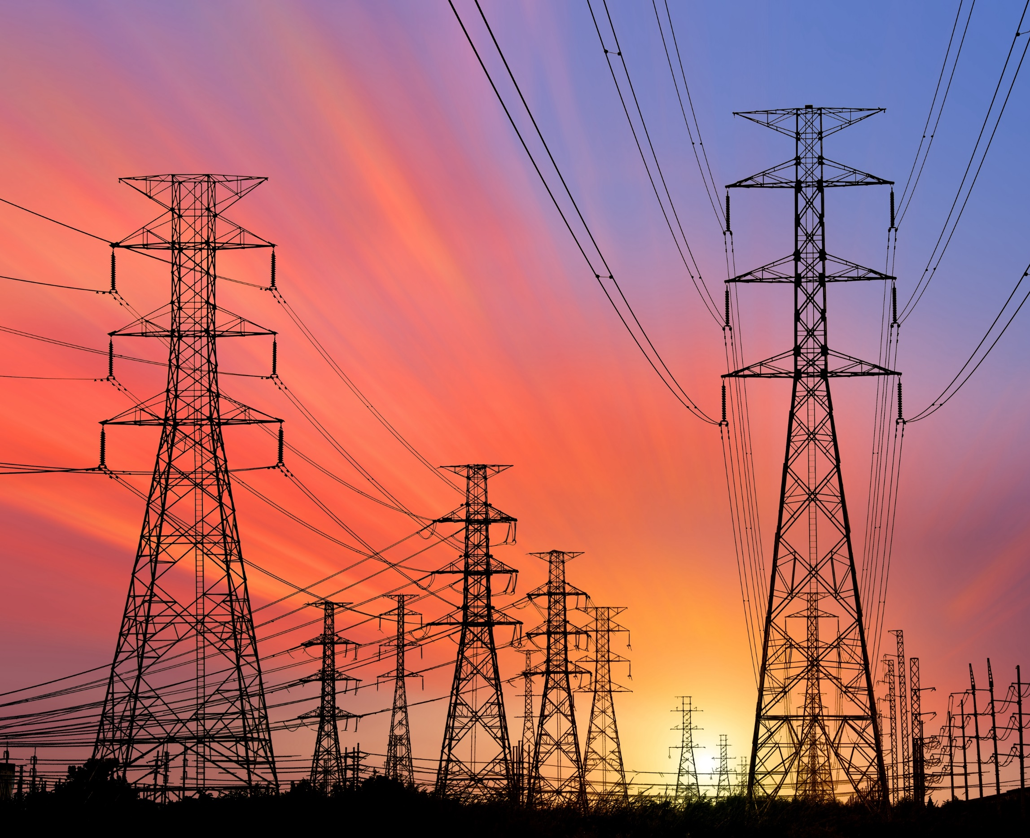
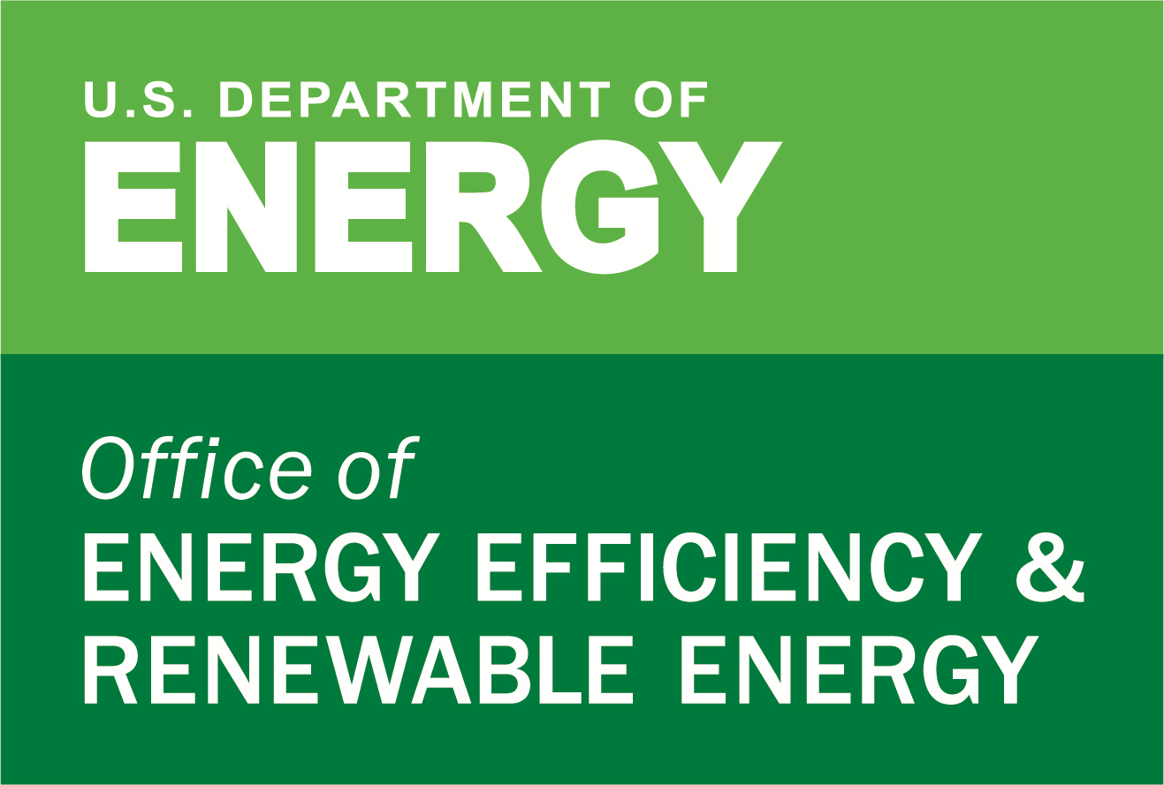
What Should Grid Resilience Plans Include? Planning Requirements, Emerging Best Practices, and Template
Presented by Josh Schellenberg, Affiliate, Berkeley Lab
Technical Training at NASUCA Mid-year Meeting
Madison, Wisconsin
June 11, 2024

Slide 2
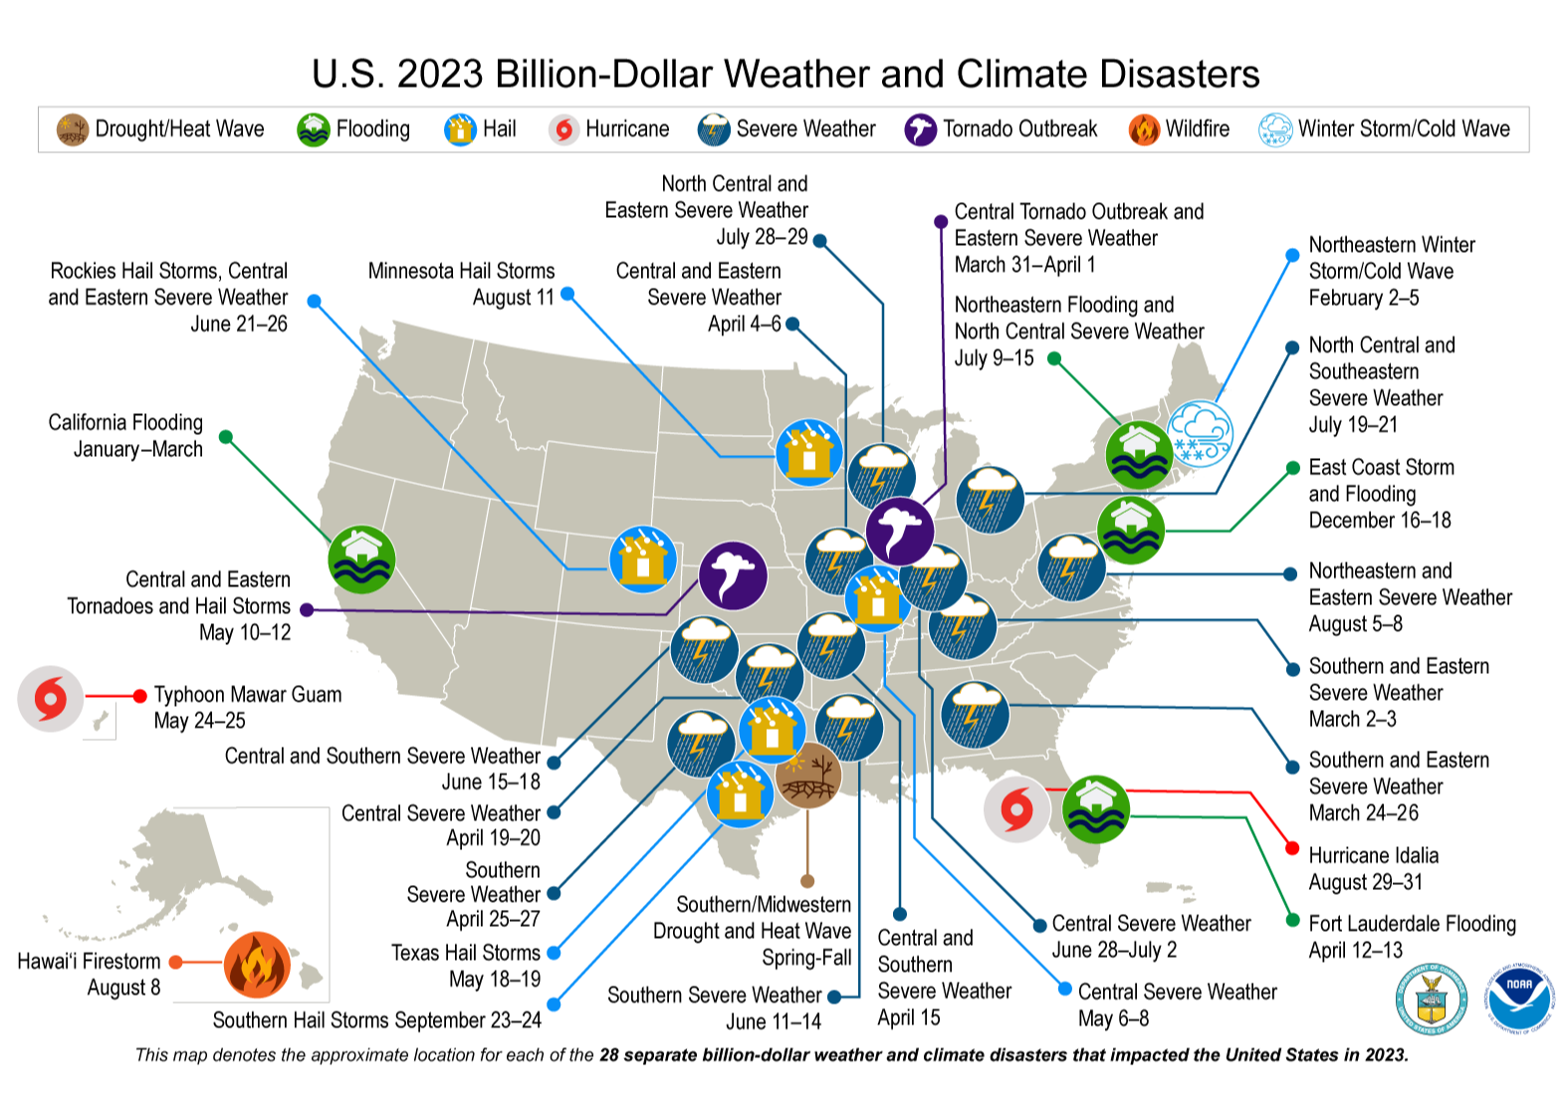
2023 had more billion-dollar weather and climate disasters than any year on record (inflation-adjusted)
All 50 states have been impacted by at least one of these billion-dollar disasters in the past 10 years
Hawaii did not have any disasters of this magnitude for over 30 years until the August 2023 firestorm that destroyed the historic town of Lahaina on Maui Island
2023 was also the hottest year on record worldwide

Slide 3
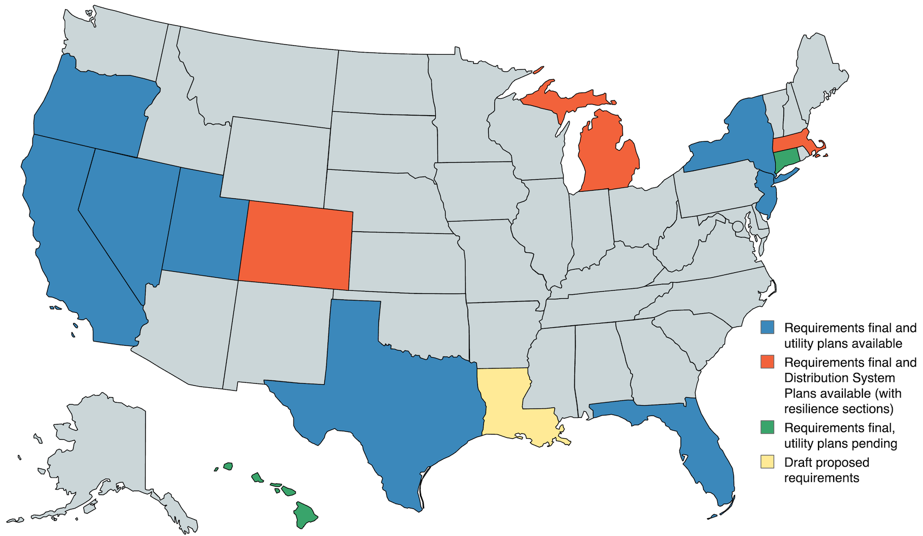
States are responding with resilience planning requirements for regulated utilities
The four largest states – California, Texas, Florida and New York, accounting for a third of the U.S. population – have adopted resilience plan requirements, as well as nine other states.
Existing requirements and utility plans have begun to point toward best practices, which serve as guidance to states that have not created resilience plan requirements and regulatory processes.
Wildfire mitigation plans only, incl. coops and municipal utilities
Wildfire mitigation plans only, incl. coops and municipal utilities
Wildfire mitigation plans only, incl. coops (optional)
Wildfire mitigation plans only, incl. coops (optional)
Separate reporting requirements by New Orleans City Council for Entergy New Orleans
Separate reporting requirements for cooperatives and municipal utilities

Slide 4
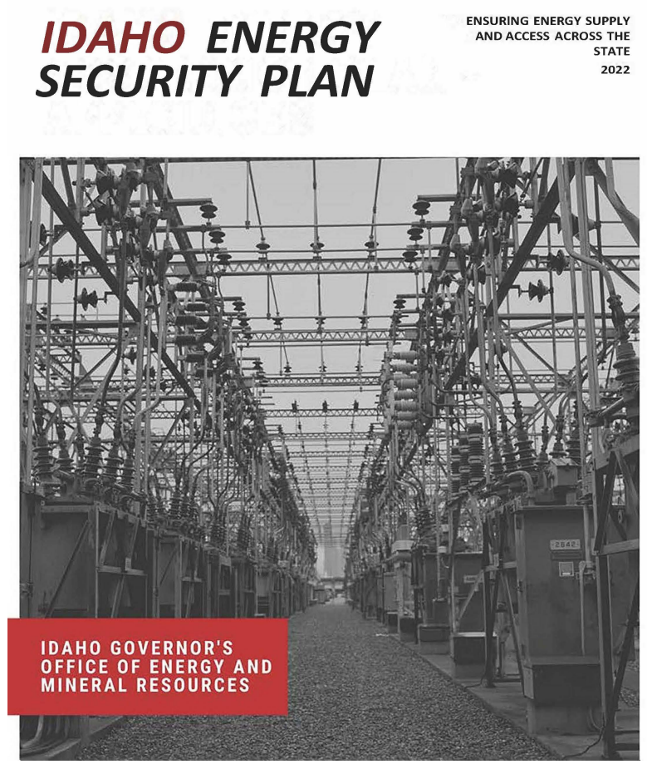
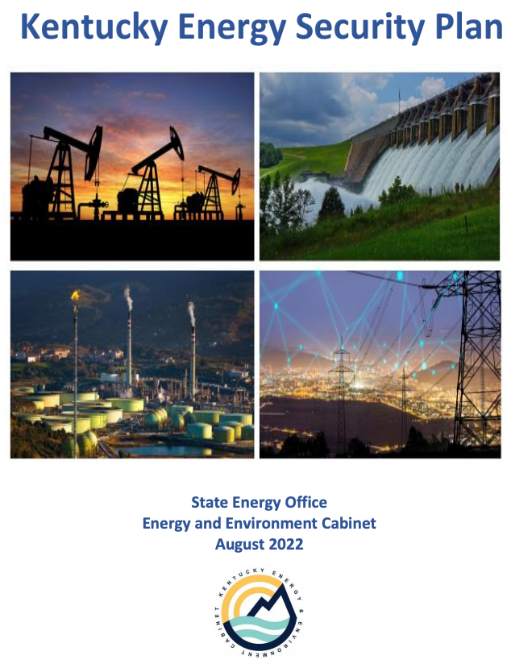
States are also developing Energy Security Plans
Under IIJA, State Energy Security Plans must assess existing circumstances in the state and propose methods to strengthen its ability to:
Secure energy infrastructure against all physical and cybersecurity threats
Mitigate the risk of energy supply disruptions
Enhance the response to, and recovery from, energy disruptions
Ensure that the state has reliable, secure, and resilient energy infrastructure
Specific resilience-related requirements include:
Addressing physical and cybersecurity threats and vulnerabilities
Providing a risk assessment of energy infrastructure and cross-sector interdependencies
Developing a risk mitigation approach to enhance reliability and end-use resilience
The security plans are the foundation of grid investment resilience planning under the IIJA. They highlight resilience risks, discuss investment priorities for enhancing the grid, and provide insights into potential priority investments by utilities.
Utility resilience plans should align with methods, data sources and priorities in the state’s Energy Security Plan
Source: NASEO and Berkeley Lab (2023). State Energy Offices’ Engagement in Electric Distribution Planning to Meet State Policy Goals

Slide 5
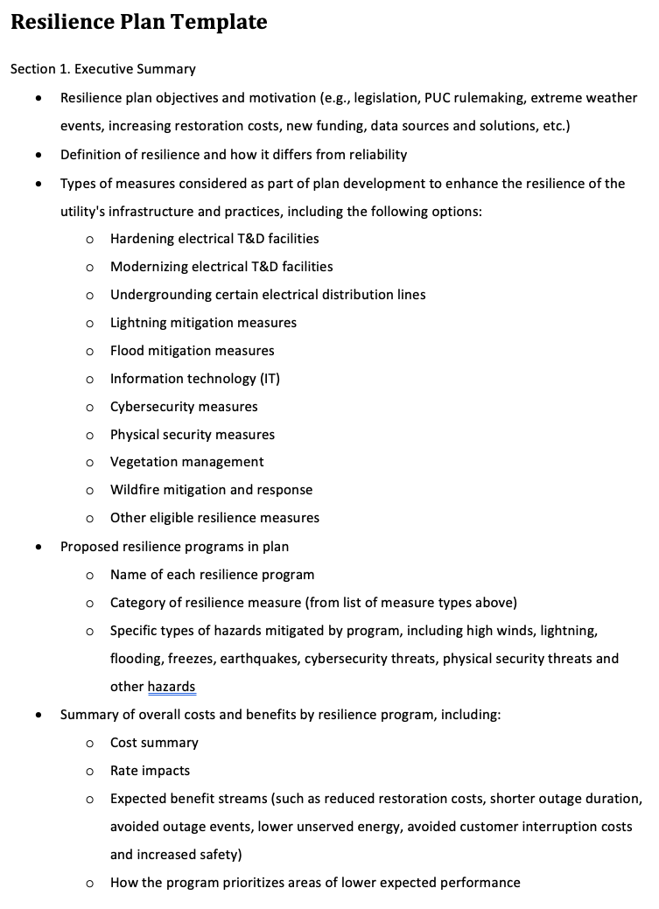
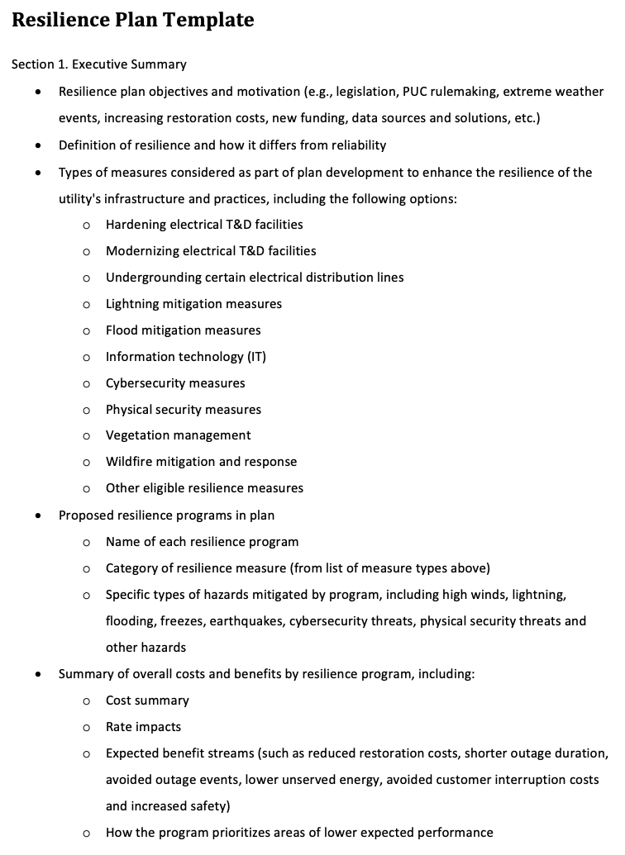
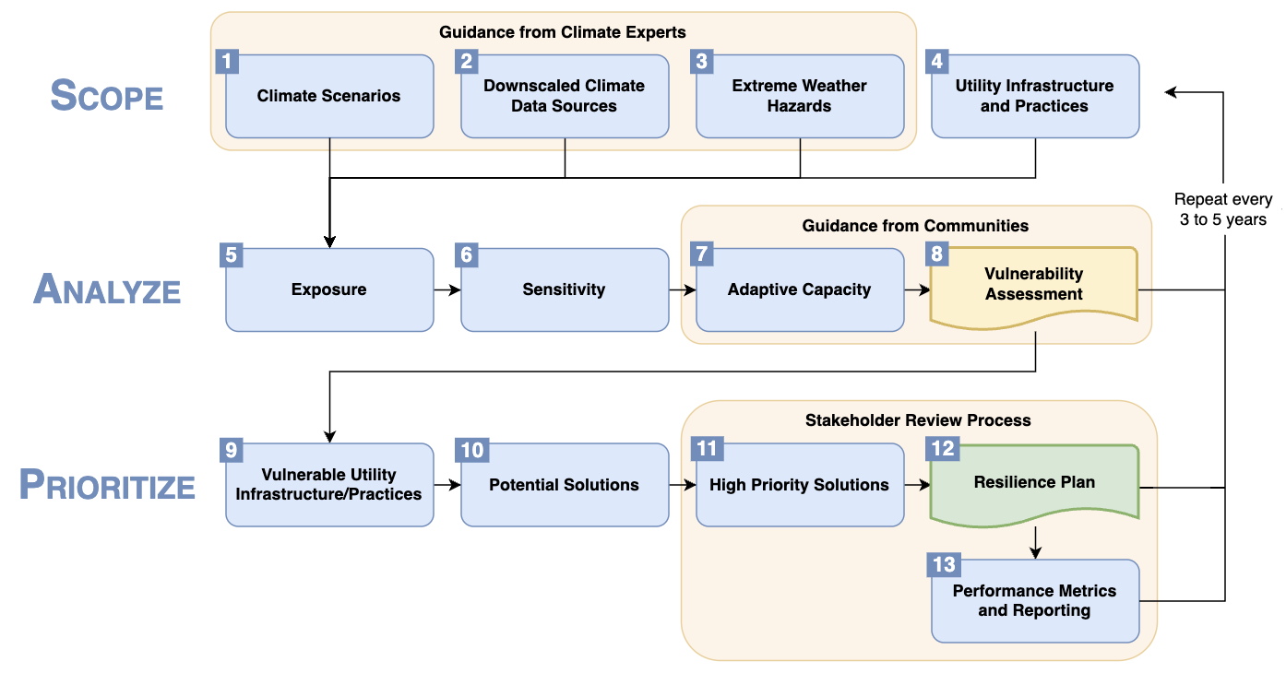
Berkeley Lab will publish a resilience planning framework and standardized template for utility plans in mid 2024
Objectives:
Facilitate development of plan requirements
Assist with review of prepared plans
Offer a standard format states can adapt (standardizing across utilities reduces burden of review)
Page 1 of 5

Slide 6
Resilience Planning Requirements and Emerging Best Practices

Slide 7
Resilience planning requirements Storms are impetus for requirements in Southern states, but rules in TX and proposed rules in LA take an ”All-Hazards” approach
State | Plan Name | Hazards in Scope | Plan Frequency | Planning Horizon
Florida | Storm Protection Plan | Extreme weather | 3 years | 10 years
Louisiana (excluding NOLA) | Grid Resilience Plan (proposed final rule) | Any low-probability/high-consequence events, including cyber/physical security threats | 5 years | 10 years
New Orleans | System Resiliency and Storm Hardening Plan | Extreme weather | TBD | 5 years
Texas* | T&D System Resiliency Plan | Any event involving extreme weather conditions, wildfires or cyber/physical security threats that poses a material risk to the safe and reliable operation of T&D systems | 3 years (voluntary) | 3 years (minimum)
* Per HB 2555 (2023) for Texas requirements

Slide 8
Resilience planning requirements Extreme weather is the primary focus in Northern states
State | Plan Name | Hazards in Scope | Plan Frequency | Planning Horizon
Connecticut | Resilience Plan | Extreme weather | 4 years (part of GRC cycle) | 10 years
Michigan | Distribution System Plan | Extreme weather | 2 years | 5 years
New Jersey | Infrastructure Investment Program | Extreme weather and cybersecurity | Voluntary | 5 years
New York | Climate Change Vulnerability Study and Resilience Plan (required by state law) | Increase in severe weather expected from climate change, including stronger storms and more flooding | 5 years | 10 to 20 years

Slide 9
Resilience planning requirements Wildfire is the primary focus in Western states
State | Plan Name | Hazards in Scope | Plan Frequency | Planning Horizon
California | Climate Change Vulnerability Assessment | Wildfires, extreme heat, extreme storms, drought, subsidence, sea level rise and other climate change hazards | 4 years (part of general rate case) | 10 to 50 years
California* | Wildfire Mitigation Plan (required in Senate Bill 901) | Wildfires | Annual | 3 years
Colorado | Distribution System Plan | Natural disasters and cyber/physical security threats | 2 years | 10 years
Nevada | Natural Disaster Protection Plan | Wildfires are primary focus, but state requirements cover other natural disasters | 3 years | 3 years**
Oregon | Wildfire Mitigation Plan | Wildfires | Annual | 3 years**
Utah | Wildland Fire Protection Plan (required in House Bill 66) | Wildfires | 3 years | 3 years**
* This linked reference is for the original CPUC decision on 2019 Wildfire Mitigation Plans (WMP), submitted pursuant to Senate Bill 901. A new state agency under the governor called the Office of Energy Infrastructure Safety (OEIS) was then formed to oversee WMPs for regulated utilities. Since 2021, OEIS has issued several revised guidelines and other new requirements for the WMPs.
** These state requirements do not specify a planning horizon, but utilities have filed 3-year plans in practice

Slide 10
Emerging best practices for resilience plan requirements
Hazards in Scope: If policymakers prefer an All-Hazards approach, requirements should specify that utilities provide a summary of all hazards analyzed and the resulting vulnerability assessment
Utility resilience plans to date have not focused on cyber/physical security threats, even if those hazards are included as an option in the requirements (Colorado and New Jersey)
Texas’ resilience planning law and proposed Louisiana requirements include cyber and physical security measures as options to include in a resilience plan
Planning Horizon and Frequency: Given the long-term nature of most resilience investments, requirements should specify a planning horizon of at least 10 years, with more detail provided in the first 3 to 5 years and updates every 3 to 5 years
Wildfire Mitigation Plans have a shorter planning horizon (3 years) and are updated more frequently (1 to 3 years), most likely due to the urgency of the wildfire threat in Western states in recent years

Slide 11
Emerging best practices for resilience plan requirements (continued)
Measures in Scope: Consider most viable resilience measures, including changes to planning/operational practices, and specify that utilities analyze those measures
Undergrounding (in California, New York, Michigan and Texas requirements)
Vegetation management (in most plan requirements)
De-energization events, including protocols and emergency communications (in Wildfire Mitigation Plans)
Lineworker staffing and storm severity forecasting (in Connecticut requirements)
Measures that mitigate gas-electric dependencies during winter storms (in Louisiana requirements)
Vulnerability Assessment: Require a matrix that summarizes all hazards relative to assets and practices analyzed with a clearly defined vulnerability rating that applies to each asset-hazard and practice-hazard pair
Emerging best practice from utility vulnerability assessment and plans (examples provided in next section of this presentation)
Resilience solutions are then identified and prioritized for each asset/practice-hazard pair that the assessment identifies as highly vulnerable

Slide 12
Emerging best practices for resilience plan requirements (continued)
Performance Reporting: Require quarterly to annual reporting of specific, impact-oriented metrics (relative to key benchmarks if applicable)
“Metrics should focus on the success of mitigation at lowering the risk of catastrophic wildfires and not simply program targets such as the number of trees removed or wires replaced” (in California requirements)
Utilities file forecasted reliability metrics and benchmarks, with and without major storm events, and map planned system investments against metrics to better understand expected impacts (in Michigan requirements)
Major storm data on outages, blocked roads, critical facility impacts and life-threatening emergency response events by storm intensity and level of resilience investment (in Connecticut requirements)
Funding Support: Include requirement to seek funding support (if applicable for a given measure), particularly IIJA, and report progress
Connecticut and Louisiana requirements include almost identical language: “Every effort must be made, both now and in the future, to identify non-ratepayer funds to offset the costs associated with implementing [resilience plans] required herein. Specifically, it is incumbent on each [utility] to continuously review the [plans] for alignment with and potential leveraging of existing and future federal or state funding opportunities, particularly those included in the Federal Infrastructure Investment and Jobs Act (IIJA).”
Connecticut requirements include detailed quarterly funding status updates

Slide 13
Emerging best practices for resilience plan requirements (continued)
Climate Scenarios and Data: For extreme weather hazards, specify climate scenarios for vulnerability assessment and provide source for downscaled climate data based on expert input
In California and New York, State Energy Offices worked with climate experts at leading universities in their states to develop extreme weather forecasts for a variety of climate hazards, downscaled for their state
This is a critical step to ensure consistency of data sources and scenarios for utilities, including municipal utilities and rural electric cooperatives
With the general warming trend and increasing frequency and severity of extreme weather events, long histories of weather data may lead to misguided resilience investment decisions

Slide 14
Example Utility Plans and Best Practices

Slide 15
Seattle City Light Climate Change Vulnerability Assessment and Adaptation Plan (2015)

Slide 16
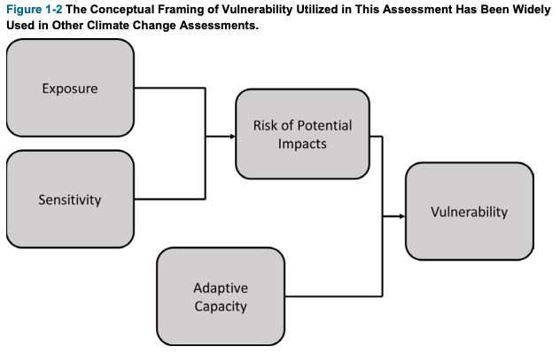
California Department of Water Resources Climate Change Vulnerability Assessment (2019)

Slide 17
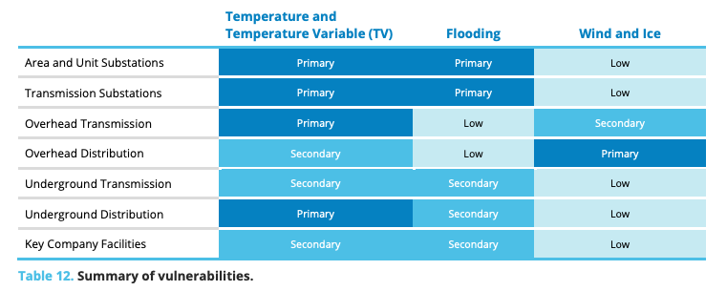
Con Edison Climate Change Vulnerability Study (2023) – Summary of Vulnerabilities

Slide 18
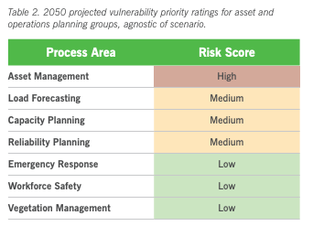
Duke Energy Climate Risk and Resilience Study (2022)
“Risks to Duke Energy’s asset management include accelerated equipment aging; a potential need to adjust design criteria to address the risk of changing precipitation, flooding and heat patterns; an incomplete understanding of the pole fleet’s weather readiness; and limited insight into failure data and impact of climate on failure rates.”

Slide 19
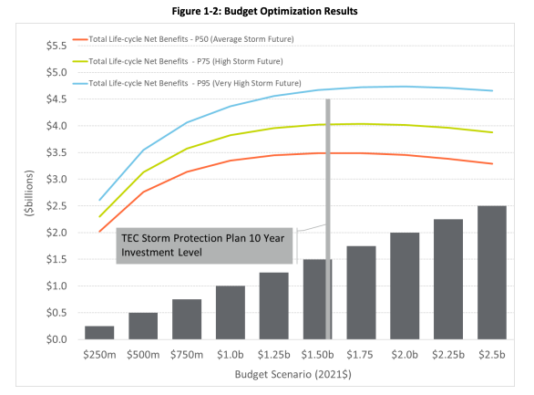
Tampa Electric Storm Protection Plan (2022)

Slide 20
Draft Resilience Plan Template

Slide 21
Overview of Draft Resilience Plan Template
Section 1. Executive Summary
Resilience plan objectives and motivation
Definitions of key terms
Summary progress report on programs included in the most recently filed resilience plan (if appliable)
Measures considered in plan development
Proposed resilience programs
Summary of overall costs and benefits by resilience program
Summary of metrics the utility will use to evaluate the plan’s performance
Describe how the resilience plan fits into other planning processes, including State Energy Security Plans
Status of state and federal resilience funding support
How the overall resilience plan is in the public interest
Section 2. Vulnerability Assessment and Prioritization Approach
Description of service area
History of resilience events in service territory
Summary of approach for projecting frequency and severity of resilience events
Practices and infrastructure prioritized for enhancement, including a matrix that summarizes all hazards relative to assets and practices, analyzed with a clearly defined vulnerability rating
Summary of third-party review/engagement

Slide 22
Overview of Draft Resilience Plan Template (continued)
Section 3. Description of each proposed resilience program
Time period (actual or estimated start and completion dates)
Expected improvement to utility’s existing infrastructure and practices
How resilience program impacts prevention of, response to, and recovery from resilience events
Estimate of the resulting benefits
Program performance metrics
Cost estimate including capital and operating and maintenance (O&M) expenses
Comparison of costs and benefits for the proposed resilience program
Description of criteria used to select and prioritize the proposed program

Slide 23
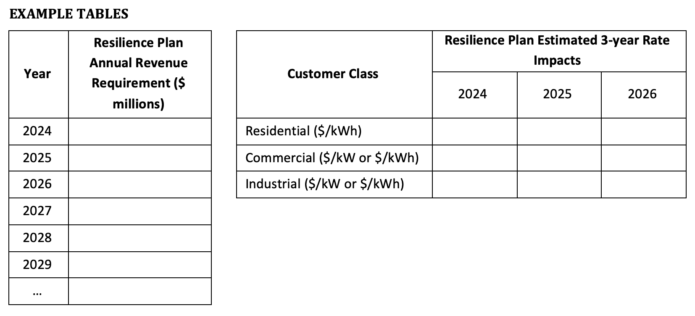
Overview of Draft Resilience Plan Template (continued)
Section 4. Projected rate impacts
Estimated number and costs of projects under each program
Relevant cost drivers for each program
Estimated annual revenue requirements for each year of the plan (see example table below)
Estimated rate impacts for each year of the plan
For each of the first three years of the plan, estimated rate impacts by customer class (see table below)
Description of options that the utility considered to mitigate the resulting rate impact

Slide 24
Guide for Applying Resilience Plan Template
Regulators can adapt the template to their state’s needs based on:
State objectives and priorities
Definitions for key terms (reliability, resilience, resilience event)
Hazards, assets and practices in scope for a given utility service territory
Size of utilities, scope of plan, investment horizon and expected level of investment
Availability of downscaled climate data for specific hazards
Most viable resilience measures, including changes to planning and operational practices
Specific, impact-oriented performance metrics and benchmarks
Equity considerations, vulnerable populations, and third-party review and engagement processes
Alignment with other applicable plans for state energy security, transmission and distribution systems, emergency response, etc.

Slide 25
Next steps
Berkeley Lab: Finish addressing external peer review comments and publish final report in July
Public Utility Commissions and stakeholders: Consider framework and template for utility resilience plans — in close alignment with integrated distribution system plans — to:
Facilitate development of plan requirements
Facilitate Commission and stakeholder review of filed plans
Reduce the burden of review by using a standard format across regulated utilities

Slide 26
Questions to ask
Should the regulated utilities in my state develop resilience plans that follow a standardized format, frequency and planning horizon?
What hazards and resilience measures should be in scope for the plans?
How can we align resilience plan development with other processes such as integrated distribution planning and State Energy Security Plans?
How can we support the development of similar resilience plans for municipal utilities and co-operatives?
How can we ensure consistency of climate scenarios and data sources across the state for these planning processes?

Slide 27
References
California Department of Water Resources (2019). Climate Change Vulnerability Assessment. https://water.ca.gov/-/media/DWR-Website/Web-Pages/Programs/All-Programs/Climate-Change-Program/Climate-Action-Plan/Files/CAP-III-Vulnerability-Assessment.pdf
ConEd (2023). Con Edison Climate Change Vulnerability Study. https://www.coned.com/-/media/files/coned/documents/our-energy-future/our-energy-projects/climate-change-resiliency-plan/climate-change-vulnerability-study.pdf
Duke Energy Carolinas (2022). Climate Risk and Resilience Study. https://www.duke-energy.com/-/media/pdfs/our-company/carolinasresiliencetransmissiondistributionstudy.pdf?rev=0c58199ed32d466d89795a3bf2dc353b
LLNL (2023). Cyber and Physical Threats to the Grid. https://eta-publications.lbl.gov/sites/default/files/gdo_se_resilience_training_klauberllnl_final.pdf
NARUC (2023). Critical Infrastructure, Cybersecurity and Resilience. https://www.naruc.org/cpi-1/critical-infrastructure-cybersecurity-and-resilience/cybersecurity/
NOAA (2023). Billion-Dollar Weather and Climate Disasters (as of September 30, 2023). https://www.ncei.noaa.gov/access/billions/state-summary/US
South Central Climate Adaptation Science Center at the University of Oklahoma (2019). Managing for a Changing Climate (2.2.1 Statistical Downscaling). https://www.youtube.com/playlist?list=PLeQQSAEHE5PoblZ-Kfqt9FJDVX77SYBqX
SCL (2015). Seattle City Light Climate Change Vulnerability Assessment and Adaptation Plan. https://www.seattle.gov/documents/Departments/CityLight/ClimateChangeAdaptationPlan.pdf
Tampa Electric (2022). Storm Protection Plan. https://www.floridapsc.com/library/filings/2022/11038-2022/11038-2022.pdf

Slide 28
Contacts
Josh Schellenberg, Berkeley Lab affiliate, JSchellenberg@lbl.gov
Lisa Schwartz, Berkeley Lab, lcschwartz@lbl.gov, 510-926-1091
For more information
Download publications from the Energy Markets & Policy Department: https://emp.lbl.gov/publications
Sign up for our email list: https://emp.lbl.gov/mailing-list
Follow the Energy Markets & Policy on Twitter: @BerkeleyLabEMP
Acknowledgements
This work was funded by the U.S. Department of Energy under Contract No. DE-AC02-05CH11231.
The views and opinions of authors expressed herein do not necessarily state or reflect those of the United States Government or any agency thereof, or The Regents of the University of California.

