Slide 1
TM
Presentation for NASUCA Mid-Year Meeting
Katherine Stainken
June 10th, 2024

Slide 2
Addressing the Barriers to Achieving EVs at Scale A Three-Pillar Strategy to Address the Key Industry Gaps
1
2
3
COALITIONS & ROADMAPS
STRUCTURAL SYSTEM REFORMS
UNIFYING TOOLS & PILOTS
Bilateral Convening Series
Utility-OEM Forum
Utility-Fleet Forum
Charging Infrastructure
Reliability: Benchmarking, Standards
Charging innovation & affordability
Vetted Product List (VPL); Approved Product List (APL)
NEVI/NEHC Coordination with EEI
National EV Driver Research Board
Grid Readiness
50-state eRoadMAPTM to 2030 outlining EV loads, grid impacts, leadtimes, workforce, costs
Streamlined Grid Interconnect
Expedited Interim Charging Solutions
Managed Charging at Scale
Interconnect Standards for V2H/V2B/V2G
GridFASTTM Online Data Exchange
OEM/Utility V2H/V2B Pilot
EV Resilience/Evacuation Pilot
Enabling Regulatory and Oversight Framework
Equity Blueprint & Workforce Development

Slide 3
Addressing the Barriers to Achieving EVs at Scale A Three-Pillar Strategy to Address the Key Industry Gaps
1
2
3
COALITIONS & ROADMAPS
STRUCTURAL SYSTEM REFORMS
UNIFYING TOOLS & PILOTS
Bilateral Convening Series
Utility-OEM Forum
Utility-Fleet Forum
Charging Infrastructure
Reliability: Benchmarking, Standards
Charging innovation & affordability
Vetted Product List (VPL); Approved Product List (APL)
NEVI/NEHC Coordination with EEI
National EV Driver Research Board
Grid Readiness
50-state eRoadMAPTM to 2030 outlining EV loads, grid impacts, leadtimes, workforce, costs
Streamlined Grid Interconnect
Expedited Interim Charging Solutions
Managed Charging at Scale
Interconnect Standards for V2H/V2B/V2G
GridFASTTM Online Data Exchange
OEM/Utility V2H/V2B Pilot
EV Resilience/Evacuation Pilot
Enabling Regulatory and Oversight Framework
Equity Blueprint & Workforce Development

Slide 4
eRoadMAPTM Updates

Slide 5
Is EV load still coming? – Light-duty
Light-Duty
To note:
11 states above 10% market share in 2023.
26 states above 5% market share in 2023.
EPA Multi-pollutant LD, MD Emissions standards projected to result in 56% BEVs by 2032.
Source: Alliance for Automotive Innovation, “Get Connected EV Quarterly Report”, Fourth Quarter 2023. https://www.autosinnovate.org/posts/papers-reports/Get%20Connected%20EV%20Quarterly%20Report%202023%20Q4.pdf
Notes:
2023 sales data shows growth
We’re hitting the bottom of the S curve for many states now.
This is not the time to walk away, but the time to get it right.

Slide 6
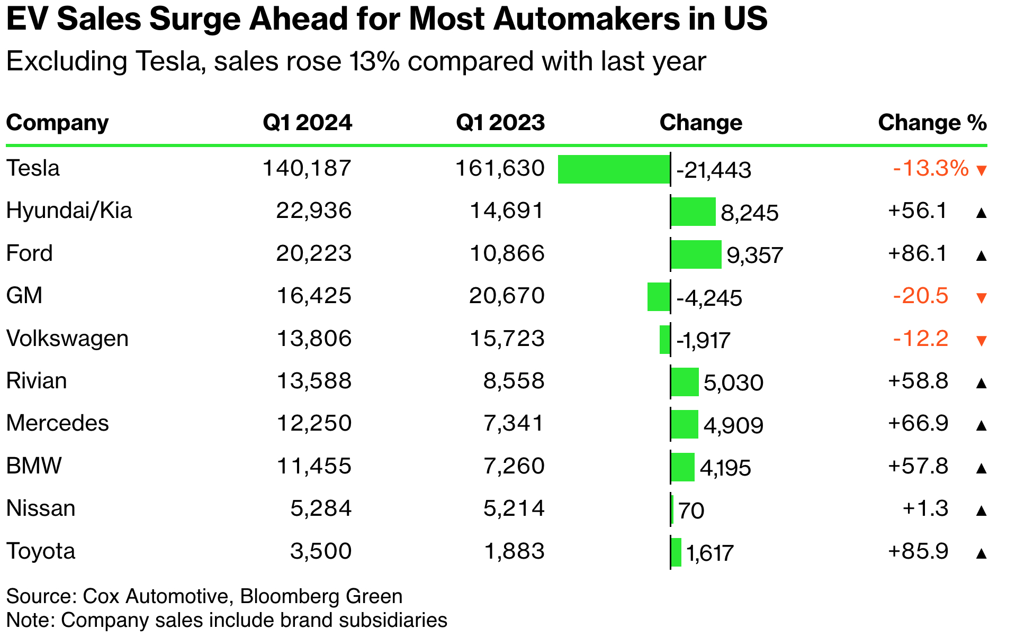
Is EV load still coming? – Light-duty
To note:
EVs from Ford, Mercedes-Benz, BMW, Toyota, Rivian, Hyundai and Kia have seen a retail surge.
China hits 44% EV sales in April 2024.
EV sales in Europe increased 11% in April 2024 (compared to April 2023).
Notes:
2023 sales data shows growth
We’re hitting the bottom of the S curve for many states now.
This is not the time to walk away, but the time to get it right.

Slide 7
Is EV load still coming? - MHD
To note:
EPA GHG Phase 3 numbers final target ZEV adoption rates range from 25% (HHD Sleeper cab trucks)- 60% (light HD trucks) in 2032.
Joint Office National Zero-Emission Freight Corridor Strategy launched in March / April.
EPA Clean HD Grant Program opened: $1 bn for class 6, 7 ZEVs
ACF zone | California
ACT zone | Colorado, Maryland, Massachusetts, New Jersey, New Mexico, New York, Oregon, Rhode Island, Vermont, Washington
Notes:
Class 4-5

Slide 8
EV load is coming! Where and when exactly?
We need granular level data from the fleets themselves.
DMV data doesn’t always work.
(Registrations are at a HQ, not where the vehicle is driven, and we don’t know the vehicle behavior.)
Buying data sets aren’t always complete.
(Only certain percentage of the market.)
County level, census tract level data isn’t granular enough.
Need a data set that shows where the vehicles are, and the vehicle behavior.
The eRoadMAP data builds confidence and shows clear signals for where and when EV load is coming.

Slide 9
| Input Collaborators
ANALYTICS
DATA
Other:

Slide 10
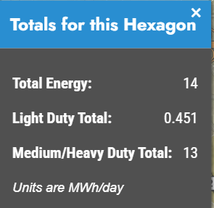
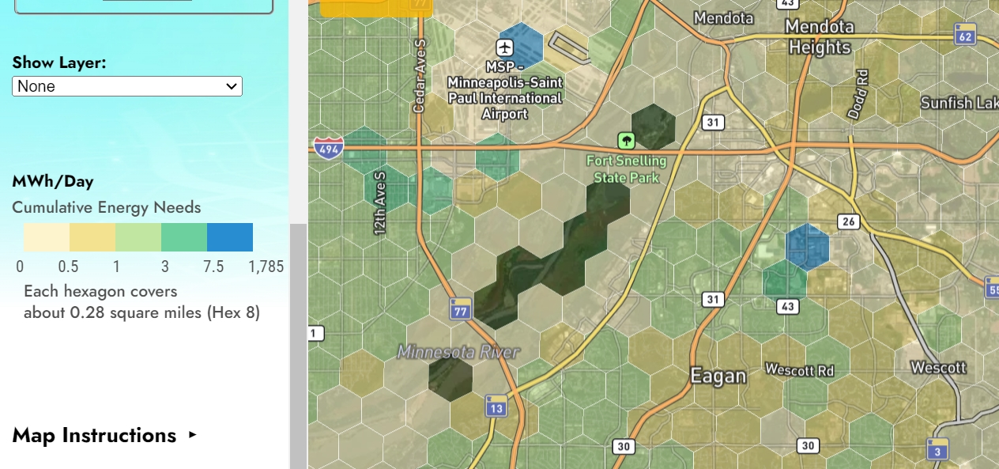
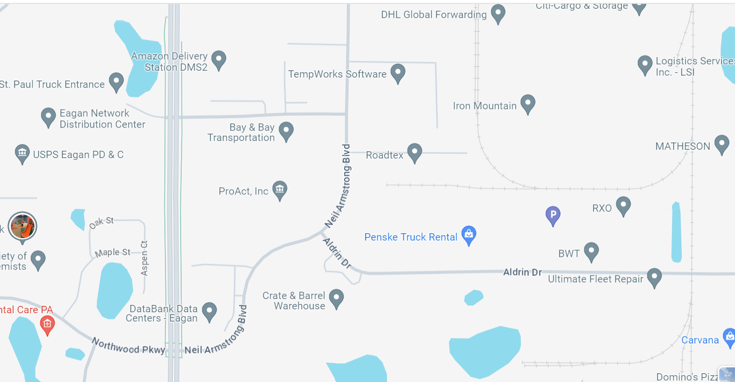
eRoadMAP compared to Google Satellite: MN
Hex 8 (0.28 mi²)
Shows: Amazon Delivery Station, USPS, Eagan Network Distribution Center, Bay & Bay Transportation, DHL Global Forwarding, Ultimate Fleet Repair, Logistics Service Inc, etc.

Slide 11
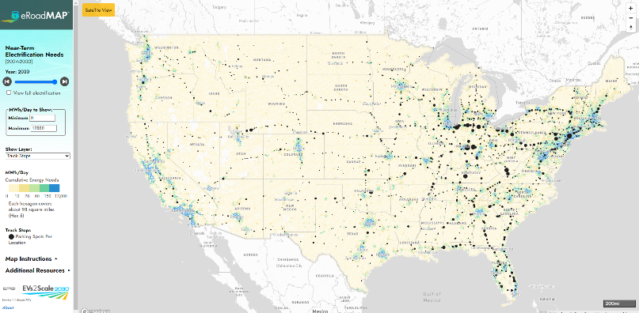
eRoadMAP: eroadmap.epri.com
New Capabilities:
Satellite Layer View (On/off)
MWh Filter (Min+Max)
Added Layers:
Truck Stops: (dot indicates number of parking spots)
Current EV Charging Stations: (L2 +DCFC indicated by colors) - DOE/AFDC
Air Quality of Concern: EPA’s EJ Screen used. Above 9 Ug/ML is above primary health based standard.
Justice 40 Census Tracts: (Yes/No)
Transportation Disadvantage: Shows Census tracts that have transportation access in the lowest 10th percentile (EPA’s EJ Screen)
Hosting Capacity: 10 utilities.
Data Addition/changes:
Added in energy needed for airport rental cars. Enterprise supplied data and we used market share to get the full vehicle fleet.
Light Duty Vehicle edit: Modified the LD energy needs at prisons to better represent them.

Slide 12
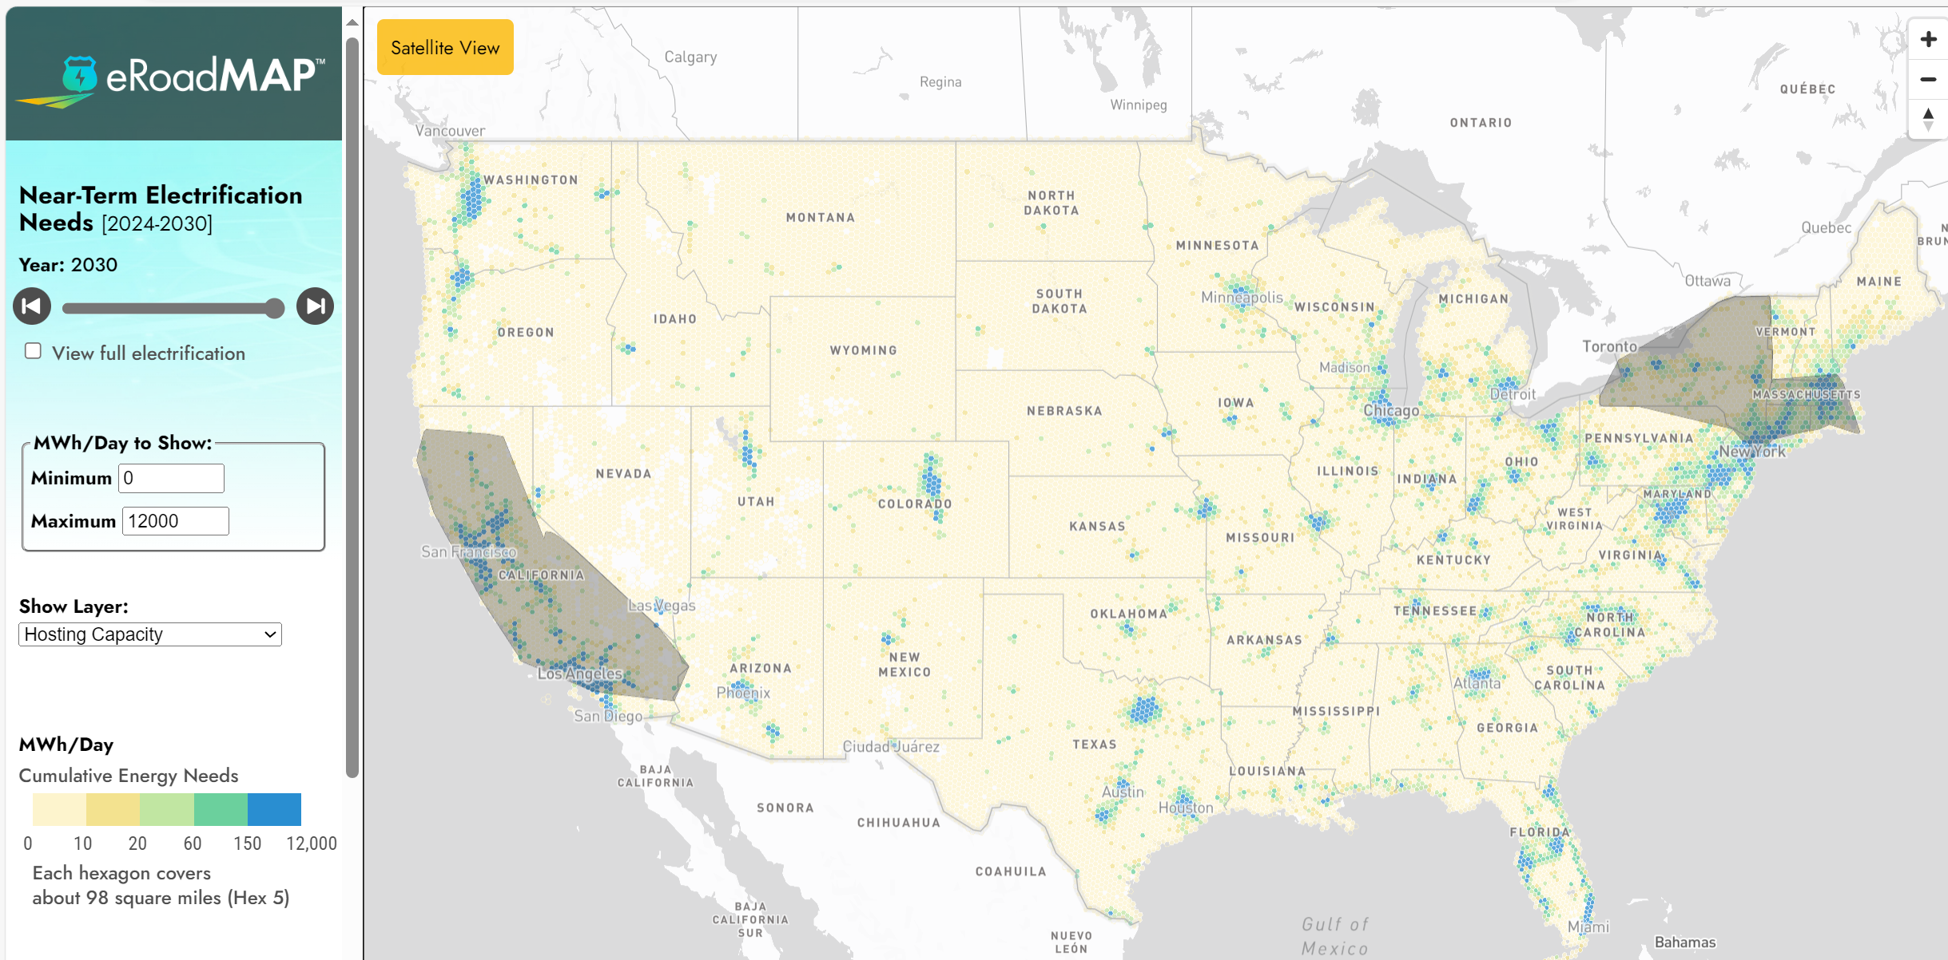
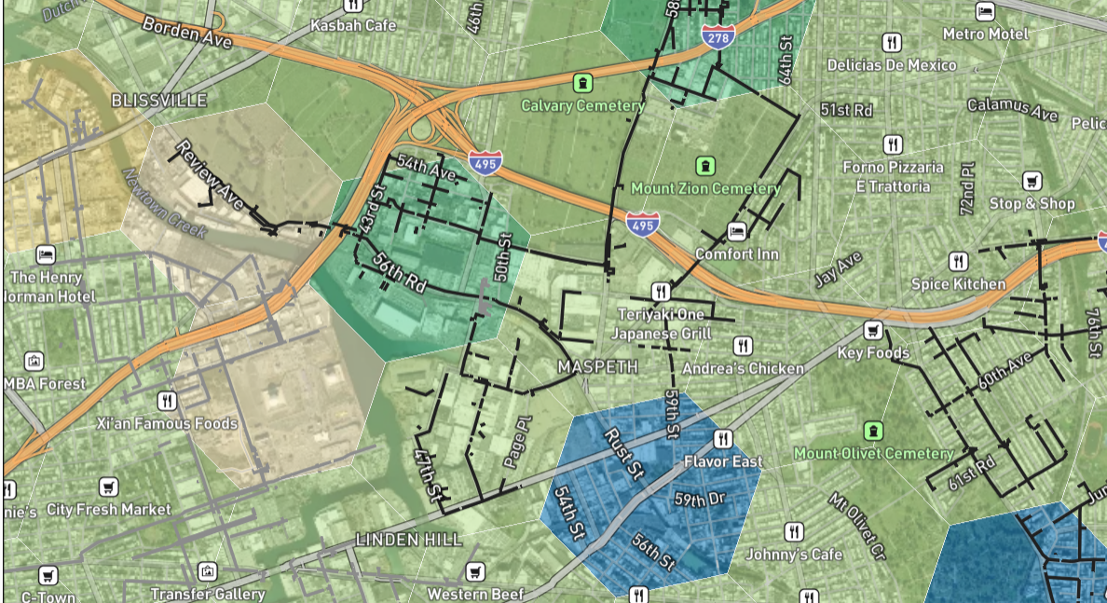
Grid Capacity Maps
Load Capacity Maps from 10 Utilities include:
California: PG&E, SCE, LADWP
Massachusetts: National Grid
New York: National Grid, ConEd, Orange & Rockland, Central Hudson, NYSEG, and Rochester G&E
New Jersey: Orange & Rockland
Rhode Island: Rhode Island Energy
ConEd’s feeder hosting capacity map with an estimated 4.6MW (power) available today. Note, major logistics providers are located in this area.

Slide 13
eRoadMAP | Near Term Plans
Website Enhancements
Power (load shapes)
Utility Service Territory Outlines
City and County Outlines
Refinement of Assumptions
More granular segmenting
Temperature and seasonality
Managed Charging
Data Sets to be added (EPRI has the data already)
Tesla charging station growth (added)
Airport Rental Car Fleets (added)
NADA (OEM dealerships)
Pitt Ohio
Others in the works:
Uber/Lyft (NDA Signed)
Prologis (NDA Signed)

Slide 14
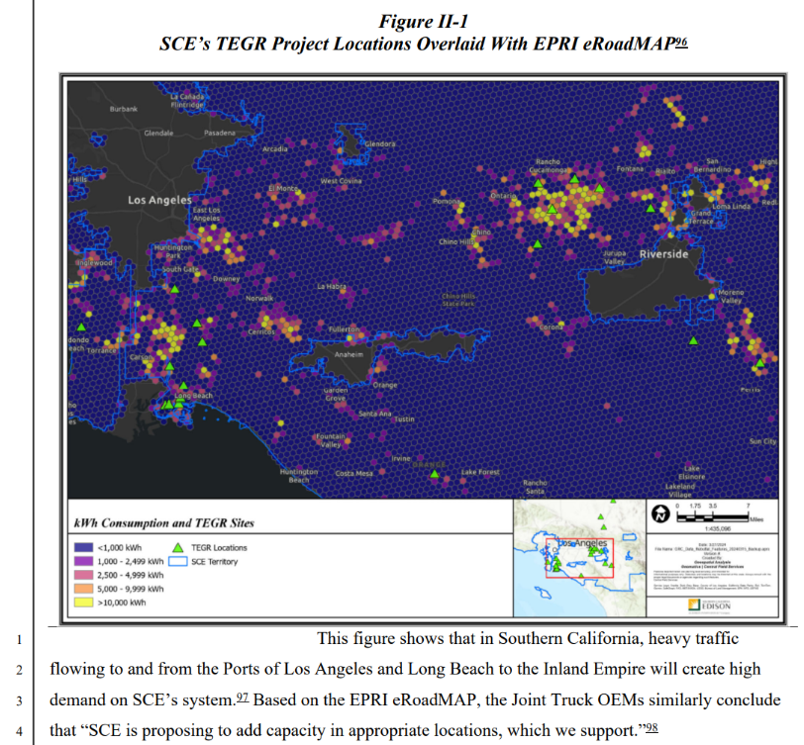
How is eRoadMAP currently being used?
California
SCE’s 2025 General Rate Case.¹ (See right.) SCE Transportation Electrification Grid Readiness forecast with project locations overlaid with EPRI eRoadMAP for second verification.
Joint Truck OEMs (Daimler, VOLVO, Navistar – pre-PACT) cited eRoadMAP to also verify their future depots and need for power.
1 SCE 2025 General Rate Case. Rebuttal Testimony - Rebuttal Load Growth, Transmission Projects, and Engineering; April 15, 2024. Exhibit Number: SCE-013 Vol. 07. Available in SCE regulatory portal.

Slide 15
How is eRoadMAP currently being used?
Springboard for emerging trends with many utilities:
Scenario planning with EV policies.
Improved forecasting methodologies.
Bottom-up vs top-down; specific fleet data
Longer horizon, at least 10 years.
LD forecasts (DMV, EPRI, 3rd party).
Robust distribution planning processes.
Identification of MHD energy hotspots with
known key account customers.
Some utilities layering eRoadMAP over distribution systems as a first step, now identifying ways to improve overall planning.

Slide 16
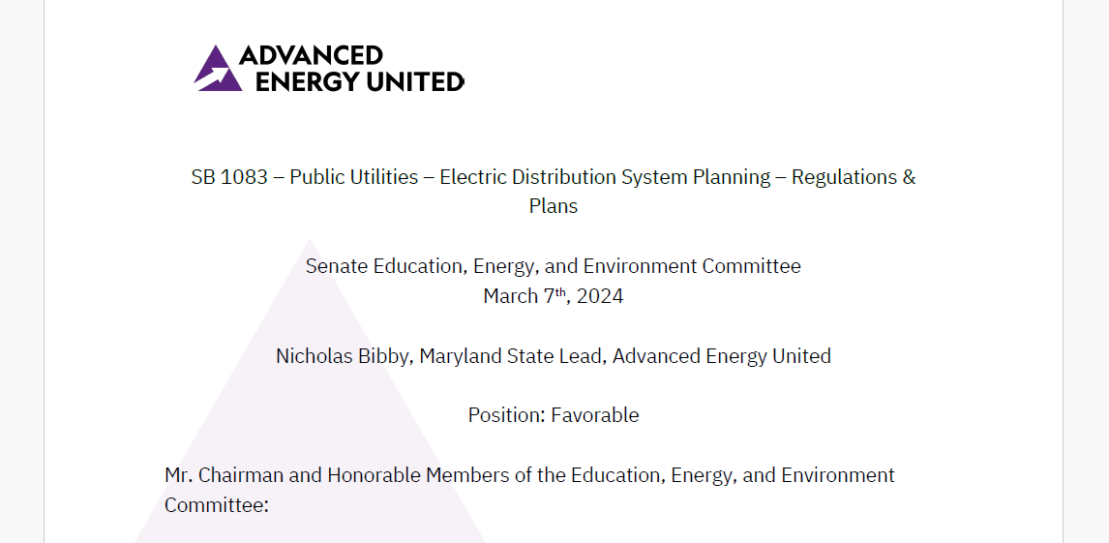
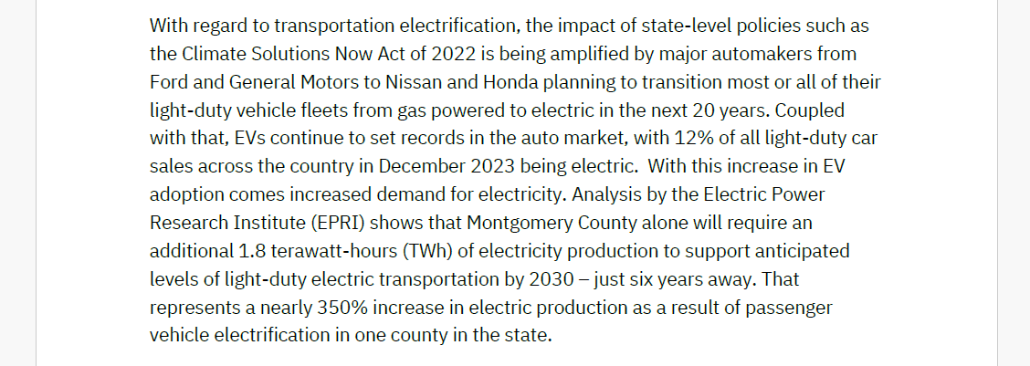
How is eRoadMAP currently being used?
Colorado
CO legislation SB-218 “Modernize Energy Distribution Systems” on proactive planning and grid build; eRoadMAP used in conversations with legislators by EV advocate groups.
Pennsylvania
PA legislation HB 1240 on TE planning; eRoadMAP used in conversations with legislators by EV advocate groups.
Maryland
MD legislation SB 1083 on electric distribution system planning; cited by AEU (see right).

Slide 17
How is eRoadMAP currently being used?
AEU, Synapse: Presents a framework with 6 key steps for analyzing and preparing for the large-scale electrification of MHDs. Focuses on assessing the impacts of the ACT rule and other policies on electric distribution grids (feeder, substation level): On the Road to Fleet Electrification: A Framework for Estimating Distribution System Impacts of Medium- and Heavy-Duty Vehicle Electrification (advancedenergyunited.org)
Case studies for PA and IL at each step of the framework to showcase data limitations, discuss simplifying assumptions and alternative methods. eRoadMAP data analyzed.
EDF, Black & Veatch, ConEd, Centerpoint, EPRI: looking at NY and TX, the cost to proactively build vs reactively build. Summer timeframe. eRoadMAP data analyzed.
Atlas Public Policy, EPRI, 15+ groups: MHD charging infrastructure and grid build needed along corridors, more to come.

Slide 18
GridFAST

Slide 19
How might we help EV customers and utilities get actionable information, earlier in this process?
GridFAST problem statement
Vision
Plan
Fund
Design
Procure
Build
Deploy
EV CUSTOMER
Close communication between fleets & utilities
Close communication between EV customers & utilities
Opportunity
Opportunity
Service Request
Service Request & Refinement
Design
Construction
Distribution Planning Cycle
UTILITY
Transmission Planning Cycle
GridFAST
current

Slide 20
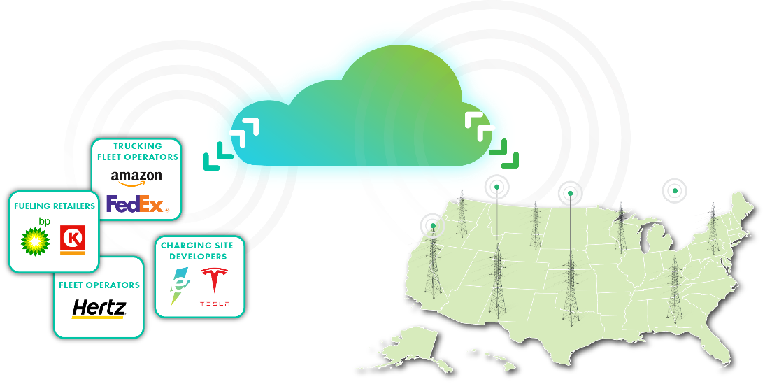
GridFAST
Goal: Improve transparency in EV charging planning to inform grid investments and accelerate grid interconnects
Complementary to eRoadMAPTM ; continues the communication across all parties.
Complementary to fleet advisory services.
2024-2035 fleet plans or project plans, locations, timing
GridFAST Secure online data exchange platform
Matched with utility, brief load assessment; utility provides one Advisor, hosting capacity map or proxies, other program information, service connection next steps

Slide 21
GridFAST - a Many-to-Many Platform Which Generates Network Effects
Current State
Future with GridFAST
Many-to-Many
EV Customers need to navigate across the spectrum of Utilities
One-to-Many
GridFAST
EV Customers
Utilities
EV Customers
Utilities
Some Utilities are creating jurisdictionally limited tools to reach EV Customers
Value Proposition
Many-to-One
Reduces Search Costs
(Utility matchmaking, program eligibility, rates, grid conditions, …)
Single system minimizes learning curve
Improved transparency to information
Customer Driven info for Grid Planning
Improves quality of information
Reaches broader range of customers
Reduces internal IT development costs
Leverages learnings across industry
Utilities
EV Customers
Secure information exchange
Opportunity to form “complements” to the platform

Slide 22
GridFAST
Goal: Improve transparency in EV charging planning to inform grid investments and accelerate grid interconnects
Complementary to eRoadMAPTM ; continues the communication across all parties.
Complementary to fleet advisory services.
2024-2035 fleet plans or project plans, locations, timing
GridFAST Secure online data exchange platform
Matched with utility, brief load assessment; utility provides one Advisor, hosting capacity map or proxies, other program information, service connection next steps
Coming in September!
“Common App” in development.

Slide 23
Policy / Regulatory

Slide 24
PUCs starting to address these key areas to be ready for EV load at scale.
Forecasting policies and practices
Bottom-up forecasting
Long-term horizon of at least 10 years
Treatment of “pending loads” – taking known factors into consideration for no-regrets build
Fleet advisory services for access to fleet electrification plans, lead generation
Interim charging solutions framework (“Bridge-to-wires” alternatives)
Cost recovery policies and practices
Memorandum accounts for EV projects
Key advisory group to approve projects
Small fleets and line extension policies
Grid data sharing and hosting capacity map policies
EV rate design and tariffs
Distribution planning processes
Grid modernization plans
Load integration capacity analysis (risk analysis)
Interconnection policies for EVs
Interconnection policies for V2G capable EVs
Through PUC workshops, proceedings: MI, WA, MN; CA, MA, NY are active, CO soon to start
Through current utility filings.
Your PUC? Let us know – can share EPRI tools and work

Slide 25
Upcoming

Slide 26
Upcoming…
Interim Charging Solution – June / July!
Key attributes of EV projects (timeline, energy density, uncertainty characteristics)
Solution categories
Managed Charging Utility Survey - TBD
50 state resources with eRoadMAP analysis – 10 states in July

Slide 27
Thank You
Katherine Stainken: kstainken@epri.com

Slide 28
Appendix

Slide 29
EV Load at Scale – other IOU, NGO, DOE, Ratepayer advocate, ISO studies and analyses
DOE: Multi-State Transportation Electrification Impact Study: March 2024. https://www.energy.gov/policy/articles/new-multi-state-analysis-helps-guide-grid-planning-electric-vehicle-charging: examines the anticipated impact of the EPA’s rulemakings if finalized as proposed on GHG emission standards for LDVs, MDVs, and HDVs; provides in-depth analysis of EV charging infrastructure and distribution grid upgrades for five states: California, Illinois, New York, Oklahoma, and Pennsylvania.
Key takeaways are that the proposed rules could—effectuated from 2027 to 2032—for those five states: 1. Result in an incremental increase of 3% in annual EV charging infrastructure installations (including public and private infrastructure), 2. Result in an incremental distribution grid investment that equates to approximately 3% of current annual utility investments, 3. Result in a 30% reduction of those annual utility investments using basic managed charging techniques, illustrating the potential for additional cost savings from local load optimization, and, 4. Result in net consumer benefits, primarily in fuel savings, 2.5 times greater than the incremental charging and distribution grid costs.
RMI: Feb. 2024. ACT Now: Impacts of the Advanced Clean Trucks Rule on the Electric Grid and Fleets. Analyzed telematics data from Geotab ITS in 15 states that planned to implement Advanced Clean Trucks (ACT) regulations – looked at where chargers are needed, energy, how to make prioritized equitable investments.
EDF: Jan. 2024. How utilities and their regulators can enable proactive, affordable grid expansion in the era of truck electrification. Takeaway: changes in forecasting, frequency of filing and bridge-to-wires solutions needed
Xcel, Enterprise: Jan. 2024. Electrifying Airport Ecosystems. Looks at peak load impacts to Denver and MN-St.Paul airports under industry, policy scenarios for growth. Takeaways: invest and plan now, airports are a “no regrets” investment.
Exelon, EEI, Clean Energy Works, WRI, Calstart, EPRI: Dec. 2023 The ESB Transition: Accelerating Equitable Deployment through Understanding Grid Impacts and Policy Solutions. Analyzes the charging profiles and infrastructure impacts of ESBs on the electric distribution system, the role for utilities, and potential policy enablers. Those policy enablers are ESB FAS, ESB rate design, proactive grid planning to prepare for greater ESB adoption, and more ESB V2G programs.

Slide 30
EV Load at Scale – other IOU, NGO, DOE, Ratepayer advocate, ISO studies and analyses
CA Public Advocates Office: Aug. 2023. Distribution Grid Electrification Model. Takeaways: total cost to upgrade distribution grid by 2035 for CA IOUs is $26 billion.
Brattle, ERCOT: Aug. 2023: ERCOT EV Allocation Study. Shows methodology for determining EV load impact at the substation level. Takeaway: shows their process in creating a tool, assumptions, approach for analyzing EV load impacts for forecasting out to 2029. Shows EV adoption by vehicle class at zip code level, load impacts of 6.7 TWh overall, load growth impacts by county.
National Grid:
Sept. 2021: “The Road to Transportation Decarbonization: Understanding Grid Impacts of Electric Fleets,” focused on a Top 100 metro region to understand how differences in fleet locations, usage patterns, fleet sizes, vehicle types, and/or charging patterns impact specific portions of distribution or transmission systems. Takeaway: fleet electrification would require strong collaboration and proactive planning.
Nov. 2022: “Electric Highways: Accelerating and Optimizing Fast-Charging Deployment for Carbon-Free Transportation,” examines the planning considerations for AFC with the freight and goods movement in mind. This first of its kind study examined the traffic patterns and infrastructure needed to support the transportation decarbonization mandates in NY and MA. Takeaway: looked at 71 sites in both states, shows that by 2030, over a quarter of the sites would need more than 5 MW of capacity to meet peak charging demand.
Sept. 2023: “The Road to Transportation Decarbonization: Readying the Grid for Electric Fleets”, examines one “study feeder” line in their service territory, estimating the electric demand and system impacts as vehicles in the MHD sector electrify. Takeaway: when 10% of the 400 electric trucks electrify along that feeder line at a depot, peak demand will almost double. At 33% of the total trucks electrified, the capacity along the study feeder will be exhausted. Need to proactively plan!
Kevala, prepared for CPUC: May 2023. “Electrification Impacts Study Part 1: Bottom-Up Load Forecasting and System-Level Electrification Impacts Cost Estimates.” Provides preliminary estimates of the scope and scale of potential electric distribution grid impacts for PG&E, SCE and SDG&E from EVs and PV penetration by 2035. Study develops a highly granular load forecast for baseline load and DER adoption, including PV, battery energy storage systems (BESS), EE, buildings and EVs. Baseline scenario uses IEPR, looks at 4 policy scenarios for load growth. Estimated $50 billion needed in CA for distribution grid investments by 2035.

Slide 31
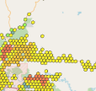
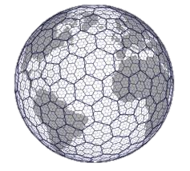
Improved Data Resolution Techniques
LAYERED DATA APPROACH
1
2
H3 – Level 8 Maps
LD Vehicles
Registrations
Travel Models
MDHD Vehicles
OEM data
Fleet data
Travel Data
Other Vehicle Sectors
Transit/School Buses
Government Fleets
Ports/Airports
Vocational Fleets
Other Load Data
EVSPs/Fueling Retailers
Individual layer
Res | Average Hexagon Area (km²) | Average Hexagon Area (mi2)
0 | 4,357,449.42 | 1,682,419.93
1 | 609,788.44 | 235,440.54
2 | 86,801.78 | 33,514.34
3 | 12,393.43 | 4,785.13
4 | 1,770.35 | 683.53
5 | 252.90 | 97.65
6 | 36.13 | 13.95
7 | 5.16 | 1.99
8 | 0.74 | 0.28
9 | 0.11 | 0.04
10 | 0.0150 | 0.0058
11 | 0.0021 | 0.0008
12 | 0.0003 | 0.0001
+
Individual layer…
+
+
+
Where Hex8 ~ 1 or 2 feeders
+
+
=
One map with energy + power needs
*EV Service Providers
Notes:
Where one hex8 ~0.28 sq. mi
(roughly one feeder circuit)

Slide 32
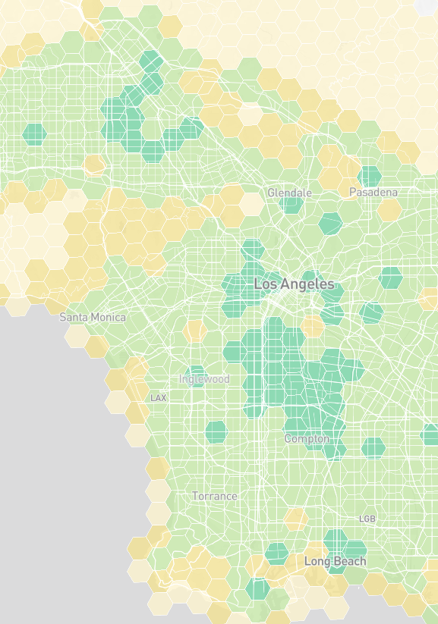
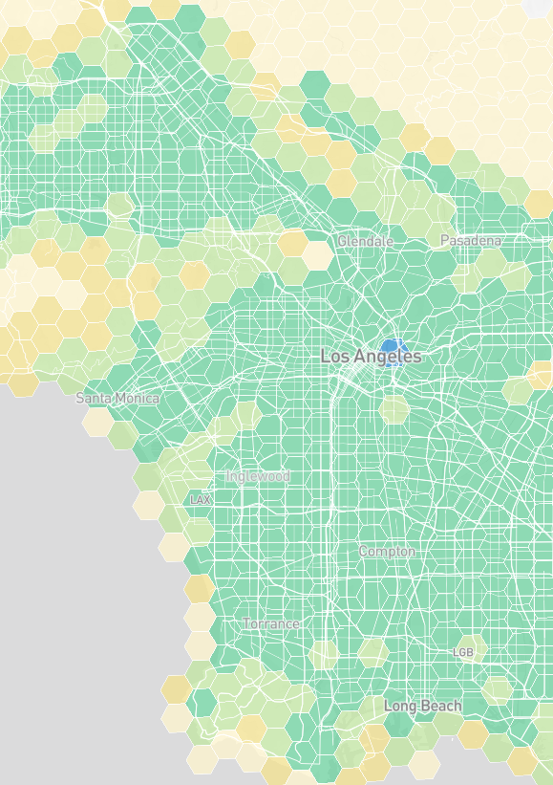
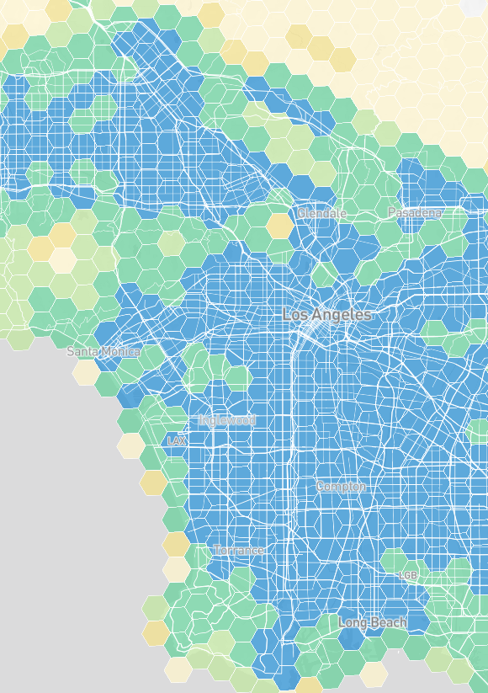
eRoadMAP Overview | Data Sources and Methodology
REGISTRATIONS
TRAVEL AND DWELL BEHAVIOR
Document Conventional Vehicle Behavior
+ Weighting as needed to supplement and represent the behavior of the full LDV-MDV-HDV U.S. vehicle fleet
FEDERAL GOAL
STATE MANDATES
Convert to EV Energy Needs to Meet 2030 State and Federal Policy Mandates/Goals
+ Adoption Trajectories which align with the state and federal goals and mandates
50% LDV sales electric in 2030
ACT by 2030 (CA + 7 States):
Class 2b-3 = 30% of sales
Class 7-8 tractors = 30% of sales
Class 4-8 = 50% of sales
ACF by 2030 (CA):
Class 2b-3= ~47%
Class 7-8 tractors = 100%
Class 4-8= ~79%
Rest of U.S.:
No policy assumed; some spillover effects from tech advances
ELECTRIFICATION PLANS (ongoing)
Add Fleet Electrification + Charging Plans
- Overlapping Fleet Data above to ensure no double-counting of load data
2023
2030 (Policy Compliance)
100% ELECTRIFIED
eRoadMAP.epri.com

