Slide 1

Asking the Right Questions
About Water Cybersecurity
Ben Bolton
Senior Energy Programs Administrator
Office of Energy Programs
June 10, 2024
Notes:
.

Slide 2
U.S. Department of Energy Disclaimer
This material is based upon work supported by the U.S. Department of Energy (DOE) Office of Energy Efficiency and Renewable Energy (EERE) under Award Number DE-EE0009487.
Disclaimer:
This report was prepared as an account of work sponsored by an agency of the United States Government. Neither the United States Government nor any agency thereof, nor any of their employees, makes any warranty, express or implied, or assumes any legal liability or responsibility for the accuracy, completeness, or usefulness of any information, apparatus, product, or process disclosed, or represents that its use would not infringe privately owned rights. Reference herein to any specific commercial product, process, or service by trade name, trademark, manufacturer, or otherwise does not necessarily constitute or imply its endorsement, recommendation, or favoring by the United States Government or any agency thereof. The views and opinions of authors expressed herein do not necessarily state or reflect those of the United States Government or any agency thereof.

Slide 3
State Energy Offices: What We Do

Slide 4

Energy Security Planning
State Energy Security Plan
Facilitate energy emergency preparedness and planning to create a rapid response capability for recovery from disasters.
Outlines the State’s responsibilities during an energy emergency, and the coordination of federal and State resources, when required.
State Energy Profile
IIJA-requirements – 6 Elements
2022 Revision: Cyber, All Hazards, Mitigation, and Risk Profile
Notes:
EA

Slide 5


Cyber Ransomware Attack
Town hit by ransomware attack.
Email News alert Actions Taken
Notified TDEC Water inspector to contact water and wastewater systems in impact town(s)
  Compliance assistance?
Alterted TEMA District Coordinator
Alerted State Special Agent for Cybersecurity
Oak Ridge National Laboratory
Notes:
EA

Slide 6
Cybersecurity for PUC-Regulated Systems
Tennessee Code Annotated
7-51-2302. Cyber security plan.
  (a) By July 1, 2023, or within one (1) year after a utility is formed, whichever is later, a utility shall prepare and implement a cyber security plan to provide for the protection of the utility's facilities from unauthorized use, alteration, ransom, or destruction of electronic data. [my emphasis]
  (b) A utility shall assess and update the cyber security plan implemented pursuant to this section every two (2) years to address new threats.
7-51-2303. Verification of implementation of cyber security plan.
  (a) Each year, the comptroller of the treasury, or the comptroller's designee, shall verify that a utility has implemented a cyber security plan in accordance with this part.

Slide 7
Cybersecurity for PUC-Regulated Systems
TN Public Utility Commission Rule 1200-04-15
Requires utilities to submit, annually by July 1, documentation verifying it has implemented a cybersecurity plan. That statement must include:
  Contact info for utility staff responsible for cybersecurity
  Statement if utility conducts annual cybersecurity training for utility staff with access to IT and/or Operation Technology (OT) systems
  Statement if the utility has cybersecurity insurance

Slide 8
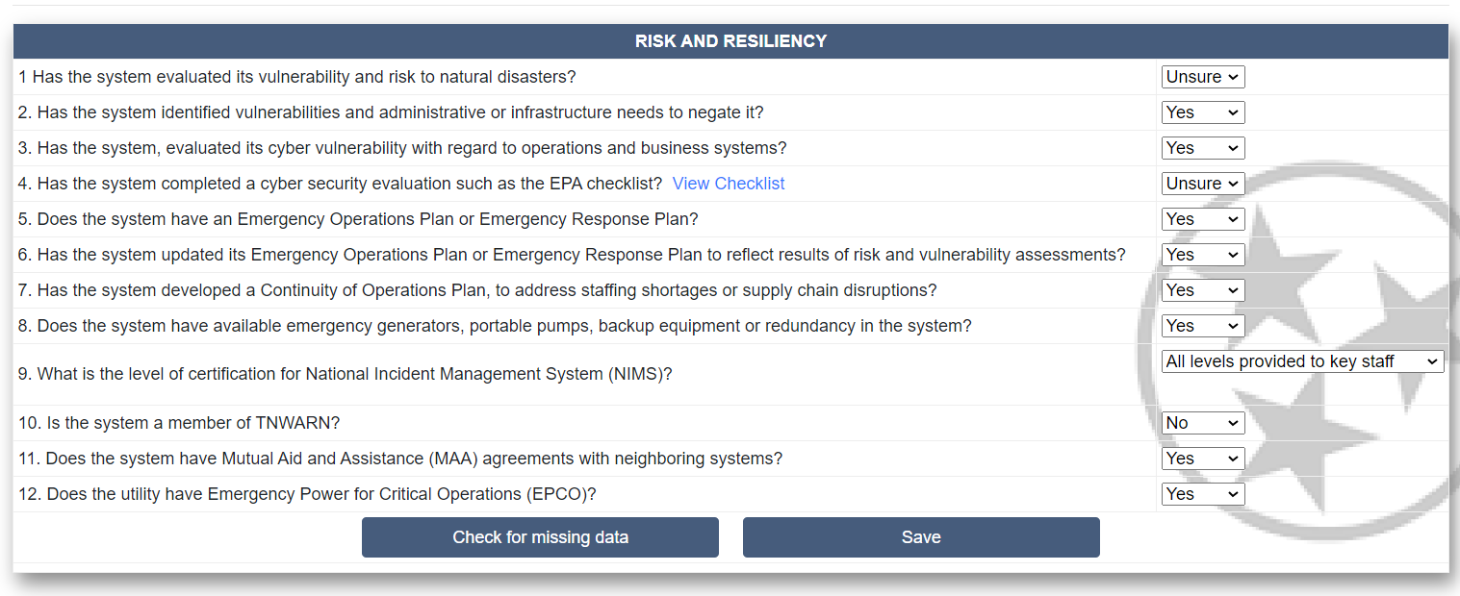
State Revolving Loan Fund Survey
*Conducted with Tennessee Association of Utility Districts, an affiliate of the Rural Water Association

Slide 9
Questions to Ask
Does the system have a risk mitigation plan or cybersecurity plan to address cybersecurity vulnerabilities? Does it include specific actions, funding, and responsible personnel needed to implement it?
Does the system have an emergency response/incident response plan to prepare for, respond to, and recover from a cyber incident? When was the plan exercised last?
EPA and CISA provide free cybersecurity assessments to water and wastewater systems.

Slide 10
Resources
EPA Water Sector Cybersecurity Resources
  Case Study
  Evaluation Program
  Cybersecurity Technical Assistance Program
Cybersecurity & Infrastructure Security Agency (CISA)
  Cyber Security Advisors
  Top Cyber Actions for Security Water Systems
NARUC Cybersecurity Manual

Slide 11
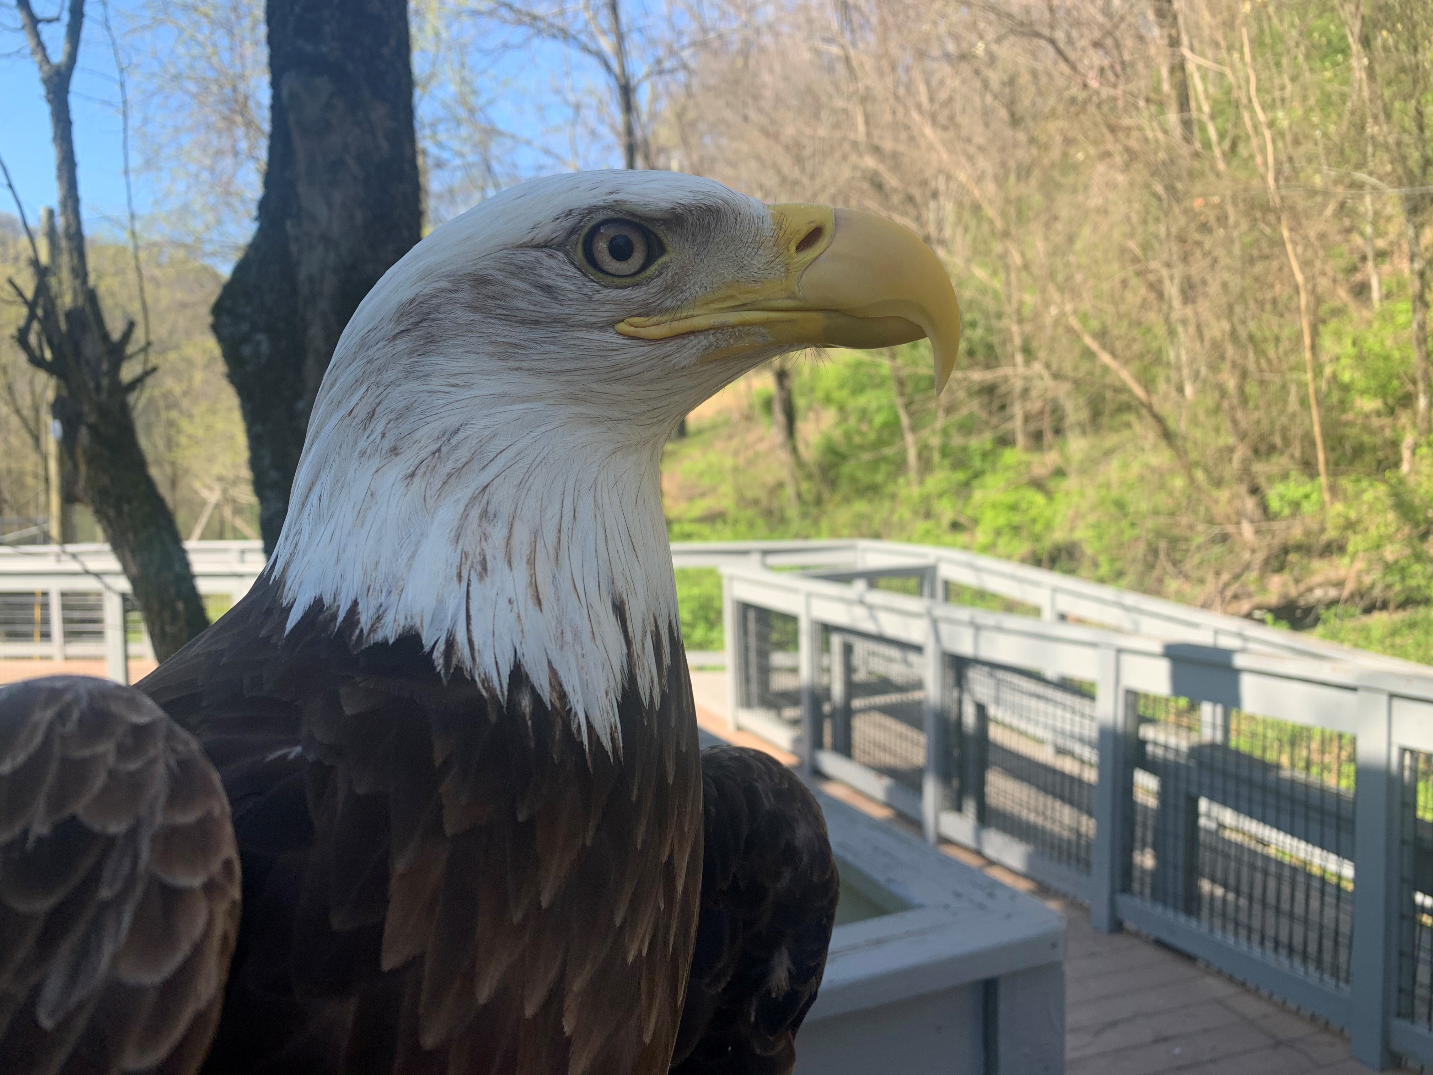

Questions?
Ben Bolton
Senior Energy Programs Administrator
Office of Energy Programs
615.306.5908
Ben.Bolton@tn.gov
Eagle at Radnor Lake State Park
© Steve Ward, State Parks ESC
Fall Creek Falls State Park

