Slide 1
Planning for energy storage and microgrids
Jeremy Twitchell
Pacific Northwest National Laboratory
Distribution Systems and Planning Training
for NASUCA
October 30, 2020

Slide 2
Agenda
Technology Overview
Services and Valuation
Energy Storage in Regional Markets
Storage in Microgrids

Slide 3
Technology Overview

Slide 4
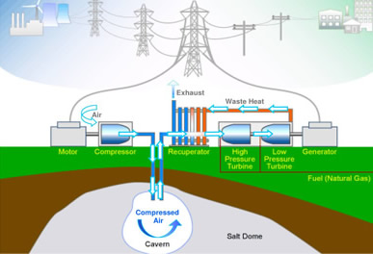
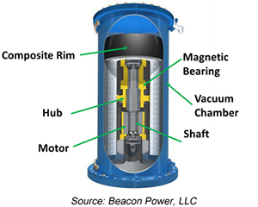
Storage Technologies: Mechanical
Electricity is stored as potential energy that is later used to generate electricity.
Pumped-Storage Hydro (PSH)
Compressed Air Energy Storage
Long duration (8+ hours)
Low RTE (~50%)
Cycle life: 10,000 (~25 years)
Limited flexibility
Ridge Energy Storage & Grid Services LP
Flywheels
Short duration (~15 min)
Very good RTE (~85%)
Cycle life: 200,000 (~20 years)
Highly flexible
Long duration (8+ hours)
Good round-trip efficiency (RTE) – 80%
Cycle life: 15,000 (40+ years)
Limited flexibility

Slide 5
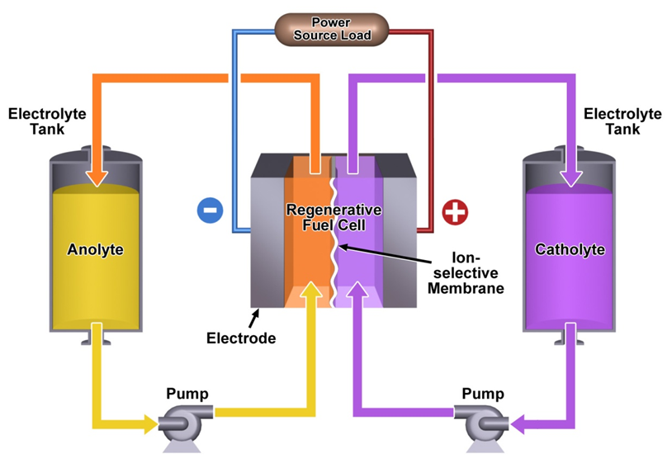
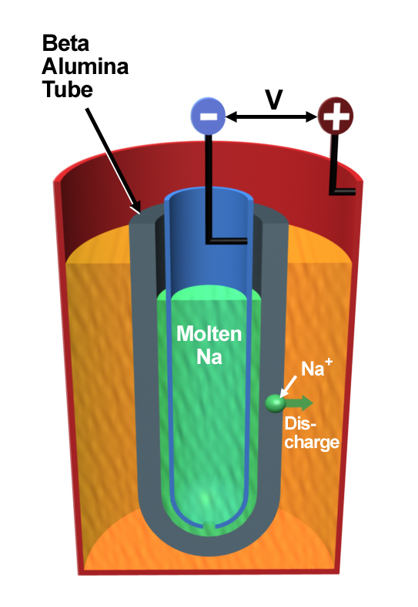
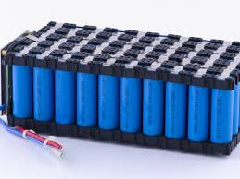
Storage Technologies: Electrochemical
Electricity is stored in chemical bonds and later released.
Lithium-ion Batteries
Flow Batteries
Sodium Batteries
Short to mid-range duration (0.5 - 4 hours)
Very good round-trip efficiency (RTE) – 86%
Cycle life: 3,500 (7-10 years)
Highly flexible
Developed supply chain
Safety concerns
Recycling challenges
Moderate durations (4-8 hours)
Moderate round-trip efficiency (RTE) – 70%
Cycle life: 10,000 (15-20 years)
Highly flexible
Improved safety
Highly recyclable
Mechanical challenges
Moderate durations (4-6 hours)
Good round-trip efficiency (RTE) – 75%
Cycle life: 4,000 (10-13 years)
Highly flexible
High-temperature ops

Slide 6
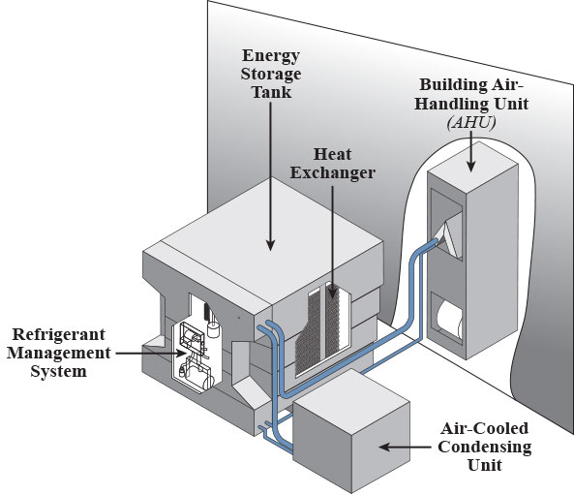
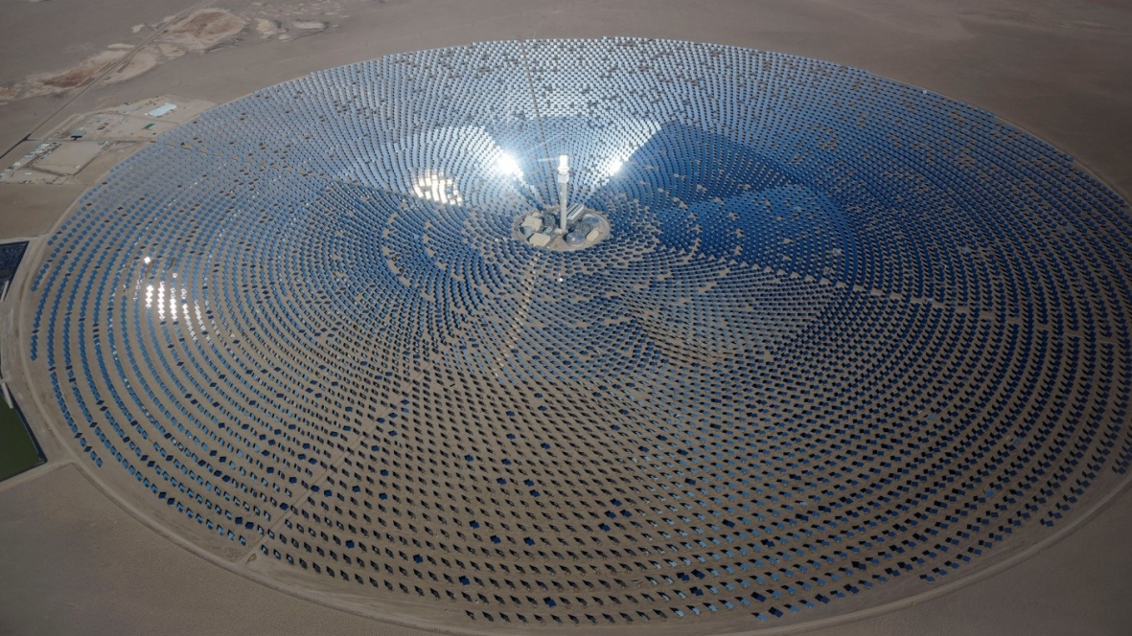
Storage Technologies: Thermal
Electricity is stored by heating/cooling air or another medium for energy management or electricity production.
Ice thermal storage
Concentrating Solar
Ice Energy, Inc.
Moves energy through time, but does not inject electricity into the grid
Moderate duration (4-6 hours)
Can shift up to 95% of HVAC loads to off-peak
U.S. DOE
Longer duration (6-12 hours)
Very good RTE – 86% (Hameer and Van Niekerk 2016)
Moderate life (20-30 years)
Moderately flexible (turbine generator)

Slide 7
Current Installed Capacity – U.S.
Total Energy Storage Capacity
Total Battery Capacity
Pumped Hydro (92.8%)
Pumped Hydro | 22.6 GW
Battery | 0.9 GW
Thermal | 0.7 GW
Compressed Air | 0.1 GW
Total | 24.3 GW
Lithium-Ion
(88.2%)
Lead Acid
(5.4%)
Thermal (2.7%)
Nickel (3%)
Compressed Air (0.5%)
Sodium(2.8%)
Battery (4%)
Flow (0.5%)
Lithium-Ion | 792 MW
Lead Acid | 49 MW
Nickel | 40 MW
Sodium | 26 MW
Flow | 4 MW
Flywheel | 58 MW
Capacitor | 2 MW
Sources:
DOE Global Energy Storage Database (https://www.sandia.gov/ess-ssl/global-energy-storage-database-home/);
EIA Form 860 Data (https://www.eia.gov/electricity/data/eia860/)

Slide 8
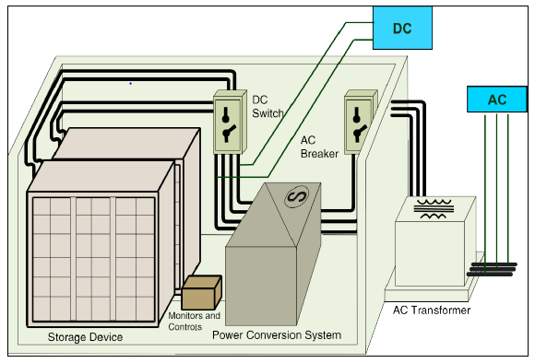
Interconnection and Control Infrastructure
Battery storage prices are generally given based on the battery itself, but interconnecting the device to the grid and allowing for control and interoperability requires additional infrastructure (and cost):
Example 4-hour lithium-ion project
Construction & Commissioning:
$101/kW
($25/kWh)
Balance of Plant (controls, switches, HVAC, etc.):
$100/kW
($25/kWh)
Power Conversion: $288/kW ($72/kWh)
Battery capacity:
$271/kWh
($1,084/kW)
DOE/EPRI 2013 Electricity Storage Handbook in Collaboration with NRECA
Total all-in cost for a 4-hour li-ion battery: $469/kWh, $1,876/kW

Slide 9
Services and Valuation

Slide 10
Energy Storage Services
Generation Services
Capacity
Energy
Ancillary services
Regulation
Frequency response
Spin/non-spin reserve
Etc. …
Transmission Services
Thermal management
Congestion relief
Infrastructure deferral
Distribution Services
Voltage support
Conservation voltage reduction
DG integration/hosting capacity
Flow management
Infrastructure deferral
Customer Services
TOU rate management
Demand charge reduction
Power quality
Resilience
Image: U.S. Department of Energy, “Grid Modernization Multi-Year Program Plan”

Slide 11
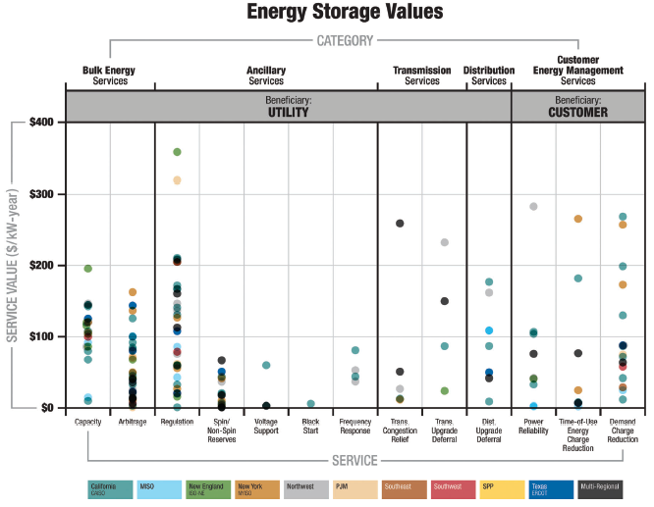
Energy Storage Values
Storage values are locational, subject to:
Resource mix
Local infrastructure
Contingency conditions
Utility tariffs
Market structure
Balducci et al, “Assigning Value to Energy Storage Systems at Multiple Points in an Electric Grid.”

Slide 12
A Different Paradigm: Embedded Energy Storage
Electricity is unique among commodities in that its “supply chain” was developed without a storage component.
Every other commodity has the ability to store excess quantities built into its supply chain – warehouses, granaries, reservoirs, etc.
Embedded storage creates a buffer between mismatches in supply and demand, stabilizing prices and protecting customers.
Question: Now that we have the technology to store electricity, should we retrofit the grid with it?
To date, energy storage has been added “on the margins” to impart flexibility to the grid.
If storage were embedded infrastructure, similar to a substation or a transformer, it could act as a natural buffer between mismatches in supply and demand and the grid would be flexible.
First report available here; watch PNNL’s Grid Architecture site for additional reports in the series

Slide 13
Embedded Storage in the Natural Gas System
A simple comparison: Natural gas and electricity
Simple assumptions: City has average daily demand of 1 million cubic feet (CF) of natural gas, peaking to 1.5 million CF; average electricity demand of 100 MW, peaking to 125 MW
Adapted from Aspen Environmental Group
Result: Embedded storage on the natural gas system means that pipelines upstream of the storage facility can be sized based on average demand, and only downstream pipelines need to be sized based on peak.
On the electric side, the entire system (generation, transmission, and distribution) serving the city must be designed based on peak demand.

Slide 14
Energy Storage in Regional Markets

Slide 15
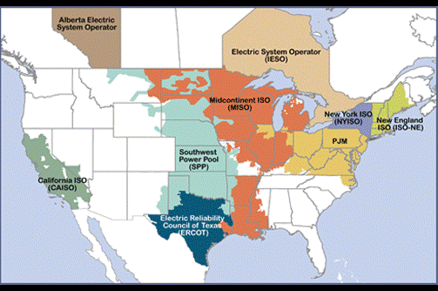
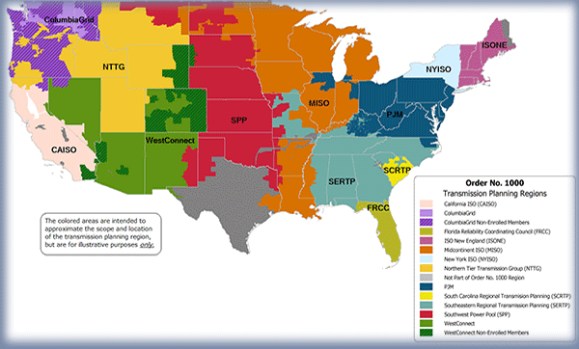
Energy Storage and Regional Markets
The Federal Energy Regulatory Commission (FERC) has two primary areas of regulatory authority over the electric grid:
Market design and operations in the deregulated market footprints (minus ERCOT)
Transmission system planning, operations, and ratemaking in all regions with interstate transmission
In recent years, FERC has sought to improve access for energy storage in both areas.

Slide 16
Market Access: FERC Order 841
In February 2018, FERC issued Order 841 to “remove barriers to the participation of electric storage resources in the capacity, energy, and ancillary service markets operated by Regional Transmission Organizations (RTO) and Independent System Operators (ISO).”
Filings must meet seven criteria:
Create a participation model;
Make storage eligible to participate in all applicable markets;
Account for the physical and operational characteristics of storage resources;
Allow storage owners to self-manage their state of charge;
Establish a minimum size requirement no greater than 100 kW;
Accurately meter and charge storage devices when charging (wholesale rates, no transmission charges when directed to charge by ISO); and
Have an effective date within one year of FERC acceptance unless more time is reasonably necessary.

Slide 17
Transmission Access: FERC Policy Statement
Prompted by two proceedings involving PSH facilities
Nevada Hydro (2008): FERC rejects developer’s petition to build a pumped storage hydro (PSH) project and require California Independent System Operator (CAISO) to assume operational control and operate it as a transmission asset; bid in market at $0
Western Grid (2010): FERC approves developer’s petition to build a PSH project that will be operated as a transmission asset at CAISO’s direction, no market bids
Policy Statement: Storage can be a dual-use (transmission and generation) asset, subject to three clarifying principles:
Avoid double recovery of costs
Minimize adverse impacts on markets
ISO/RTO independence must not be compromised
A policy statement is a nonbinding document; no action required
CAISO and MISO were the only entities to initiate a direct response to statement

Slide 18
Storage in Microgrids

Slide 19
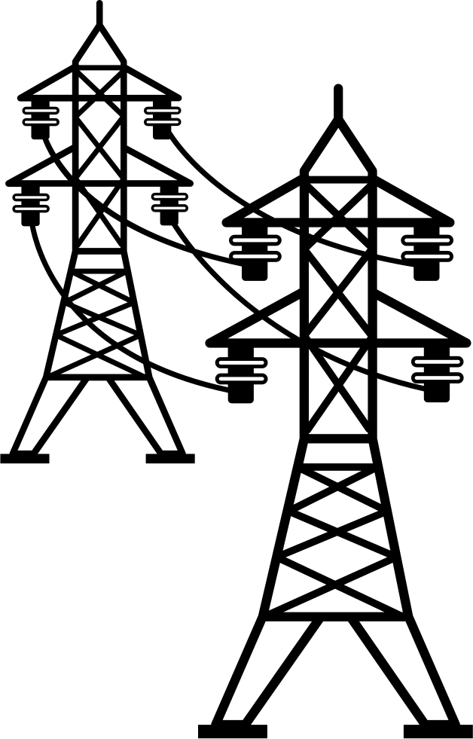
Storage and Microgrids: A New Resilience Paradigm
The advent of cost-competitive energy storage options has enabled us to go from:
Mission-critical Resilience
Economic Resilience
Capacity
Energy
Regulation
Reserves
Arbitrage
…
to
Capacity
Energy
Limited opportunities for grid participation
High cost
Limited to facilities in which resilience is mission critical
Increased opportunities for grid participation
Offsetting revenues reduce system costs
Viable resilience for broader range of facilities

Slide 20
Questions States Can Ask
Are planning tools accounting for the granular values and operational characteristics of energy storage technologies?
Are tariffs and rates in place to incent customers who deploy storage and other distributed energy resources to use those assets in a way that benefit the grid and reduce system costs?
Can tariffs be used to incent development and grid-beneficial use of microgrids?
What plans are in place for end-of-life disposal of battery assets?
Absent resilience metrics, how can planning processes be adapted to meet resilience goals in a cost-effective manner?
Are there opportunities for furthering state goals through increased engagement in RTO/ISO processes?

Slide 21
Questions?
Jeremy Twitchell
jeremy.twitchell@pnnl.gov
971-940-7104

Slide 22
Appendix Slides

Slide 23
Resources for More Information
Y Xu, CC Liu, KP Schneider, FK Tuffner, DT Ton: Microgrids for Service Restoration to Critical Load in a Resilient Distribution System
Schneider et al., Preliminary Design Process for Networked Microgrids
M Armendariz et al., Coordinated Microgrid Investment and Planning Processes Considering the System Operator
JB Twitchell, RS O’Neil, MT McDonnell, Report: Planning Considerations for Energy Storage in Resilience Applications
B Ward et al., The Advanced Microgrid: Integration and Operability
Schwartz, Lisa C, and Greg Leventis. Grid-Interactive Efficient Buildings: An Introduction for State and Local Governments
Eckman, Tom, Lisa C Schwartz, and Greg Leventis. Determining Utility System Value of Demand Flexibility From Grid-interactive Efficient Buildings
Schiller, Steven R, Lisa C Schwartz, and Sean Murphy. Performance Assessments of Demand Flexibility from Grid-Interactive Efficient Buildings: Issues and Considerations
PNNL energy storage site: https://www.pnnl.gov/energy-storage
Sandia National Laboratories energy storage site: https://www.sandia.gov/ess-ssl/
LBNL Electricity Markets & Policy Group: https://emp.lbl.gov/

Slide 24
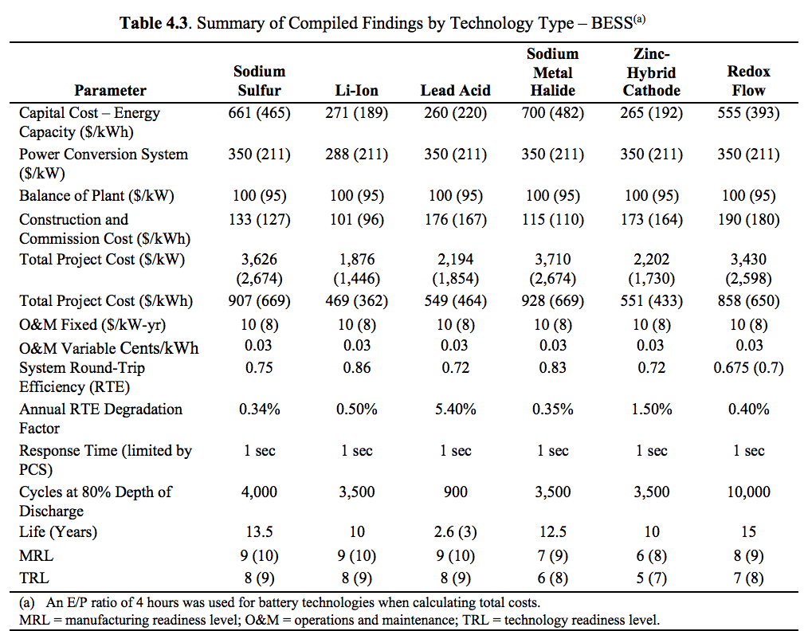
Storage Technologies: Additional Information
Mongird et al, Energy Storage Technology and Cost Characterization Report. http://energystorage.pnnl.gov/pdf/PNNL-28866.pdf.

Slide 25
Questions Raised by Embedded Storage
Theoretically, embedded storage could facilitate more efficient design and use of the electric grid and reduce costs by managing volatility (no daily price swings, reduced need for ancillary services, etc.).
Several regulatory barriers exist:
Lack of underlying standards (not contemplated in reliability standards; no resilience standards)
Inclusion in planning processes (regional transmission planning processes are generally slow to integrate new technologies)
Ownership models (security and control issues complicate third-party ownership)
Compensation structure (current market structures not designed to value this kind of service; lack of standards means it’s difficult to make a case for it as a regulated asset)
Metrics (how do you measure a buffer?)
Valuing this type of asset is something we’re just starting to think about:
How would you quantify its impacts on the grid and compensate them?
Valuation will be the focus of a forthcoming paper.

Slide 26
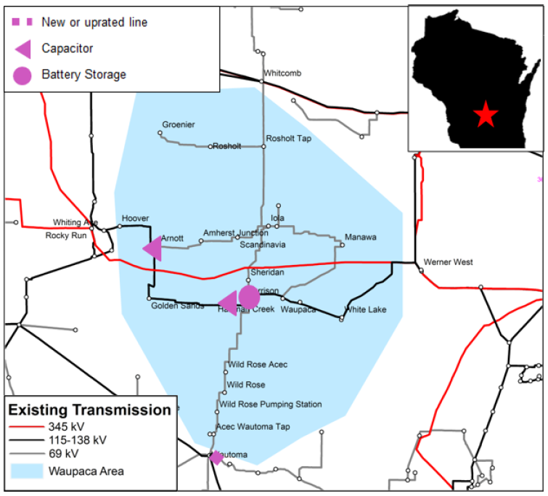
Storage as Transmission: Case Study
The 2019 MISO Transmission Expansion Plan (MTEP) was the second regional transmission plan to select energy storage as a transmission asset
Storage as Transmission: Waupaca, WI
Under certain N-1 contingency scenarios, the Waupaca area would be cut off
At $12.2 million over 40 years, a 2.5 MW/5 MWh energy storage system, coupled with line sectionalization, was selected over a $13.1 million project to install an additional circuit
Expected in-service date: Dec. 2021
As a transmission asset, the storage system’s costs will be recovered through MISO’s FERC-approved transmission system rates, and it will not participate in energy markets.

