Slide 1
Impacts of DERs on net loads and approaches for actively managing load shapes
Chandler Miller
Lawrence Berkeley National Laboratory
Prepared for National Association of State Utility Consumer Advocates
October 22, 2020

Slide 2
Agenda
Overview
  Definition of net load
  Importance of net load shape management
  Current trends in net load shapes
Impact of individual distributed energy resources (DERs) on net load
  Solar
  Energy storage
  Energy efficiency
  Demand response
    Time-of-use
    Critical peak pricing
    Direct load control
Combined impact of multiple DER strategies
Utility strategies for managing net load shapes
Resources for more information

Slide 3
What are net load shapes?
The profile of a customer’s grid electricity demand over time as affected
by behind-the-meter generation and other DER technologies
Net load lessens the impact of idiosyncrasies in individual load shapes but accentuates shared patterns of behavior.
Aggregated
without DERs
Aggregated
with DERs
Source: Ongoing Berkeley Lab research

Slide 4
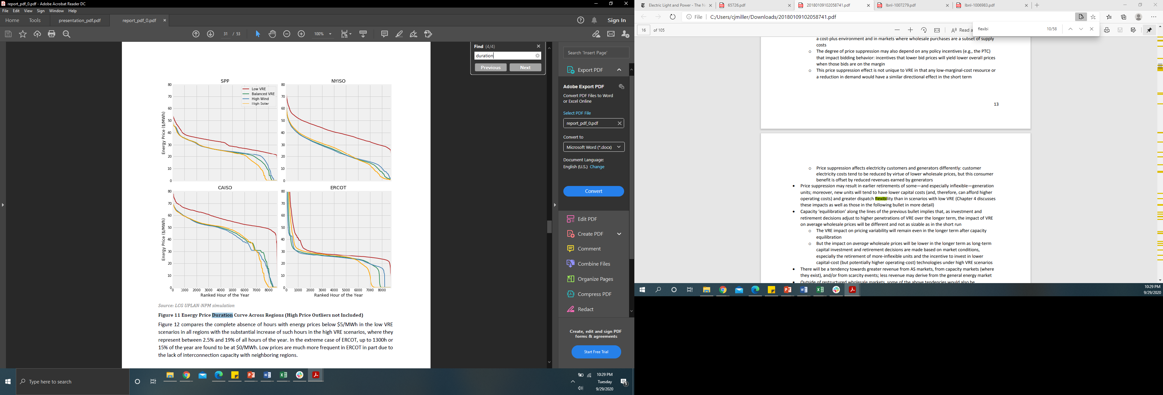
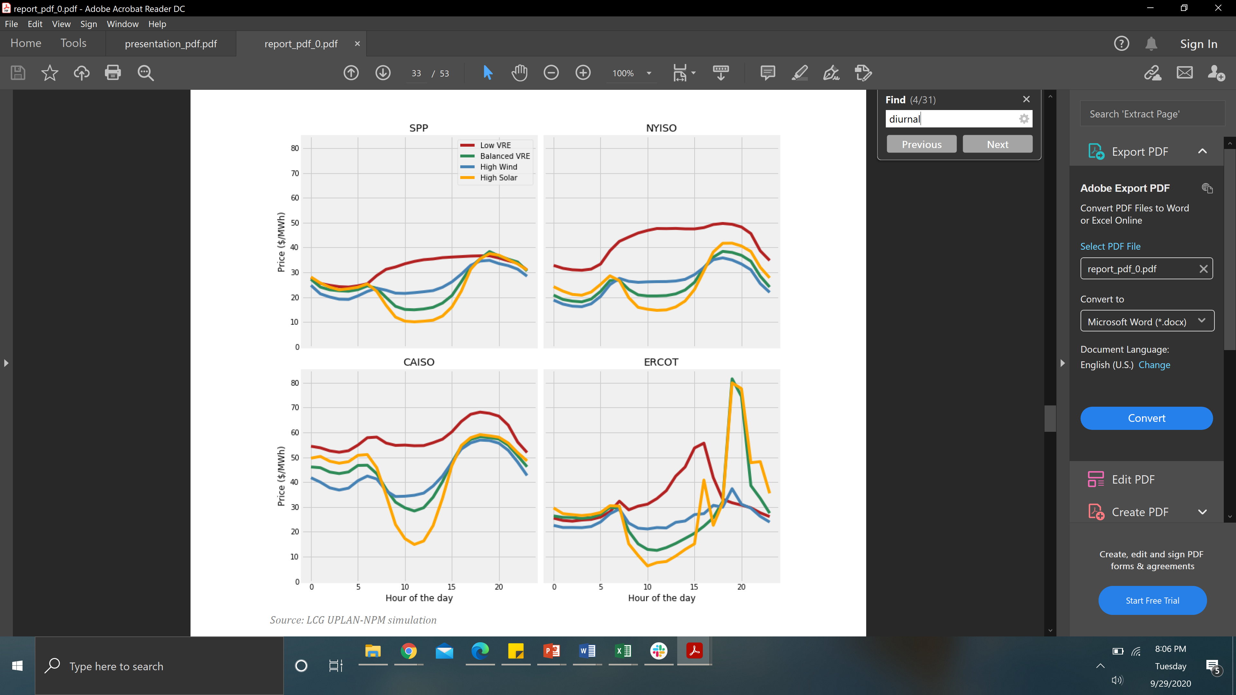
DERs are a growing opportunity for net load shape management.
More flexible electricity systems are more reliable and resilient.¹
  DERs offer the opportunity for utilities and customers to control electricity loads during periods of high system demand and costs.
  Top figure shows energy price curves that demonstrate how a small portion of hours during the year have much higher prices.
Variable renewable energy (VRE) increases the need for more flexible loads and more opportunities to shift load to periods with lower energy prices.
  Bottom figure shows simulated diurnal energy prices and energy price duration curves with increased VRE penetration.²
  Potential for better alignment of solar and demand during summers, when energy prices typically are higher
  VRE-generated electricity can be stored and dispatched when there is more need.
State climate goals also will require flexible resources to balance generation and load.
Energy Price Duration Curves
Mean Diurnal Energy Price Profiles for Weekdays
Source: Seel, J., A. D. Mills, and R. Wiser. Impacts of High Variable Renewable Energy Futures on Wholesale Electricity Prices, and on Electric-Sector Decision Making. 2018.

Slide 5
Net load shapes are changing — for example, with increasing penetration of distributed solar.
The upper-right figure shows how annual generation of small-scale solar (i.e., residential and commercial) is increasing each year, as estimated by EIA.¹
As solar capital costs decrease, customers will continue to install more distributed solar.
Distributed solar adoption levels in MISO are not high, as shown in the lower-right figure, but emerging regulatory goals indicate that may change.
  4 states working towards plans for 100% clean energy goals by 2050 (MN, WI, IL, MI),² with many cities also establishing decarbonization goals
Many large utilities in MISO’s footprint have set clean energy and decarbonization targets:
  Xcel Energy, Ameren, Duke, and Alliant have net-zero carbon by 2050 goals.
  Other utilities in the region also are working towards carbon reduction targets.
Source: EIA Electric Power Monthly
Source: 2018 EIA-861 data
Notes:
EIA Electric Power Monthly Table 1.1.A
http://view.ceros.com/miso-energy/misoforward2020/p/1

Slide 6
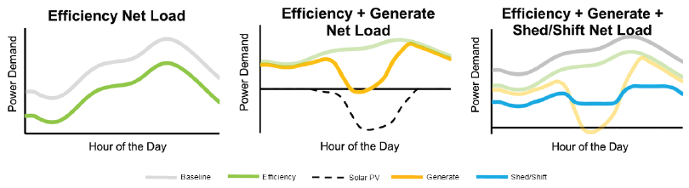
Impact of individual DERs on net load
DERs can impact net load in the following ways:
  Generation: Provide electricity onsite, behind-the-meter, from sources such as solar or storage discharge. Reduce grid demand and potentially export electricity back to the grid.
  Energy efficiency: Long-term reduction in energy usage with changes in customer end-uses.
  Load shifting: Change the timing of electricity usage using DERs such as storage or behavioral demand response
  Load shedding: Reduce intended electricity usage, usually for a scheduled period, using DERs such as demand response
Impact of DERs on Net Load Shape¹
Source: Neukomm, et al. Grid-Interactive Efficiency Buildings. 2019.
Notes:
1. Neukomm et al. Grid-interactive Efficient Buildings. 2019.

Slide 7
How DERs affect net load shapes: Illustrative examples
Distributed solar
Energy storage
Energy efficiency
Demand response
  Time-of-use
  Critical peak pricing
  Direct load control

Slide 8
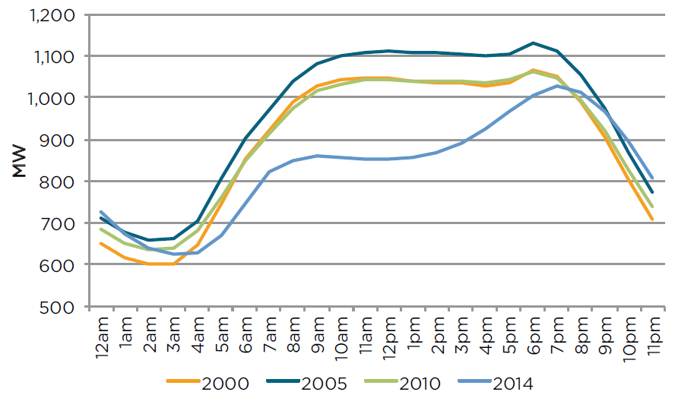
Distributed solar PV lowers midday net load through self-consumption and export.
Customers use onsite solar PV for self-consumption, reducing electricity purchased from the grid.
  Solar PV lowers net load while generating during midday.
  Excess solar PV is exported to the grid through net metering and other programs.
  The top figure shows the modeled impact of increasing solar penetration on an aggregate load of 60 homes in California.
  The bottom figure shows historical average daily load for Hawaiian Electric Company.
Utilities can use several strategies to manage net load impacts from solar PV.
  Set late-in-day peak periods (for time-of-use) that promote west-facing solar installations
  Change compensation for solar exports
  Establish time-based rates to shift demand to midday
  Promote technologies that smooth midday curve (e.g., energy storage)
Source: Ongoing Berkeley Lab research
Oahu Average Daily Net Load by Year
Source: The Economic Research Organization at the University of Hawai’i. Estimating the Opportunity for Load-Shifting in Hawaii: An Analysis of Proposed Residential Time-of-Use Rates. 2016.
Notes:
“Estimating the Opportunity for Load-Shifting in Hawaii: An Analysis of Proposed Residential Time-of-Use Rates” from UHERO
HECO - over 90% of installed solar was distributed residential or commercial as of 2014²

Slide 9
Customers can use storage with solar PV to increase system value, smoothing peaks.
Energy storage can charge from solar PV generation and discharge during other periods, reducing the impact of solar PV on midday net load.
Storage has incentive to dispatch:
  When exporting solar is less valuable than offsetting net load at other periods (top figure)
  When it can offset positive net load during peak period (top figure) with TOU pricing
With value-of-solar tariff, storage dispatch is always more economic than solar PV export.
  Bottom figure shows modeled impact of solar and storage on net load for 60 homes with flat-rate pricing and a value-of-solar tariff.
  Storage absorbs more generation, with larger impacts on midday and evening loads.
With TOU rates and net metering, storage only discharges during peak period.
  New peak from storage discharge as peak period begins; excess solar exported (bottom figure)
Peak rate: $0.36
Off-peak rate: $0.27
Retail rate: | $0.12417
Export rate: | $0.097
Source: Ongoing Berkeley Lab research
Notes:
TOU rates are period-based pricing, where retail rates vary based on time, season, and day of week

Slide 10
Storage behavior is sensitive to electricity prices, rate schedule, and efficiency losses.
With net energy metering 2.0, solar export rates are slightly lower than retail rates due to non-bypassable charge (~$0.02/kWh).
  Figures show impact of seasonal electricity price variation on modeled net load for 60 homes with TOU pricing and net energy metering 2.0.
Storage can create value for customer by charging from grid during off-peak, leading to new net load peaks if not managed.
  Top figure shows storage charging during morning super off-peak period in summer despite solar availability because of greater value to customer
Smaller difference in winter TOU prices eliminates an incentive to dispatch through grid or solar charging (bottom figure)
  Storage will not discharge if price differential of charging and discharging periods is too small.
  Although price differential is positive, storage must overcome roundtrip efficiency losses in order to provide value through dispatch.
Super Off-peak
Rate: $0.25
Off-peak
Rate: $0.30
Peak Rate: $0.51
Super Off-peak
Rate: $0.25
Off-peak
Rate: $0.26
Peak Rate: $0.27
Source: Ongoing Berkeley Lab research

Slide 11
For large commercial customers, storage behavior is driven by demand charges.
Large commercial customers with demand charges ($/kW) are adopting standalone storage to target daily peak shaving.
  Non-coincident demand charges apply to the customer’s highest demand any time during billing period. Coincident demand charges apply only to defined periods.
Storage charges when customer demand is low and discharges when demand exceeds target.
  Behavior is dependent on storage dispatch algorithm’s ability to predict time, duration, and amplitude of peak.
Storage shaves peak throughout day for non-coincident demand charges, but only dispatches during peak with TOU demand charges (see figure).
  For TOU demand charges, demand reduction is more significant as the same amount of energy is discharged from storage in a shorter period.
  Peak shaving with non-coincident demand charge creates a flat net load throughout the day. With TOU demand charges, it creates a large ramp between the peak period and other hours.
Energy Storage Peak Shaving Behavior for Non-Coincident and Time-of-use Demand Charges
Peak period
300
250
200
150
100
50
0
Load (kW)
0 | 4 | 8 | 12 | 16 | 20
Hour of Day
Source: Darghouth, N., G. Barbose, and A. Mills. Implications of Rate Design for the Customer-Economics of Behind-the-Meter Storage. 2019.

Slide 12
What can utilities do to manage net load impacts from storage?
Paired solar and storage provides load reduction and load opportunities only when price signals incentivize storage dispatch.
  For example, winter TOU prices with smaller price differentials may lead to inactive storage.
  Standalone storage can provide load shifting through grid charging, but may also create new net load peaks.
Utilities can design rate structures that incentivize when storage charges and discharges based on desired impact.
  For example, non-coincident demand charges target daily reduction of consumption, while TOU demand charges cause higher reduction only during peak demand.
Utilities can design value of solar tariffs to incentivize maximizing self-consumption of solar generation or solar export.

Slide 13
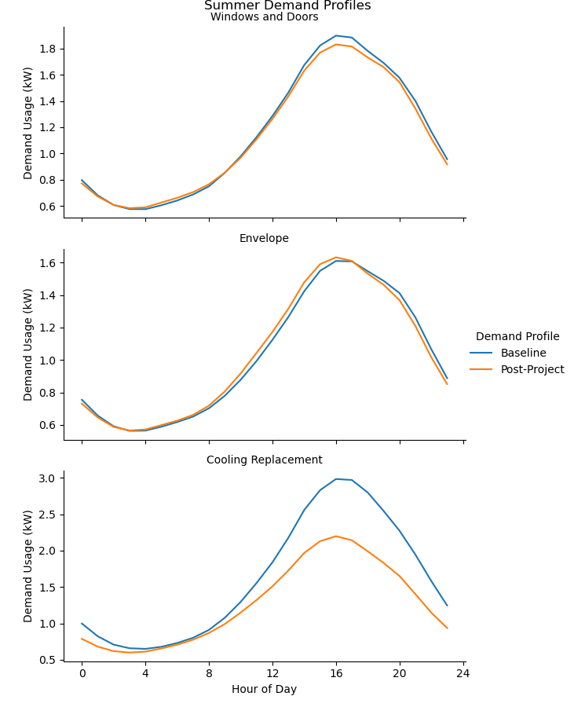
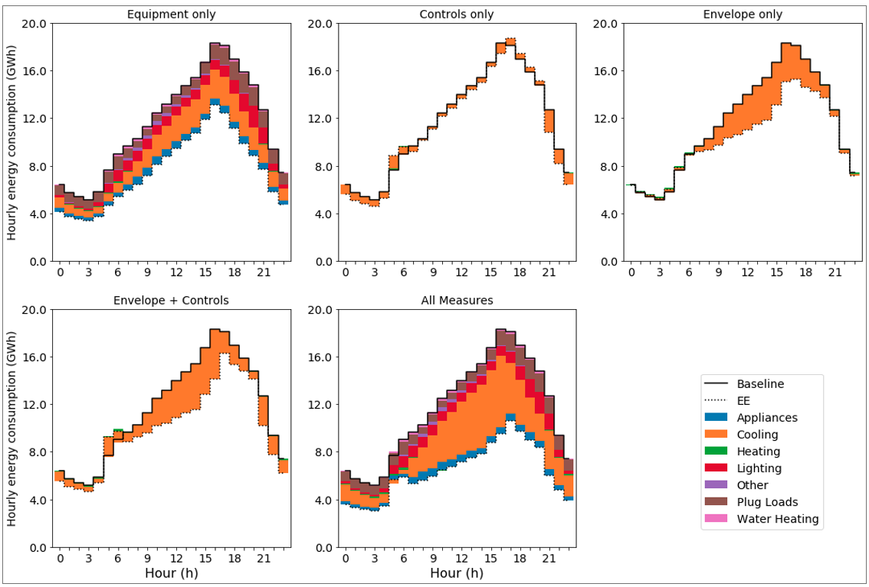
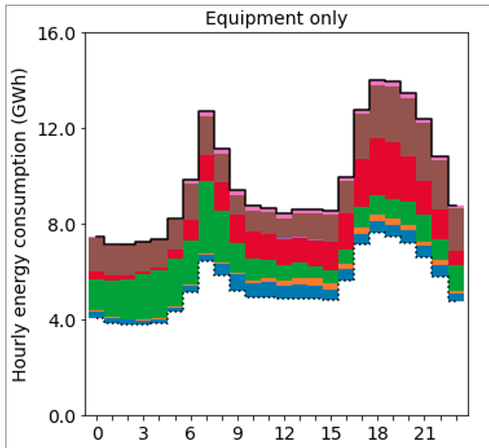
Energy efficiency measures affect net loads without active management.
Energy efficiency impacts vary based on applied measure, generally decreasing net load shape in line with customer’s usage.
Efficiency programs to upgrade buildings target common equipment like lighting, cooling, heating, water heating, envelope, and large appliances.
Improved building performance can reduce system peak demand — e.g., during peak hours for space heating or cooling.
  Top figure: avr. measured impact of cooling equipment replacements in CA homes
Efficiency upgrades affect different time and seasonal periods of net load.
  Bottom figure: simulated impact of other equipment upgrades for CA homes
Diversity of efficiency measures provides opportunities for specific demand reduction
  Utilities can strategically design programs to target reduction by period, season, and customer sector.
Measured Impact of Residential Energy Efficiency Upgrades for Summer Day
Simulated Impact of Residential Energy Efficiency Upgrades
Summer Peak Day
Winter Peak Day
Source: Figures from ongoing LBNL research
Notes:
Upper-figure: Berkeley Lab work in progress
Lower-figure: LBNL Memo “Status update on modeling EE and DR load interactions:
1. Electricity end uses, energy efficiency, and distributed energy resources baseline

Slide 14
TOU rates provide demand response through price responsiveness.
TOU pricing growing due to increase in:¹
  Advanced metering infrastructure
  Increased DER penetration
  Surplus DER generation during midday
TOU rate design can impact net load by influencing changes in customer behavior, even absent enabling technologies.
  Despite behavior diversity, customers consistently reduced or shifted peak period consumption in utility pilots²
Example: modeled customer response to TOU pricing based on measured response (see figures showing 60 homes)
  For 3-period pricing, customers decreased usage during peak period and slightly increased usage during super off-peak.
  Increase in off-peak usage near zero for 2-period rates (not shown), despite decrease in on-peak usage
Studies show high retention rate for opt-in and opt-out groups, with opt-in recruitment 15% on average²
Super Off-peak
Off-peak
Peak
Super Off-peak
Off-peak
Peak
Source: Ongoing Berkeley Lab research

Slide 15
Critical peak pricing provides more control through customer response on peak days.
Under critical peak pricing (CPP), customers pay a higher price for energy during a pre-defined period during critical event days (i.e., days with high demand).
CPP provides a day-ahead net load management for targeted peak reduction.
Critical peak period prices are generally much higher than TOU peak prices and only occur when called (typically 5-22 days per year¹)
  Median on-peak to off-peak price ratio is 2.7 to 1 for TOU² compared to lowest critical peak price ratios around 4 to 1¹
  Customers incentivized to enroll through slight price reduction for non-peak periods
Figure shows net load with modeled customer response to a critical peak period on a peak summer day
Combination of higher price signal and advance notification to customers leads to higher reduction during critical peak period
CPP Period
Rate: $1.16
Source: Ongoing Berkeley Lab research
Time-Based Pricing Programs³
Program | Definition
Time-of-use | Fixed, pre-set retail rates vary by time of day, season, and day type. Generally, period are defined as peak, off-peak, and potentially others.
Critical Peak Pricing | Event is called day-ahead, and infrequently, where customers pay a pre-defined electricity price premium during event period.
Critical Peak Rebate | Like critical peak, event is called day-ahead and infrequently. Unlike critical peak pricing, customer received a rebate for reducing during event.
Variable Peak Pricing | Peak hours are defined, like TOU, but peak price is adjusted daily based on wholesale market prices.
Real-time Pricing | Customers are charged prices that vary over short time intervals, typically hourly, that are set one day in advance.
Source: Cappers, R. and R. Scheer. 2016.

Slide 16
Direct load control provides predictable impact on peak days.
Direct load control (DLC) allows utilities to remotely cycle air conditioners and water heaters, or adjust thermostat settings, during events for pre-established periods.
  Equipment cycled between 50%-100% during event depending on program
Like CPP rates, there’s a cap on the number of events per year.
  Customer can opt out for single events.
Customer receives an annual credit or enrollment incentive.
Top figure shows modeled net load impact of air conditioning DLC during a peak summer day for varying levels of DLC enrollment
Programs largely target residential (4M enrolled in U.S. as of 2018); small C&I customers enroll to a smaller extent (84,000 as of 2018)¹
  Bottom figure shows top 10 utilities in MISO by customer enrollment in DLC
DLC period
Source: Ongoing Berkeley Lab research
Source: 2018 EIA-861 data
Notes:
Customers receives notice, but adjustment is made by utility during event period

Slide 17
Combined DERs provide strategies for managing different net load needs.
Combining DERs provides utilities with a menu of options that allow them to generate, shift, and shed.
On peak days, solar and storage provide additional benefit by responding to changes in net load profile from DLC and peak period rate for CPP.
Top figure shows changes in net load as DERs are sequentially applied for a peak day (for Pacific Gas and Electric).
  CPP alone: est. 15% reduction in customer usage during event period (2 pm to 7 pm)
  With solar PV: Reduces midday net load; generation overlaps with CPP in afternoon
  With storage: Charges from solar, absorbing all generation at 1 pm and fully discharges during CPP period
Without critical peak period, storage would have dispatched only during peak period from 5 pm to 8 pm (bottom figure).
Source: Ongoing Berkeley Lab research
Figures demonstrate interaction of DERs with 100% customer adoption.

Slide 18
Looking forward: Utilities are designing platforms to tap into DER flexibility.
Utilities are exploring how to have more visibility and control for better DER management.
In California, Rule 21 requires all distributed solar to use inverters with remote communication and grid service capabilities.
  While platforms are still developing, distributed solar PV installations will be capable of utility control without requiring additional technological upgrades.
  CA passed a bill in 2019 that will foster higher adoption of demand response-ready appliances.²
  Such regulations enable technologies that provide utilities with more visibility and control.
Some utilities are creating centralized platforms for aggregating dispatchable DERs to control net load, such as “virtual power plants” (VPPs), that can potentially operate DERs synchronously, provide grid services, and participate in wholesale markets.
  Like direct load control, utilities can schedule and dispatch other DERs, such as energy storage systems.
  By aggregating smaller resources, VPPs facilitate a unified approach to providing demand response and other grid functions for greater impact.
Some utilities testing VPPs through pilots:
  Portland General Electric, Southern California Edison, Austin Energy, California Community Choice Aggregators

Slide 19
Resources for more information
Schwartz, L., M. Wei, W. Morrow, J. Deason, S. Schiller, G. Leventis, S. J. Smith, W. L. Leow, T. Levin, S. Plotkin, Y. Zhou, and J. Teng. Electricity End Uses, Energy Efficiency, and Distributed Energy Resources Baseline. 2017.
Darghouth, N., G. Barbose, and A. Mills. Implications of Rate Design for the Customer-Economics of Behind-the-Meter Storage. 2019.
Satchwell, A., P. Cappers, and G. Barbose. Current Developments in Retail Rate Design: Implications for Solar and Other Distributed Energy Resources. 2019.
Satchwell, A., P. Cappers, J. Deason, S. Forrester, N. M. Frick, B. F. Gerke, and M. A. Piette. A Conceptual Framework to Describe Energy Efficiency and Demand Response Interactions. 2020.
Cappers, R. and R. Scheer. American Recovery and Reinvestment Act of 2009: Final Report on Customer Acceptance, Retention, and Response to Time-Based Rates from Consumer Behavior Studies. 2016.
Gerke, B., G. Gallo, S. J. Smith, J. Liu, S. V. Raghavan, P. Schwartz, M. A. Piette, R. Yin, and S. Stensson. The California Demand Response Potential Study, Phase 3: Final Report on the Shift Resource through 2030. 2020.
Potter, J., E. Stuart, and P. Cappers. Barriers and Opportunities to Broader Adoption of Integrated Demand Side Management at Electric Utilities: A Scoping Study. 2018.

