Slide 1
EV State of Play
EV market and public policy update
Nick Nigro, Atlas Public Policy
November 10, 2020

Slide 2
About Atlas Public Policy
Our Key Focus Areas
Access: Collect and disseminate publicly available information.
Interpret: Create technology to spur insights and conduct data-driven analyses.
Empower: Strengthen policymakers, businesses, and non-profits’ ability to meet emerging challenges and identify and seize opportunities.
DC-based policy tech firm started in 2015
We equip businesses and policymakers to make strategic, informed decisions through the greater use of technology that aggregates publicly available information

Slide 3
ABOUT THE ATLAS EV HUB
The EV Hub gives stakeholders from across the EV industry quick access to key data and information on the market, policies and regulations, and activities by the EV community
A one-stop shop for businesses, policy professionals, and the advocacy community to learn more about what’s going on in the EV market
A comprehensive platform for the EV community: www.atlasevhub.com
Free access for public agencies and Clean Cities Coordinators!
Notes:
37 Unique Datasets

Slide 4
Battery Advances are Making All-Electrics Affordable
Range in miles | MSRP
259 | $37,495
238 | $36,620
250 | $39,990
259 | $79,500
84 | $29,010
238 | $83,000
114 | $43,600
76 | $29,170
74 | $32,780
81 | $41,350
76 | $39,200
87% decline from 2010-2019
Source: Bloomberg New Energy Finance (2020)
Tesla announces 56% decline (~56 kWh) in battery costs by 2023
Notes:
Most analysts claimed lithium-ion battery technology was not capable of powering a robust market for long range vehicles. The belief was that new chemistries with much higher energy densities were needed for EVs to reach their full potential. While this may still be true for batteries to power all vehicles, the cost per kilowatt-hour of batteries has declined far faster than expected and resulted in long range EVs being introduced many years ahead of expert opinions. A good example is the 2012 and 2017 California Air Resources Board analyses for its ZEV program. The 2012 analysis assumed 100-mile BEVs would be the norm out to 2025 while the 2017 analysis assumes vehicles capable of traveling over 200 miles on a charge will be common in that timeframe. According to Bloomberg New Energy Finance, prices have declined over 70% from 2010 to 2016.

Slide 5
2020 Election Summary for electric transportation
Immediate Executive action very likely
Vehicle standards for light-, medium-, and heavy-duty
Public fleet vehicle purchasing
California waiver for state vehicle standards
U.S. Congress action uncertain
Reform of federal EV tax credit for passenger vehicles
Stimulus for EV infrastructure
2021 “cash for clunkers”
States continue to push with funding and new policies
ZEV states expand into trucks and buses
VW Settlement funds drive deployment for school buses
Federal grants and VW drive transit buses

Slide 6
$439 Billion of private investment announced
U.S. investment up but still lags China, Germany, and South Korea
U.S. expected to get about 16% of total investments
$9.24B of $11B in Q3 expected to be in U.S.
$11B announced in Q3
Fisker: $2.9B
Rivan: $2.5B
General Motors/Nikola: $2B
$459M announce in October so far
Arrival: $164M
Hyundai: $295M

Slide 7
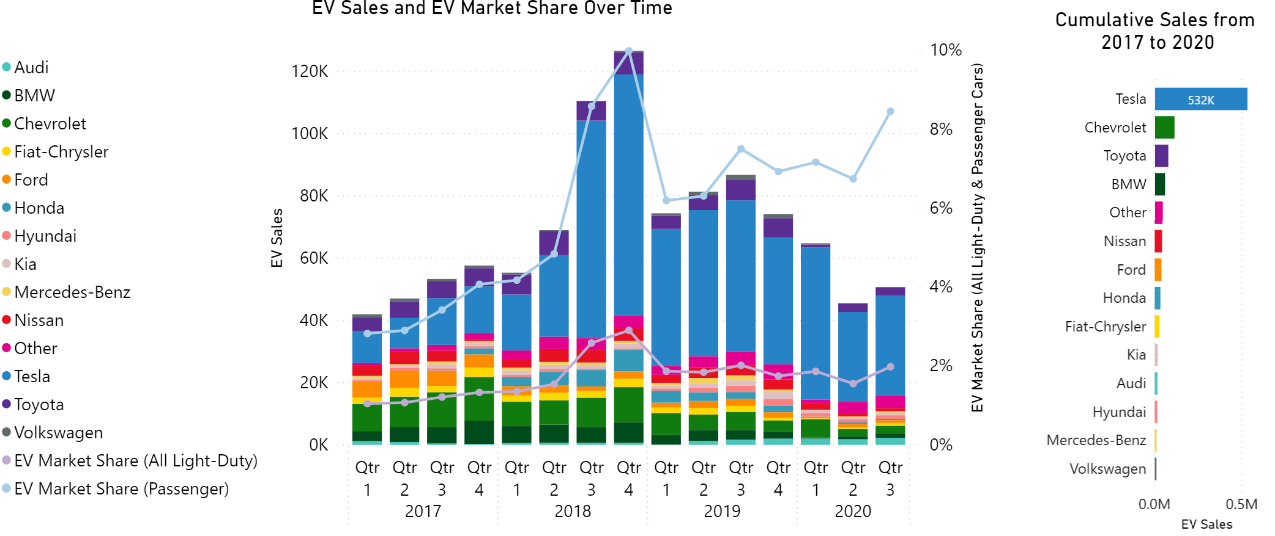
More than 1.5m EV sales in U.S.
Tesla has more than 40% of total sales and 61% since January 2019
5 models make up 58% of total sales; 70 total models sold
2020 sales down 25% from 2019 levels through August
EV market share for passenger cars steadily above 6% (~2% including light trucks and SUVs) since January 2019

Slide 8
COVID-19 Has Hurt but Not Wounded EV Market
U.S. sales struggling but EV investments continue
Charging deployment gaining
Government programs progressing for now
Volkswagen Settlement awards continue to be made
Budgetary challenges and transportation revenue shortfalls persist
EV sales faltering (25% decline in U.S. through August)
Large announcements of new investments in EVs in Q3
Very large utility investments being led by California and New York
Station deployment continuing in 2020
Trucks and buses continue to receive support
Electric transit buses received the largest Low-No allocation yet with $133 million in new funding
New models delayed earlier in year due to COVID-19
Advanced Clean Trucks rule adopted in California in the second quarter
Government funding for EVs passed the $2 billion mark in Q2
DCFC charging deployment already in 2020 already higher than in 2019

Slide 9
California adopts the Advanced Clean Trucks Rule
Target to reach 100% ZEV truck sales by 2045
Rules increase every year, reaching midpoint of 50 percent of new vehicle sales in 2030.
Rule applies to all truck classes and use types.
Recognition of emissions burden borne by underserved communities was a key driver behind the adoption of the rule
Source: CARB

Slide 10
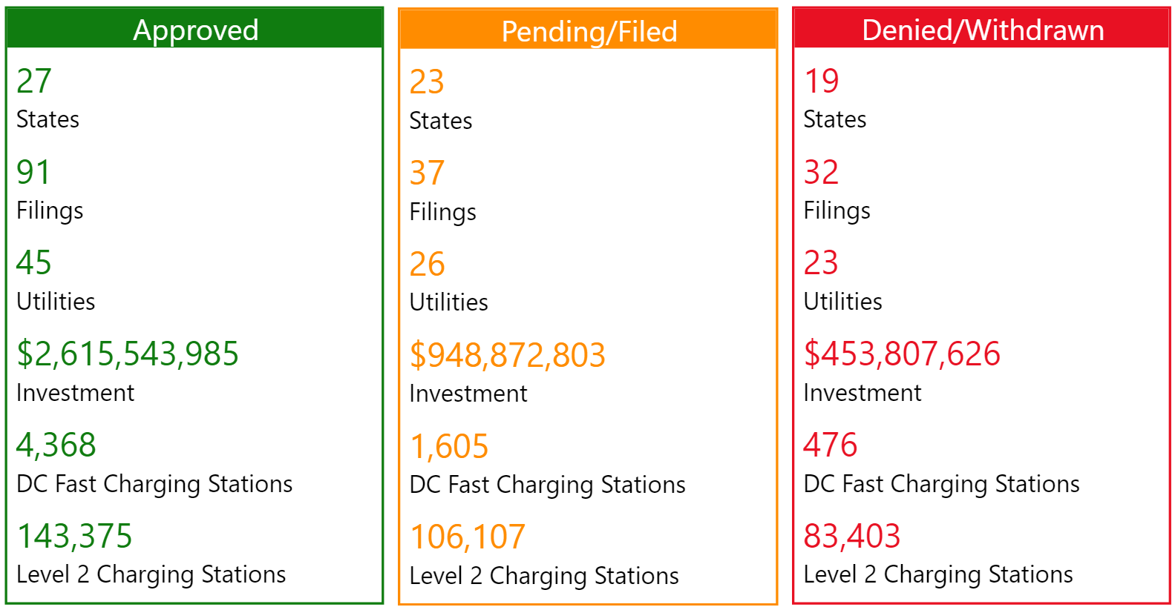
Utility Filings Status (2012 through September 2020)

Slide 12
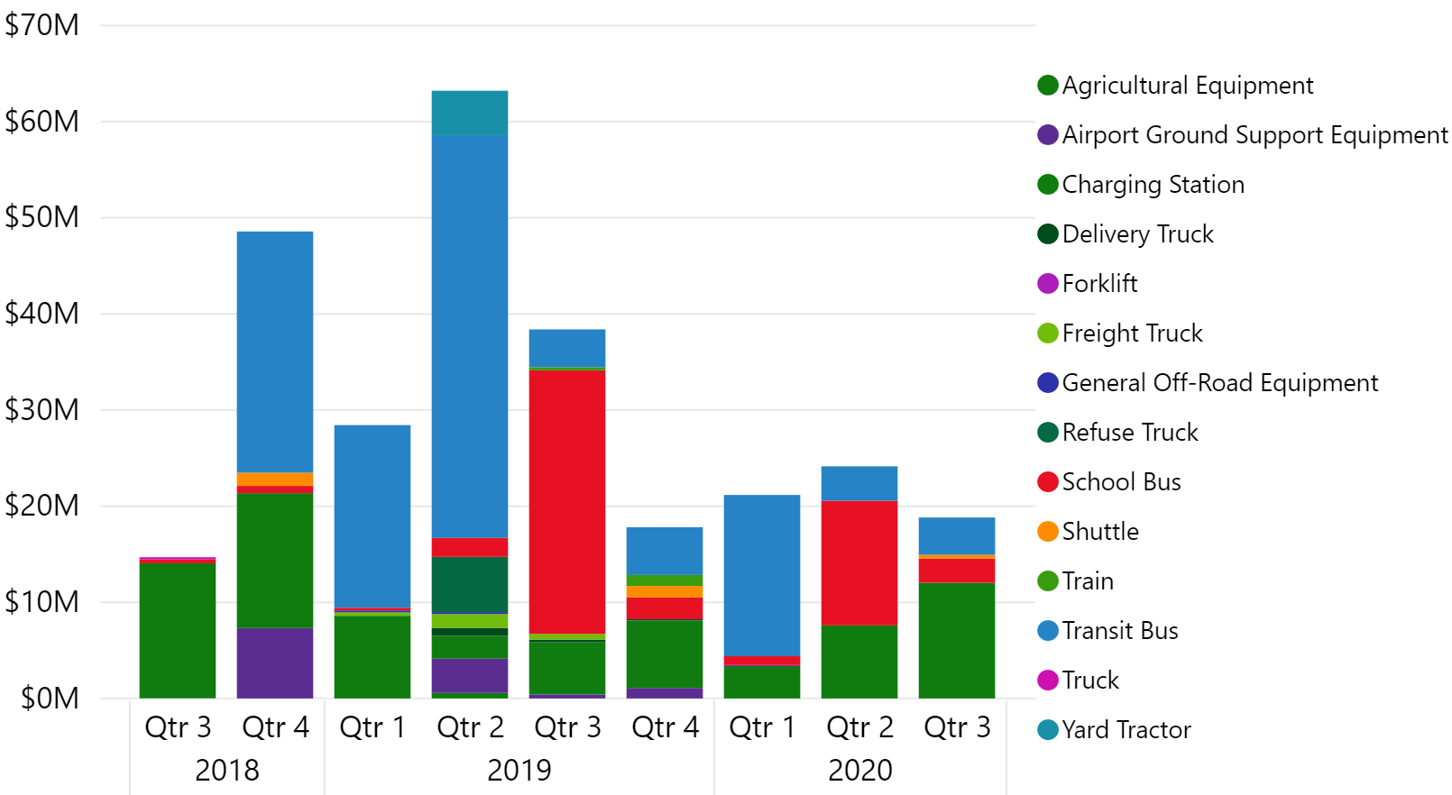
Total VW Settlement Funding Awards for ZEV Technology
ZEV makes up 46% of total funding awards
$275m out of $600m
Transit buses and light-duty charging dominating awards
Funding awards for electric trucks increasing
Projects | States | Funding Amount | VW Settlement Eligible Mitigation Action
73 | 28 | $171,611,067 | Class 4-8 School Bus, Shuttle Bus, or Transit Bus
25 | 16 | $74,455,668 | Light-Duty Zero Emission Vehicle Supply Equipment
12 | 5 | $12,397,322 | Airport Ground Support Equipment
10 | 4 | $8,336,829 | Class 8 Local Freight Trucks and Port Drayage Trucks (Large Trucks)
4 | 2 | $4,727,365 | Forklifts and Port Cargo Handling Equipment
5 | 4 | $1,876,848 | Freight Switchers
4 | 3 | $1,235,500 | Class 4-7 Local Freight Trucks (Medium Trucks)
2 | 1 | $631,034 | Diesel Emission Reduction Act (DERA) Option
135 | 36 | $275,271,633
Source: Atlas EV Hub (www.atlasevhub.com)

Slide 13
nick.nigro@atlaspolicy.com

