Slide 1

Using analytics to remove barriers to storage adoption
Patrick balducci
Argonne National Laboratory
NATIONAL ASSOCIATION OF STATE UTILITY CONSUMER ADVOCATES 2020 Annual Meeting
November 10, 2020

Slide 2
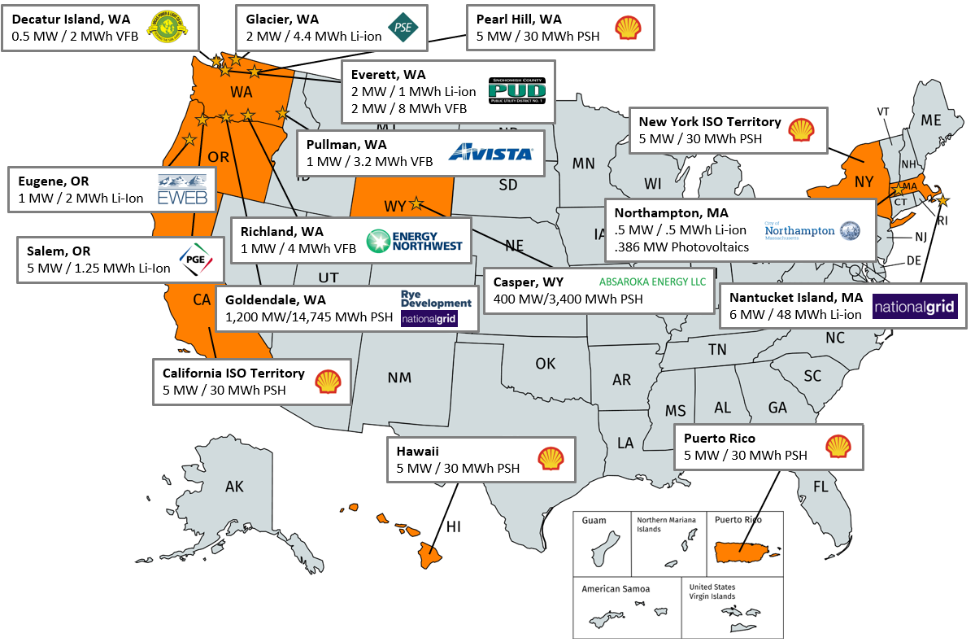
Recent energy storage assessments
1,626
MW
18,248
MWh at
16
Sites
Analytics Task-flow
Preliminary Economic Analysis and Identification of Use Cases
Baseline Testing to Evaluate Ratings etc.
Use Case Testing and Analysis
Final Techno-Economic Analysis

Slide 3
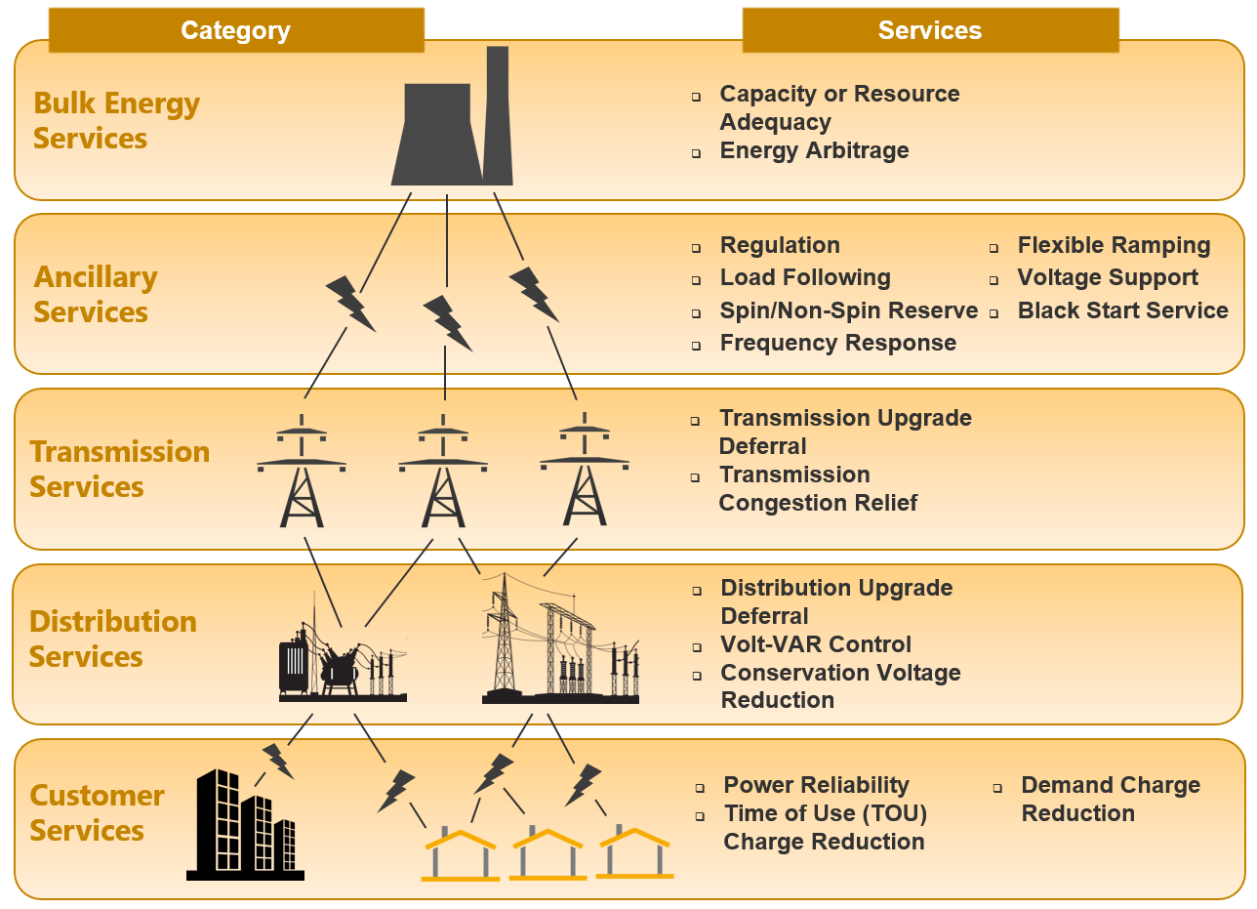
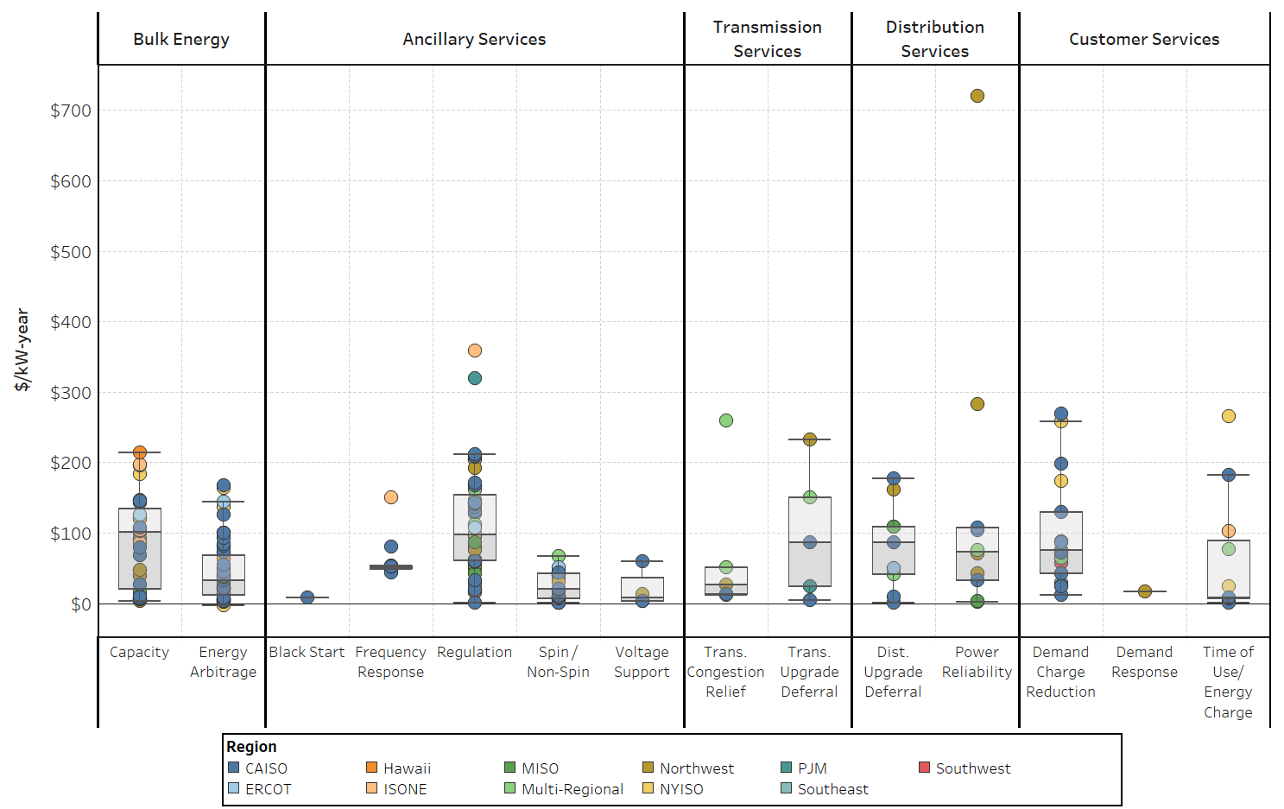
Valuation taxonomy and meta-analysis results

Slide 4
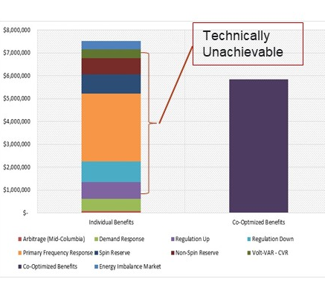
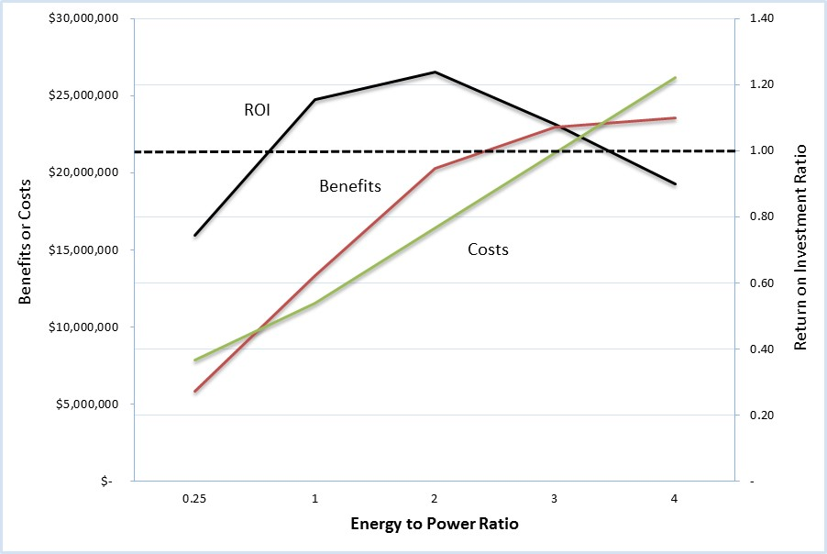
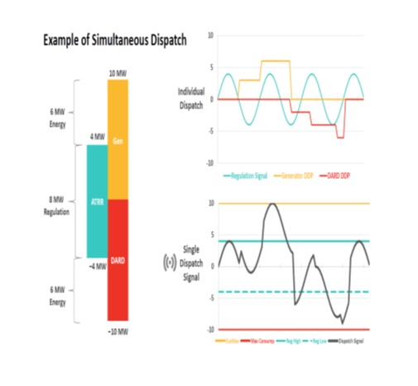
Challenges to accurately estimating economic benefits
Multidimensional competition for energy – not all services can be provided simultaneously and there exists intertemporal competition for energy
Economic results are sensitive to sizing of energy storage system in terms of power and energy capacities
Markets are complex and common practices of assuming perfect foresight into prices, price-taker position, and consistent performance lead to overestimation
Battery performance is dynamic and there are challenges in capturing real-time value
Battery degradation is an important consideration
Co-Optimization of Services
Avoiding Overestimation of Benefits
Optimizing Storage System Scale
Market Complexities

Slide 5
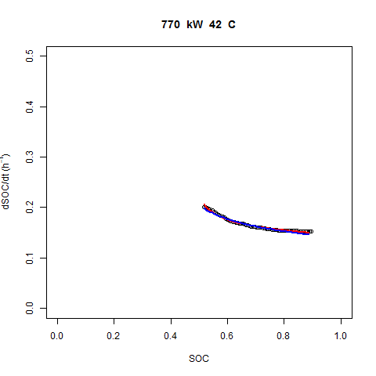
Importance of Operational Knowledge in capturing energy storage value
Non-linear Performance Modeling
  Model estimates state of charge (SOC) change during operation based on operating mode, power, SOC, and temperature
  Model has been validated with data
  Actual battery performance can be anticipated, thus providing a high degree of flexibility to the energy storage system owner/operator
  Self-learning model applicable to any type of storage system
Modeling State of Health

Slide 6
Development of effective control systems
Field deployed commercially sourced optimizers – generally no dedicated process to keep track of the difference between ‘anticipated’ vs. ‘generated’ value – essentially an open loop process
Reasons could be lack of adequate information/approach (logic, forecast error, lack of operational knowledge of energy storage system)
Analytics to determine the reasons could close the loop and help improve the value generated

Slide 7
DISCUSSION

