Slide 1
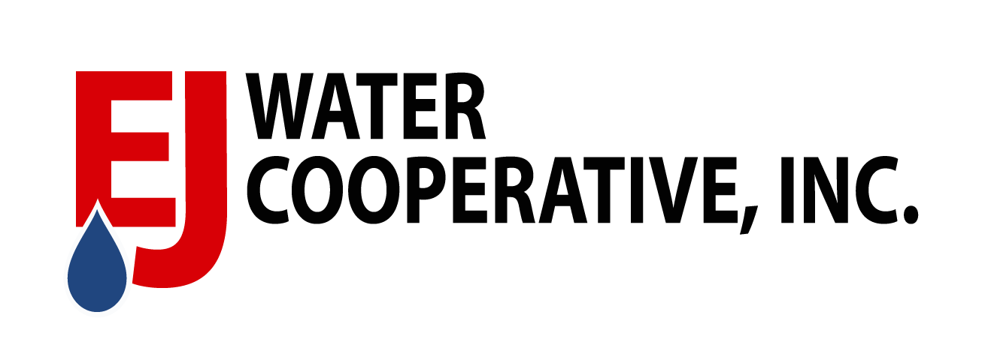

Slide 2
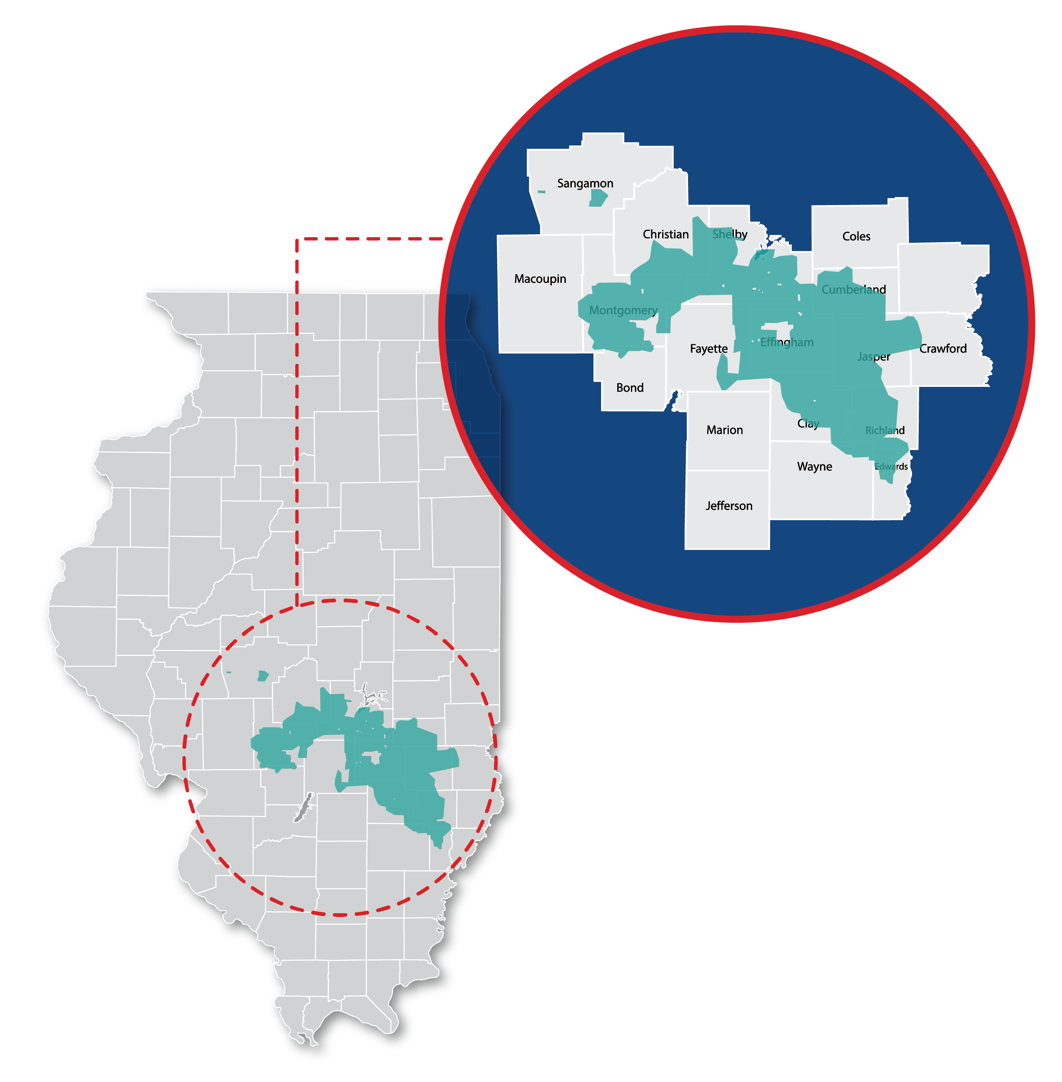
3,200+
SQUARE MILES

Slide 3
Gas
Electric
Water

Slide 4
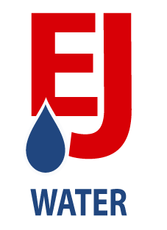
Regionalization Helps Community Sustainability
Contract Services | Regionalizaing Treatement | Mergers & Acquisitions
Community Benefits:
Shared infrastructure costs across a larger user base
Access to Highly Trained Team Members
- Access to cutting-edge technology that streamlines office and O&M
- Access to unique funding opportunities through EJ's not-for-profit statu
- Communities typically range between 20-2,500 connections

Slide 5
Cooperative Advantage (Contract Services)
Population Serviced: 25,560 People
Billing | Customer Service | Reporting | Accounting & Budgeting
Asset Management | Mapping | On-Call Services | License Operators (Water & Wastewater)
Routine Samples | Field Service Technicians| ROW Easements
Savings could be anywhere from 20%-40% for each community
due to technology and highly trained workforce.
Notes:
Cooperative Advantage - Contract Services + Population Impacted/Meters
Billing Customer Service, Accounting, O&M (Field Service/Contract Water Sewer Operating) – Outsourcing
Savings could be anywhere from 20%-40% for each community. Based upon the technology and highly trained workforce.
Overstaffed/Understaffed In small Communities

