Slide 1
PJM’s Experience with COVID-19
Paul McGlynn
Executive Director – System Operations
PJM Interconnection
National Association of State Utility Consumer Advocates
Nov. 9, 2020

Slide 2
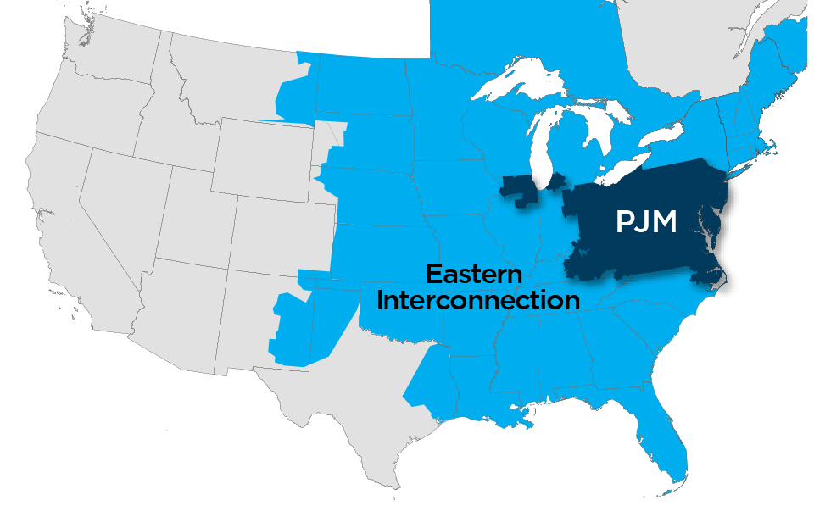
PJM as Part of the Eastern Interconnection
Key Statistics
Member companies | 1,040+
Millions of people served | 65
Peak load in megawatts | 165,563
Megawatts of generating capacity | 186,788
Miles of transmission lines | 84,236
2019 gigawatt hours of annual energy | 787,307
Generation sources | 1,446
Square miles of territory | 369,089
States served | 13 + DC
21% of U.S. GDP Produced in PJM
27% of generation in Eastern Interconnection
26% of load in Eastern Interconnection
20% of transmission assets in Eastern Interconnection
As of 2/2020
Notes:
David Kimmel Updated Feb. 2020
Note: updated territory number was pulled using the GIS tool, which is a more accurate.

Slide 3
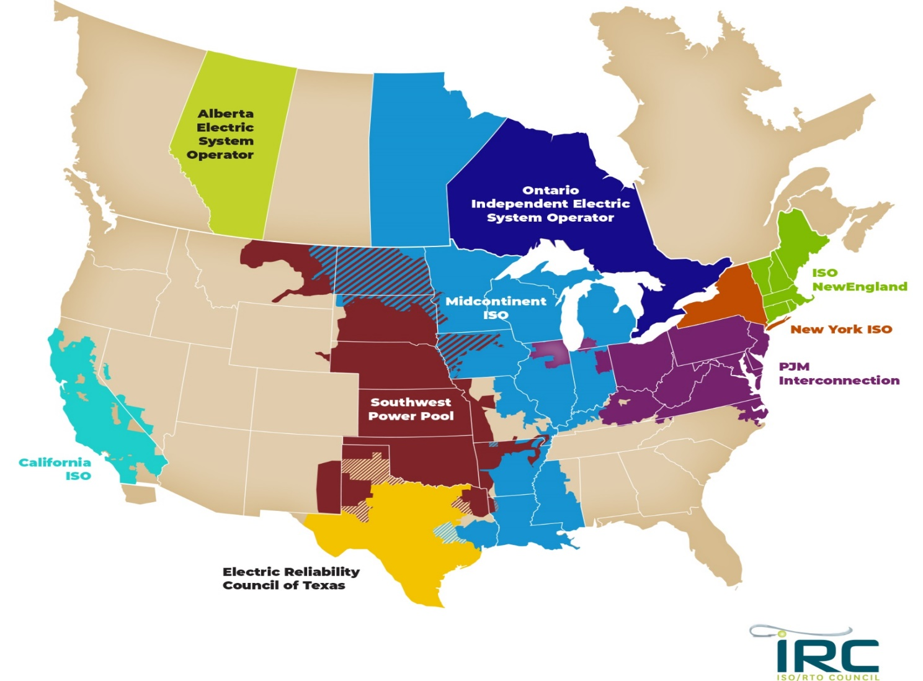
Nine Major North American RTOs/ISOs
6037
Notes:
This map illustrates the 9 major North American RTOs or ISOs. PJM is located in the eastern part of the United States and is highlighted in purple on this map.

Slide 4
Estimated Impact of COVID-19 on Daily Peak and Energy
March
April
May
June
July
August
Sept.
Oct.
Notes:
Peak impacts had eased through the Summer, accelerated in early Fall as the impact of heightened weather sensitivity fades, and are now showing some signs of easing once more.
July to August weekday impacts came in 1.9% less (~2,600 MW) than what we would have anticipated. Thus far in October, this figure stands at 4.6% (~4,150 MW) with more recent observations in the 2 - 4% range.
Energy impacts show the same trend. July to August energy peaks were 4.1% and in October so far have been 4.4% with more recent observations in the 2 - 4% range.
Consider these estimates to be a guide not a rule.

Slide 5
Impact of Weather
RTO Zone-Weighted Avg. Daily Temperature

Slide 6
COVID-19 Impact vs RTO Average Daily Temperature
COVID-19 Impact vs RTO Avg. Daily Temperature

Slide 7
Moody’s Analytics Economic Forecast U.S. Real Gross Domestic Product (2018Q1 = 1.0)
U.S. Real GDP (2018Q1 = 1.0)
October
2020
September 2019
September
2020
August
2020

Slide 8
Summary
PJM saw declines in the demand for electricity through the spring, reductions in the range of 12% to 14% for peak and overall energy consumption by early May.
Demand saw some recovery throughout the summer, then declined again in September in the range of 8% below previous highs. Load appears to be recovering again through October.
Long-term load growth, which is a function of economic growth, is likely to be muted in 2021 but then will increase in 2022 and beyond as the economy recovers.

Slide 9
Appendix

Slide 10
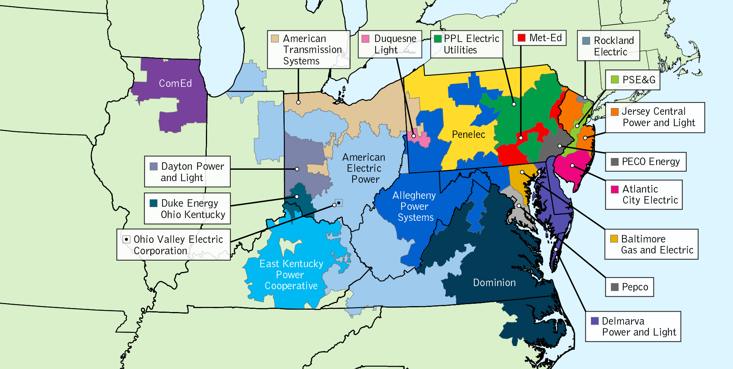
PJM TO Zone Map
Notes:
Updated Dec, 2019 – Creative Services

Slide 11
PJM Response - Timeline
Canceled all non-essential meetings on-site
Social distancing implemented
Separation/isolation of control rooms (VF & M)
Implemented dedicated doors for operators
Critical support staff working remotely
Eliminated in-person handoffs between operators
Implemented third control room
Sequestered team of operators
Initiated Bench Operator program
Started return-to-work planning
Converted mezzanine to Physical Security Perimeter (REs)
Jan. 2020
Feb. 2020
March 2020
April 2020
Eliminated international business travel & international visits
Began to track personal international travel
Enhanced cleaning
Suspended all PJM travel
Implemented 14-day self-quarantine for personal international travelers
Required reporting and tracking of illness
Disinfected control rooms daily; work stations – before and after each shift
Encouraged operators to self-quarantine when off shift
Encouraged operators to conduct a self-observation checklist (temperature checks, etc.)
Dedicated cleaning staff for control rooms
March 13: Telecommuting through May 4
March 21: Dispatch moved to 12-hour shifts

Slide 12
PJM Response - Timeline
PJM All Hands (RTC) update
Constructed Valley Forge training room to facilitate operator exams
Tested OTS/Third Control Room Conversion plan
Reliability Engineers introduced back in the control room
Developed and communicated PJM Return-to-Campus (RTC) Plan
Initiated anonymous submit-a -question form
Implemented contactless temperature kiosks
Reliability engineer return to control center
Completed Bench Operator Training
Communicated employee survey results
May 2020
June 2020
July 2020
Aug. 2020
Sep. 2020
Ended sequestration
Implemented PJM RTC Phase I
Launched RTC refreshed Wired resource page and FAQs
Continued implementation of on-campus precautionary measures
Communicated push of PJM Return-to-Campus (RTC) timing
Began planning for potential winter sequestration

Slide 13
Estimated Impact of COVID-19 on Daily Peak and Energy

