Slide 1
Energy Efficiency Market Transformation:
Key to a low-carbon future
June 21, 2019
Susan E. Stratton,
Executive Director

Slide 2
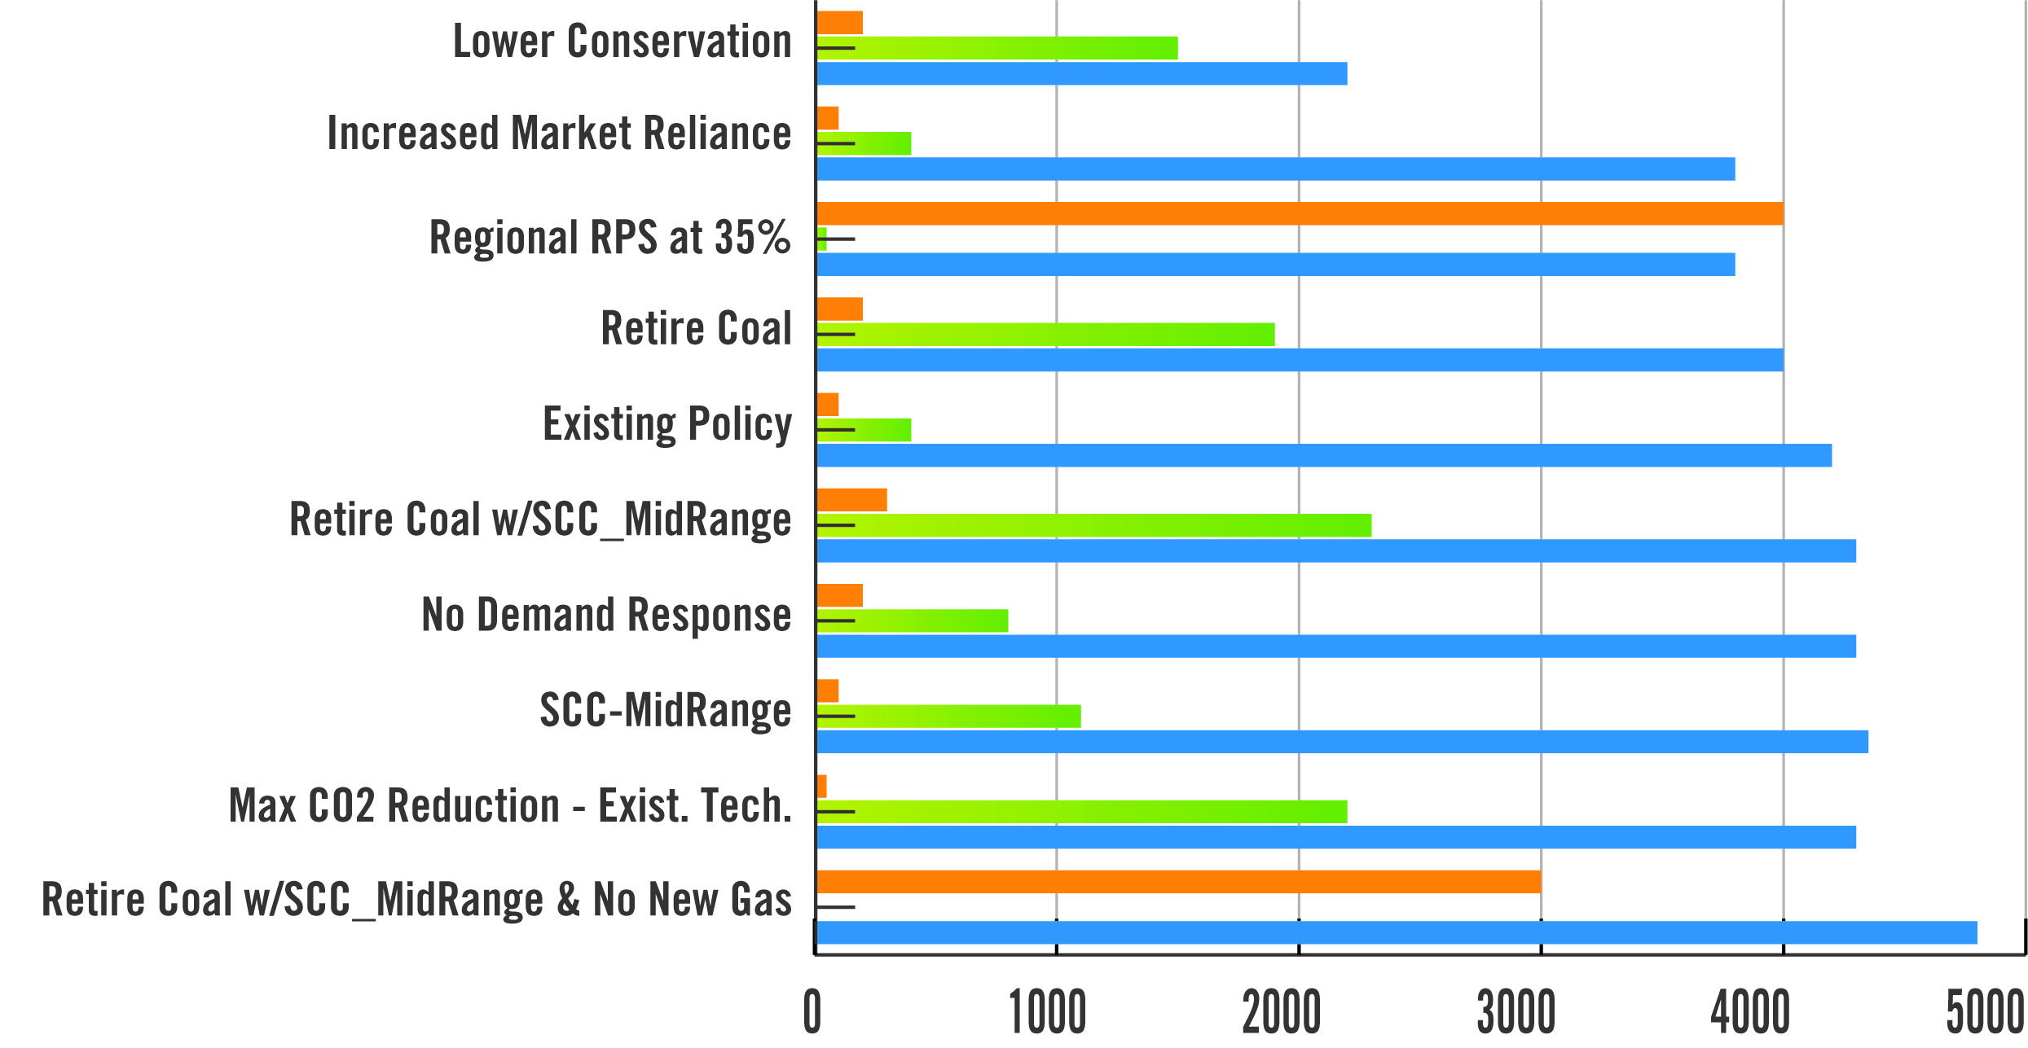
10 Scenarios: Average Least Cost Resource Acquisition by 2035
Energy Efficiency: a Foundation for De-Carbonization
Renewable
Natural Gas
Energy Efficiency
Average Megawatts

Slide 3
Market Transformation
Dollars Invested
Codes & Standards
New Market Baseline
Natural Baseline
Market
Market Share
Transformation
Emerging Tech
Early Adopters
Early Majority
Late Majority
Laggards
Time

