Slide 1
Evaluating and Shaping the Impacts of EVs on Customers
Tools for Consumer Advocates
June 19, 2019
Bruce Biewald, Melissa Whited

Slide 2
Agenda
Background
Shaping
Evaluating
Why the focus on EVs?
What are the impacts of EVs on electric utility customers?
What are the broader public interest impacts of transportation electrification?
What actions and policies can help maximize the benefits of EVs for all customers, including non-EV owners?
From our forthcoming publication: “Analyzing the Customer Impacts of Electric Vehicles: A Guidebook for Consumer Advocates”

Slide 3
Why EVs?

Slide 4
#1: They’re coming
EV sales increased by ~80% in 2018
We need to have good policies in place to manage the additional load
We need to make sure the benefits and costs are felt equitably

Slide 5
#2: Can significantly increase peak demand

Slide 6
#3: Potential for large customer benefits
Rate reductions for ALL customers | More efficient use of grid capacity (spread out the fixed costs) Better use of low-cost renewables during off-peak hours Cost-effective way to meet state environmental goals
Lower total cost of ownership | Reduced maintenance and fuel costs can save customers money Reduced public transit costs
Health and environmental benefits for all customers | Lower criteria pollutants & mercury = reduced health impacts Reduced greenhouse gases

Slide 7
Evaluating the impacts

Slide 8
Evaluating the Impacts
What are the impacts of EVs on electric utility customers (particularly non-EV owners)?
Rate impacts
What are the broader public interest impacts of transportation electrification?
Health impacts
Economic impacts

Slide 9
Analysis tools, data
Utility system costs
Total cost of ownership
Health & pollution impacts
Rate impacts
Production cost models, capacity expansion models, transmission and distribution planning studies
Revenue requirements, electricity sales, rate designs
Up-front costs, financing costs, rebates/incentives, fuel costs, maintenance costs
Emissions from vehicles, emissions from electric grid, health impacts (BenMAP, COBRA)

Slide 10
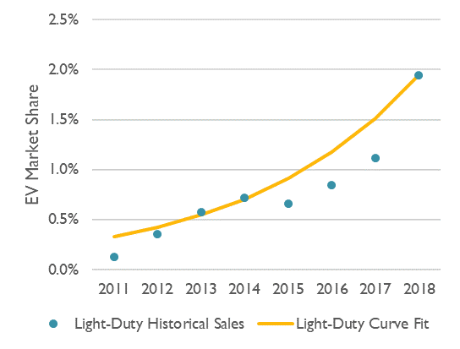
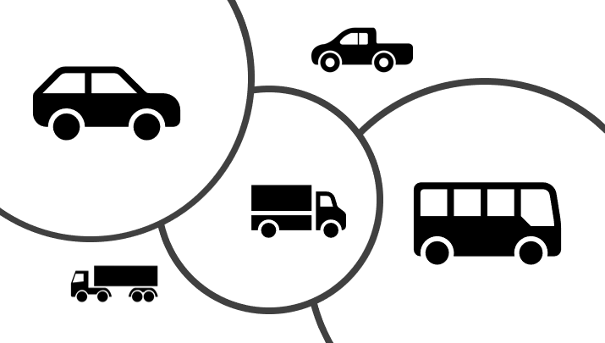
Synapse’s EV-REDI
EV adoption curves
Six types of EVs
Electricity consumption from EVs
Avoided fossil fuels
Emissions

Slide 11
Intertwined impacts
Electric System
Rates & rate design
Total cost of ownership
Health impacts
EV charging habits
When do EVs charge?
Additional generation, T&D?
Which generation resources are deployed?
What is the impact on rates?
What’s the cost to charge EVs?
What’s the total ownership cost?
How do emissions change?
EV adoption

Slide 12
Setting up the analysis
Analysis timeframe
10-15 years, or longer
EV adoption scenarios
E.g., High/med/low
EV charging scenarios
E.g., TOU vs. flat rates
Ratepayer-funded EV programs

Slide 13
Example Results
How do rates change over time?
What are the health impacts relative to BAU?
What are the cost of ownership impacts?
 | Avoided Deaths | Avoided Work Loss Days | Monetized Health Impact (2018 $M)
Med EV Scenario | 20 | 8,600 | $178
High EV Scenario | 90 | 44,000 | $920
 | Low EV - BAU | Med. EV & Flat Rates | Med EV & TOU Rates | High EV & Flat Rates | High EV & TOU Rates
Car | -$3,700 | -$3,100 | -$3,600 | -$3,100 | -$3,700
SUV | -$7,000 | -$5,900 | -$7,000 | -$6,000 | -$7,000
Bus | -$139,300 | -$114,500 | -$137,600 | -$116,900 | -$139,300

Slide 14
Policies to shape transportation electrification

Slide 15
Maximize benefits while minimizing costs
Promote equitable distribution of the benefits

Slide 16
1. Policies to maximize benefits & minimize costs
Implement sound rate design principles
Shift new EV load toward the least-constrained hours, minimizing the costs that are imposed on the utility system and maximizing the positive impact that increased energy sales have on rates and bills.
Time-of-use rates, critical peak pricing, etc.
Designing rates is not enough – must ensure enrollment
Use demand response programs
Reduce peak demand
Help balance supply and demand to optimize the use of zero-emitting resources or to avoid use of expensive or highly polluting peak resources.

Slide 17
1. Policies to maximize benefits & minimize costs (cont.)
Site public charging infrastructure in locations that minimize the need for distribution system upgrades.
Are utilities providing this information to charging station developers?
Ensure costs of ratepayer-funded EV programs do not outweigh benefits
Leverage other funding sources where possible
Ensure utility investments are providing value, not redundant
Collaboration in program design among utilities, consumer advocates, other government agencies can lead to greatest benefits
E.g., federal funds for transit electrification

Slide 18
2. Promote equitable distribution of the benefits
Design utility EV incentives to benefit low-income customers
Low-income customers may not be able to take advantage of tax incentives
Up-front rebates more helpful for low- & moderate-income customers
Incentives can target lower cost EVs, used EVs, or vehicle leases (as opposed to only new car purchases)
Income guidelines to provide larger rebates for those with lower incomes
Collaborative process with underserved communities
What are their specific needs?
Varies by community
Do they want to own/lease vehicles? Or is transit a better option?

Slide 19
2. Promote equitable distribution of the benefits
Direct EV investments to services relied on by lower-income customers
Target services that low-income or non-driving customers may rely on, such as public transit, school buses, mobility services
Public charging infrastructure that serves multi-unit dwellings, mobility service drivers, and low-income areas.
Ride-hailing services (Uber/Lyft):
Drivers disproportionately low-income
Lower operational costs can benefit underserved communities
Electrify vehicles with greatest health impacts in lower-income communities
School buses, yard trucks at ports, delivery trucks in urban areas, or heavy trucking on freeways
Ride-hailing vehicles

Slide 20
Real world example

Slide 21
California
By far the most EVs in the country
Approximately half of EVs in the United States
Nearly 10% of new cars purchased are EVs
Commission requires utilities to report data regarding EV customer load profiles and system upgrades to accommodate EVs
EV TOU rates have effectively encouraged off-peak charging in California
85% - 90% of charging on TOU rates is off-peak
Only ~25% of EV drivers are on TOU rates currently.
From 2011-2018, only one out of every 670 EVs (0.01%) has resulted in a distribution system or service line upgrade.

Slide 22
California
To date, EV drivers have provided far more revenues than costs
Most drivers currently paying high tiered rates
But finding holds if we assume 75% of EV drivers pay mostly low, off-peak rates

Slide 23
Contact
Melissa Whited Synapse Energy Economics
617-661-3248
mwhited@synapse-energy.com www.synapse-energy.com
About Synapse Energy Economics
Synapse Energy Economics is a research and consulting firm specializing in energy, economic, and environmental topics. Since its inception in 1996, Synapse has grown to become a leader in providing rigorous analysis of the electric power sector for public interest and governmental clients.
Staff of 30+ experts
Located in Cambridge, Massachusetts
Melissa Whited

