Slide 1

Notes:
Introduce yourself
Sergio Lopez
Program Manager at Forth
Manage the Go Forth Electric Showcase and lead the delivery on our demonstration projects that help bring new transportation options to underserved communities.
Tonight’s presentation will highlight a key part of Forth’s work on brining different transportation options to new and underserved communities and what it means for not only for the industry but for the social development of our society.

Slide 2
Diversity, Equity and Inclusion in Electric Transportation
Sergio Lopez, Program Manager
June 2019

Slide 3

Who we are:
Forth is a nonprofit trade association and advocate for electric, shared, and smart mobility. Through innovation, demonstration projects, advocacy and engagement, we are advancing electric, smart, and shared transportation in the Pacific Northwest and beyond
Based in Portland, Oregon we have over 160 member companies and organizations, including many global automakers, utilities, and local governments
Notes:
We are an automotive trade group
Our mission encompasses our work outside of Oregon now and also ACES
We are funded by member dues, grants, and our annual conference

Slide 4
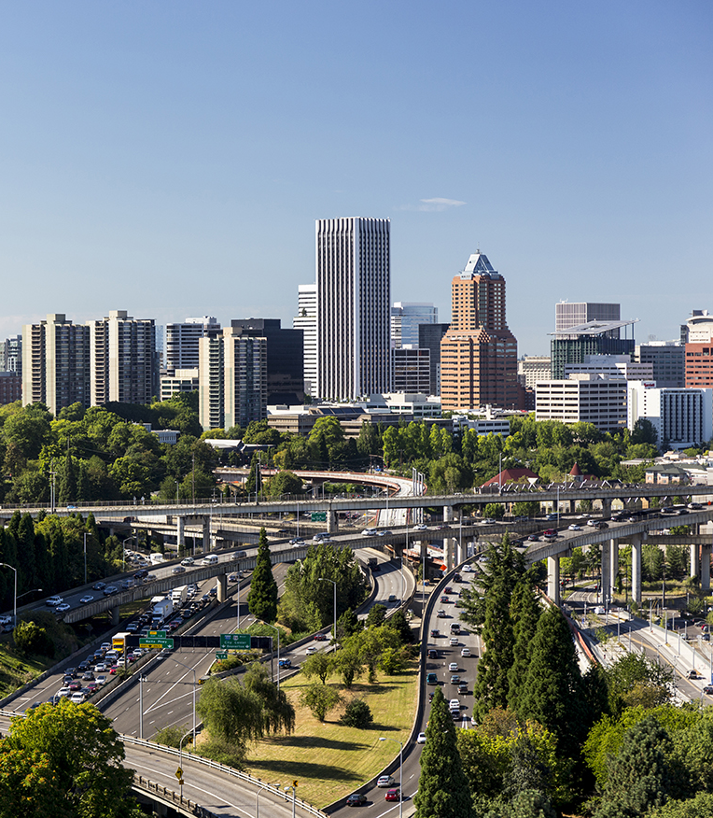
We Are Active In
Four Main Areas
Industry growth and development
Policy advocacy
Direct consumer engagement
Demonstration and pilot projects

Slide 5
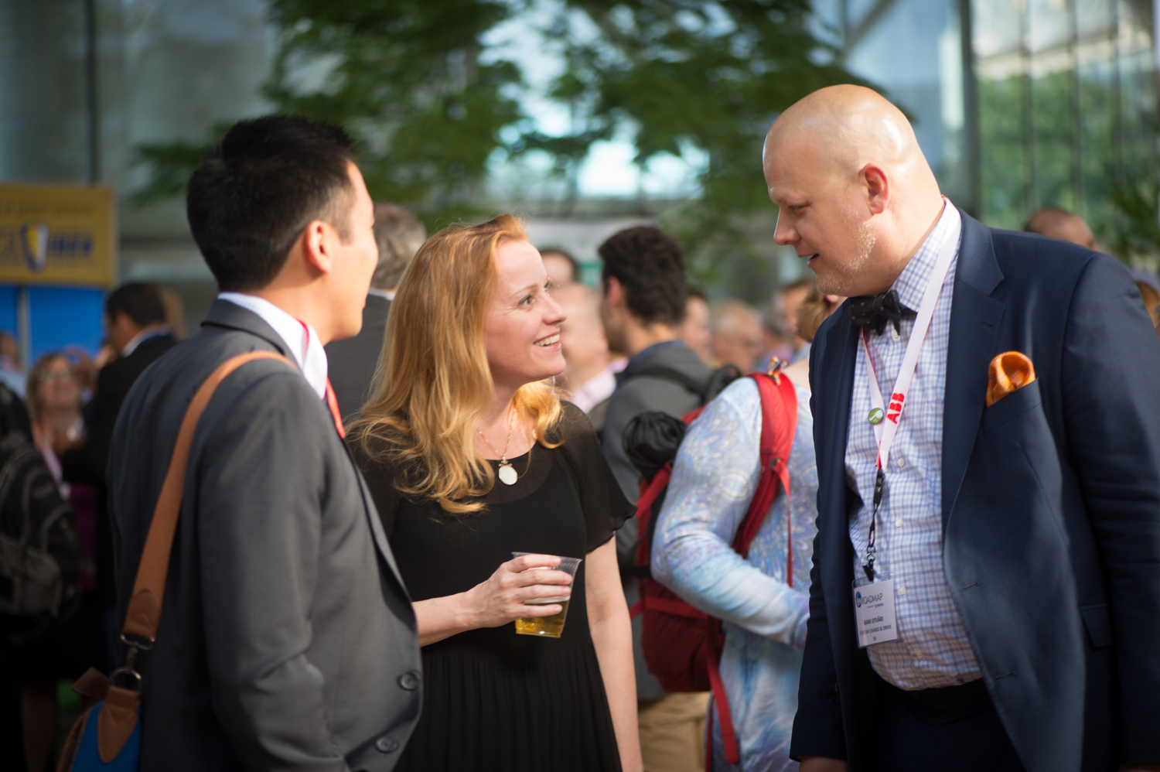
Industry Development
We bring together businesses, utilities and communities to support growth, create living-wage jobs and strengthen our economy.
Roadmap Conference www.roadmapforth.org
Electric Vehicle Symposium (EVS 2020) in Portland
www.evs33portland.org
Monthly Networking Events & Webinars
Connect companies & resources

Slide 6
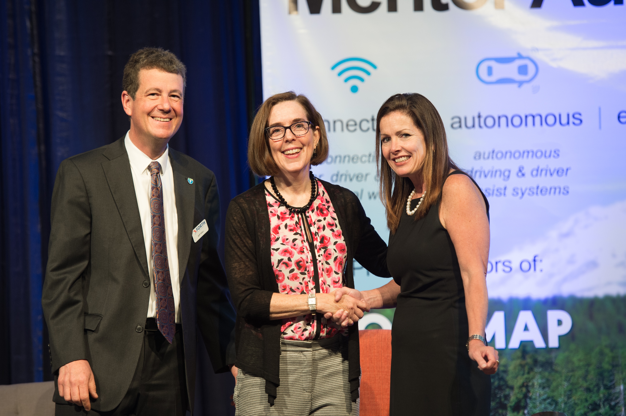
Policy Advocacy
We advocate for smart laws and policies that strengthen emerging mobility solutions and ensure cutting-edge technologies benefit us all.
HB 2017, secured EV rebate and Charge Ahead rebate (up to $5,000 total)
SB 1547 (OR), directed utilities to accelerate transportation electrification

Slide 7
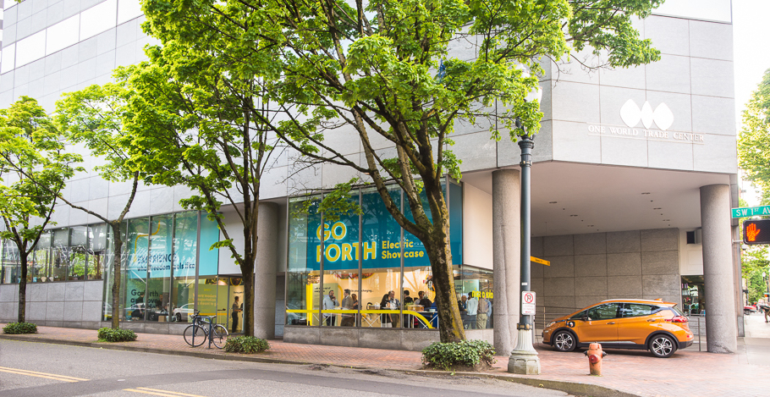
Consumer Engagement
Notes:
Showcase
Ride & drive events
Utility tookits and plans
work with employers, fleets
Scooter Safety/Workshops

Slide 8
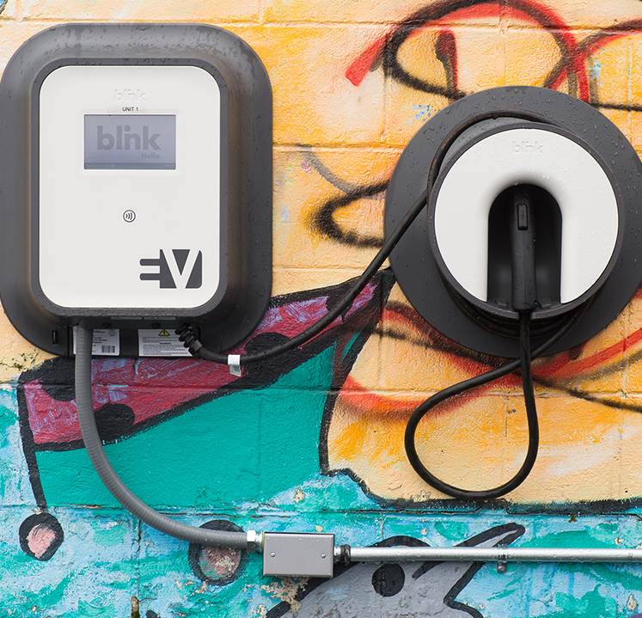
Demonstration Projects
We bring partners together to demonstrate new technologies in real-world projects that help improve our lives and expand mobility options.
Community EV Project
Community E-bike Project
Lloyd Spark E-bike Project
Uber/Ride Sharing Project
Financing Pilot, Bloomberg Smart Cities Micro-transit Pilot, Community EV Project 2.0

Slide 9

How do did you get here today?
Notes:
How did everyone get here today? How did everyone get here? How is everyone getting home tonight? Transportation is a part of our daily lives!
The United States Bureau of Labor Statistics calculates that the average American household spent USD $9,576 on transportation expenses annually in 2017. As the second highest expense for households - after housing https://www.bls.gov/news.release/pdf/cesan.pdf, accessed on 2019-4-12.

Slide 10
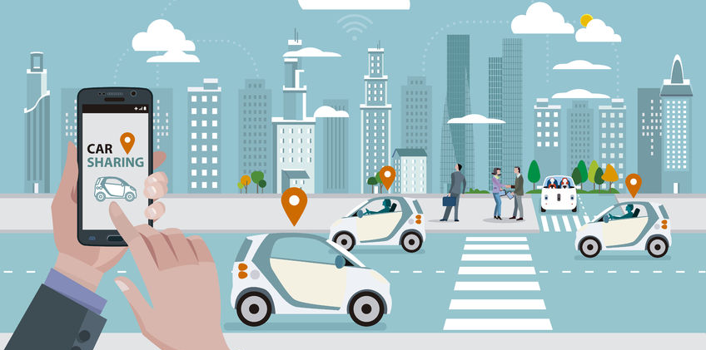
Ride Sharing Services… what’s that?
Notes:
Traditionally underserved communities – particularly low-income communities of color – face especially daunting mobility challenges. They are less likely to be able to afford reliable automobiles, relying instead on vehicles that may be cheap to operate, but expensive to fuel and maintain. They are less likely to have access to good transit service, safe bicycle facilities, or other transportation options

Slide 11
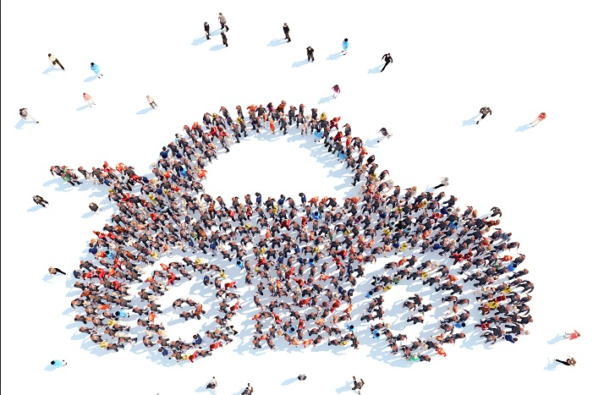
City Center focused
Notes:
It is no surprise that new technologies tend to go first to communities with more wealth.
Downtown Portland. Maxline- Trimet buses gutter to downtown Portland, Lightrail(Streetcar), Biketown stations are equally visible to a starbucks, car2go, reach now,
However, the inequalities in America’s mobility system are not simply a function of market forces, and they are definitely no accident.

Slide 12
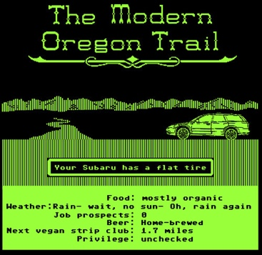
Notes:
. Early examples include the 19th Century expansion of railroads and the “Oregon Trail” which brought wagon loads of settlers to live on land stolen from native Americans.
Excuse the humor, but if this picture isn’t accurate and relevant, I don’t know what is.

Slide 13
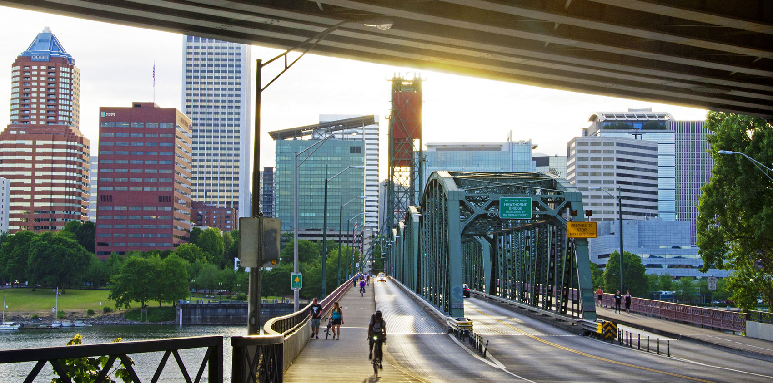
Notes:
In the decades following World War II, the United States created new programs designed to encourage home ownership, including long term mortgage loans, federal loan guarantees, and tax-deductibility for home mortgage interest payments. Suburban development was encouraged and subsidized in most major metropolitan areas.
Massive road projects enabled these new suburban dwellers to easily reach jobs downtown. Meanwhile, many of those new road projects and other “urban renewal” schemes involved destroying established communities of color. This lead to the term “White Flight”. Define it!

Slide 14
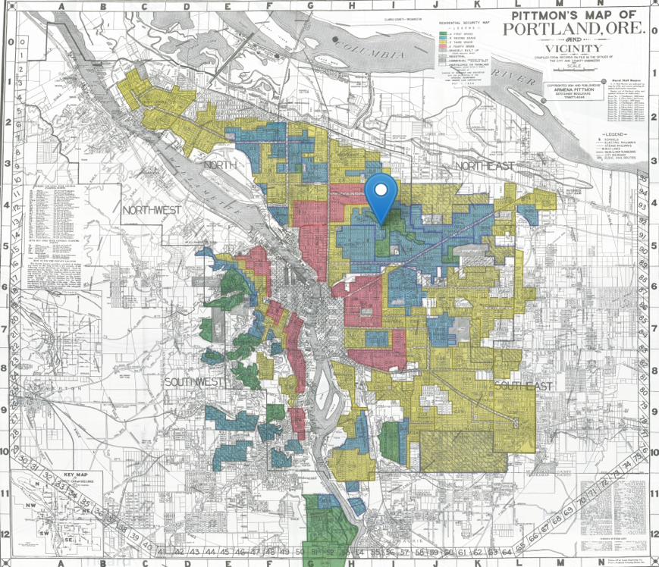
“Redlining”
Notes:
One of the most powerful examples of US government policies that reinforced racially segregated housing patterns was “redlining” in the US government’s program to back home mortgages. To help carry out this program, government surveyors assessed lending risks by neighborhood.
green areas for “best,” blue for “still desirable,” yellow for “definitely declining” and red for “hazardous.” The “redlined” areas were deemed credit risks because of the influx or presence of racial and ethnic minorities Redlining was banned 50 years ago. It’s still hurting minorities today, accessed on 2019-4-12.

Slide 15

Poor Air Quality
Notes:
These inequities continue to manifest in well-documented racial and ethnic disparities in common quality of life indicators like education, economic stability, distribution of transportation burdens and benefits, and others. For example, greater exposure to transportation pollution in communities of color is tied to decades of segregation and structural racism in land-use decisions and government policy, which has resulted in low-income communities of color living near busy roads, freeways, ports, and other freight corridors at higher rates than wealthier communities and whites National Equity Atlas; Systemic Inequality: How America’s Structural Racism Helped Create the Black-White Wealth Gap; Race Counts: Advancing Opportunities for All Californians, accessed on 2019-4-12.

Slide 16
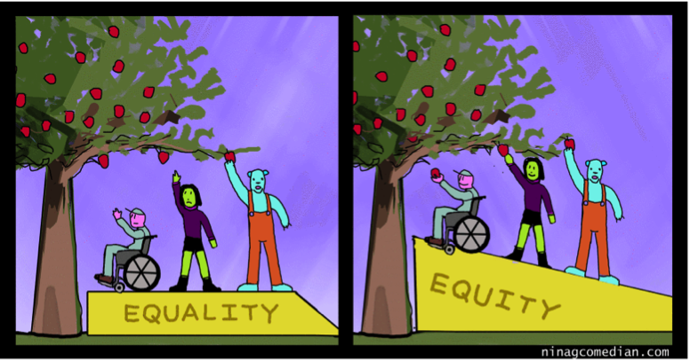
Equality vs Equity
Notes:
, it’s important to distinguish between “equity” and “equality,” two terms that are often interchanged in policy discussions. Equality generally refers to treating people similarly. For example, charging everyone the same price to ride the bus may seem equal and “fair.” However, this assumes everyone starts from the same place and needs the same help. By contrast, an equity approach focuses on making sure people receive what they need to be successful and recognizes the need to overcome past inequality.

Slide 17
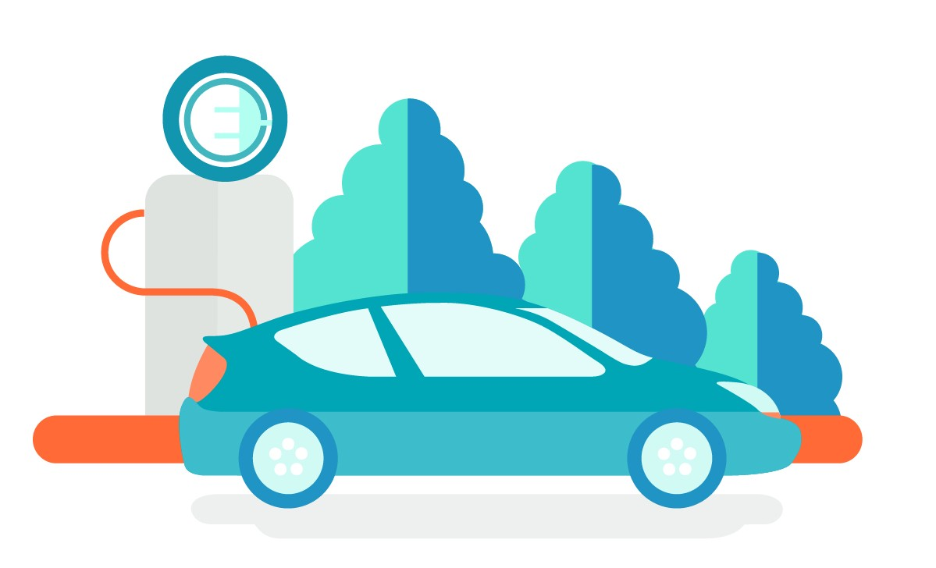
“Human” Infrastructure
Notes:
With the political establishment that has created this disparity, we can change it moving forward.
HB 2017, secured EV rebate and Charge Ahead rebate (up to $5,000 total)
SB 1547 (OR), directed utilities to accelerate transportation electrification
Member, Technical Advisory Committee for NASEO’s “PEV Policy Evaluation Rubric”
Serve on National Governors’ Association Transportation Learning Network Advisory Group
Priorities for 2019:
Promote Rebate
Secure VW 15% funding for EVSE infrastructure
EV Building Codes

Slide 18
Demonstration Projects
Notes:
We bring partners together to demonstrate new technologies in real-world projects that help improve our lives and expand mobility options.

Slide 19
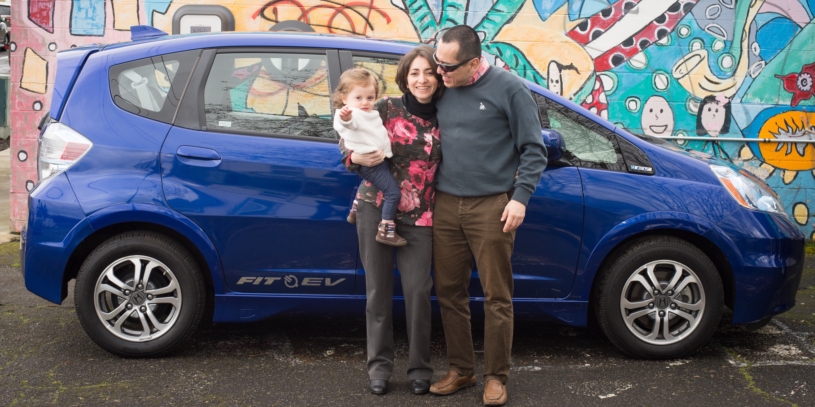



Community Electric Vehicle Project
Notes:
Have a related poster being developed and white paper for EVS30, several presentations. New AmeriCorps starting next week.

Slide 20
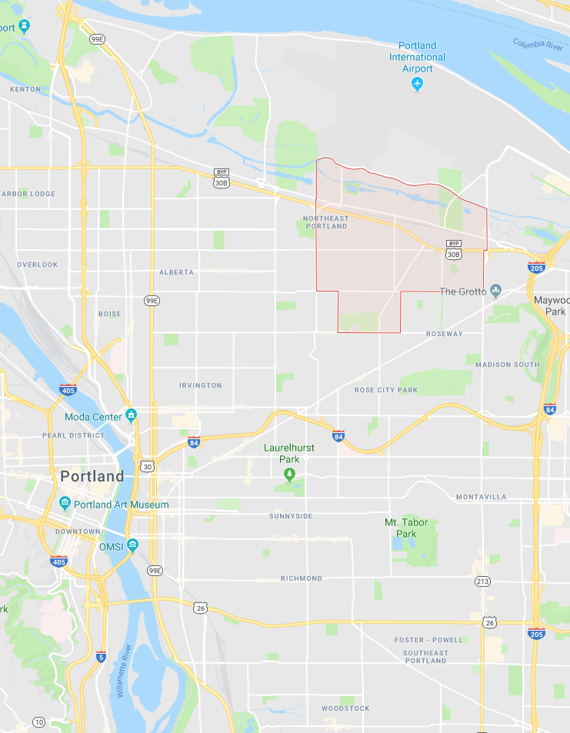
Cully
Most diverse census tract in Oregon
43% of residents are renters
85% of Cully students qualify for free or reduced lunch
Limited transit and transportation options (redlined by Getaround)
Adjacent to rail lines, industrial yards, and the airport
Notes:
Both the entirety of the CEV project and the third and final cohort of the CEB project took place in Cully.
Cully is relatively close to city center in Northeast Portland and is an area that is facing and currently going through high rates of gentrification and displacement
That being said, it is an incredibly diverse community where dozens of languages are spoken and many refugees and immigrants reside
It is also a fairly working class area where many of the students qualify for free or reduced lunch and many families work long hours.
Notably, Cully is poorly connected to transit and other transportation options. 5 bus lines have stops in Cully, but there is no access to light rail, no bikeshare hubs, and services like ReachNow and Car2Go do not service the entire neighborhood. Furthermore, when developing this project, we discovered that Getaround refuses to service Cully because its ZIP codes have been deemed too risky.
We partnered with Hacienda Community Development Corporation, a Latino CDC that works to provide affordable housing and economic and educational opportunities in the Cully neighborhood.
Hacienda helped with marketing the program within their community, they administered the program onsite, and they also utilized one of the vehicles as a staff vehicle to help reduce their mileage costs.

Slide 21
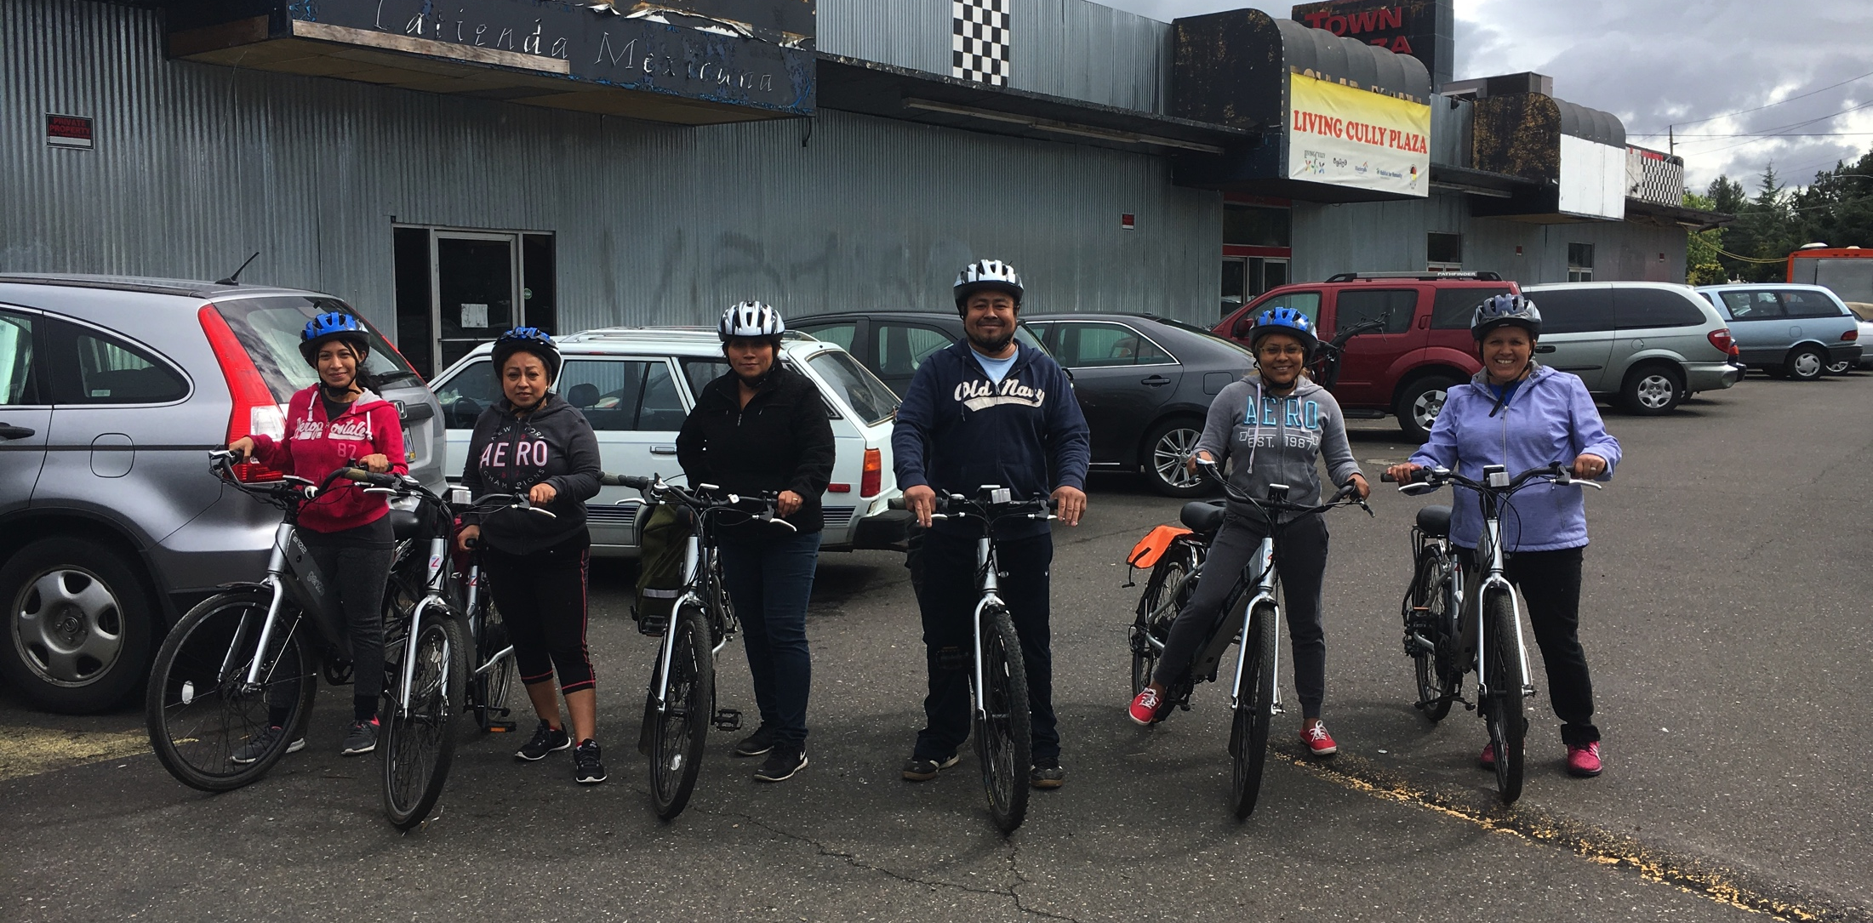
Community E-Bike Project
Notes:
Also mention Transportation Needs Assessment here and equity workgroup.

Slide 22
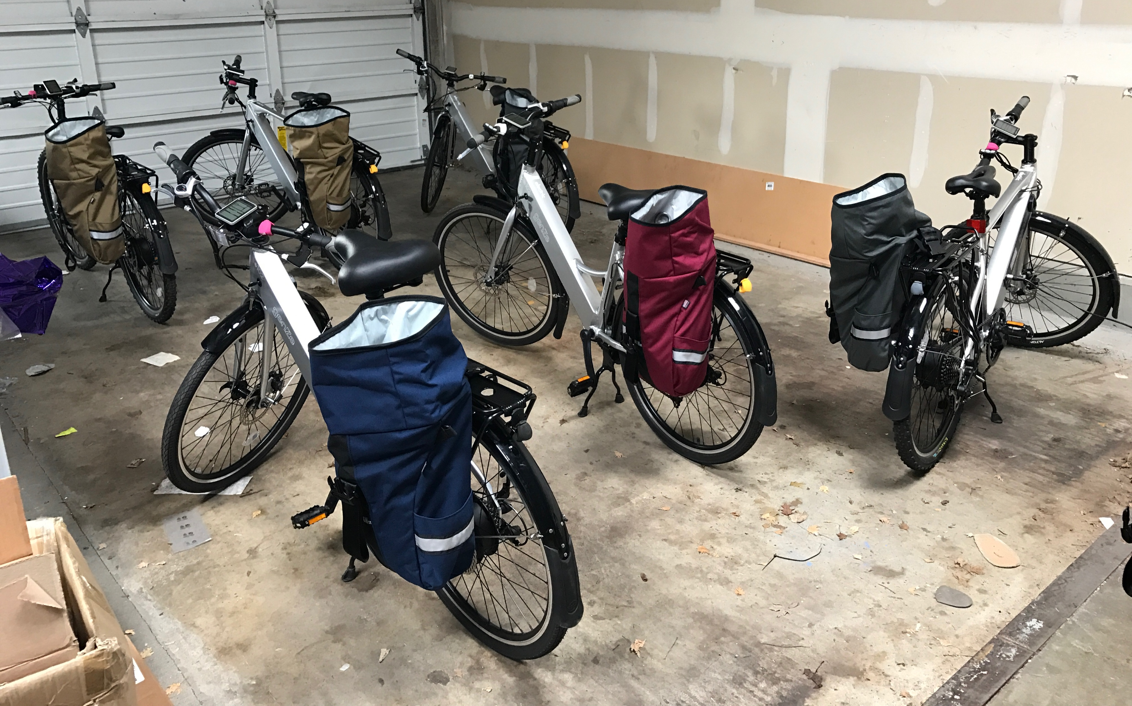




Notes:
This project was made possible by the 11 Hour Project and GenZe. Additionally, we purchased most of our gear from CCC’s shop on Alberta and used locally made panniers from North St. Bags.

Slide 23
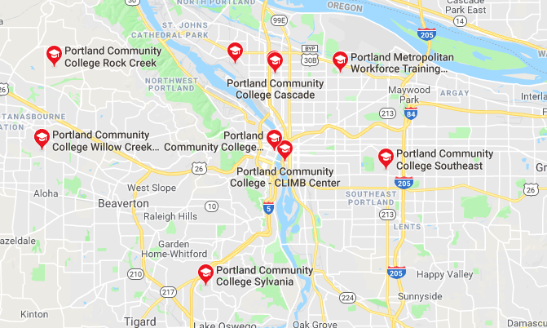

Slide 24
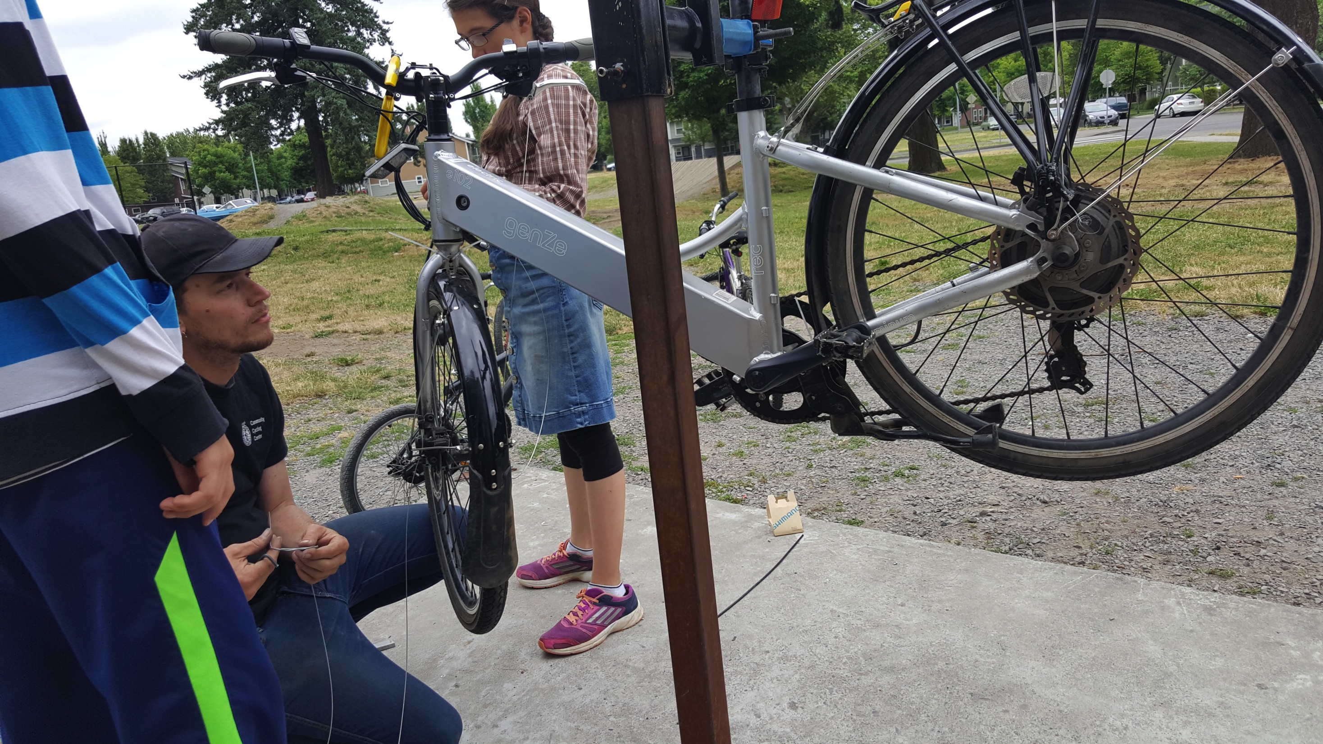

Slide 25
Notes:
Several organizations and programs have emerged to do this outreach. For example, Forth conducts dozens of “ride and drive” events annually. We partnered with Electrify America to deliver 31 days of “discover and drive” events in California during 2018, and worked closely with community based organizations to insure that over 50% of participants identified as low-income. Forth now has “EV 101” education and outreach materials available in eight different languages https://www.electrifyamerica.com/sites/default/files/inline-files/2018Q2ReporttoCARB.pdf, accessed on 2019-4-23.

Slide 26
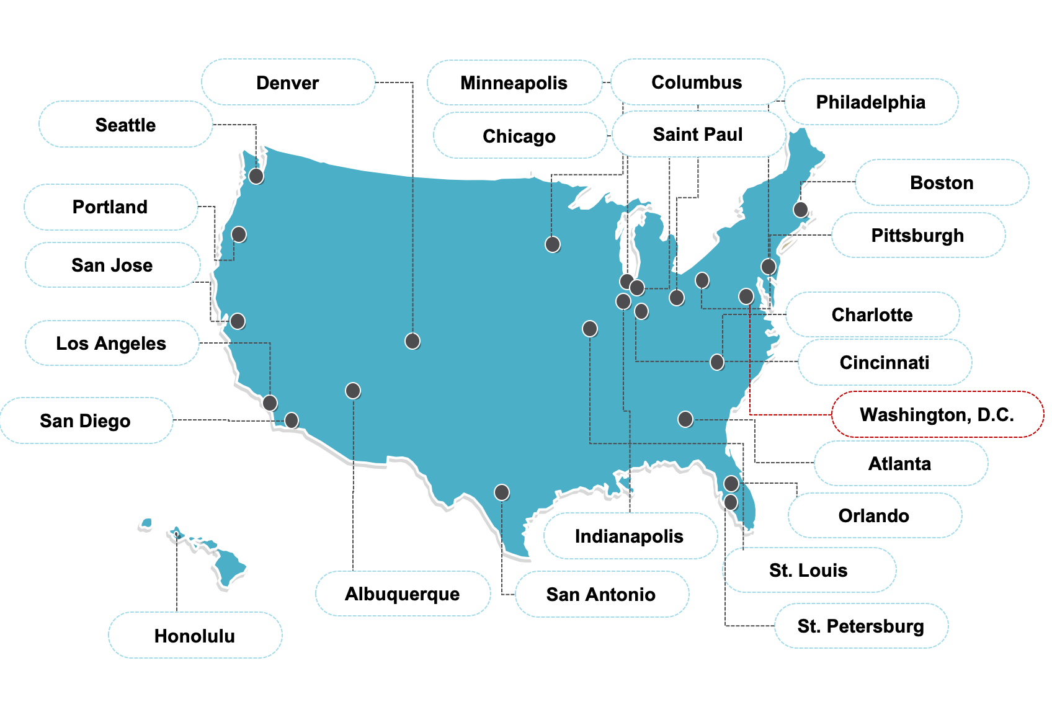

Slide 27
Thank you!
Sergio Lopez
sergiol@forthmobility.org
www.forthmobility.org
Notes:
Electric vehicles and other forms of new mobility create an opportunity to disrupt these traditional patterns
Scooters are a gateway to active transportation…equally important is that scooters are a gateway to creating awareness to transportation equity

