Slide 1
Renewables Up/Carbon Down and
Electrify Everything
You good with that?
NASUCA
November 18, 2019
Jeffrey Ackermann, Chair
Colorado Public Utilities Commission

Slide 2
The Three Circles of Consumer Advocacy
Existential Threat
- “Choose Your Own Adventure”
- “Public Interest” redefined
Disruption & Chaos
-Managing Options
-Rethink/Reinforce Regulation
Growth & Decay
-Bill Impact
-Fairness/
Equity

Slide 3
Pursuing RE, Reducing CO2 & BE:
Charting a Course
Early Retirement:
All futures have rate impacts
Financing (securitization)
Identify/isolate (“hold harmless”) most vulnerable
Incorporating “Existential Threat-Based” Public Policy
Status Quo not an option
Evolving regulatory processes
Notes:
Complexity and uncertainty

Slide 4
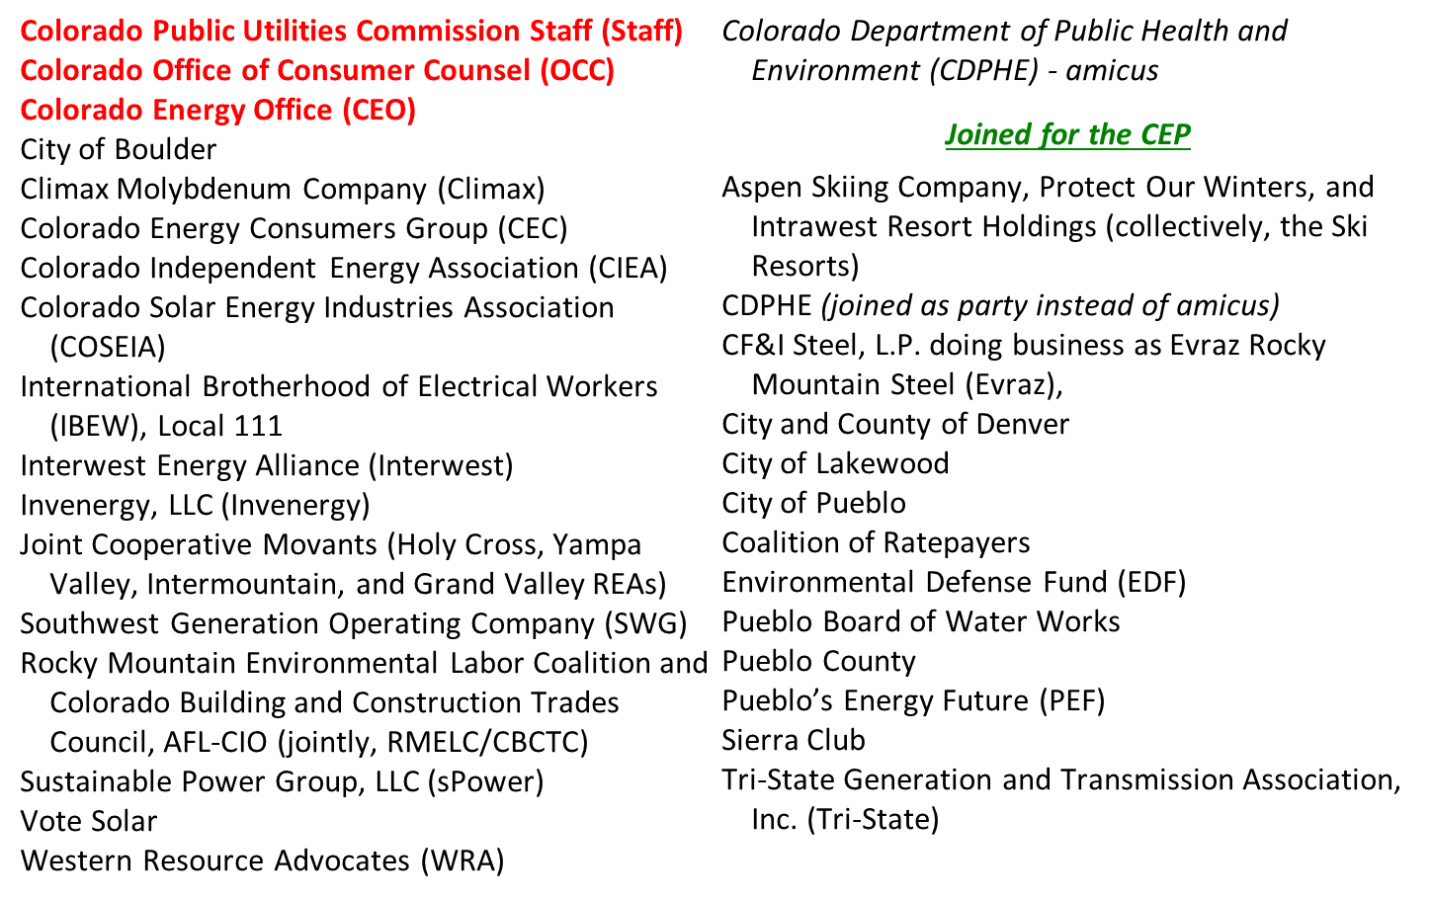
2016-18: “Clean Energy Plan” Parties
Notes:
Active participation by 17 parties (original proceeding), 13 additional for the CEP (retirement) supplemental portion

Slide 5
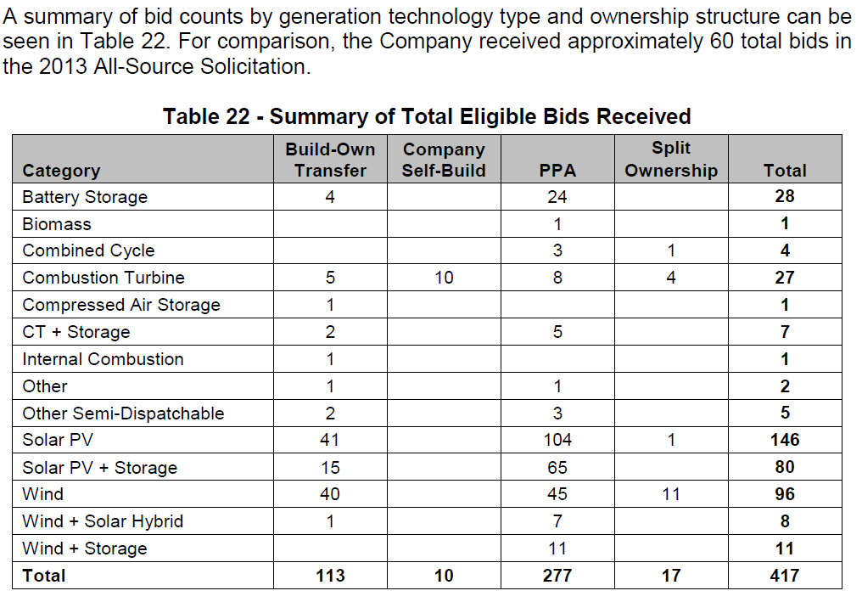
Notes:
Market-driven transition to renewables

Slide 6
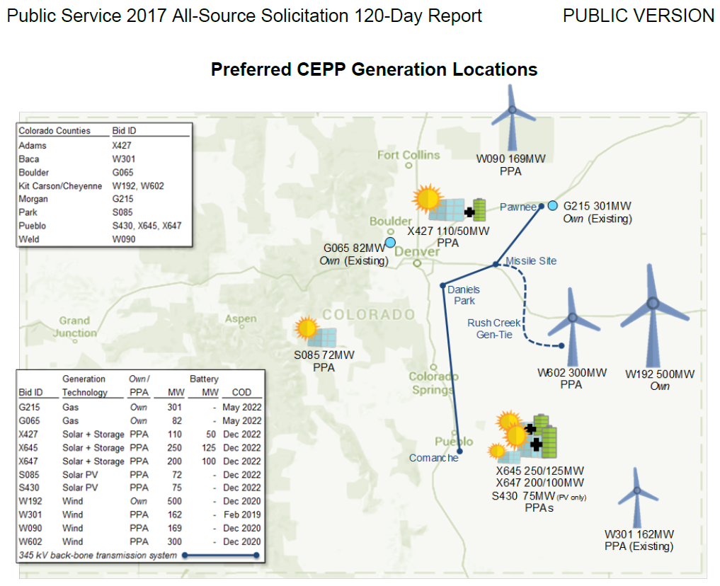
Notes:
660 MW retirement; all new capacity and energy via NEW wind, solar, solar+storage and purchasing existing PPA gas assets

Slide 7
Decision: Retire 660 MW of Coal Generation (CO Energy Plan – CEP)
“…we determine that the costs are comparable of the CEP Portfolio,
which embodies the early retirement of Comanche units 1 and 2, and the costs of the Preferred ERP Portfolio, which assumes the continued operation of the Comanche units through their expected retirement dates. Given the comparability of the costs of these two portfolios, we focus on the relative benefits of the two options.”
“…we conclude that the CEP Portfolio can be acquired at a reasonable cost and rate impact due to the abundant competitively priced bids for new utility resources available to Public Service and due to the ratepayer protections we adopt for the new wind resources that the Company proposes to own.”

Slide 8
Thank you.
Jeffrey Ackermann, Chairman
jeffrey.ackermann@state.co.us
303-894-2007
Colorado Public Utilities Commission
https://www.colorado.gov/dora/puc
Notes:
Active participation by 17 parties (original proceeding), 13 additional for the CEP (retirement) supplemental portion

