Slide 1
ELECTRICITY REFORM PROJECT
National Association of State Utility Consumer Advocates
June 20th, 2019
Tom Hassenboehler
The Coefficient Group

Slide 2
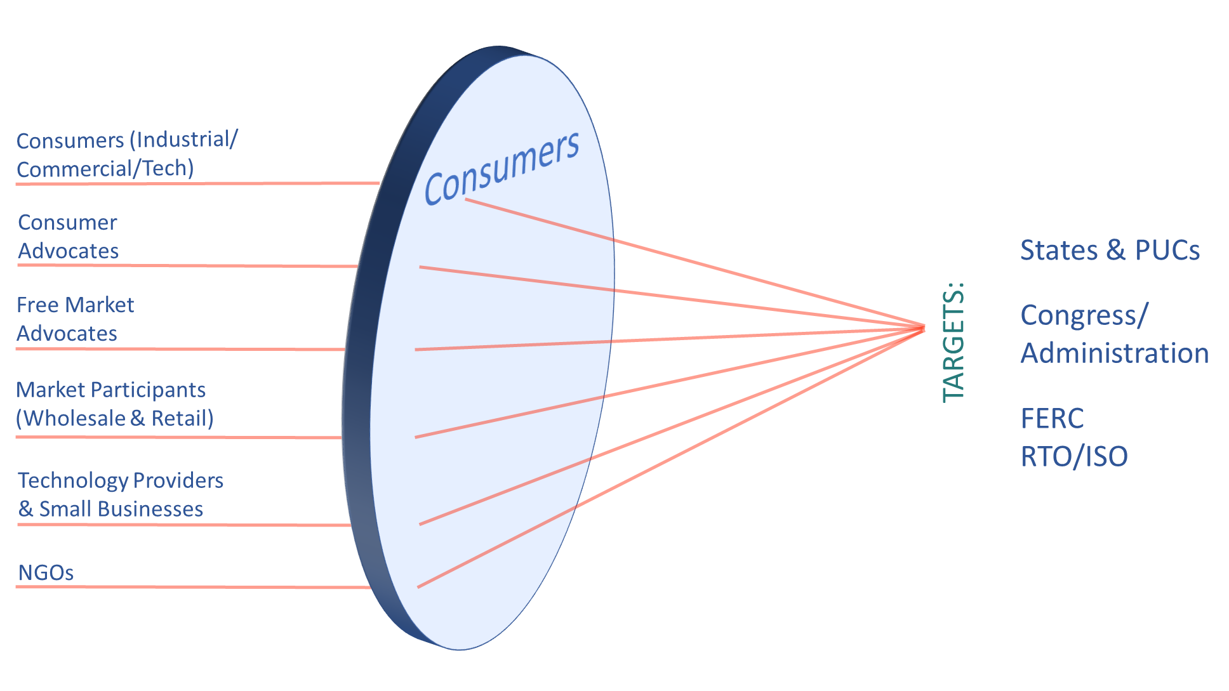
Lens of the Electricity Consumer
We are focusing our collective knowledge and voice to place U.S. consumers squarely at the center of the electricity industry’s business model.

Slide 3
Join a diverse ecosystem of stakeholders
interested in partnering with EC-MAP!
Wholesale Market Campaign
Ecosystem Partners include consumer aligned interests who are supportive of our action plan
Third party think tanks on the left and right who will serve as problem validators
Diverse industrial, tech and commercial companies and associations and
Public interest and residential consumer advocates
3

Slide 4
Wholesale Market Campaign
“Foundational Principles of Good Governance for Wholesale Electricity Markets” include:
Fair Representation. Accessible to all types of stakeholders, with added emphasis on balancing diverse interests, and ensuring adequate consideration of minority positions.
Transparency. Both the operations of RTO and stakeholder process must adhere to the highest level of transparency to bring greater accountability.
Independence. RTOs should function as independent and neutral organizations and should not be Impacted by external political interference .
Oversight. Improved role for FERC in oversight. (FERC has not been checking in on them/regularly updating process from Order 719.)

Slide 5
Multi-Trade Consumer Letter

Slide 6
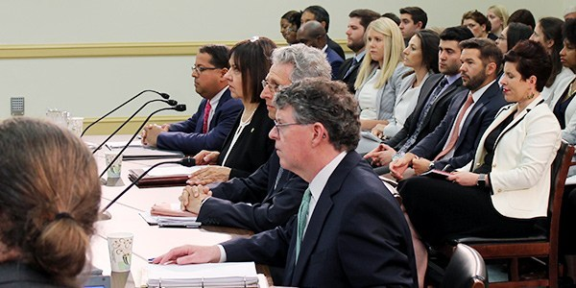
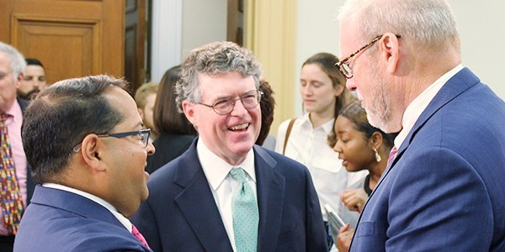
June 12th U.S. House FERC Oversight Hearing

Slide 7
Hearing Results
Democrats, consumer groups urge FERC to review grid operator rule-making
By Gavin Bade, Politico
House Democrats on Wednesday urged FERC commissioners to review the rule-making processes used by regional power grid operators, saying current procedures give large utilities more power than consumers.
"Consumer voices are often overlooked, ignored, or cut out of the [grid operator rule-making] process entirely," Rep. Bobby Rush, chairman of the House Energy and Commerce Energy Subcommittee told the regulators an oversight hearing.
House committee chair: Time for FERC to revisit RTO governance
BY GEORGE LOBSENZ, Energy Daily
The Democratic chairman of the House Energy and Commerce Committee Wednesday urged the Federal Energy Regulatory Commission to revisit its governance rules for regional transmission organizations, prompting FERC’s chairman and other commissioners to agree that there are increasing concerns about transparency and decision-making at the FERC-regulated grid operators on key transmission expansion projects and power market rule changes.
FERC Probed on RTO Governance, Market Issues
By Michael Brooks
WASHINGTON — Several members of the House Energy and Commerce Committee’s Subcommittee on Energy on Wednesday urged FERC commissioners to holistically review RTO and ISO governance rules, while also pressing them on when to expect decisions on languishing dockets — including PJM’s capacity market proposal.

Slide 8
Next Steps, Gaining Momentum
Foundational Activity:
Engage diverse stakeholders from free market groups to NGOs and consumer advocates
Research & Analysis:
Produce and build off “Foundational Principles of Good Governance” with white papers to tee up remedies discussions
Communication:
Content Products & Joint “Position Products” with Ecosystem Participants
Engagement:
Internal & external capacity building and advocacy meetings, build momentum through oversight, FERC action, and legislation

