Slide 1
Grid Modernization Considerations
Joe Paladino
US Department of Energy
NASUCA 2019 Annual Meeting November 17, 2019

Slide 2
Influencing Factors for Grid Modernization
The challenge is to manage the transition and related operational and market systems in a manner that doesn’t result in an unstable or unmanageable system¹
Federal, State and Local Policies
Renewable Portfolio Standards
Federal/Local Tax Credits
Reliability and Resilience
Integrate Distributed Energy Resources
Enable Customer Choice
Technology Availability
Convergence of IT/OT
Electric Vehicles
Solar and Wind
Energy Storage
Building Energy Management Systems
Microgrids
New Participants
Customers/Prosumers
Merchants
Technology Providers
1 - from Grid 2020, Resnick Institute Report, Sept 2012
Notes:
There are a variety of factors influencing the future direction of grid modernization.
The electric grid is at an early stage of undergoing a fundamental structural transformation prompted by the advent of digital technology, the evolution and availability of renewable and distributed energy resources, and the emerging participation of customers and third-party merchants in providing grid resources (either through the generation of electricity or via load management).
Perhaps, the three main factors are:
Federal, state and local government policies that are driving the grid to adopt increasing amounts renewable and energy efficient technologies, including:
Increased concerns about reliability and resilience.
RPS, renewable energy goals, energy storage mandates, federal and state tax credits, etc. that are driving investments in both renewable and distributed energy resources.
The availability of new technology due to reduced costs and an increase in commercial/business technology/service providers and practical application. The technologies include digital information management and communications technology. (should probably get a factoid in the decreasing cost of computing power and/or information storage and/or bandwidth and latecy improvements over time.) They also include distrbuted resources such as solar, energy storage, microgrids, EVs, energy management systems for buildings.
The emergence of customers (residential, commercial and industrial) and 3rd-party merchants, enabled by technology providers, that are become increasingly involved in the generation and management of electricity. These new participants are able to provide services (e.g., energy, capacity, frequency response) back to the grid. Such services provide value that need to be factored into grid planning, operations and markets. Concept of non-wires alternatives; see notes on slide 5 (Customers, as prosumers, are those that can deliver energy or any of these services back to the grid.)
Perhaps, we should mention the observed reduction in natural gas prices as a major contributing factor.
Distribution System will evolve in response to both top-down (public policy) and bottom-up (customer choice and technology availability) drivers. Even in the absence of state policies (e.g. in Florida), we are seeing uptake of solar technology due to its commercial availability. When these forces come together there is rapid acceleration, as witnessed in Hawaii.

Slide 3
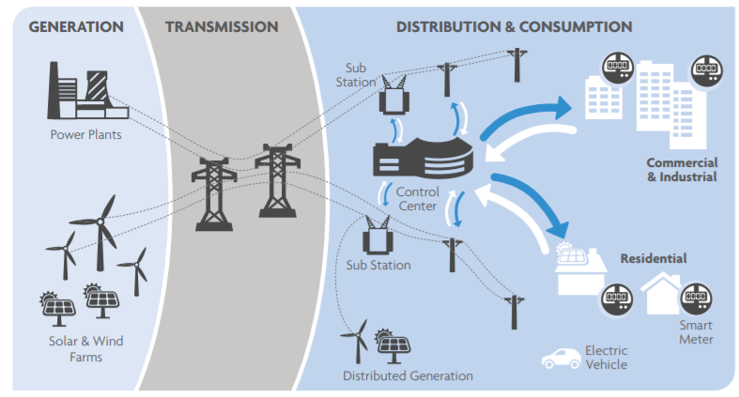
Increasing Complexity
We are evolving from a one-directional to multi-directional network with regard to the flow of energy, information, and financial transactions, yet need to maintain or improve reliability, resilience, and affordability
Notes:
What is driving the need for IDP?

Slide 4
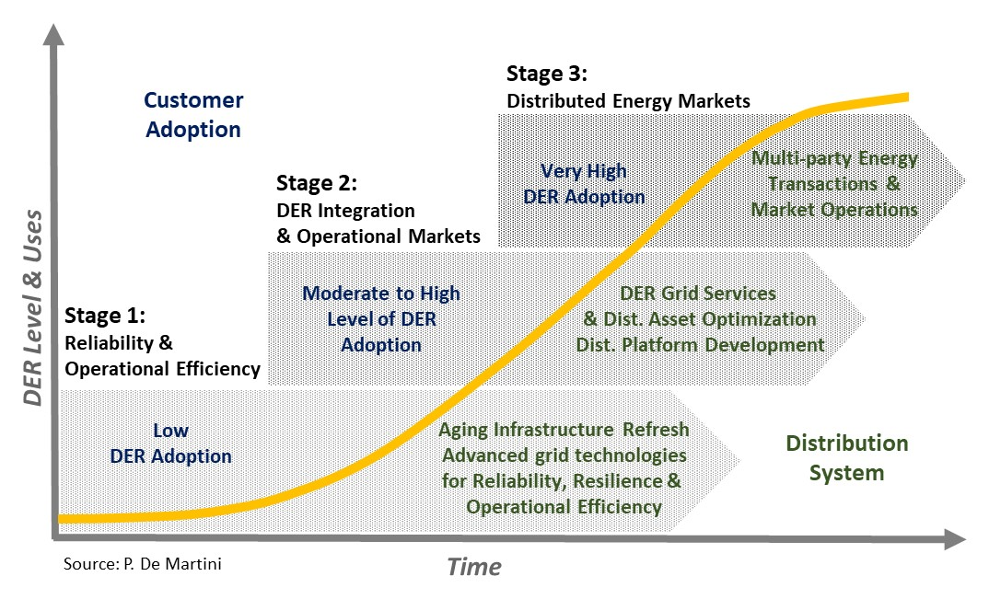
Distribution Grid Evolution
U.S. distribution systems currently have Stage 1 functionality - a key issue is whether and how fast to transition into Stage 2 functionality
Material impact on grid planning and operations
From: De Martini, Paul, and Lorenzo Kristov. Distribution Systems in a High Distributed Energy Resources Future. Ed. Schwartz, Lisa C. Vol. FEUR Report No. 2. 2015. LBNL-1003797. Link: https://emp.lbl.gov/projects/feur
Notes:
In stage 1, DER adoption is low and can be accommodated within existing distribution systems without material changes to infrastructure or operations. However, we need to anticipate DER adoption rates and implications for growth in interconnection requests and needed changes in distribution planning. We might also begin to consider hosting capacity analysis and locational value assessments (where the addition of DERs would profit the system).
In stage 2, DER adoption levels become material and reach a level that requires enhanced functional capabilities for reliable and flexible operations. Rule of thumb: we enter stage 2 when DERs can provide 5% of the system-wide peak load. In this stage we need to modify planning approaches and operations.
Need to manage for bi-directional power flows
Need more advanced protection and control technologies
DERs can effectively play in bulk system markets
Opportunities for sourcing at the distribution system level
In stage 3, combination of high DER adoption and enabling policy decisions (sale-for-resale) to create distribution-level energy markets for multi-sided (“many-to-many” and “peer-to-peer”) transactions across the distribution system.
In a DOE-sponsored project we call “DSPx” we focused on grid modenization efforts at Stage 1 and movement from Stage 1 into Stage 2.

Slide 5
Distributed Energy Resources
What we need to understand:
Rate of adoption
  Policy impacts
  Price/availability impacts
Utility/customer/3rd-party interactions w/regard to planning, operations and markets
  Information requirements
  Roles and responsibilities
Their impact on the system (topology re-design, plus integration requirements for sensing, communication, control, computing, and information management)
How to utilize them, e.g., determining their purpose with regard to providing efficiency, reliability and resilience
How to source them:
  Pricing – for DER grid services (customer behavior)
  Programs – such as demand response and energy efficiency programs to increase customer adoptions and optimize system benefits
  Procurements – initiating targeted solutions and incorporating NWA into utility decision-making on necessary grid investments
DERs:
Energy efficiency
Demand response
Distributed generation (e.g., PV)
Variable rates
Energy storage
Flexible loads (buildings)
Microgrids
Combined heat & power
Electric vehicles
Notes:
Initial value streams for NWAs are typically capacity deferment or elimination and improved reliability or resilience.
Performance attributes of NWAs include: availability, intermittency (predictability), dispatchability, and coincidence (with local of system peaks)
System data includes grid information such as real and reactive power consumption, calculated hosting capacity, power quality, and reliability, which can be collected at specific granularities including circuit, feeder, substation, and system level.
The availability of system data is closely linked to the presence of monitoring and sensing technologies and AMI.
Customer information includes customer energy usage data, customer-sited generation data, and account and load profile information
Data privacy is important

Slide 6
Integrated Distribution Planning
Integrated planning identifies “Where”, “When” and “How Much”
Load & DER Forecasts
(Scenario Analysis, Non-Deterministic)
Integrated Resource Planning & Transmission Planning
Distribution Engineering Analysis
Current Distribution Assessment
Annual Long Term Distribution Planning
Locational Net Benefits Analysis
Value of DER
Sourcing DER Provided Services (Pricing, Programs, Procurements)
Hosting Capacity
Interconnection Studies
Interconnection Process
Distribution Investment Roadmap
Asset Refresh
Capacity Expansion
Grid Modernization

Slide 7
Grid Modernization Planning Process
Strategy
Identify Grid Mod Objectives, Scope & Timing
Identify Grid Capabilities & Functionality Needed
Identify Grid Architecture Considerations & Develop Strategies (e.g., assessment of grid state, coordination framework, operational data/information management and flow, communication system requirements, central vs distributed control, cybersecurity)
1
2
3
Objectives, Scope & timing
Grid Capabilities & Functionality
Architecture Considerations
& strategies
Use Cases & Requirements
Detailed Design
Technology selection
Deployment roadmap
4
5
6
7
Implementation Plan
Develop Functional Use Cases to Identify Detailed Business & Technical Requirements
Develop Detailed Architecture & Design
Technology Assessment & Selection
Develop Deployment Roadmap & Cost Effectiveness Assessment
Version 3.0 091818

Slide 8
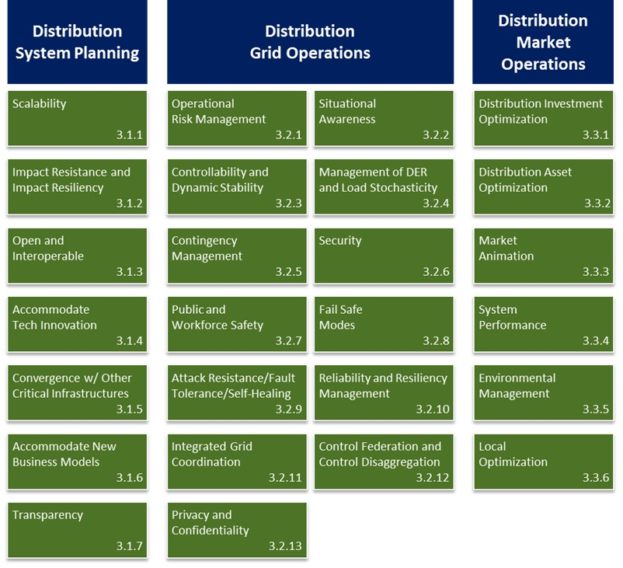
Distribution System Capabilities
Capabilities derived from customer, policy & business objectives
Source: DOE-OE, 2017. Modern Distribution Grid, Volume I: Customer and State Policy Driven Functionality. Available online at: https://gridarchitecture.pnnl.gov/media/Modern-Distribution-Grid_Volume-I_v1_1.pdf

Slide 9
Taxonomy Example
Objective | Attribute | Capability | Function | Technology
Enable customer choice | Information to support customer decisions | Provide online customer access to relevant & timely information by 2020 for small business & residential customers | Remote meter data collection & verification Customer data management Energy management & DER purchase analysis | Customer Portal Customer analytic tools Greenbutton Time interval metering Meter Data Management System Customer Info System Data Warehouse Meter communications
Source: DOE-OE, 2017. Modern Distribution Grid, Volume I: Customer and State Policy Driven Functionality. Available online at: https://gridarchitecture.pnnl.gov/media/Modern-Distribution-Grid_Volume-I_v1_1.pdf

Slide 10
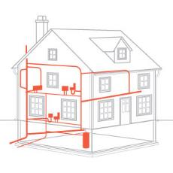
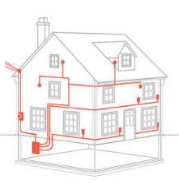
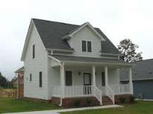


Architecture Manages Complexity
The engineering issues associated with the scale and scope of dynamic resources envisioned in policy objectives for grid modernization requires a holistic architectural approach
Before trying to hang windows
So, pick-up a pencil
Resist temptation to start with technology choices
Notes:
We applied a grid architectural discipline throughout the process. Grid architecture is the specialization of systems architecture, network theory and control systems. It is a discipline, not a design, but provides an approach that enables designs. It is concerned with structures.
As the grid becomes more sophisticated, we are looking at the integration of structures: information/data management, communications networks, sensing and control infrastructure, but also industry, market and regulatory structures. These structures influence each other tremendously and interact at specific interfaces.
In examining complex systems, we need to understand how these structures influence each other, including how they evolve together, in our effort to reach a desired state and eliminate unintended consequences.
Grid modernization, therefore, requires a holistic approach, provided by the practice grid architecture, that begins with objectives and determines how these structures integrate and coordinate.
As an architect needs to develop a coherent structure based on objectives, design principles, constraints, and an analysis of structures leading to an effective design, so does a grid architect.

Slide 11
Architectural Considerations
Grid architecture is primarily about structure and ensuring coherence
Coordination is the process that causes or enables a set of decentralized elements to cooperate to solve a common problem
  How will we coordinate utility and non-utility assets?
  How will we address the information sharing requirements among participants?
Scalability is the ability of a system to accommodate an expanding number of endpoints or participants without having to undertake major rework
  How do we enable optimal performance locally and system-wide?
  How do we minimize the number of communication interfaces (cyber-intrusion)?
Layering is applying fundamental or commonly-needed capabilities and services to a variable set of uses or applications through well-defined interoperable interfaces (Leads to the concept of platform)
  How do we build out the fundamental components of the system to support new applications and convergence with other infrastructures?
Buffering is the ability to make the system resilient to a variety of perturbations
  How do we address resilience and system flexibility requirements (role of storage)?

Slide 12
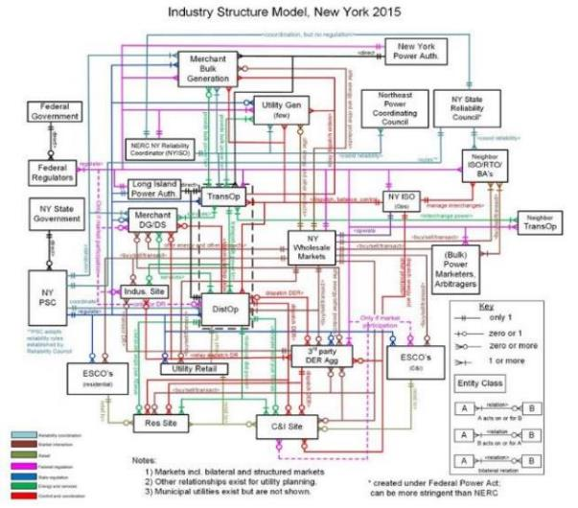
Industry Structure
Participants:
Federal Government
Federal Regulators
NERC NY Reliability Coordinator
Northeast Power Coordinating Council
NY State Reliability Council
NY ISO (Ops)
Neighbor ISO/RTO/BAs
NY Wholesale Markets
Bulk Power Marketers/Arbitragers
Merchant Bulk Generation
Utility Generation
NY Power Authority
Long Island Power Authority
Transmission Operators
Neighbor Transmission Operators
NY State Government
NY PSC
Distribution System Operator
Utility Retail
Residential Customers
C&I Customers
ESCOs
Third-Party DER Aggregator
Nature of Interaction:
Reliability coordination
Market interaction
Retail
Fed/state regulation
Energy and services
Control and coordination
Notes:
Began with a determination of state objectives through examining legislative and regulatory records. Determined that the objectives were fairly consistent across states (see state objectives slide).

Slide 13
Coordination of DER
The presence of DER not owned by utilities changes the problem from direct control to a combination of control and coordination
distribution system operator
Elements need to coordinate to solve common problems of grid operations (in the presence of DER)
Each element has performance constraints and optimization objectives
By examining relationships and interfaces, can develop coordination frameworks and underlying control and communication requirements
Laminar coordination allows us to manage an increasing number of nodes
Proper coordination permits local/system optimization
substations
customer and/or microgrid
T/D Markets
Utility Edge
AGG
From JD Taft, Architectural Basis for Highly Distributed Power Grids: Frameworks, Networks, and Grid Codes, PNNL-25480, June 2016
Coordination node
DER
Communication bus
Notes:
The potential of high penetrations of mixed DERs presents an entirely new problem in control, coordination and value-determination within distribution systems
Considerations: Scalability, security and optimization (selfish and system)
GE estimate that there will be over 7 billion devices installed by 2020 (representing a 26% annual growth from 2014) and the devices will generate 24 exabytes of data, with 50% stored in clouds (representing a 32% annual growth rate from 2014)

Slide 14
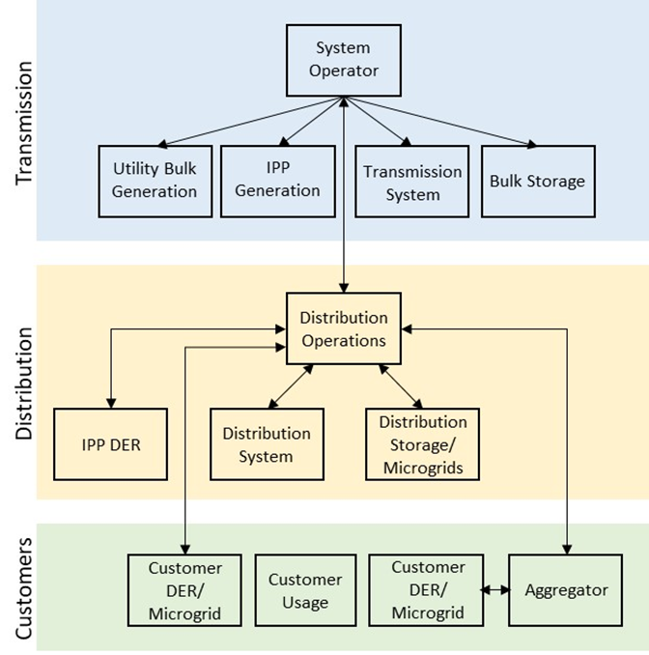
Coordination Framework
A coordination framework should identify roles, responsibilities and information sharing requirements
Grid architecture principles for examining and comparing coordination models:
  Observability
  Scalability
  Cyber security vulnerability
  Layered decomposition
  Tier bypassing
  Hidden coupling
  Latency cascading

Slide 15
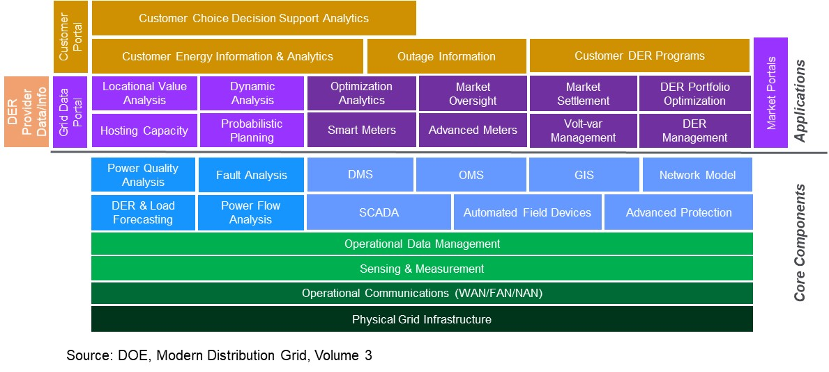
Distribution System Platform
Logical layering of core components
Green - Core Cyber-physical layer
Blue - Core Planning & Operational systems
Purple - Applications for Planning, Grid & Market Operations
Gold - Applications for Customer Engagement with Grid Technologies
Orange - DER Provider Application
Source: U.S. Department of Energy-Office of Electricity Delivery and Energy Reliability, 2017. Modern Distribution Grid, Volume III: Decision Guide. Available online at: https://gridarchitecture.pnnl.gov/media/Modern-Distribution-Grid-Volume-III.pdf

Slide 16
Convergence
From “Value Creation Through Integrated Networks and Convergence”, De Martini and Taft, February 2015

Slide 17
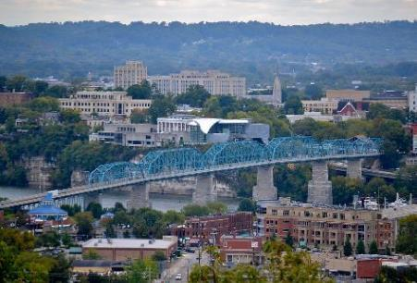
Chattanooga
In Chattanooga, TN:
Fiber used to communicate with all substations and distribution line equipment (capacitor banks, regulator banks and automated switches) and it is used for all the AMI backhaul
Fiber optic service provided to customers has led to many economic development initiatives
  Especially where entrepreneurs are working on applications involving high-speed, low-latency broadband networking (3D printing, healthcare, and software-defined networking)
  Examples are GIGTANK 365 and Lamp Post Group
Gigabit-per-second internet service to the county school system
  The local STEM school has leveraged this to develop a program in which they are provided with microbiology instruction from University of Southern California
  It takes 33 seconds to download a 2-hr, high-definition movie compared with 25 minutes for average systems
  http://www.stemschoolchattanooga.net/?PageName=bc&n=249035
Chattanooga, a city in southeastern Tennessee, is set along the Tennessee River in the foothills of the Appalachian Mountains. It has a population of 178,000.

Slide 18
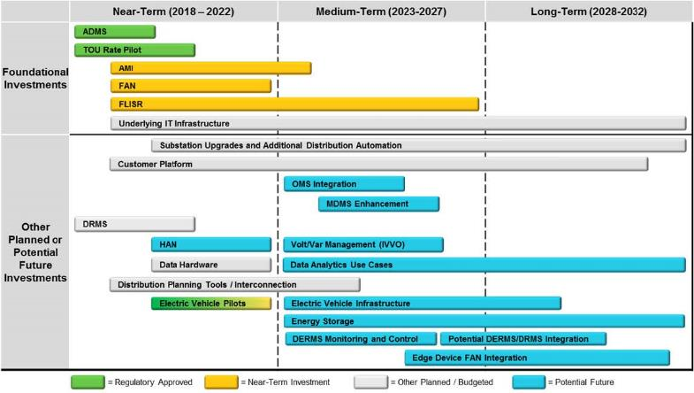
Sequencing of Investments
15-year view of the planned and potential advanced grid investments presented in the Xcel Energy 2018 Integrated Distribution Plan
From the Xcel Energy 2018 Integrated Distribution Plan. Link: https://www.edockets.state.mn.us/EFiling/edockets/searchDocuments.do?method=showPoup&documentId={E098D466-0000-C319-8EF6-08D47888D999}&documentTitle=201811-147534-01

Slide 19
Strategy and Implementation Roadmap
Regulators, utilities and stakeholders have respective roles in the process; regulators approve the strategy, implementation process, and roadmaps
Grid Modernization Strategy
Articulation of grid modernization objectives
Determination of timing, scale and scope of grid capabilities to meet objectives
  Based on needs identifies through integrated planning efforts, including forecasts (load, DER uptake and service expectations)
Includes strategies to address grid architecture considerations
  Coordination framework
  Sensing and measurement; assessment of grid state
  Operational data flow and information management (including computing requirements)
  Central vs distributed control
  Communication system requirements
  Platform/applications and convergence strategy
  Cybersecurity strategy
Implementation Roadmap
  Scope and schedule for achieving grid mod capabilities and functions
  Articulation of implementation strategy for various technologies and business process changes
  Articulation of technology adoption strategy
  Cost-effectiveness assessment

Slide 20
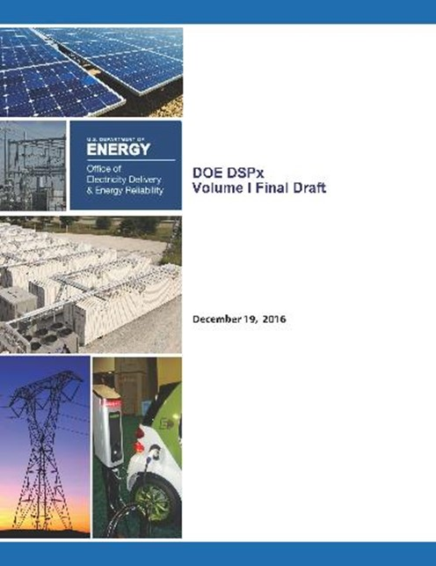

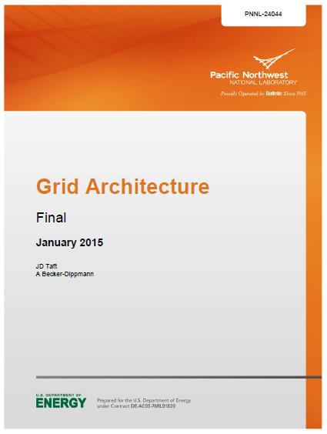
Thank You
Contact:
Joe Paladino, joseph.paladino@hq.doe.gov
References:
Modern Distribution Grid Report
PUCO Grid Mod Roadmap
Grid Modernization Strategy Using DSPx
Grid Architecture
https://gridarchitecture.pnnl.gov/modern-grid-distribution-project.aspx
https://puco.maps.arcgis.com/apps/Cascade/index.html?appid=59a9cd1f405547c89e1066e9f195b0b1
www.hawaiianelectric.com/gridmod
http//gridarchitecture.pnnl.gov

