Slide 1
Advanced Buildings and Energy Communities for All
How Buildings can Act as a Point of Integration to Scale Emerging Customer Technologies
Ben Clarin
Sr. Project Manager
Electric Power Research Institute
June 20, 2019

Slide 2

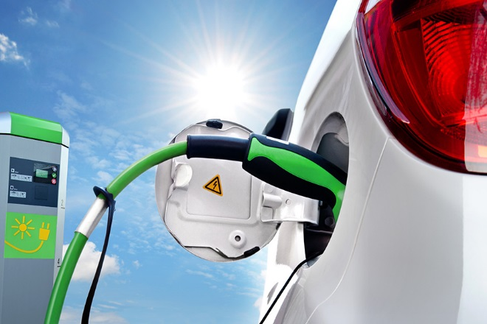
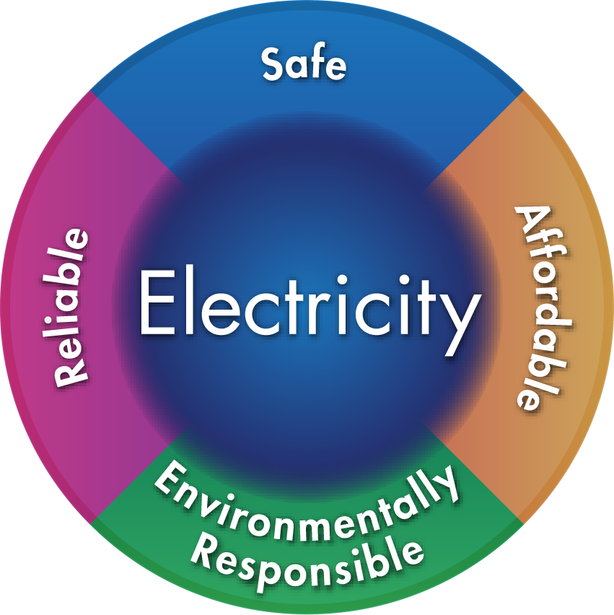
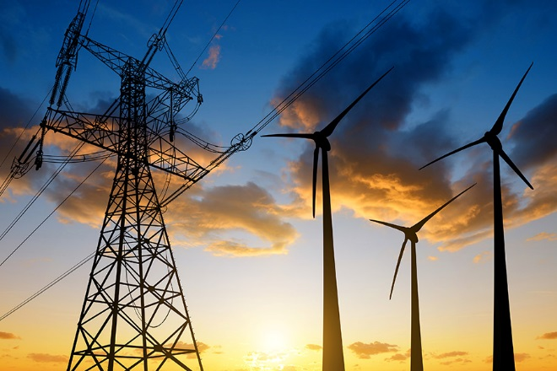
EPRI Mission and Membership
Not-for-profit research organization working on public benefits research on electricity issues
450+ participants in more than
30 countries with international members comprising 25% of research funding
EPRI members generate approximately 90% of the electricity in the US
Notes:
2

Slide 3
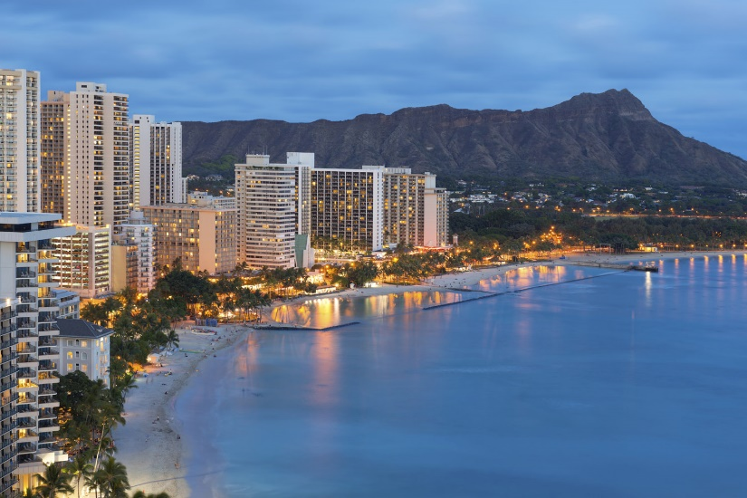
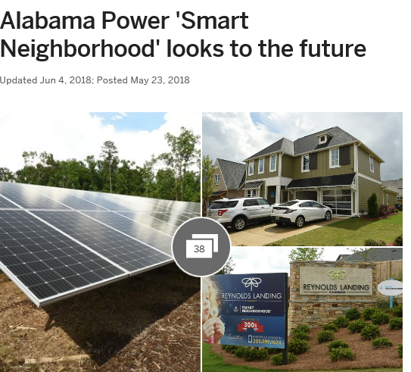
Program Vision – Advanced Buildings
Provide strategic insight on grid transformation to a cleaner, customer centered energy system by understanding how buildings act as a point of integration, application and a medium to scale emerging customer technologies.
Notes:
Knowing and predicting changes to the built environment will impact core utility functions such as distribution planning and tariffs
We also have to start looking at buildings strategically but from a different angle as low hanging fruit for traditional customer programs disappears, but new drivers require reshaping the customer engagement
For example, if you want to understand how your revenue will be affected in the future, or how to implement carbon policy goals, it is important that you understand building design and performance.

Slide 4

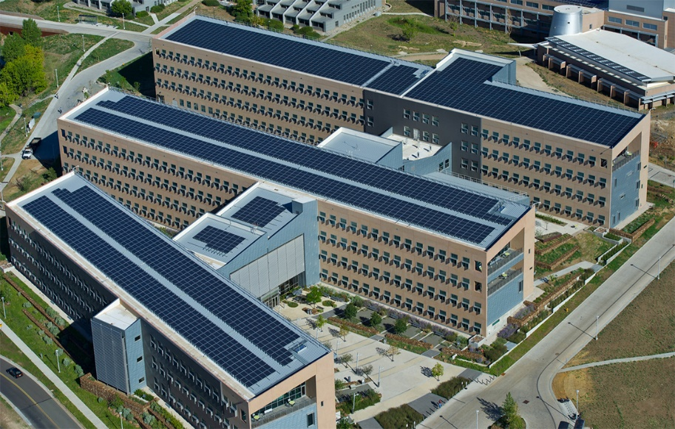
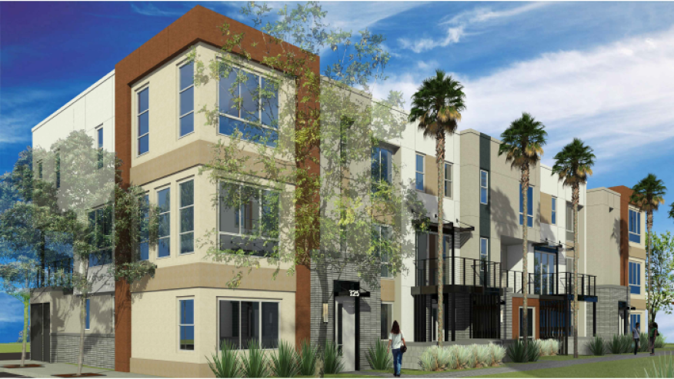
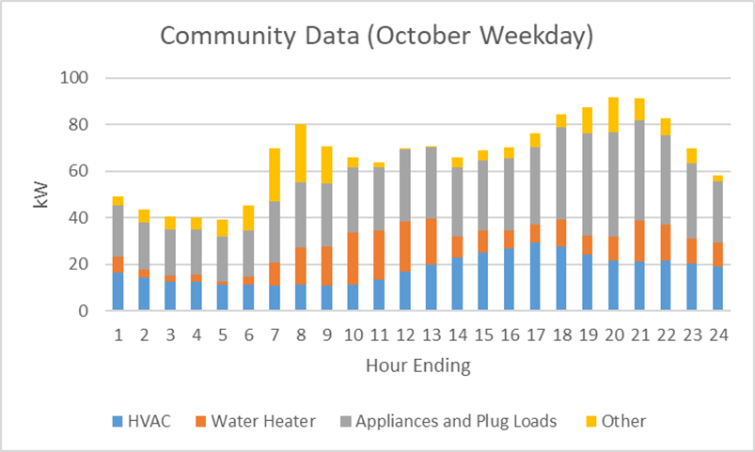
Core Research Areas
Smart Buildings and Communities
Building Decarbonization
Healthy Affordable Communities
Building Analytics

Slide 5
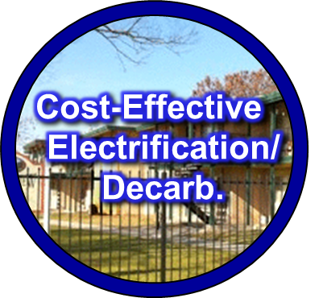
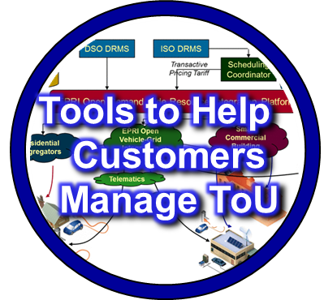
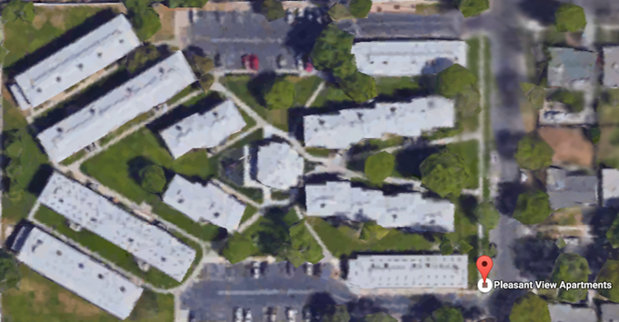
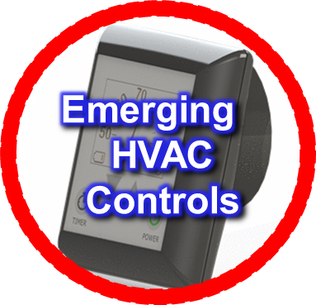
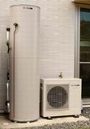
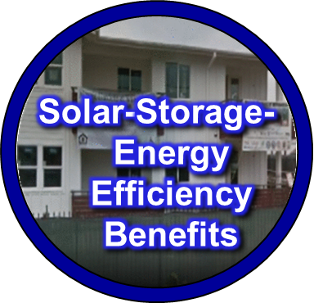
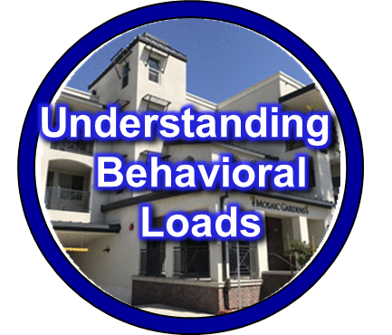
Focus Area: Healthy Affordable Communities
Healthy Affordable Communities
Environmental impacts of advanced buildings

Slide 6
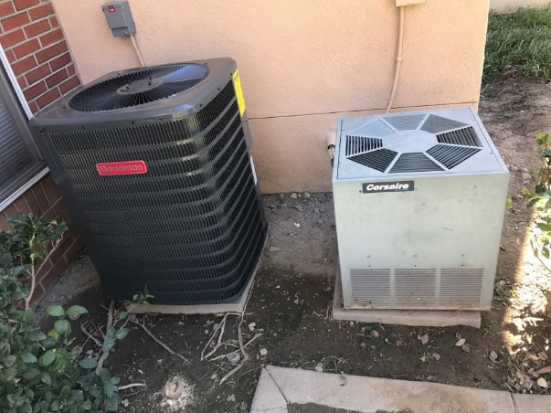
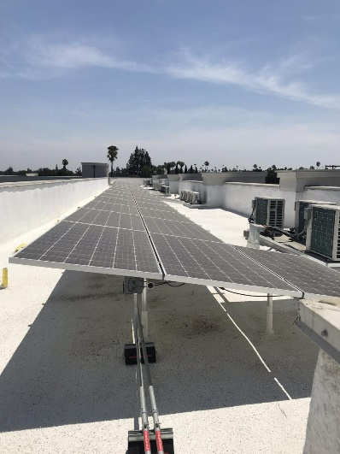
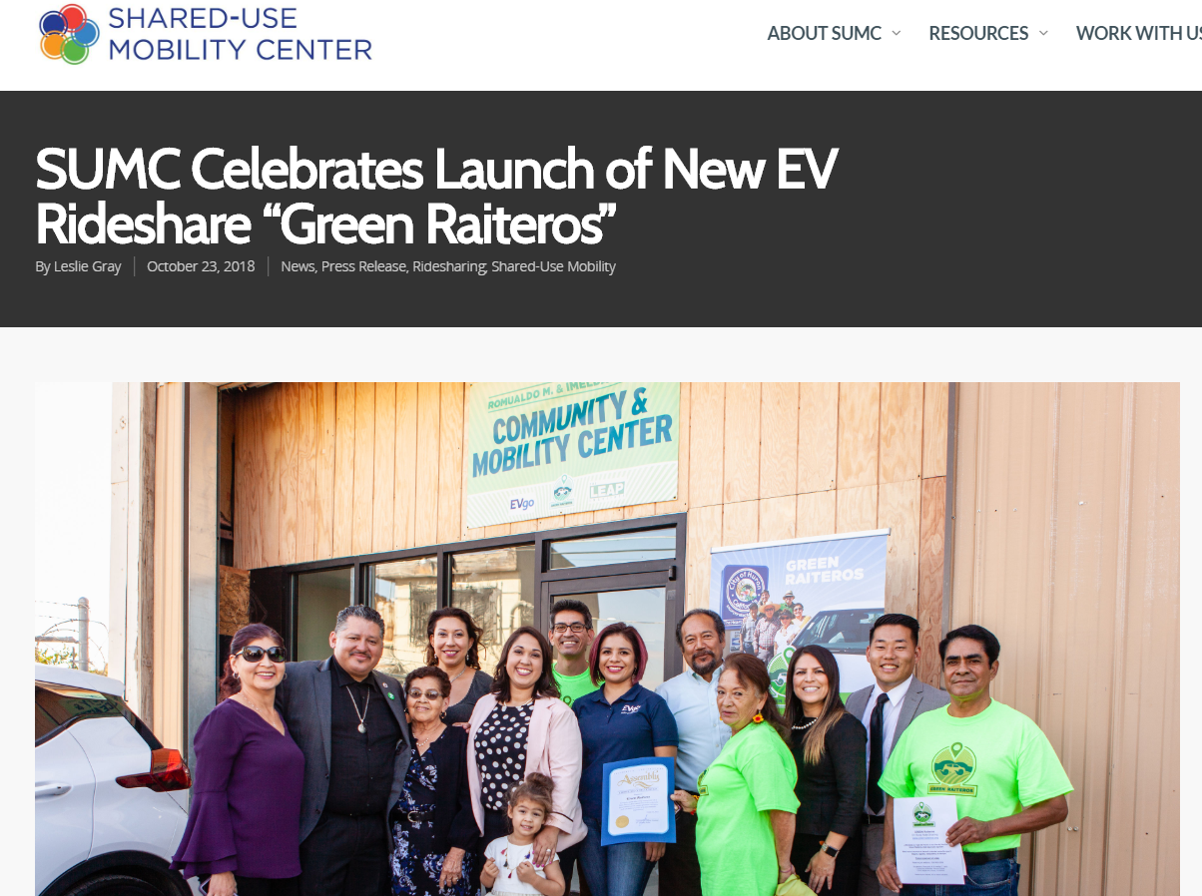
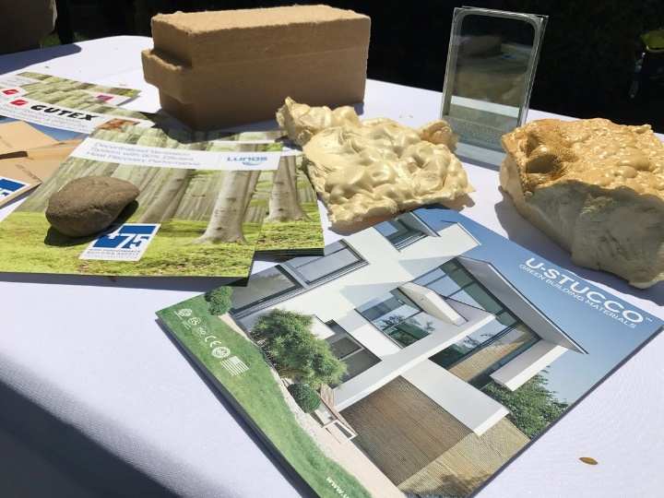
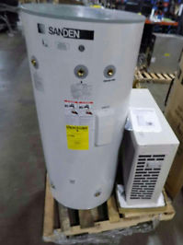

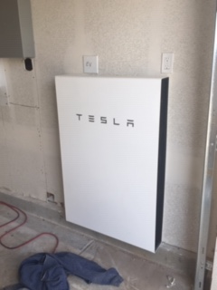
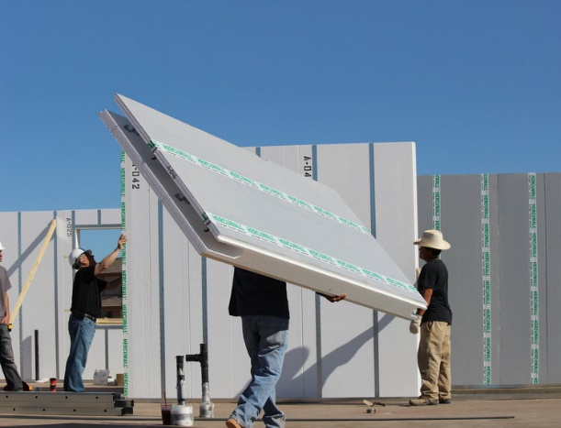
Part of the Solution – Integrated Technology Approaches
High Efficiency Heat Pump with wifi thermostats to replace 20 year old air conditioners
EV/Rideshare Programs
Rooftop Solar
Integrated roof replacement with PV, insulation and cool roof membrane
Evaluating 110V Package Terminal Heat Pumps for cooling additional and electrification
Battery Storage
Heat Pump Water Heaters
Advanced Wall Systems

Slide 7
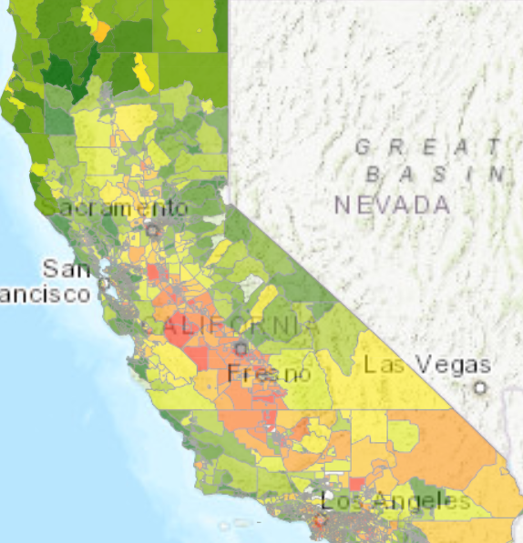
Equitable Decarbonization - Can it Happen?
This is the question we ask – can decarbonization really be driven in an equitable manner
Past experience with distributed solar, IoT and electric vehicle adoption is not great for equity
However, we are learning how to programmatically invest in affordable communities
Cal Enviroscreen 3.0 Map

Slide 8
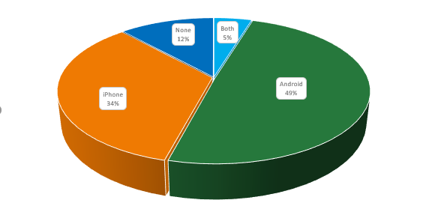
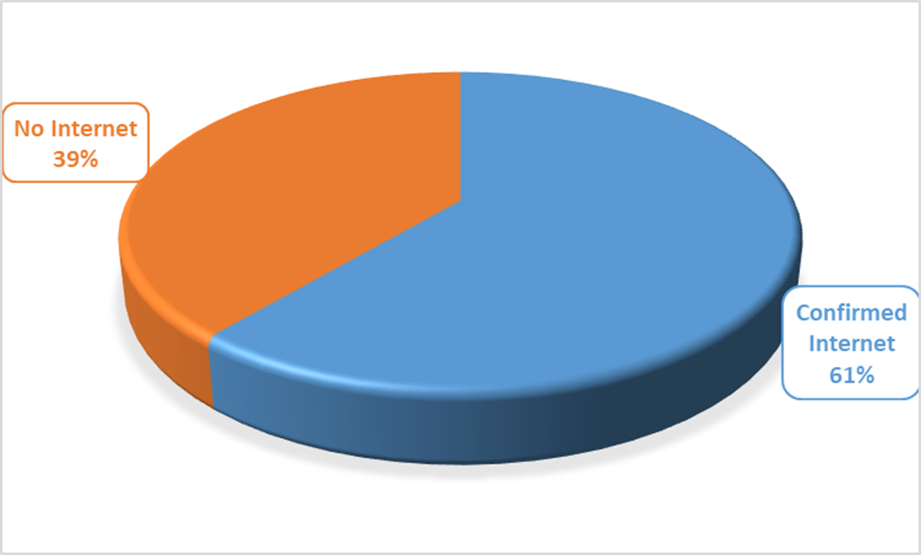
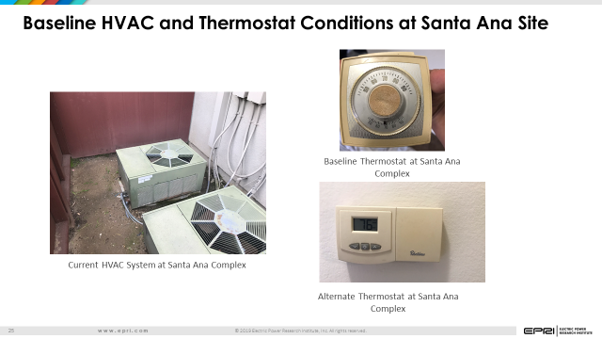
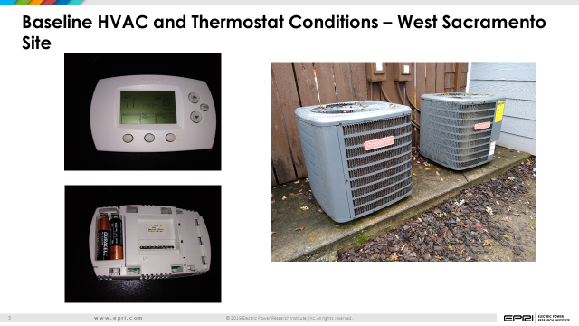
Challenges to Equitable Decarbonization and Demand-Side Management Programs
Energy Affordability – Larger part of monthly budget is energy bill for low-income/disadvantaged residents.
Shifts to Needs for Energy to become More “Dynamic” – Tools for customers to make energy decisions
Digital Divide based on Income – IoT solutions typically rely on consumer broadband. Broadband becomes less reliable on in low-income disadvantaged residents
Ease of Use – Need for tech solutions for those who are not early adopters
2019 Survey of LINC Santa Ana and West Sacramento Site: 27% of tenants main broadband connection is via smartphone
Older equipment not compatible w/ IoT

Slide 9
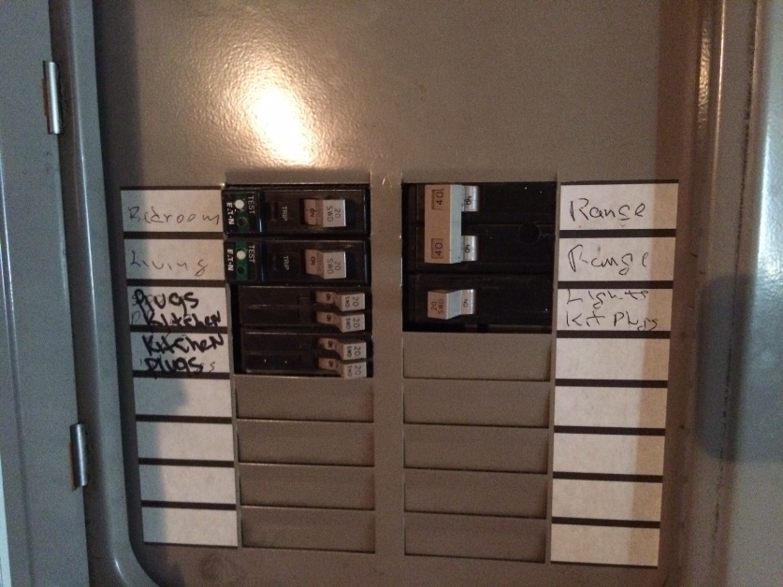
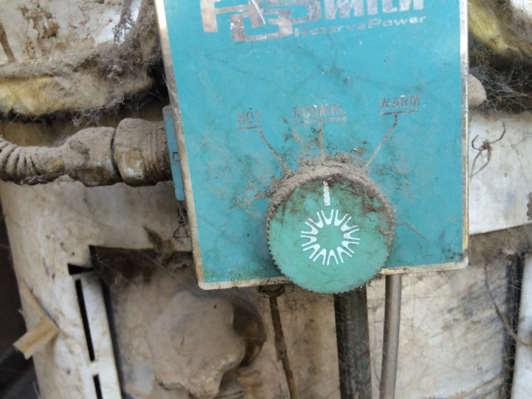
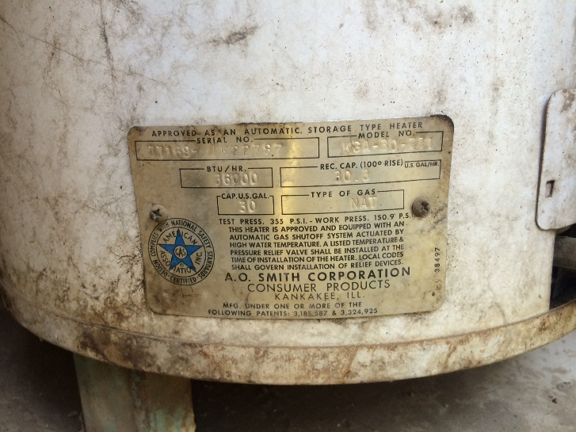
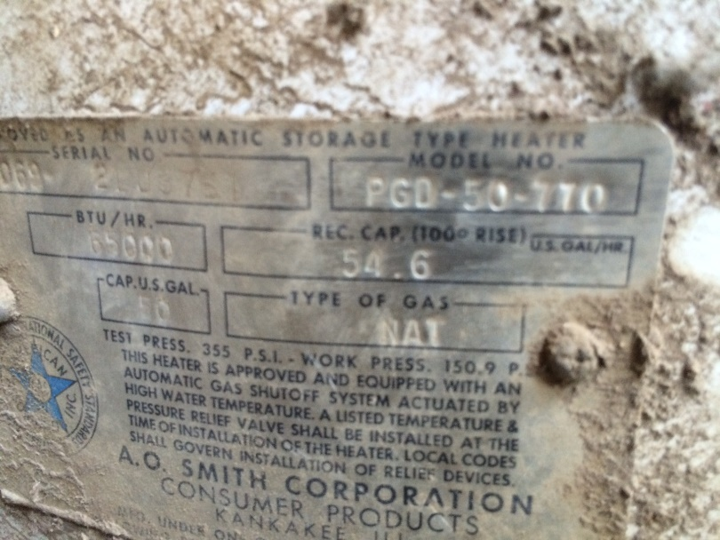
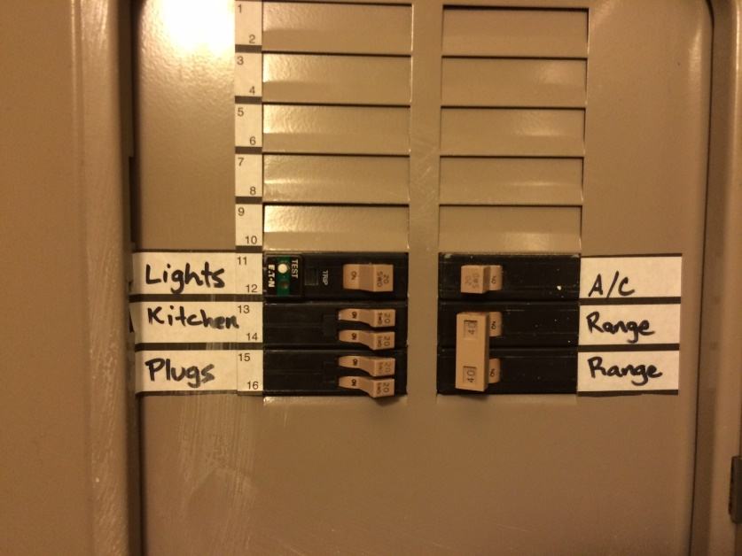
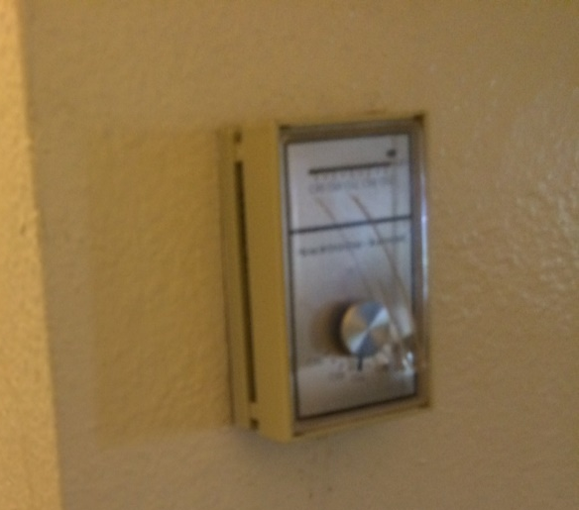
Barriers of Equitable Efficiency and Decarbonization

Slide 10
Call to Action - Tenant Survey Data Collection
Completion by 41 out of 58 (71%) occupied households.
Primary Problems:
  AC does not cool apartment down quickly or cool all rooms evenly, and emits dirt and dust.
  Heater does not heat all rooms evenly.
  Indoor air is stuffy/stale, dirty, and has odors.
  Inadequate interior lighting
Complaint | % of Survey Participants
Dissatisfied with Cooling | 74%
Dissatisfied with Heating | 51%
Major Problem with Dirty Air | 55%
Dissatisfied with Hot Water | 27%
“Too Dark” in Apartment | 76%
Inadequate Outdoor Lighting | 54%

Slide 11
The Efficiency Program Alphabet Soup
Many programs exist, but difficult to manage them together for full benefit to tenants and property owners
Multifamily Upgrade program
Low Income Weatherization Program
Multifamily affordable Solar housing (MASH) program
Low Income Direct Install Programs
CARE program
Some are rebated, some are direct install, different rule sets for each program, some programs obviate incentives from others, etc.
Some programs expire rapidly resulting in unexpected costs

Slide 12
Lessons Learned

Slide 13
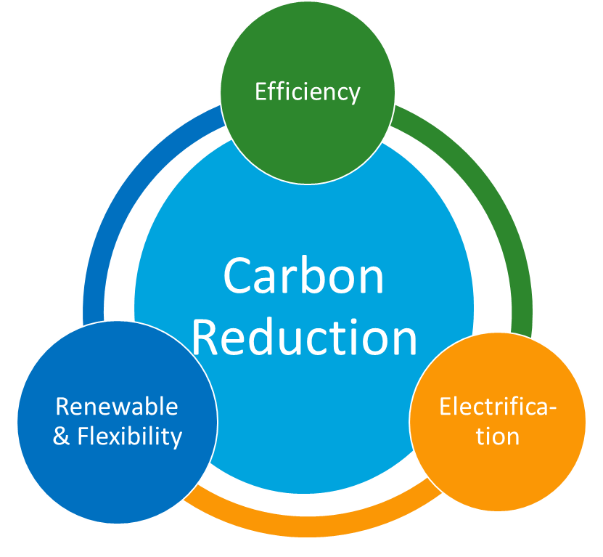
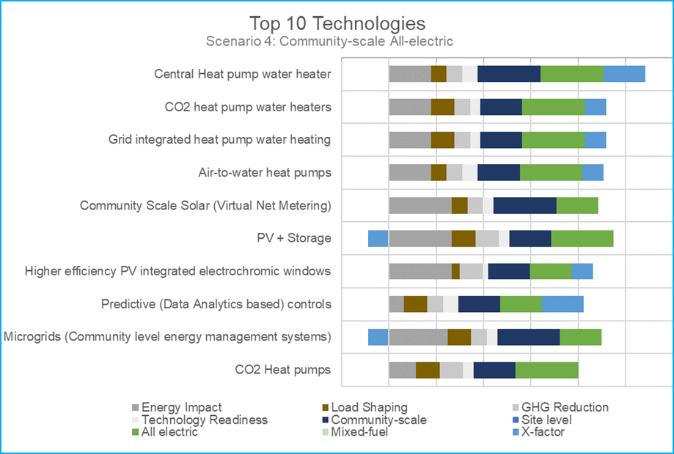
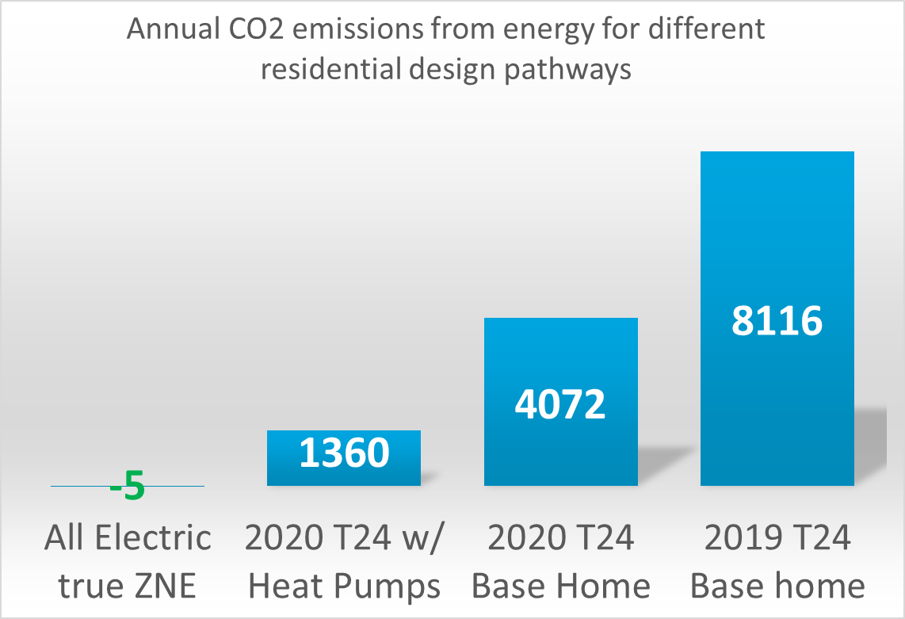
Integrated Approaches to Manage Short Term Requirements with Long Term Targets
Multi-faceted approach to efficient electrification
Prioritize Sets of Technologies
Understand long-term implications to new construction

Slide 14
Stringing Financing for Customer Economics
Step 1: Utility Direct Install Programs
Step 2: Multifamily Affordable Solar programs
Step 3: Low Income Weatherization Programs
These programs cover full retrofit costs, but require individual tenant agreements
These programs offset cost of solar and set the path for electrification while at the same time reducing customer costs
These programs are based on carbon metrics and enable electrification, but need solar to support customer costs in many cases (as tenants have additional cost burden from electrification)
Step 4: Multifamily Upgrade Programs
These programs are rebates and are post install to cover some of the costs not covered by other programs
Customer Process: First conduct audits, apply for direct install programs, recruit tenants, then install solar through PPA, in parallel conduct electrification and deep retrofits, obtain rebates from LIWP, complete final EE for MUP programs

Slide 15
Example Tenant Benefits – Survey Data Post Integrated Retrofits
More than 65% respondents reported lower energy bills post retrofits.
Apartment satisfaction has risen up from 88% (baseline) to 97% (post-retrofits). Major increase in community satisfaction seen post retrofit- rise from 37% (baseline) to 55% (post-retrofits)
Marked increase in resident assessment of HVAC retrofit performance. Exceedingly high customer satisfaction in cooling and heating during summer and winter.
Based on resident assessment of retrofit performance
I. Windows and Sliding doors
II. Air conditioned and Heater (HVAC)
Based on customers favorite measures
I. Refrigerator
II. Cooking Range and Dishwasher
III. Cooking Range
III. Windows and Sliding doors
Efficiency Benefits → Piece of Mind

Slide 16
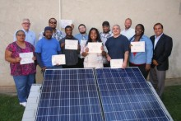
EPRI Webcast – Lessons Learned from Utility Programs Enabling Healthy and Affordable Communities
Speakers:
  US Department of Energy
  NYSERDA
  Lincoln Electric System
  Pacific Gas and Electric
  Consolidated Edison
  Roanoke Electric
Tenant solar install training as part of ZNE multifamily upgrade project
Webcast June 26th, 2019 12PM Pacific (3PM Eastern)

Slide 17
Project Contacts
Ram Narayanamurthy
rnarayanamurthy@epri.com
650-492-9576
Ben Clarin
bclarin@epri.com
650-855-2317

