Slide 1
Community Solar 101
Scott Thomasson
Southeast Director
November 13, 2018

Slide 2
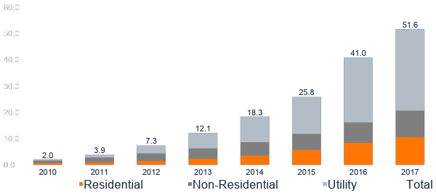
U.S. Solar is Rapidly Growing Cumulative Operating U.S. Solar by Market Segment (GWdc)
Operating U.S. solar has grown 7x in the past 5 years
Source: GTM Research and SEIA U.S. Solar Market Insight Q2 2018

Slide 3
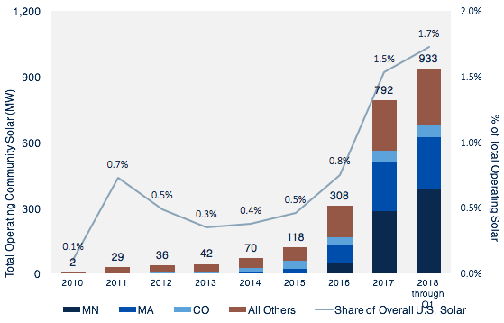
Community Solar Nears 1 Gigawatts of Total Operating Capacity Nationwide
U.S. community solar is growing at a quicker pace than the overall U.S. solar deployments
Still, community solar represents less than 2% of all operating U.S. solar to date.
67% of the capacity is administered by a third-party

Slide 4
Americans Want Solar. Overwhelmingly.
89% of Americans favor expanding solar as an energy source (2018) Pew Research Center
Strong bipartisan support for increased use of solar
71% of Americans support increasing reliance on renewable energy (2018) Pew Research Center
Interest in community solar soars from 14% to 47% when people learn about it (2016) SEPA Report

Slide 5
But Access to On-Site Solar is Limited
150,000 customer-sited solar energy systems by the end of 2010
2 million customer-sited solar energy systems by the end of 2018
36 million to 74 million residences and businesses without solar but suitable for onsite solar
75 million to 113 million households and businesses without onsite solar access
Source: GTM Research / SEIA, EIA, U.S. Census
Notes:
U.S. consumers want solar
…and solar is getting more affordable
…but access to solar is limited. According to NREL, only 3 out of 4 homes can install traditional on-site solar.
Community solar gives all customers the ability to choose local clean electricity that can support local economic development, resiliency and healthier communities.

Slide 6
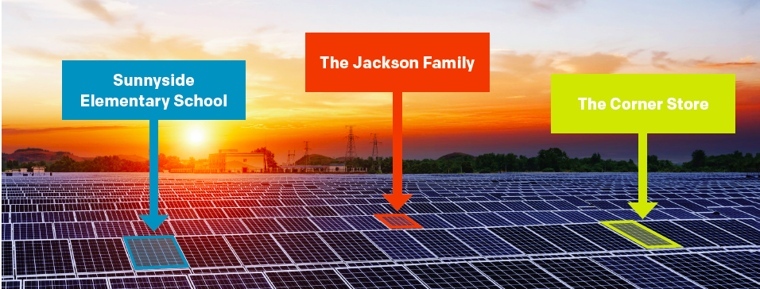
The Solution: Community Solar
What is community solar? Community solar refers to local solar arrays shared by individual community members, who receive credits on their electricity bills for their portion of the power produced.
Notes:
Expand solar access
Overcome physical barriers
Overcome financing barriers
Promote equity and access by low-income households, renters
It provides 75% of Americans the right to choose solar energy to lower their electric bills. Community solar is a simple policy tool that provides every American, regardless of housing type or income level, the opportunity to choose local, reliable, and cost-effective clean energy solutions
“In a nutshell, with the community solar program, you no longer have to put panels on your rooftop. When you subscribe to the garden, it’s like you have them on your rooftop. The point is to provide access to solar to people and institutions who otherwise would not be able to do it.”

Slide 7
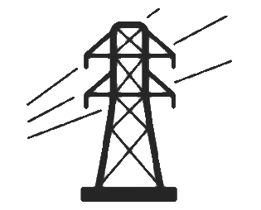
Defining Community Solar
Over the years, many projects have been labeled community solar, but we define community solar as a solar project with multiple subscribers that receive on bill benefits directly attributable to the community solar project.
The Typical Community Solar Model
SUBSCRIBERS
Solar Project Participation
Bill Payments
Upfront or Ongoing Payments
On-Bill Credits
Subscribers receive a credit on their electric bill for their share in a community solar
Subscribers must be tied to a specific solar project
COMMUNITY SOLAR PROVIDER
UTILITY
Energy and Other Grid Services
Notes:
CS differs from other programs like bulk purchasing by a local community, often called community solar, or other subscription based products where participants only receive renewable energy credits

Slide 8
Why Choose Community Solar?
Customer Benefits
Equal Access: Gives ALL consumers equal access to solar energy, regardless of housing type or income level.
A Tool for Equity. A properly designed program can help unlock the benefits of going “green” for LMI communities who have been priced out or have limited suitable rooftop options.
Tangible Economic Savings: Customers should save money on their electric utility bill, and receive stable energy bills and predictable energy prices
Hassle free clean energy: Customers can sign up to participate in a community solar project without having to worry about on-site contractors, permits, or maintenance.
Flexibility: Community solar allows customers to move within the utility territory and still retain their participation in the community solar project, making it an easy, portable energy solution.

Slide 9
Consumer-focused offerings are key
Average Response to “Rate the Importance of the Following Attributes to You / Constituencies You Work With”
Subscriber economics generally come first
Subscribers want tangible bill savings
LMI customers require higher relative savings than other segments
Predictability of costs is the most important for non-residential and non-LMI residential subscribers
Non-economic factors (e.g., alignment with values, the program administrator) are still important
Source: Based on GTM Research Wood Mackenzie interviews and surveys with two dozen community solar developers, customer representatives and stakeholders
Notes:
Setting the stage: What community solar subscribers actually want
From a survey of over two dozen community solar operators and subscriber organizations, we find that:
Community solar economics are important…
Subscribers overwhelmingly chose community solar due to financial options and benefits:
Over 60% of responses ranked “tangible economic savings” as the most important factor of a community solar subscription. Community solar operators and lead generators indicate that 5%-15% savings is typically considered desirable
Low- and moderate-income subscribers often need higher relative discounts on their energy bill—sometimes at least 20%-50%
The second and third most important factors were, respectively, a predictable cost of electricity and compelling finance options (e.g., zero-down leases and pay-as-you-go models)
Residential subscribers are primarily looking for predictable energy costs where the benefits and terms are simple to understand. Interviews indicate that:
Rate escalators and double bills (one from utility and another from community solar operator) result in more difficult communication around savings
Short-term contracts may be needed to attract renters, who may not be willing to sign up for 15- to 25-year contracts that include exit fees
…but non-financial benefits need to be included
Simplicity is the highest rated non-financial benefit identified, referencing an easy-to-subscribe and intuitive process to procure solar energy
Subscribers also care about who is administering the program, meaning trust is important. But that can mean local organizations, private developers or a local utility, depending on the party.
While subscribers may not universally value economic co-benefits highly (e.g., workforce development), other stakeholders, such as community leaders, policymakers and regulators, will.

Slide 10
Levelized Cost of Energy:
Lazard Review Nov 2017
Source: Lazard LCOE 11.0
Notes:
Remember: this is a chart comparing new build projects. Primary competition is with existing build.
KEY TAKEAWAY: Community solar is cost competitive with other forms of energy

Slide 11
Where is Community Solar?
42 states and Washington, D.C. currently have some voluntary community solar projects, but only 19 states and D.C. have statewide programs that provide an early opportunity for community solar to scale.
Policy-Enabled Market
One-Off Programs (1-5)
One-Off Programs (5+)
Notes:
Voluntary utility-led community solar programs—including those initiated by investor-owned utilities, municipal utilities and rural cooperatives—provide limited access in states without state-wide policy.
Community solar is both enabled and encumbered by individual program rules and regulations on who can participate and how community solar projects and subscribers are compensated.
Although nearly every state has a community solar project, policy-enabled markets account for 71% of all currently operating community solar capacity.

Slide 12
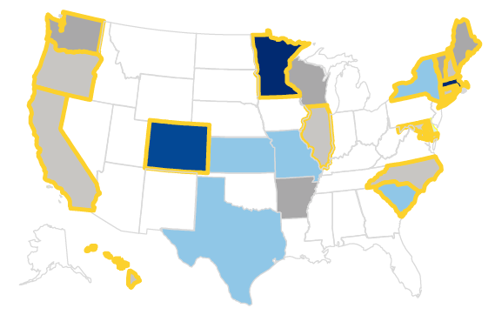
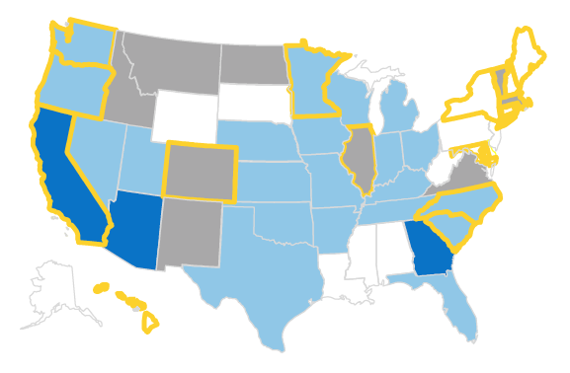
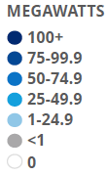
State Policy Drives Substantial Growth
Policy-enabled markets account for 71% of all currently operating community solar capacity.
Figure 1: Third Party Administered Capacity
Figure 2: Utility Administered Capacity
Image Source: Smart Electric Power Alliance. Community Solar Program Design Models. Data from December 31, 2017

Slide 13
Why isn’t Community Solar Everywhere?
31 states across the country without laws that explicitly allow for community solar
Utilities can voluntarily launch community solar programs – but these take time, have historically been offered at an extra cost, and result in limited capacity and available subscriptions
SOLUTION: Statewide programs mandated at the state legislature drive solar projects, create jobs, can include meaningful low-income provisions and may be designed to maximize the customer value proposition.

Slide 14
Case Studies: Individual Projects

Slide 15
Case Study: Denver Housing Authority
Project Location: Colorado
Project Summary:
2 MW community solar project
The project’s output will benefit DHA housing as well as other Low-income Housing Tax Credit and Public Housing Buildings in the Denver metro region
The project offers 15-20% savings average monthly electricity bills for these properties, which flow to residents via reduced and predictable energy rates, etc.
Developer: Denver Housing Authority, in partnership with GRID Alternatives and Namaste Solar
Notes:
https://www.lowincomesolar.org/dha-community-solar-project-keeps-housing-affordable/
DHA developed an innovative financing structure for the project in partnership with GRID, National Housing Trust, Enterprise Community Loan Fund and Monarch Private Capital, as detailed by SEIA (https://www.seia.org/blog/expanding-solar-availability-low-income-community-learnings-denver-housing-authority) . The financial structure was also made possible by higher incentives for the purchase of the project’s RECs by Xcel, supported through innovative bid evaluation factors in Xcel Energy’s Community Solar Request for Proposals, including ‘level of low-income subscribership’ and ‘innovative proposals that benefit low-income subscribers throughout the life of the contract.’ This helps encourage projects like DHA’s within the Xcel community solar program.
Denver Housing Authority (DHA) partnered with GRID Alternatives Colorado and Namaste Solar to develop and install a 2 MW DC community solar project through Xcel Energy’s Solar*Rewards Community Program. The project’s output will benefit DHA housing as well as other Low-income Housing Tax Credit (LIHTC) and Public Housing Buildings in the Denver metro region - properties housing over 700 low-income residents in total. The project will generate savings of over 20% for these properties, which will flow to the residents in the form of additional supportive services. Additionally, the project construction was connected with DHA’s resident workforce training programs, in partnership with GRID Alternatives, to provide 10 DHA residents hands-on and classroom based solar training, and 4 full time paid temp positions to residents who completed the course.
EACH YEAR, this project saves CO₂ emissions from
-- Over 250,000 gallons of gasoline consumed
-- Over 2.5 million pounds of coal burned

Slide 16
Case Study: Statewide Programs

Slide 17
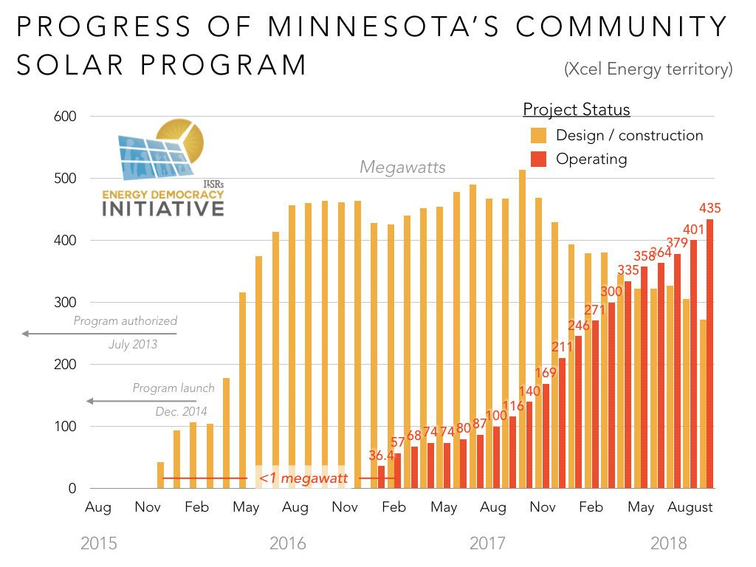
Case Study: Minnesota
Enacted in 2013
Uncapped program that uses value of solar credit rate as opposed to retail rate.
Systems have a 1 MW size limit.
Over 430 MW deployed so far and continues to grow.
https://ilsr.org/minnesotas-community-solar-program/
Notes:
Each year, these 430 MW of community solar can result in 429,934 metric tons of carbon dioxide equivalent that isn’t injected into Minnesota’s local communities.

Slide 18
Case Study: Colorado
Pros
Program started with 5% per project for low-income households.
Applied lessons learned to improve the program structure.
13.5 MW of 100% low-income community solar projects (2017 – 2019)
Include ”affordable housing” in the definition of low-income
Competitive solicitation evaluates bill savings, coordination with energy efficiency measures, and job training
Funding streams and incentives available through 2% rider on all ratepayers bills
Cons
Limited by annual utility solicitations for capacity
Restrictive siting criteria

Slide 19
Case Study: Massachusetts
Part of MA’s net metering program – no difference between Virtual Net Metered (VNM) facilities and non-VNM facilities
Prior State Incentive Program (SREC II applied “factors”
Up to 25% higher SRECs value for affordable housing projects
Result: 202 MW of solar serving affordable housing, the highest in the country per capita.
New incentive program (SMART)
6 cents / kWh adder for projects serving 50% low-income

Slide 20
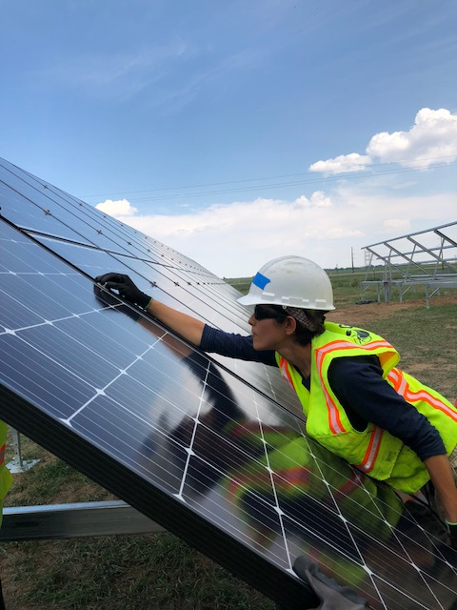
Case Study: New Jersey
Note: Still in rulemaking
Legislation passed in 2018 and signed into law by Governor Murphy
NJ can expect the following economic benefits if 450 MW of distributed community solar is installed between 2019 – 2021
1,778 sustained full-time jobs during construction
$414.7 million in earnings for those employed
$797.9 million in local economic benefits for the state, excepting local tax revenues
$3.3 million from property tax revenues in the first year alone
Notes:
Key Elements
At least 225 MWs in first 3 years, permanent program to follow (minimum capacity is 225 MW but Board of Public Utilities has authority to increase capacity in years 2 and 3)
5 MW system size limits
40% of program for LMI projects, which must be at least 51% LMI subscribers.
Board of Public Utilities may set minimum percentage requirements for residential subscribers
Takeaways from legislation and proposed rules: starting to see strong commitments to expanding access to underserved communities and realizing that there need to be clear rules to serve residential customers

Slide 21
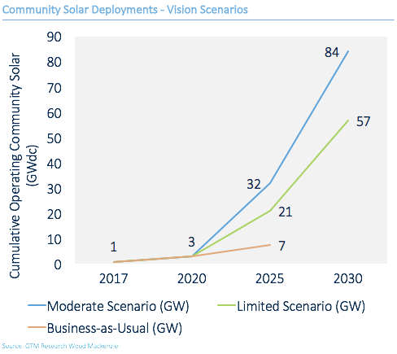
Community Solar is small today — but It can rapidly become a mainstream energy source
U.S Community Solar can grow 50 – 80 times its current size by 2030
Notes:
U.S Community Solar can grow 50 – 80 times its current size by 2030
Annual Share of National Electricity Consumption: 1.6% - 2.6%
Subscribers Served: 6.4 million to 8.8 million
Low- and Moderate-Income Households Supported: 3.5 million to 4 million
Cumulative Capital Invested*:$8.1 billion to $121 billion

Slide 22
Relevant Resources
National Renewable Energy Laboratory State Considerations for Designing Community Solar Policy
https://www.nrel.gov/docs/fy18osti/70663.pdf
Coalition for Community Solar Access Resource and Policy Decision Matrix
http://www.communitysolaraccess.org/wp-content/uploads/2016/03/CCSA-Policy-Decision-Matrix-Final-11-15-2016.pdf
Vote Solar and GRID Alternatives Low Income Solar Policy Guide, Community Solar
http://www.lowincomesolar.org/practices/community-solar/
Interstate Renewable Energy Council (IREC) Guiding Principles & Shared Solar Catalog:
https://irecusa.org/regulatory-reform/shared-renewables/
IREC and Vote Solar’s Voluntary Utility-Led Community Solar Program Checklist
https://votesolar.org/cschecklist
The Vision for U.S. Community Solar: A Roadmap to 2030
https://votesolar.org/csvision
Clean Energy States Alliance Bringing the Benefits of Solar Energy to Low-Income Consumers
https://www.cesa.org/projects/sustainable-solar/resources/resource/bringing-the-benefits-of-solar-energy-to-low-income-consumers

