Slide 1
NASUCA Annual Meeting Grid Mod Strategy for Consumer Advocates
Ron Nelson
November 13, 2018

Slide 2
Strategen provides insight to global corporations, utilities and public sector leaders, helping them to develop impactful and sustainable strategies for a transforming grid

Slide 3
Overview
Grid mod is changing the operational capabilities of grid assets
Utilities’ economic incentives are not aligned with utilizing many capabilities to maximize customer benefits
Grid mod creates additional responsibilities for consumer advocates
Strategy - set goals, link outcomes and create a roadmap for execution

Slide 4
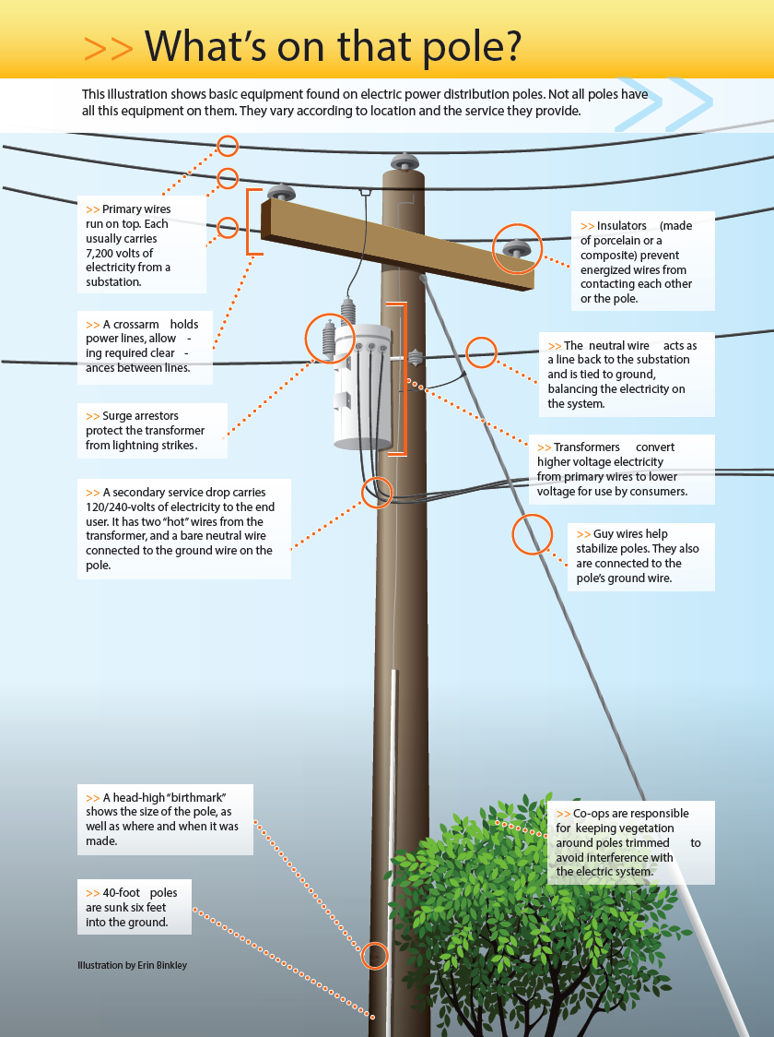
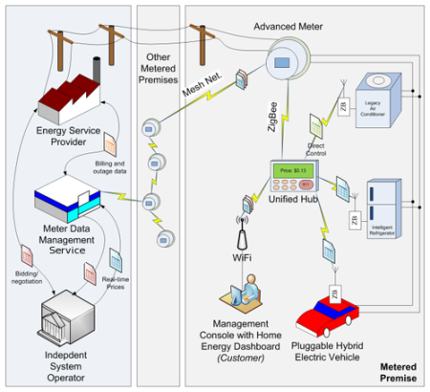
Passive to active functional capabilities
Traditional
Modern
Grid mod creates data that CAN be used to change processes and behavior
Left image: http://www.ceci.coop/content/why-electric-co-ops-replace-utility-poles Right Image: Illinois Security Lab

Slide 5
Economic incentives are not aligned
Meter reading costs
Utility
Remote outage detection
Many benefits are operational cost reductions
Customer Service
AMI Benefits
Remote diagnostics
Advanced rate design
Customer Benefits
More informed decisions
Many benefits are created through reduced capital expenditures
Less outages
Improved equity (?)
Consumer advocates need to identify perverse economic incentives

Slide 6
The role of consumer advocate’s is changing
Traditional evaluation
Financial review
Used and useful
Prudence
Consumer protection
Modern evaluation adds some of the following responsibilities
Understanding potential benefits associated with technological investments
Identifying perverse economic incentives
Proposing beneficial programs and tariffs
Developing performance metrics for accountability
Consumer advocate’s need to play defense AND offense

Slide 7
Grid mod action areas
Equity/Low-income
Cost classification and allocation
Traditionally demand/customer
Modern demand/energy
RAP¹ and MN Docket 16-664
AMI
Commercial rate design
Residential rate design
TOU – MN Docket 17-775
Grid services tariffs
Hawai’i Docket 2018-0163
Performance-based regulation
Multi-year rate plan
Performance metrics MN Docket 17-401
Utilities do not have an economic incentive to propose efficient use of grid mod assets
1) Smart rate design for a smart future (2015)

Slide 8
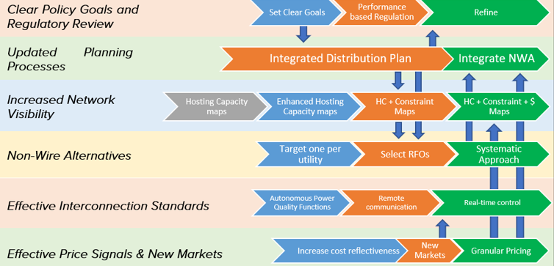
Develop a strategy to achieve goals
Determine goals, link outcomes then develop a roadmap for execution

Slide 9
Thank You
Ron Nelson
Manager
Strategen Consulting
Email: rnelson@strategen.com
Web: www.strategen.com

