Slide 1
Exelon: An Industry Leader
Note: All numbers reflect year-end 2016; revenue accounts for PHI as of the merger effective date of March 24, 2016 through December 31, 2016.

Slide 2
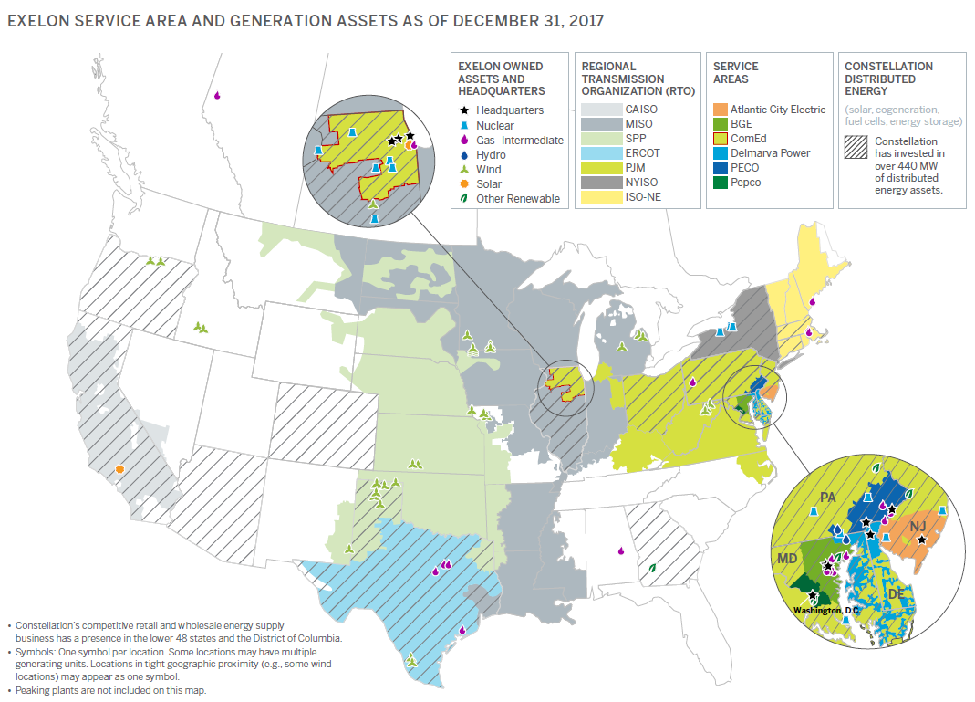
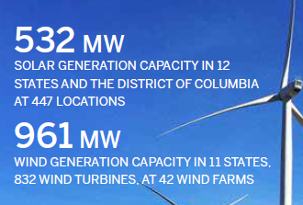
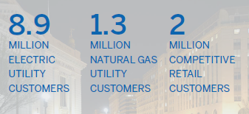
Clean Generation and Innovative Customer Services
Provide electricity and/or natural gas through ACE, BGE, ComEd, DPL, PECO, Pepco and Constellation.
Lowest owned generation fleet CO₂ emission rate out of top 20 investor-owned companies, with more than 35,000 MW of capacity.
2

Slide 3
Exelon Utilities – ACE, BGE, ComEd, DPL, PECO, Pepco
Note: Rate base number is Exelon and PHI combined and denotes year-end; revenue number accounts for PHI revenue as of March 24, 2016 merger date.

Slide 4
What’s Happening on Storage in Our Jurisdictions?
DC: Grid modernization proceeding will likely consider storage. Ambitious renewable goals and likely high EV penetration will necessitate storage in the future.
DE: EV proposal includes V2G school bus pilot.
IL: Microgrid demo with storage component approved; storage for back up power purposes only in this demo.
MD: Grid modernization proceeding includes a storage working group that has coalesced around a pilot proposal to test four business/regulatory models that allow for different stakeholder roles to be explored and understood.
NJ: Ambitious new energy plan with a significant storage component. A year of study about to begin. EV proposal includes V2G school bus pilot.
PA: Considered a bill this session to authorize utility microgrid and storage demos. Likely to move next year.

Slide 5
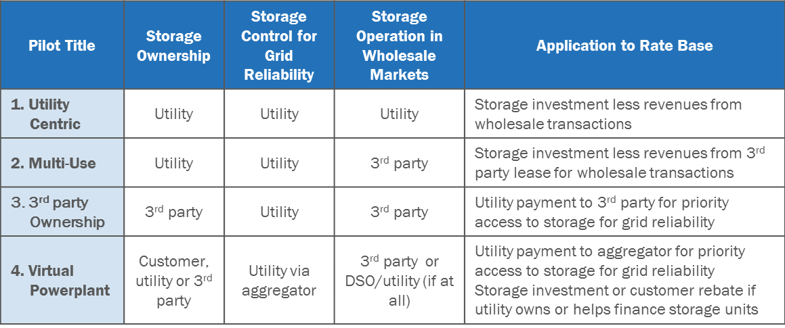
Maryland -- Storage Business Models
Currently, making distribution system storage projects pencil out on just grid reliability is difficult.
For most projects, they only make economic sense if you can tap multiple value streams. There are various business models that allow this type of value stacking. We need to learn how each would work to maximize consumer value.
We conducted two hours sessions held individually with Fluence, Tesla, Stem, Lockheed Martin, RES, NEC and ABB to determine both experience with and interest in executing pilots under each model.

