Slide 1
Forecasting load on the distribution and transmission system with distributed energy resources
Andrew D. Mills
Berkeley Lab
National Association of State Utility Consumer Advocates Distribution Technology Training
Minneapolis, MN on June 24, 2018
Notes:
Focus of the discussion will be on forecasting adoption of DER, primarily customers adoption of distributed PV
Primary challenge to utility planners: adoption of DER is exogenous – planners don’t directly decide how much, what kind, where and how to operate. Customer behavior (and response to incentives) is part of the equation. Since it is happening at the grid edge, planners do not have perfect visibility of this behavior.
Pulling from research that we’ve conducted, funded primarily by the DOE Solar Energy Technologies Office.

Slide 2
Importance of Including Distributed Energy Resources in Load Forecasts
Distribution system investments: replacing aging infrastructure and distribution expansion
Procurement of generating capacity to meet peak demand
Proactive investments to increase hosting capacity
Evaluating the costs and benefits of incentives or policies to promote distributed energy resources (DER)
Notes:
Why is it important to include distributed energy resources in forecasts?
Utilities base many investments on an identified need, that need changes as customers add DER. In some cases the need is reduced or deferred, in others the need may increase.
DER can defer certain distribution system investments.
DER can defer the need to procure generation capacity to meet peak demand
Accommodating DER on the distribution grid may require investments – can be reactive in response to interconnection requests or can be proactive in order to enable growth in DER before interconnection requests.
Forecasts of DER adoption also may figure into analysis of the costs and benefits of DER programs. Initial investments (incentives, equipment) can spur future adoption, is it worth it?
In the next few slides, I’ll walk through each of these in a little more detail.

Slide 3
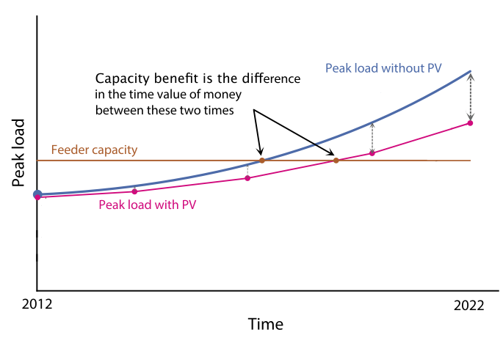
Impact of DPV on T&D Investments:
Potential Deferral Value
Source: Adapted from Cohen et al. 2016
Notes:
Here is a chart from recent research in California that quantifies the benefit of distributed PV from deferring T&D investments.
The primary driver of the value comes down to comparing the forecast of peak load at distribution level with and without DPV. Lowering peak load growth can defer the timing of when investments will be needed.
The deferral of this investment has economic value on a net present value basis.
This particular research found significant variation in this deferral value of PV, with the greatest value ($60/kW-yr) where assets are nearly fully loaded and peak load is growing. Majority of locations (99%of circuits) deferral value was very low.

Slide 4
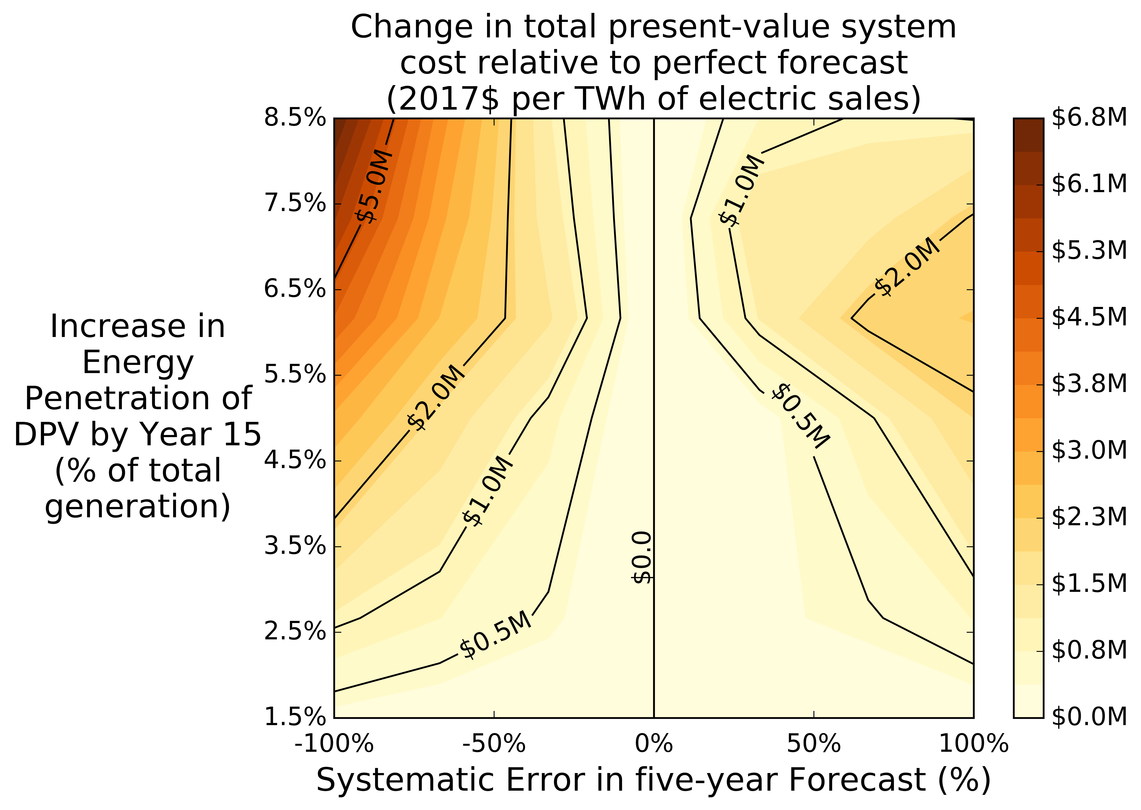
Increasing Adoption of DER Increases the Importance of Accurate Forecasts in Planning
Costs of roughly $70 million from severe underforecasting and $20 million from severe overforecasting for a utility with sales >10TWh/yr and with up to 8.5% of sales from DPV by the end of a 15-year period
Source: Gagnon et al. (2018)

Slide 5
Planning for a Distributed Disruption: Innovative Practices for Incorporating Distributed Solar into Utility Planning
Approach
Context
Growth in DPV has critical implications for utility planning processes, potentially affecting future infrastructure needs.
Comparative analysis and evaluation of roughly 30 recent planning studies, identifying innovative practices, lessons learned, and state-of-the-art tools.
Scope
Electric infrastructure planning (IRPs, transmission, distribution).
Focus on the treatment of DPV, with emphasis on how DPV growth is accounted for within planning studies.
Analysts project that distributed solar photovoltaics (DPV) will continue growing rapidly across the United States.
Appropriate techniques to incorporate DPV into utility planning are essential to ensuring reliable operation of the electric system and realizing the full value of DPV.
Notes:
Motivated the need for DER forecasts and various places within distribution planning that these forecasts fit in.
Now I’ll go into details on emerging techniques for incorporating DPV into planning based on research jointly conducted between the Berkeley Lab and NREL.
Summarized in a report called Planning for a Distributed Disruption, link to full report in the References section of these slides.
We looked at roughly 30 recent planning studies that included utility IRPs, transmission planning documents, and distribution planning documents
How did they account for DPV in planning: what were innovative practices, lessons learned, and state-of-the-art tools.

Slide 6
Key Findings
Forecasting load with DER is often “top-down”: separately forecast load and quantity of DER at the system level, allocate that system forecast down to more granular levels.
Many factors affect customer decisions to adopt DER, including the cost and performance of DER, incentives, customer retail rates, peer-effects, and customer demographics. Customer-adoption models can help account for many of these factors.
Forecasts are uncertain: It may be valuable to combine various approaches and to benchmark against third-party forecasts.
Notes:
Some of the key findings from this report:
Most planning studies focus on a top-down forecast of DPV: focus on the total quantity, then allocate that down to more granular locations within the system, rather than forecasting at each individual area and aggregating up. Expectation is that system-level forecasts are going to be more accurate.
DER adoption by customers is driven by many different factors. Customer-adoption models can provide a helpful framework for accounting for many of these factors.
Forecasts are uncertain. It may be prudent to combine various approaches to developing forecasts and benchmark forecasts against 3rd party forecasts.

Slide 7
High End of 3rd Party Forecasts Suggests More DPV Than Considered By Utilities
Notes:
We compared the planner forecasts to industry forecasts (GTM, BNEF) and NREL’s dSolar, range of other forecasts shown with orange bars.
Not surprisingly, Hawaii has highest projected penetration. They considered a wide range of DPV adoption scenarios, though the 2020 projections are lower than recent industry forecasts.
Who is bullish on solar:
Entergy La – Distributed Disruption scenario for the upper bound, historical trend with no new installs after 2017 in lower bound. Upper bound may include CHP too.
Duke Energy Indiana – Stakeholder-inspired “Increased Customer Choice” scenario
PacifiCorp: Customer-adoption modeling with low and high penetration case, determined by potential changes in technology cost assumptions, technology performance assumptions, and future electricity rate assumptions
Who is bearish on solar:
APS & TEP relative to NREL in 2030, utility primarily driven by RPS requirement of 15% by 2025, with 30% coming from DG (4.5% in 2025), TEP looked at case where even less DPV would be adopted. dSolar driven by customer economics
Georgia Power: Primarily based on program goal, dSolar driven by customer economics
PNM: Not clear how they developed the forecast, judgment?

Slide 8
A Variety of Methods are Used to Develop DPV Forecasts
Notes:
Range of approaches were used including:
- extrapolation based on recent trends (NV Energy),
setting forecasts based on program goals (APS, TEP, Georgia Power),
developing stipulated “what-if” scenarios (Duke Indiana- stakeholder driven, Hawaii four scenarios),
and the use of customer-adoption models (PG&E lower from CEC, PSE from Cadmus, PacifiCorp from Navigant).

Slide 9
DPV Deployment Drivers
DPV economics:
  DPV technology cost and performance
  Federal and State incentives
  New business models (e.g., third party ownership)
  Electricity prices
  Rate design (including the availability of Net Energy Metering)
Public policy:
  Renewables Portfolio Standards and environmental requirements
  CO₂ regulation
Customer preferences:
  DPV deployment may be shaped by interest in increased customer choice
Macro factors:
  Economic growth, load growth, oil prices, and cost and availability of complementary technologies (e.g. storage and electric vehicles)
Notes:
In developing these forecasts we looked at what were considered as the main drivers behind DPV growth.
Customer economics were a major driver: declining technology cost, but also incentives and rate level and rate design
Some utilities considered other public policy factors that do not directly affect customer economics, but may indirectly. RPS and environmental requirements -> scenarios with higher costs lead to higher rates more adoption of DPV
Customer preferences: aside from customer economics, customers may also adopt for other driven by individual preferences, or marketing.
Some of the utilities also cite macro factors that could affect adoption of DPV deployment – the direct connection it not clear, but these could be correlated – particularly around complementary technologies: e.g. customers with EV may also want PV panels to be able to charge EV with solar power.

Slide 10
Customer-adoption Modeling Brings Customer Decisions Into DPV Forecast
Method | Description | Predictive Factors Used
 |  | Recent installation rates | Incentive program targets | Technical potential | PV economics | End-user behaviors
Stipulated Forecast | Assumes end-point DPV deployment
Historical Trend | Extrapolates future deployment from historical data | X
Program-Based Approach | Assumes program deployment targets reached |  | X
Customer-Adoption Modeling | Uses adoption models that represent end-user decision making | X |  | X | X | X
Notes:
In our report we compared the factors that go into the different forecasting methods used in practice.
Four methods are
- the stipulated forecast which assumes a particular end-point based on qualitative factors.
Extrapolating deployment based on observed deployment rates
Basing the forecast on program targets
Customer adoption models
The advantage of the customer adoption models is that they provide a framework for combining several different predictive factors that can impact adoption.

Slide 11
Some Planners Use Customer-adoption Models for DPV Forecasting
Technical Potential
Willingness-to-adopt
Diffusion
Adapted from: Gagnon et al. 2016
*illustrative
*illustrative
Notes:
Customer-adoption models create a forecast that accounts for the decision of customers to install PV based on customer economics and diffusion of technology behaviors (imitators).
the first step is detailed screening of target population that filters out non-appropriate households and generates a technical potential number
the second step is a willingness-to-adopt curve that converts PV economics to the market potential (usually in % of the technical potential) that market penetration could ultimately achieve given enough time; and
the third step is a S-type curve that produces the annual adoption rate given the market potential, where the Bass diffusion model and the Fisher-Pry model are two of the most popular options
Lower forecast of PG&E came from CEC customer adoption model
PSE hired Cadmus: looked at growth with current planned expiration of incentives vs. if incentives were to continue indefinitely
PacifiCorp from Navigant: Low and high penetration case, determined by potential changes in technology cost assumptions +/-10% cost reduction per year , technology performance assumptions (+1% performance high DG, -5% performance low DG), and future electricity rate assumptions (+/- 0.5%/yr relative to base case)
Why do it?
What are limitations?
Following slides will go into each of these steps in more detail

Slide 12
Technical Potential Estimates Are Typically Based on Customer Count and Rooftops
Technical potential studies used by utilities in our sample of studies were based primarily on customer counts and floor space surveys
  Rooftop space is based on average number of floors and assumptions about the density of PV arrays
New emerging tools like Light Detection and Ranging (LiDAR) imaging can refine technical potential estimates:
  Infer shading, tilt, and azimuth from rooftop images
  Apply availability constraints to exclude unsuitable orientations or insufficiently large contiguous areas
Can also refine with permitting and zoning restrictions, if applicable
Notes:
Technical potential establishes the total upper bound on the size of the market.
Studies commonly assume that rooftop space is the limiting factor for customer adoption
Simple: customer count and floor space -> assume certain number of floors and how dense PV arrays can be on rooftops
Emerging tools: LIDAR data can make much more refined estimates of available rooftop space.
If DPV is not limited to being on customer premises, then technical potential is much larger.

Slide 13
Factors Affecting Customer Economics of DPV Can Significantly Affect Forecasts
Willingness-to-adopt curve translates the payback period of DPV to ultimate share of the technical potential.
Payback period depends on both the cost to the consumer and the consumer bill savings
The cost to the consumer will be affected by declining costs of DPV and availability of incentives (e.g. the investment tax credit).
The consumer bill savings depend on rate levels, rate design, and availability of Net Metering.
PacifiCorp forecast of DPV created a High and Low forecast by varying factors impacting customer economics:
  DPV cost, DPV performance, and electricity retail rate escalation
Notes:
Next is to look at how customer economics affects the ultimate share of technical potential that will be achieved. This is major factor in forecast.
PacificCorp used customer adoption model, three lines show how different forecast could be by changing assumptions that change estimate of customer economics.
-- High forecast assumes lower cost of DPV, better performance, and higher retail rate escalation
The linkage between the ultimate adoption rate and all the factors that go into the customer economics is the willingness-to-adopt curve which translates pay-back period into ultimate DPV share.
The payback period for the customer is based on both the cost of DPV and the bill savings

Slide 14
Rate Design Can Significantly Affect Adoption of Distributed PV
Source: Darghouth et al. 2016
Notes:
Research from Berkeley Lab looked at how different rate designs impact the customer economics of DPV and the eventual deployment.
Results are based on NREL’s customer adoption model.
Reference case shows continuation of current rate designs for commercial and residential customers, all with net metering.
Changing rate design from this reference can significantly affect adoption rates.
Most notable is that increasing the customer fixed charge results in lower bill savings and significant reduction in forecast of deployment.
Putting all customers on a time varying rate (TOU with peak and off peak periods) lower adoption in later years. Why? With higher PV penetration the on-peak periods shift away from times of high PV production, lowering bill savings. Doesn’t happen under flat rates, so flat rates for all customers sees higher adoption.
Partial net metering where net production is compensated at avoided cost rate rather than full retail rate lowers deployments.
Forecast is bounded by a high or low FiT -> importance of customer economics in ultimate share.

Slide 15
Forecasters Tend to Rely on Similar Willingness-to-adopt Curves
Note: Dashed gray lines (WECC) are for existing buildings,
and dotted gray lines are for new buildings.
Notes:
Relationship between customer economics and ultimate share is the willingness-to-adopt curve.
These curves are the actual assumptions used in various customer adoption models.
Similar curves are used across various studies: good in that there is agreement. However not usually based on independent empirical measurements, many trace back to studies of adoption of other technologies from back in the 80s. Limitation in current studies.

Slide 16
Innovative Business Models Shift Focus from Payback to Monthly Bill Savings
Payback period is not a useful metric for systems that are leased from a third party
Willingness-to-adopt curves can also be defined in terms of monthly bill savings
Notes:
New business models do not require customers to pay full cost upfront. Makes traditional “payback period” metrics less relevant.
New models from NREL used surveys to estimate new willingness-to-adopt curves based on monthly bill savings. More relevant for the third-party ownership model where customers lease PV.
EPRI has also done survey work along these lines.

Slide 17
Diffusion of Technology Impacts Time to Achieve Ultimate Market Share
Source: Meade and Islam (2006)
The Bass diffusion model and Fisher-Pry model are two common choices that produce the characteristic “S-Curve” in adoption.
Notes:
Once you have estimated the ultimate market share, an forecast also requires assessing how fast a market will get to the ultimate share.
Requires thinking about the way that new technologies diffuse into the markets.
Typical idea that you’ll have early adopters , followed by widespread adoption and laggards
Leads to an S-Shaped curve.
Two models of this diffusion behavior are the Bass diffusion model and the Fisher-Pry model

Slide 18
Diffusion Curves for DPV Forecasts Are Often Based on Fits to Data, and Can Vary Widely
Important feature of diffusion curves is that period of rapid adoption can follow period with relatively low shares of adoption.
Similar behavior has been observed for several consumer durable goods including refrigerators, VCRs, internet access, and mobile phones.
Notes:
The importance of these S-Shaped curve is that a period of rapid adoption can occur following periods with relatively low shares.
Several consumer durable goods exhibit this behavior.
The difficulty is in defining when the rapid adoption portion begins. Different models used in practice seem to have very different assumptions.
This is often based on some fit to observed behavior, can be based on other markets as an analog. Is it a good analog? Is there a better way to estimate it for your region/area?

Slide 19
Propensity to Adopt Accounts for Factors Like Customer Demographics
Method | Description | Predictive Factors Used
 |  | Location of existing load or population | Location of existing DPV | Detailed customer characteristics
Proportional to Load | Assumes DPV is distributed in proportion to load or population | X
Proportional to Existing DPV | Assumes DPV grows in proportion to existing DPV |  | X
Propensity to Adopt | Predicts customer adoption based on factors like customer demographics or customer load | X | X | X
Notes:
To complement these top-down forecasts, distribution planners also need to determine where it will occur.
Better estimates of where DPV is likely to be adopted can improve estimates of the impacts of DPV on the T&D system.
We again compared different methods for allocating down to particular levels by looking at what factors were used in the methods.
Three general approaches used to estimate the location of DPV:
Assume DPV is distributed in proportion to load or population: But analysis of previous DPV adoption patterns indicates that factors like demographics do influence DPV adoption. As demographic factors tend to cluster in different neighborhoods and cities throughout a service territory, DPV adoption patterns are unlikely to only follow the load.
Assume DPV grows in proportion to existing DPV or based on recent interconnection requests: For a simple assumption, DPV adoption is more likely to occur in areas where DPV is already starting to be adopted.
Estimated based on customer propensity to adopt DPV: If resources are available to conduct a more refined assessment, propensity to adopt DPV can be estimated based on detailed demographic and household-level information. The propensity to adopt can then be used to identify particular locations where DPV growth is expected.

Slide 20
Predicting the Location of DPV Adoption Using Propensity to Adopt
Source: PG&E 2015 DRP
Notes:
For its Distribution Resources Plan, PG&E developed a logistic regression to predict the probability of a customer adopting DPV. They fit the regression using information about previous DPV adopters, then apply it to all customers to allocate DPV growth to individual feeders.
Brown area shows where largest amount of DPV is expected to occur.

Slide 21
Factors Considered in PG&E’s Propensity to Adopt Metric
Residential Customers:
  Home ownership
  Electricity usage
  Income
  Credit
  Building characteristics (area, number of stories)
Non-Residential Customers:
  Property Ownership
  Electricity usage
  Retail Rate
  Business type (NAICS)
  Building characteristics (area, number of stories)
Propensity to adopt metric is then used to allocate system forecast down to customers.
Source: PG&E presentation to DRPWG (4/2017)
Notes:
For residential customers, the factors that are used to predict adoption include information about the housing, customer demographics, electricity consumption, and geography. For non-residential customers the factors include the customer sector, electricity consumption, and the tariff.

Slide 22
Advances in Customer Adoption Modeling
Agent based models simulate actions and interactions of agents to assess their individual effects on a larger system.
  Allows for better representation of heterogeneity of customers and more complex decision-making criteria
Discrete choice models have a well defined methodology for soliciting customer preferences and can model competition between several options
  Provides framework for empirically derived forecasts
Some open questions:
  How might consumption change after adoption of DPV: is there a rebound effect?
  How does the willingness-to-adopt curve vary across customer segments?
  How does customer adoption of DPV compare to customer demand for community solar? Do these two options compete directly for market share or are they complementary?
Notes:
Limitations in existing DPV forecasting methods
-- separating willingness to adopt and diffusion, then separate propensity to adopt to allocate down is a little adhoc
More complex decision making criteria -> agent based modeling to do bottom-up modeling, calibrated to system-wide observations.
-Discrete choice models described in the report that does a better job of creating a data-driven forecast.
Few questions that we did not see detailed answers to in existing planning studies:
-

Slide 23
Additional Challenges: Removing DER from Historical Load to Create Accurate Load Forecasts
PJM recently adjusted load forecasting methodology to better account for behind-the-meter PV
Original approach used the observed load to forecast future load, without adjusting for effect of behind-the-meter DPV on the observed load
  Load reductions from behind-the-meter DPV were being attributed to new end uses in the load forecasting model
Revised approach removes estimate of historical PV before forecasting load, then adds back in forecast of DPV to new net load forecast
Historical
Load forecast (w/o DPV)
Actual load (w/o DPV)
Combined load forecast and DPV forecast
Historical observed load (embeds DPV)
Forecast DPV
Historical DPV
Additional detail: Falin (2015)
Notes:
One other challenge in the context of load forecasting: For the most part we’ve been taking about separate forecasts of load and DPV, that are then added together to get the net load forecast.
One issue with this is that load forecasting is often based on historical observations of load. As more DPV is adopted, the observed load will embed more and more DPV.
If you use this “net load” in the forecast, then behind the meter will be attributed to some sort of new end use in the load forecasting model. PJM recently recognized this problem and started to estimate the “actual load” during the historical period by adding back in the estimated historical PV.
Then use this “actual load” for the load forecasting models, and combine load forecast without DPV to the DPV forecast to get the right net load forecast.
PJM doesn’t meter historical PV production, so they need to back cast is based on historical cloud cover and system information. Generate hourly historical profile.

Slide 24
More Examples of DER in Transmission Plans
Evaluating DPV as a resource option:
  CAISO transmission planning process identifies transmission needs to meet reliability criteria, then examines feasibility of meeting needs with DPV.
  If CAISO finds it is feasible to meet needs with increased DPV, information is passed onto CPUC and utilities to determine if programs to encourage additional DPV would be cost-effective.
Locating DPV within the system:
  ISO-NE and NYISO use the load-zone-level DPV forecast in their capacity markets and transmission planning. PJM adjusts the load-zone peak demand by the on-peak contribution of DPV for its capacity market and transmission planning.
Peak demand reduction (i.e. transmission level capacity credit):
  ISO-NE and PJM use a stricter definition of peaks in transmission planning than for the capacity market.
Consistent scenarios across planning forums:
  CAISO/CPUC/CEC coordination, NYISO Gold Book, ISO-NE 10-year regional planning process to coordinate assumptions

Slide 25
Forecasting Other Distributed Energy Resources
Some DER are similar to DPV :
  Systems can be installed either in-front-of- or behind-the-meter
  Adoption can occur for residential, commercial, or industrial customers
These technologies have yet to see significant adoption due to higher cost or other barriers, but adoption might increase in the future. Similar forecasting tools and models can be used for these emerging technologies.
Other DER systems are different in that the system cost, performance, and design are specific to individual customers and systems tend to be larger (e.g., CHP units)
In these cases, local knowledge from distribution planners might be more useful than the top-down methods described here.
Notes:
Majority of focus was on DPV but we also looked at other DER to a limited extent.
Some similar issues may apply to DER and the tools and techniques might be helpful, though there remain other barriers like cost.
In cases where the DER cost, performance and design are unique to particular customers, these top-down methods may not be as useful. Instead, local knowledge from distribution planners might be more appropriate.

Slide 26
Key Questions for Regulators About DER Forecasts
What are the primary factors that drive your forecast of DER adoption? How do you consider customer economics and factors that might affect customer economics within the forecasting horizon?
How do you account for the tendency for adoption of technologies to follow an S-shaped curve?
How does your forecast compare to forecasts from third parties for the same region?
How do you account for factors that might be uncertain such as availability of future incentives, technology cost, or customer choice?
Do you use a top-down method to forecast DER adoption at the system level? If so, how do you allocate that forecast down to the distribution level? Do you account for differences in customer demographics?
Notes:
Summarize with a set of key questions that regulators may want to ask about DER forecasts:
-

Slide 27
References
Gagnon, P., G. Barbose, B. Stoll, A. Ehlen, J. Zuboy, T. Mai, A. Mills. 2018. Estimating the Value of Improved Distributed Photovoltaic Adoption Forecasts for Utility Resource Planning. NREL/TP-6A20-71042. Golden, CO: National Renewable Energy Laboratory; Berkeley, CA: Lawrence Berkeley National Laboratory.
Mills, A.D., G.L. Barbose, J. Seel, C. Dong, T. Mai, B. Sigrin, and J. Zuboy. 2016. Planning for a Distributed Disruption: Innovative Practices for Incorporating Distributed Solar into Utility Planning. LBNL-1006047. Berkeley, CA: Lawrence Berkeley National Laboratory. http://dx.doi.org/10.2172/1327208.
Cohen, M.A., P.A. Kauzmann, and D.S. Callaway. 2016. “Effects of Distributed PV Generation on California’s Distribution System, Part 2: Economic Analysis.” Solar Energy, Special Issue: Progress in Solar Energy, 128(April): 139–152. doi:10.1016/j.solener.2016.01.004.
Darghouth, N.R., R.H. Wiser, G. Barbose, and A.D. Mills. 2016. “Net Metering and Market Feedback Loops: Exploring the Impact of Retail Rate Design on Distributed PV Deployment.” Applied Energy 162(January): 713–722. doi:10.1016/j.apenergy.2015.10.120.
Edge, R., M. Taylor, N. Enbar, and L. Rogers. 2014. “Utility Strategies for Influencing the Locational Deployment of Distributed Solar.” Washington D.C.: Solar Electric Power Association (SEPA). https://sepapower.org/knowledge/research/.
EPRI (Electric Power Research Institute). 2015. Distribution Feeder Hosting Capacity: What Matters When Planning for DER? Palo Alto, CA: Electric Power Research Institute. http://www.epri.com/abstracts/Pages/ProductAbstract.aspx?ProductId=000000003002004777.
Falin, T. 2015. “Manual 19 Changes: Distributed Solar Generation in the Long-Term Load Forecast.” Presented at the Markets & Reliability Committee, PJM, December 17. http://www.pjm.com/~/media/planning/res-adeq/load-forecast/solar-forecast-presentation.ashx.
Meade, N., and T. Islam. 2006. “Modelling and Forecasting the Diffusion of Innovation – A 25- Year Review.” International Journal of Forecasting 22(3): 519–545. doi:10.1016/j.ijforecast.2006.01.005.
Navigant Consulting, Inc. 2016a. Virginia Solar Pathways Project: Study 1 - Distributed Solar Generation Integration and Best Practices Review. Richmond, VA: Dominion Virginia Power.
Pacific Gas & Electric. 2015. Distribution Resources Plan. San Francisco, CA: California Public Utilities Commission. http://www.cpuc.ca.gov/WorkArea/DownloadAsset.aspx?id=5141

