Slide 1
U.S. Offshore Wind Update
Hannah Hunt
Deputy Director, Electricity Policy and Demand
American Wind Energy Association

Slide 2
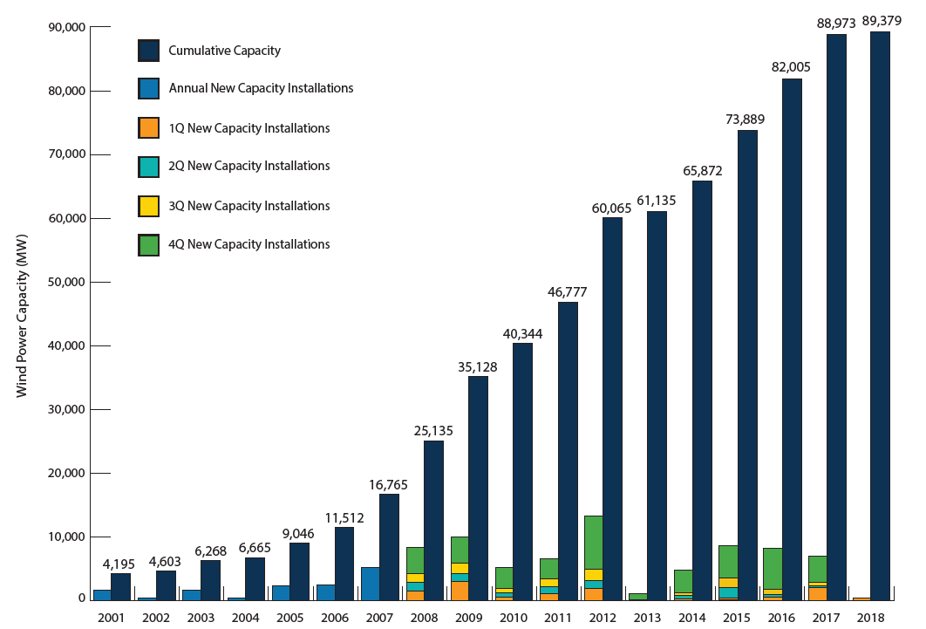
U.S. Annual and Cumulative Wind Capacity Growth
U.S. wind power capacity more than tripled since 2008
Wind now #1 renewable energy capacity source
Over 7 GW added in each of last three years
Source: AWEA U.S. Wind Industry First Quarter 2018 Market Report
Notes:
In recent years, wind has been one of the largest sources of new electric generating capacity
The U.S. is on track to generate 10% of its electricity using wind by 2020

Slide 3
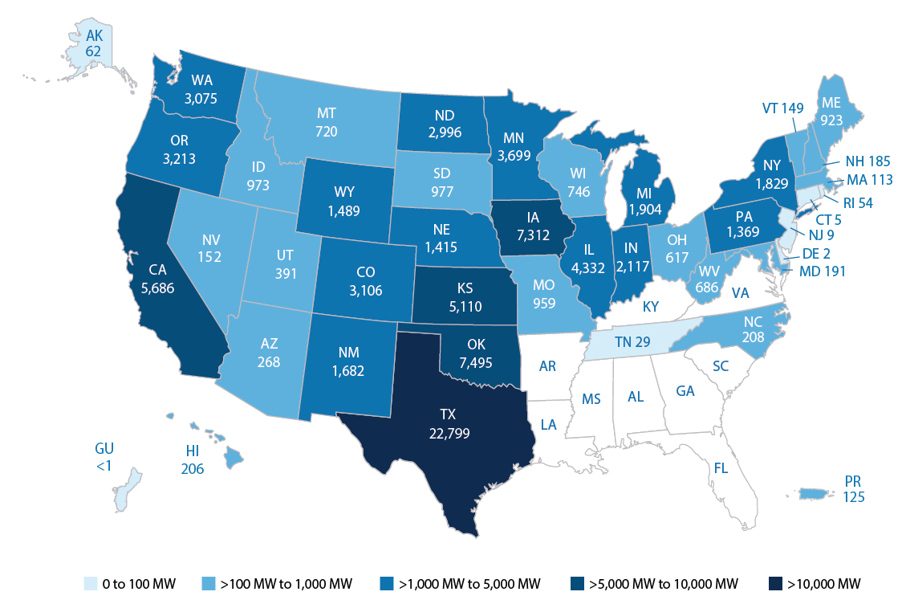
Wind Power Capacity in 41 States, Guam, and Puerto Rico
Top 5 States
Texas
Oklahoma
Iowa
California
Kansas
North Carolina the newest state
Source: AWEA U.S. Wind Industry First Quarter 2018 Market Report
Notes:
There are wind jobs in all 50 states
Over 500 U.S. factories build wind-related parts
Every state has either a wind farm, wind factory, or both
Wind tech, along with solar installer, is one of the country’s 2 fastest growing jobs according to the U.S. Bureau of Labor Statistics

Slide 4
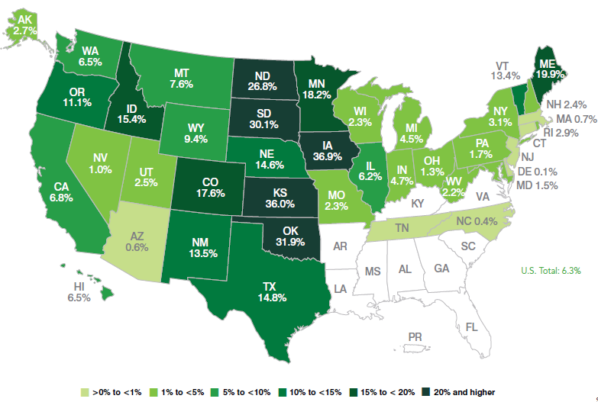
Wind Energy Provided 6.3% of U.S. Electricity in 2017
Enough installed capacity to power the equivalent of 27 million American homes
Four states generated more than 30% of their electricity from wind
Source: AWEA U.S. Wind Industry Annual Market Report Year Ending 2017
Notes:
These figures prove that wind is a reliable, mainstream part of the U.S. electricity mix
We’re not a niche player anymore– Americans depend on wind to help keep the lights on
A total of 14 states generated more than 10% of their electricity from wind

Slide 5
Wind Power is Reliably Integrated
Every grid operator experienced a new wind generation record in 2017
Wind turbines provide essential grid reliability services, including disturbance ride-through, reactive and voltage control, primary frequency response, and flexibility
Source: AWEA U.S. Wind Industry Annual Market Report Year Ending 2017
Notes:
Wind has helped improve system reliability by keeping the lights on and savings consumers money during extreme weather events
For example, during 2014’s Polar Vortex wind saved Great Lakes and Mid-Atlantic consumers over $1 billion in just 2 days
Wind output has similarly been strong when coal piles in Texas have flooded or frozen

Slide 6
Notes:
The first offshore wind farm came online in 2016; Deepwater Wind installed 5 turbines (30 MW) off the coast of Rhode Island.
At the end of last year, there were 14 proposed offshore wind projects in 10 states in various stages of development.
As we continue to invest in and develop this homegrown resource, costs will continue to drop and value to consumers will grow.
In recent announcements, New Jersey committed to 3.5 GW of offshore wind by 2030, Rhode Island announced plans to build a 400 MW offshore wind farm and Massachusetts announced plans to build an 800 MW offshore wind farm, Connecticut procured 200 MW

Slide 7
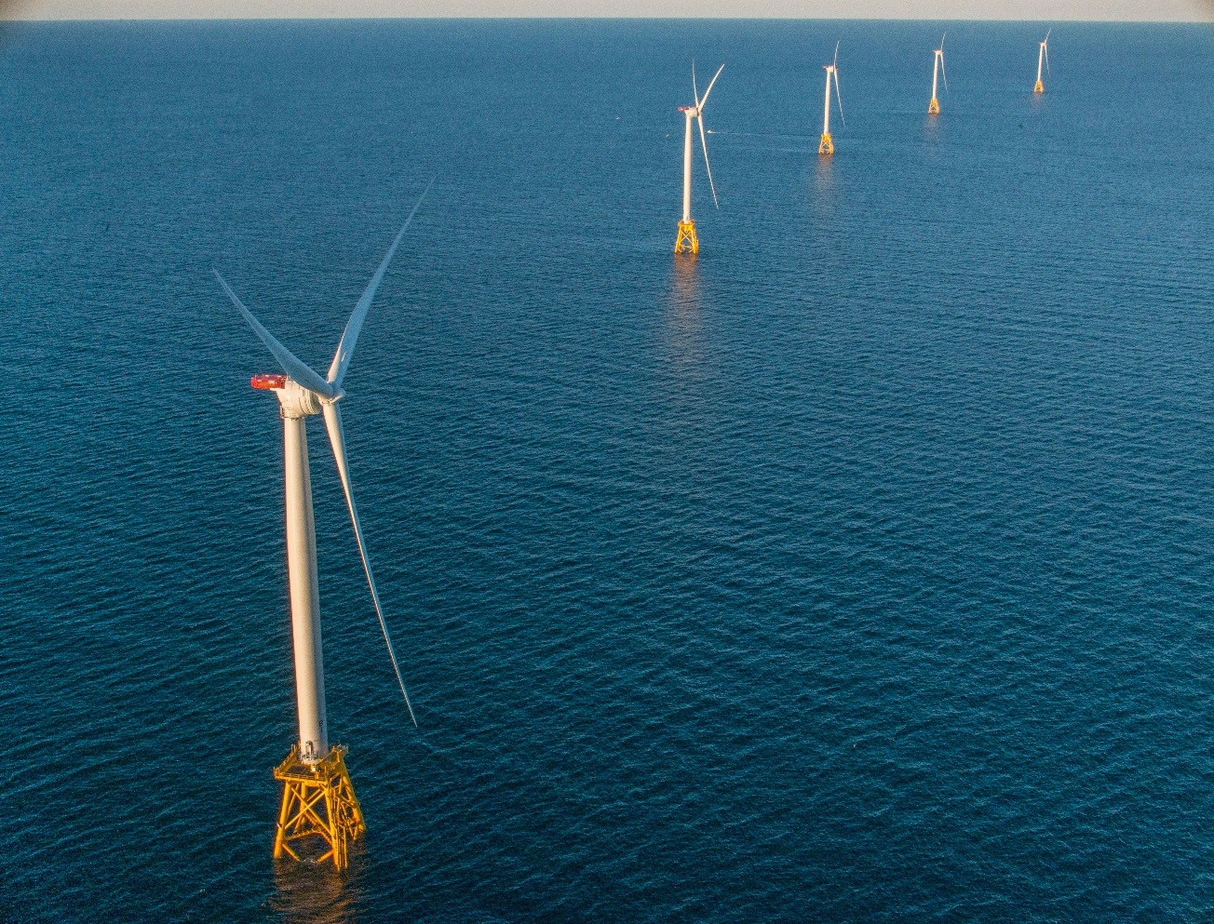
Benefits of Offshore Wind Energy
Blows strongest when demand is highest
Can serve large coastal population centers
Investments in coastal infrastructure
Job creation opportunity
Clean, domestic energy source
Increased energy security
Fuel diversity
Long-term (15-25 year) price certainty
Photo: Deepwater Wind

Slide 8
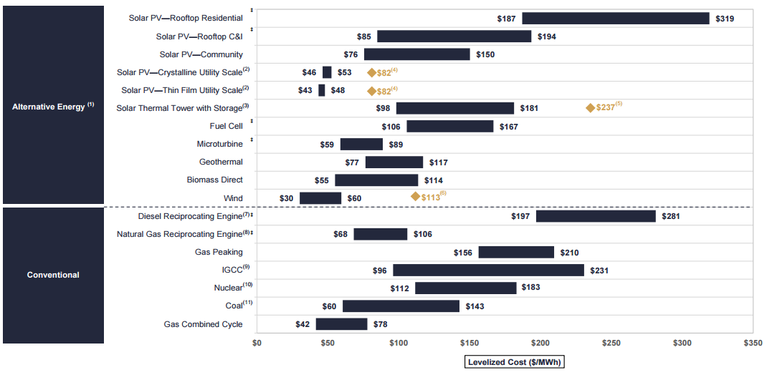
Falling Costs of Offshore Wind
2017 Unsubsidized Levelized Cost of Energy ($/MWh)
Source: Lazard, Levelized Cost of Energy Analysis Version 11.0, 2017
Notes:
Cost of wind power falling with economies of scale
Cost reductions due to technology advances, improved siting, supply chain efficiencies, and policy stability, among others
Technological advances that let modern wind turbines reach stronger, steadier winds have driven many of these cost declines.
Advances have also made wind economical in new places. North Carolina recently became the 41st state with a utility-scale wind project, and that wind farm wouldn’t have been possible without the technological improvements made in recent year.
In Colorado, wind projects offered in response to an RFP from Xcel Energy had the lowest median price ($18.10/MWh) of any energy source, showing just how competitive wind has become.

Slide 9
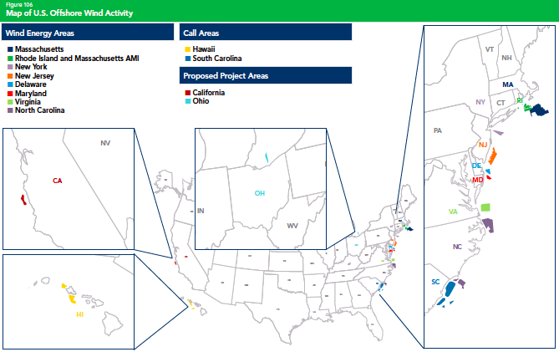
Map of U.S. Offshore Wind Activity
Source: AWEA U.S. Wind Industry Annual Market Report Year Ending 2017
Notes:
In recent years, wind has been one of the largest sources of new electric generating capacity
The U.S. is on track to generate 10% of its electricity using wind by 2020

Slide 10
Offshore Wind Policies are Spurring Development
Federal
Federal Investment Tax Credit (ITC)
Wind Energy Area Identification and Leasing Process
State
New Jersey’s Offshore Wind Economic Development Act of 2010
Massachusetts law requires 1,600 MW of offshore wind
New York’s 2017 Offshore Wind Master Plan
Maryland, Connecticut, and others

Slide 11
