Slide 1
20 YEARS AFTER –
A CLOSER LOOK AT RTOs
by Bill Malcolm, Senior Legislative Representative,
State Advocacy and Strategy Integration
A presentation to NASUCA
Baltimore, Maryland
November 14, 2017

Slide 2
About AARP
AARP, with its nearly 38 million members, is a nonprofit, nonpartisan organization that helps people turn their goals and dreams into real possibilities, strengthens communities and fights for the issues that matter most to families such as healthcare, employment and income security, retirement planning, affordable utilities, and protection from financial abuse.
Learn more at www.aarp.org.

Slide 3
Our utility positions
Fair and affordable rates
Oppose mandatory demand charges, increased customer charges
Question subsidies, surcharges, fast tracking rate increases, etc.
Low prices and a surplus of power are not a problem for consumers

Slide 4
AARP’s RTO Policy
Improving regional transmission organizations -
The Federal Energy Regulatory Commission, with assistance from the states, should ensure that RTOs:
• are cost-effective, transparent, and accountable in governance to a broad group of stakeholders, including residential consumer representatives;
• minimize cost of operations to ratepayers;
• include mechanisms for diverse representation of residential ratepayers in proceedings;
• follow open meetings laws and publish market bid data in a timely fashion;
• are completely independent of transmission and distribution owners and generators;
• provide protections against market manipulation; and
• enact ethics reforms, including a ban on revolving-door hiring.

Slide 5
AARP has engaged on RTO issues
Opposed MISO’s plan to impose a 3 year capacity market on IL and MI only
Questioned Colorado utilities plan to join SPP
Urged ERCOT and the PUC to closely monitor the Vistra Dynegy merger
Utah and Wyoming’s questions on joining CAL ISO
State subsidies for power plants vs. regional approaches (PJM)
ISO New England’s role in the Millstone subsidy debate
Testified at November 7 hearing (re: MISO push for subsidies in Illinois, letter to Governor)

Slide 6
RTOs: Myths vs. Realities?
RTOs are independent. (Reality: RTO membership is voluntary. They have a duty to maximize throughout for their members)
RTOs are transparent. (Reality: RTOs are complex institutions with hundreds of meetings.)
RTOs reduce rates. (Reality: Uplift fees, surcharges, enhanced capacity payments, shared costs for new transmission built in other states need to be considered.)
RTOs are heavily regulated. (Reality: Budgets not filed, more generous returns, formula rates, filed rate doctrine, RTOs unregulated through much of 2017)

Slide 7
Making a good thing better
Establish consumer advocate sector like PJM CAPS
Encourage RTOs to focus on the cost to retail consumers of their proposals
Question calculations (SSR uplifts) and their impact on consumers
Geography 101
Mission creep: Don’t allow RTOs to perform “free” modelling for single states .
Question spending.
Don’t accept “free” travel, gifts, or meals.
No false shortages.

Slide 8
Additional thoughts for states not in an RTO
Consider the impact of turning much regulatory decision making over to the Federal government
Will regional decision making be aligned with state energy goals?
What are the costs and benefits to retail consumers?

Slide 9
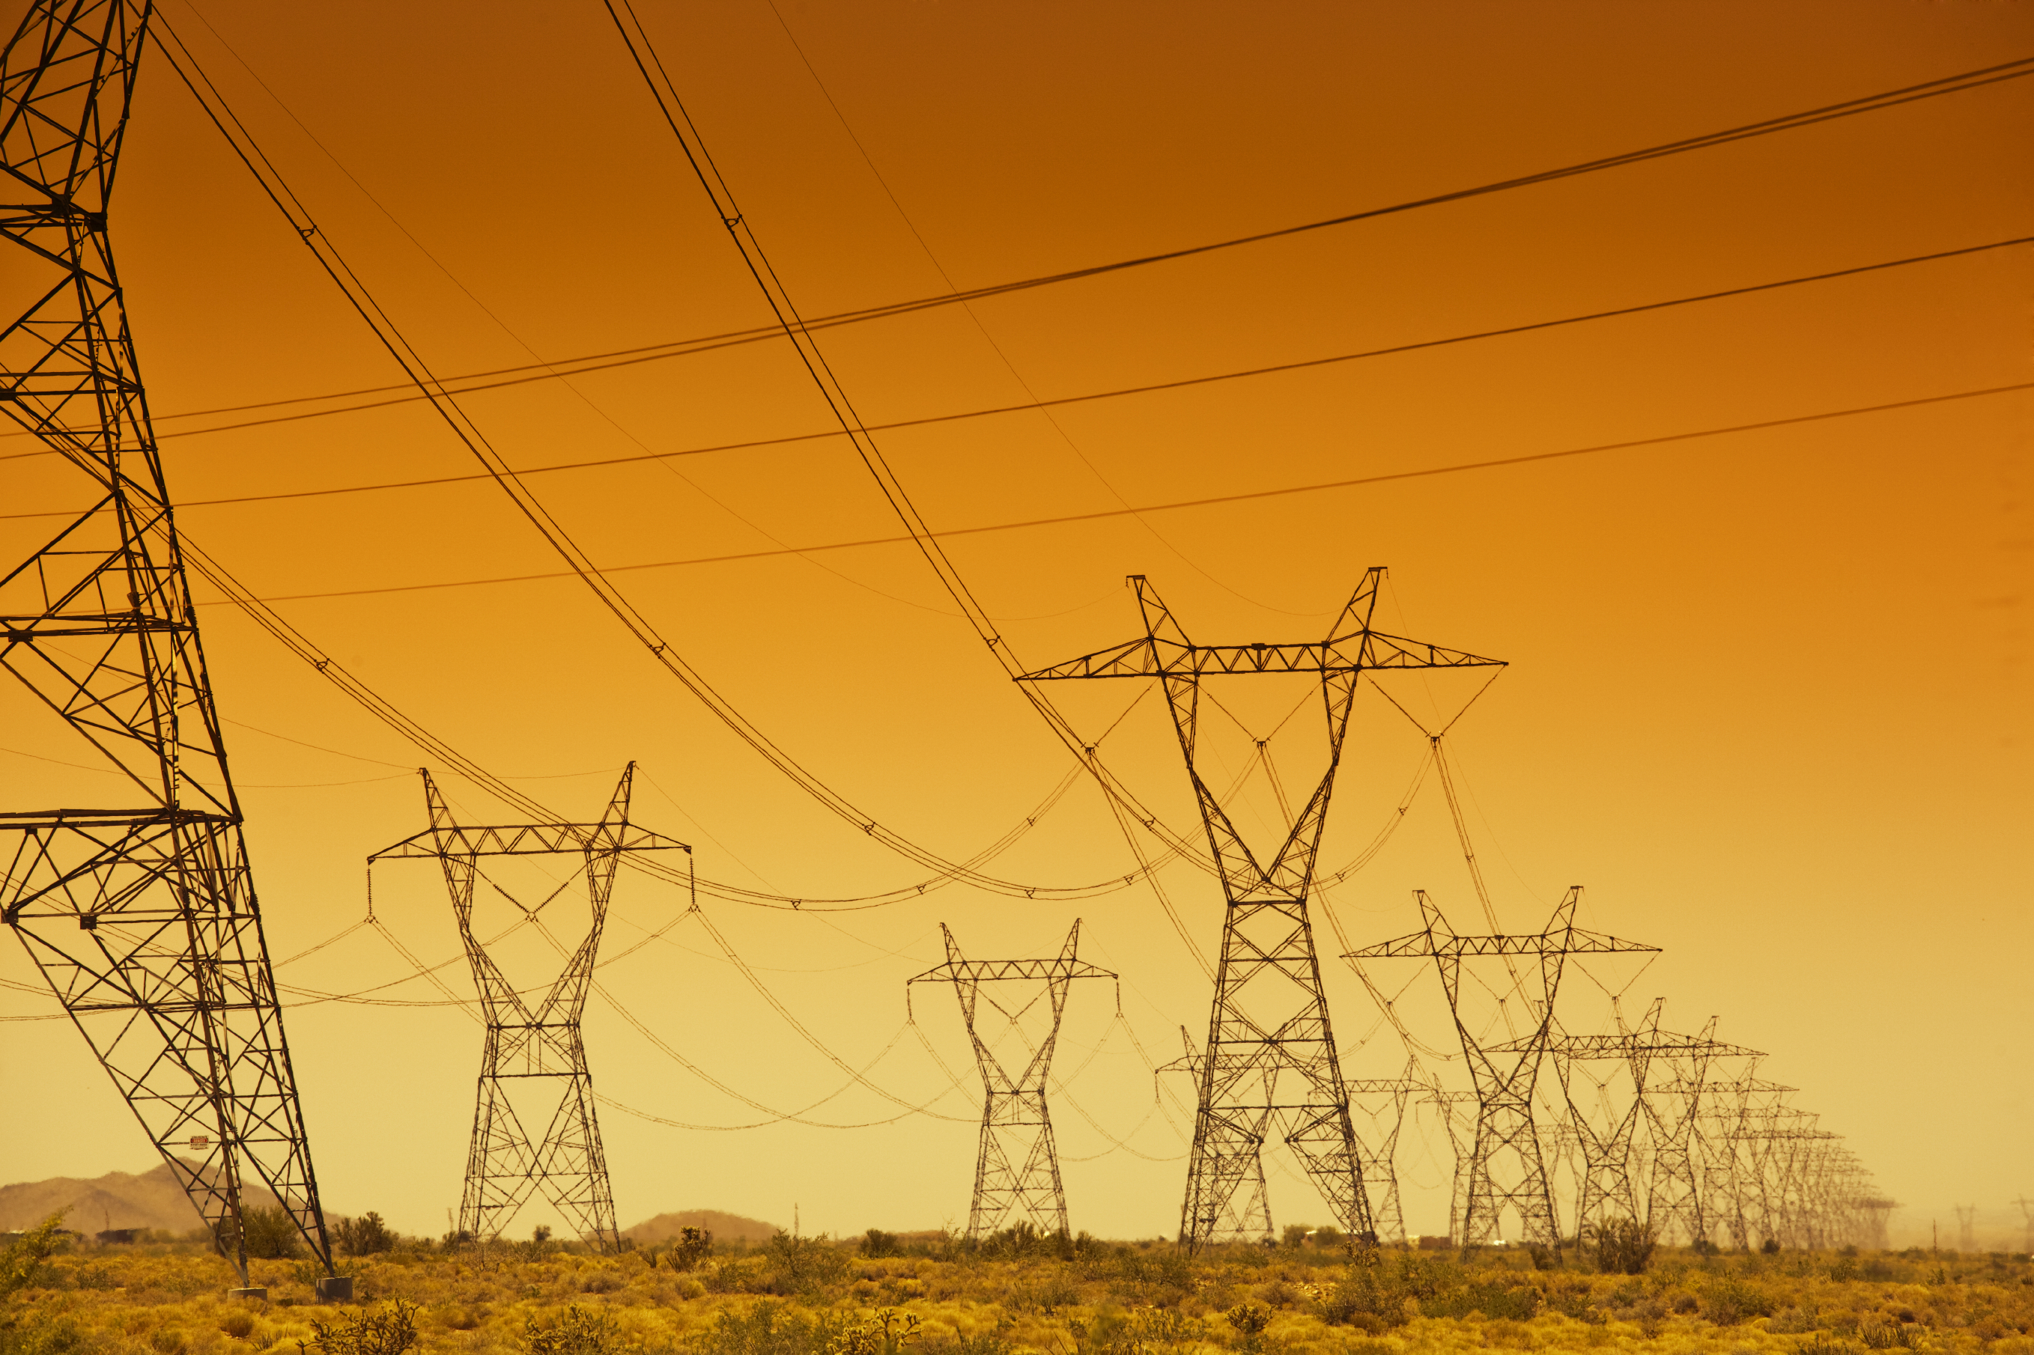
For further information
AARP.org/Policy Book (see Chapter 10)
wmalcolm@aarp.org, (202) 746-7590
On LinkedIn
On Twitter-
@billmalcolm6 Final 2-7-17 2:52pm

