Slide 1
Using Performance Benchmarking to Gain Leverage in an “Infrastructure Oriented” Environment
Unleashing Latent Value in Distribution Utility Businesses
NASUCA Mid-Year Meeting
Denver
June 6, 2017

Slide 2
Preview
Introduction to the Wired Group
Distribution Investment: Why the Big Push?
Top 5 Reasons Customers Not Getting Value (AMI) & Best Practice Solutions
Postcard from the Future: SCE Gold Plating for DER
California & New Hampshire Advocate Examples
Opportunity: Grid Modernization Working Group

Slide 3
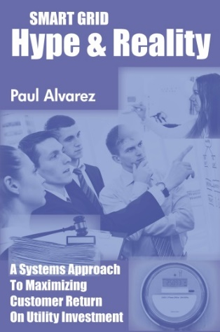
Wired Group Introduction
SMEs on electric distribution grids/utilities/businesses
DSM program development, marketing, evaluation
RPS compliance/PV Solar incentive program design
TVR development, offer design, and marketing
Distribution utility performance and compensation
Smart Technology: distribution, metering, communications
Comprehensive, objective evaluations of smart grid deployments
SmartGridCity™ for Xcel Energy
Duke Energy Ohio for the Ohio PUC
2017 Clients: TURN(CA); KY AG; MA AG; NH OCA; OH OCC; EDF

Slide 4
Grid Mod: What’s Behind the Big Push?
Generation: Investment Opportunities Gone
Transmission: Lead Times Exceed CEO Tenure
COC to ROE Spread Larger Now than Ever
Popular & Political Interest Is Strong
Lower Nat Gas Prices Mask Distribution Increases
The “Window of Opportunity” Is Closing!

Slide 5
Grid Mod: Why No Value for Customers?
IOUs “Time” Benefits to Accrue to Shareholders
Low Participation Reduces TVR/CPP/PTR Benefits
Data Communications & Access Deficiencies Hinder Competitive Services Development
Cost Estimates are Understated w/o Consequences
Throughput Incentive Discourages Grid Modernization’s Conservation Capabilities

Slide 6
Grid Mod: Why No Value for Customers?
1. Op Ex & Revenue Bene’s Lost to Rate Case Timing
$
Rate Case
2. Rates established at new, higher level
4. Shareholders receive O&M savings benefits until next rate case -------→
t
1. Smart meters installed; rate base grows
3. IOU implements Op Ex cost reductions made available by smart meters
Best Practice Solution:
Revenue Requirement Reduction Mechanism

Slide 7
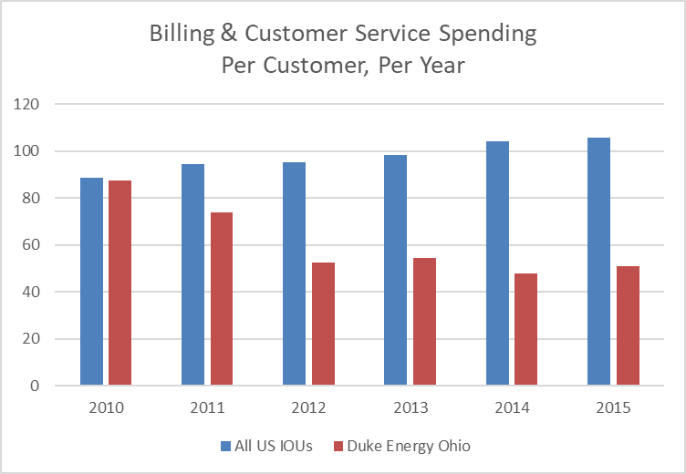
Grid Mod: Why No Value for Customers?
Op Ex & Revenue Bene’s Lost to Rate Case Timing

Slide 8
Grid Mod: Why No Value for Customers?
2. Low participation hinders TVR/CPP/PTR Benefits
Source: “SGIG Consumer Behavior Study Analysis” LBNL (6247E). June, 2013. Page XIX.
Best Practice Solutions:
Traditional Regulation: default CPP w/flat rate as an option?
Retail Choice #1 (MD): Peak-Time Rebate for All
Retail Choice #2 (TX): Customer-Specific Whsle Accounting

Slide 9
Grid Mod: Why No Value for Customers?
3. Data Communications & Access Deficiencies
Southern Cal Edison: $10 million post deployment
Pacific Gas & Electric: $20 million post deployment
Duke Energy Ohio: $143 million post deployment
Best Practice Solutions:
Develop product requirements/specifications/use cases
Demand “Connect My Data” standard compliance
Explore use of public wireless cellular networks?

Slide 10
Grid Mod: Why No Value for Customers?
4. Understated Cost Estimates; No Consequences
Of 3 post-deployment evaluations, all 3 over budget
No consequences for inadequate cost estimates
Cost estimate never include carrying costs!
Best Practice Solutions:
Demand that cost overruns be split 50/50
Demand that business cases include carrying costs

Slide 11
Grid Mod: Why No Value for Customers?
5. Throughput Incentive Discourages Conservation
High-bill Exception Reports
Time-varying Rates
Prepayment
Conservation Voltage Reduction
Best Practice Solutions:
Lost Revenue Adjustment Mechanisms
Bills Still Fall as Fuel Charge Falls
Requires an Increase in Conservation Targets

Slide 12
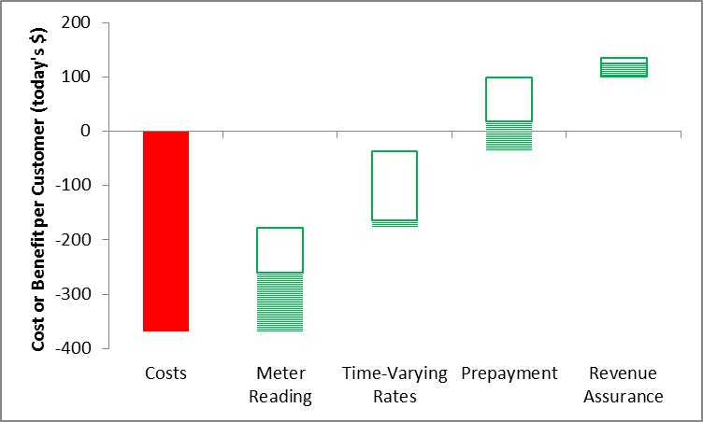
Summary: AMI Benefit-Cost/Customer, 13 yrs.
X
X
X
Typical Deployment Ideal Deployment Increment

Slide 13
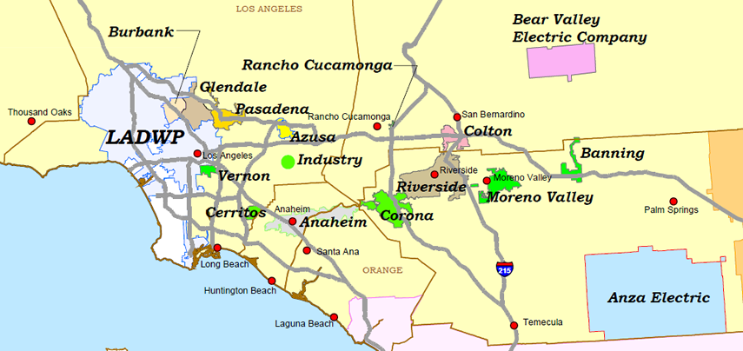
SoCal Edison: Gold Plating for DER ($2.3 b)
Best Practice Solutions:
Increased Grid Flexibility
Enhanced Grid State Visibility & Modeling

Slide 14
SoCal Edison: Gold Plating for DER ($2.3 b)
Needless automation ($1.0 b)
What is the potential incremental automation benefit?
Can automation deliver benefits in excess of costs?
Are new capabilities required? (FAN; WAN; SW; etc.)
Premature Deployment ($0.2 b)
Cost to Replace 4kV Circuits ($0.6 b) = 3x Benefits
Cost-shifting to ratepayers (away from DER owners)

Slide 15
Summary: Grid Mod Benefits Are Highly Variable!
Utility/SH (Rates)
Customer (Benefits)
Adding capabilities doesn’t deliver benefits; what an IOU does with the capabilities determines benefit levels!
Grid Modernization
Capital?
Outcomes?
AMI (Smart Meters)
Capital?
Outcomes?
DSM Programs
Capital?
Outcomes?
Economic Growth and Development
Capital!
Outcomes!
Inputs Easy to Measure in $
Outcomes Not Easy to Measure
CUSTOMER
VALUE

Slide 16
Measure Performance!
IOU GRC/Grid Mod Proposal Stage
Critique Past Performance, Cast Doubt
Improve Negotiating Position, Challenge ROE %
Post-GRC/Post-deployment Stage
Ensure Benefits Are Delivered
Assess Economic Penalties for Lack of Performance
Public Data Is Available to Make Your Case!
FERC Form 1
EIA Form 861

Slide 17
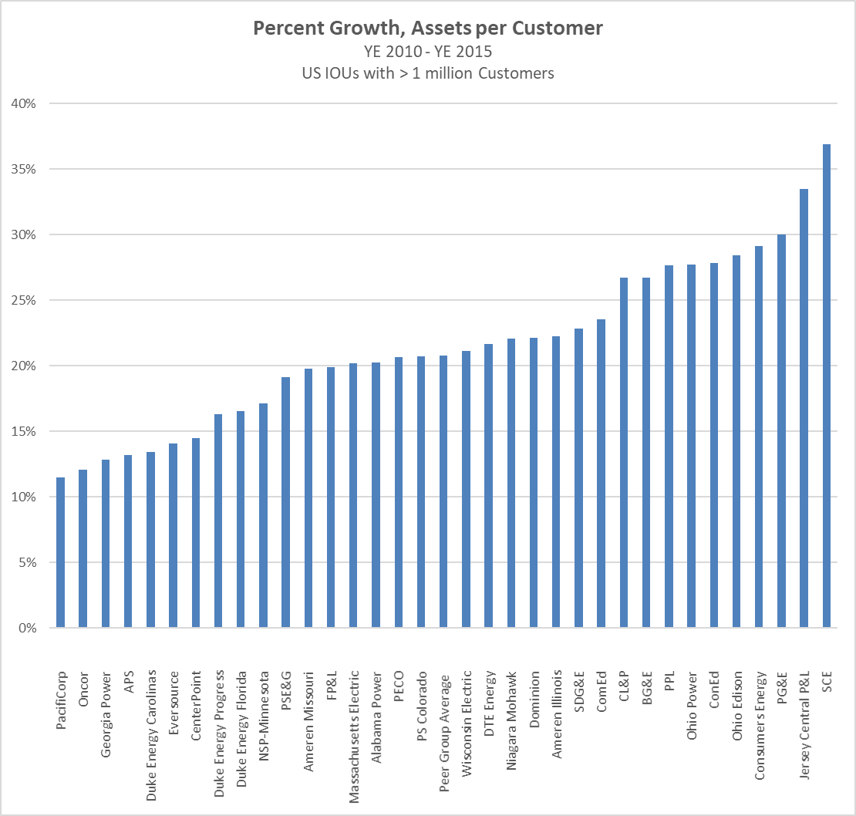
Case Study: SoCal Edison 2017 Rate Case
Gold Plating in the Name of Reliability or PV Solar

Slide 18
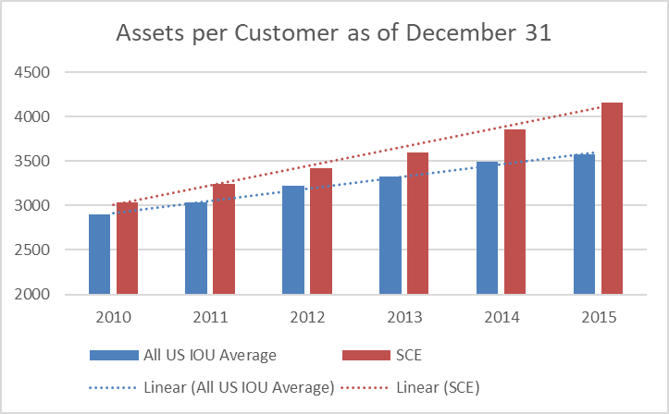
Case Study: SoCal Edison 2017 Rate Case
Gold Plating in the Name of Reliability or PV Solar

Slide 19
Case Study: Liberty Utilities 2017 Rate Case
Gold Plating in the Name of Reliability or PV Solar
Algonquin purchased Granite State Electric in 2011
Ontario-based generation & finance execs with no distribution utility operating experience
Immediately went on capital spending spree
Poor operating expense controls
Requested large increases and future capital tracker cost recovery in 2016 rate case

Slide 20
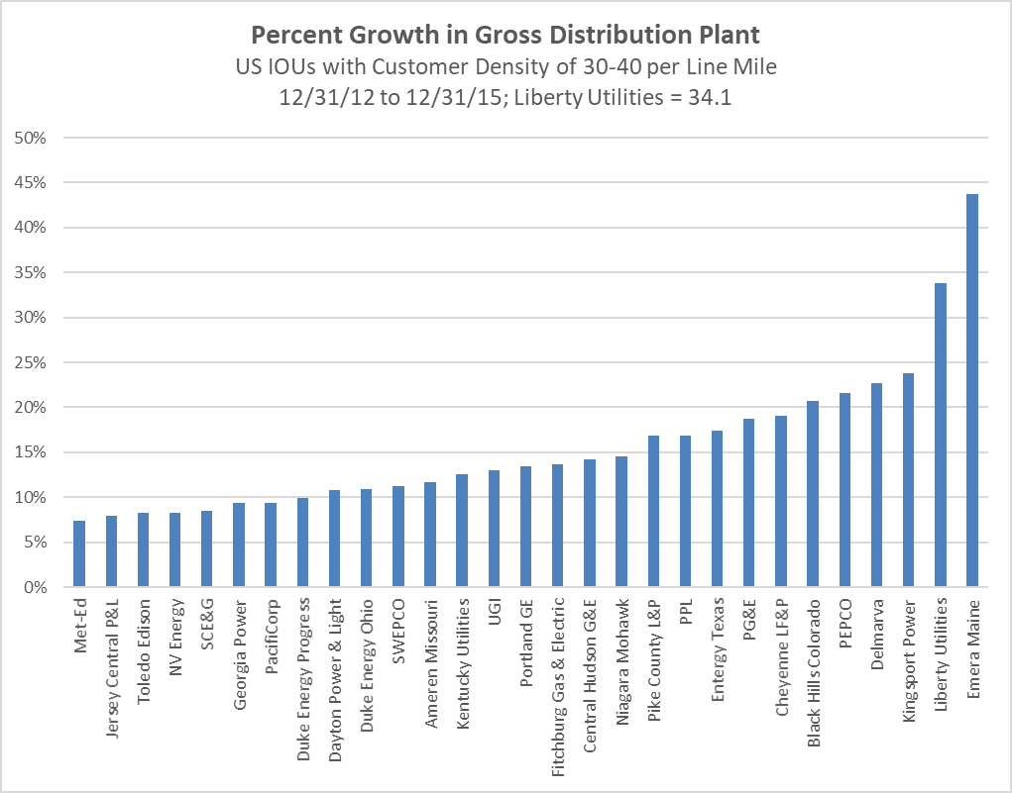
Case Study: Liberty Utilities 2017 Rate Case
Gold Plating in the Name of Reliability or PV Solar

Slide 21
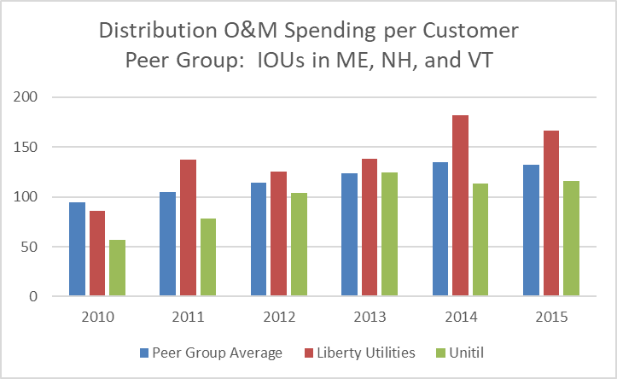
Case Study: Liberty Utilities 2017 Rate Case
Poor Control Over O&M Spending

Slide 22
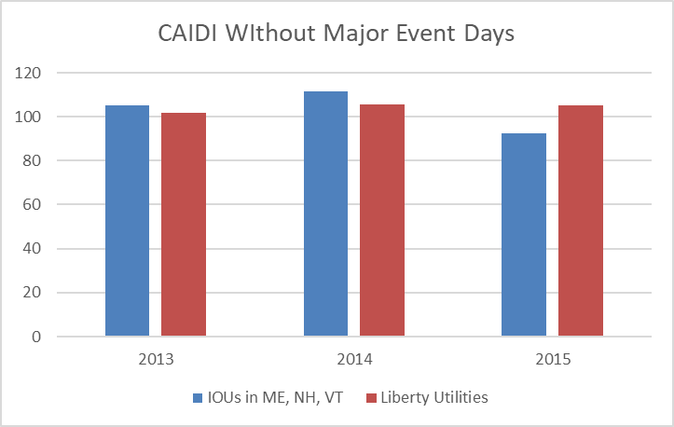
Case Study: Liberty Utilities 2017 Rate Case
Are Customers Receiving Value for Money?

Slide 23
Grid Modernization Working Group
Goal: Reduce Grid Modernization Cost & Risk
Objective: Slow distribution rate base growth
Strategy: Develop & share a body of knowledge
Lessons Learned
Best Practices
Experiences (operating, regulatory, market, etc.)
Tactics: Website? Guidance Document? Internal? Public?

Slide 24
Thank You!
Paul Alvarez, President, Wired Group
palvarez@wiredgroup.net
Mobile 720-308-2407
Office 303-997-0317, x-801
www.wiredgroup.net
Copies of Smart Grid Hype & Reality are being made available to NASUCA members at no charge; simply e-mail Paul Alvarez with preferred mailing address and number of copies desired

Slide 25
APPENDICES
Unleashing Latent Value in Distribution Utility Businesses
NASUCA Mid-Year Meeting, Denver
June 6, 2017

Slide 26
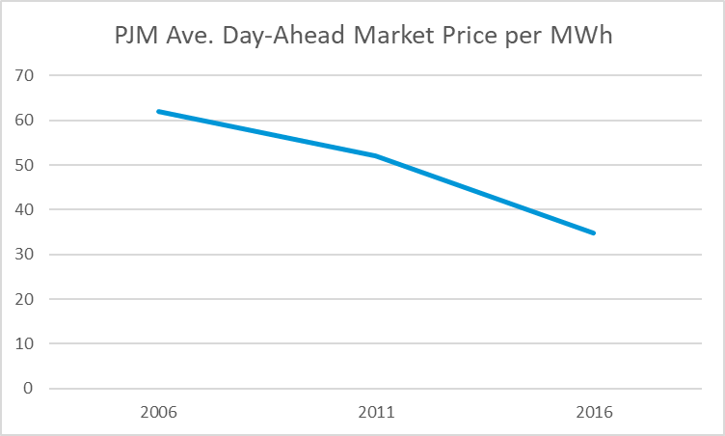
Grid Mod: What’s Behind the Big Push?
Generation: Investment Opportunities Gone

Slide 27
Grid Mod: What’s Behind the Big Push?
Transmission: Long Lead Time (Years)

Slide 28
Grid Mod: What’s Behind the Big Push?
Difference Between ROE & COC: Never Larger!
Slide courtesy of Len Hyman, CFA, President, Private Sector Advisors. SURFA presentation April 21, 2017.

Slide 29
Grid Mod: What’s Behind the Big Push?
Popular & Political Infrastructure Sentiment Is Strong!
State | Impetus | Utility | Proposal
OH | Regulation | First Energy | $1.0B bailout of generation biz for “distribution modernization”
IN | Legislation | Duke Energy | $1.9B for “infrastructure improvement” plan
CA | Legislation | So Cal Edison | $2.3B for PV on just 20% of grid!
IL | Legislation | Com Ed Ameren Illinois | $2.6B smart meters $1.0B smart meters
Reliability; Economic Development; Jobs; PV Solar; Technological Leadership

Slide 30
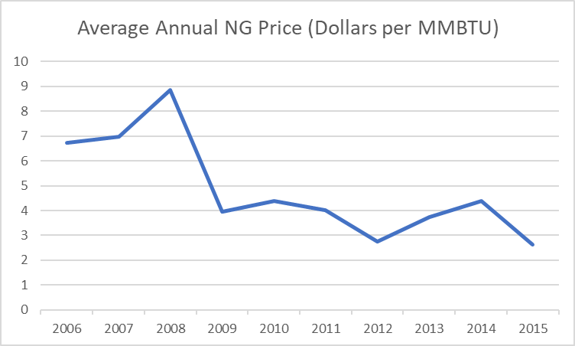
Grid Mod: What’s Behind the Big Push?
Low Nat Gas Prices Mask Distribution Rate Increases

Slide 31
Grid Mod: What’s Behind the Big Push?
The Window of Opportunity Is Closing!
Slide courtesy of Len Hyman, CFA, President, Private Sector Advisors. SURFA presentation April 21, 2017.

