Slide 1

NASUCA 2017 Mid-Year Meeting
Retail Choice
Consumer Protection:
Avoiding Whack-a-Mole in Connecticut
Lauren H. Bidra
Staff Attorney
John Viglione
Economist
Connecticut Office of Consumer Counsel

Slide 2

Strategy?

Slide 3
REGULATORY Landscape
PUC Investigation Dockets, et al.
Electric Supplier Marketing Standards Docket
Direct Energy
Energy Plus
Liberty Power
North American Power & Gas
Choice Energy
Palmco Power
Public Power

Slide 4
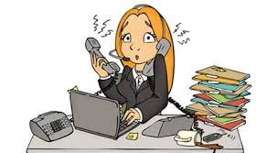
Sales calls

Slide 5
Vulnerable Populations
Through the review of customer complaints and docket evidence, we have found that Predatory Supplier Marketing Practices have a Disproportionate Impact on Vulnerable Populations.
Vulnerable Populations
Senior Citizens
Low-Income
English Second Language
Disabled Consumers

Slide 6
Why it matters to all electric ratepayers
All Ratepayers Subsidize Uncollectibles from Vulnerable Populations with an Electric Supplier
Consolidated Billing: electric utilities bill consumers on behalf of electric suppliers for the generation portion of the bill.
Purchase of Receivables: electric utilities purchase the receivables of electric suppliers at a discounted rate.

Slide 7
Number Crunching
The data for 2016 shows . . .
As a public, monthly compliance filing in PURA Docket No. 06-10-22, EDCs submit the number of residential customers, at each rate, for each supplier in CT
OCC tracks this data on a monthly and annual basis, and posts Fact Sheets on OCC’s website

Slide 8
Number Crunching for 2016
In 2016, Connecticut residential customers of electric suppliers paid approximately $58.75 million more than Standard Service customers
  Based on an average monthly usage of 750 kWh
In 2016, retail suppliers served on average 30.9% of Eversource Energy residential customers, and 36.33% of United Illuminating (UI) customers
  These averages are down from 33.55% for Eversource and 37.84% for UI in 2015

Slide 9
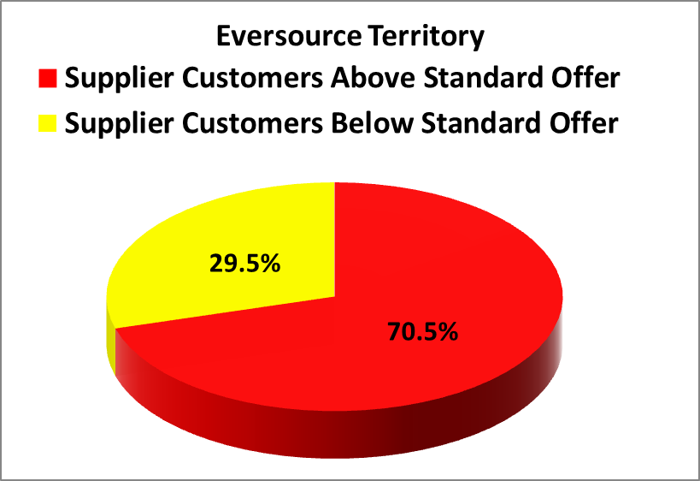
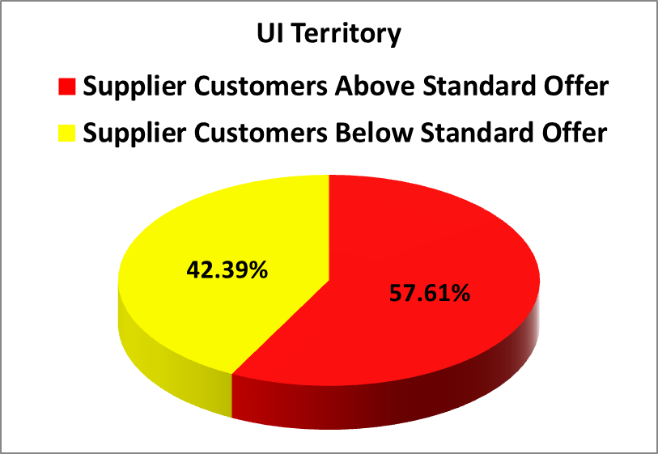
Number Crunching for 2016
During 2016, 70.5% of residential supplier customers paid more than Standard Service on average in Eversource territory, and 57.61% of residential supplier customers paid more than Standard Service on average in UI territory

Slide 10
Number Crunching for 2016

Slide 11
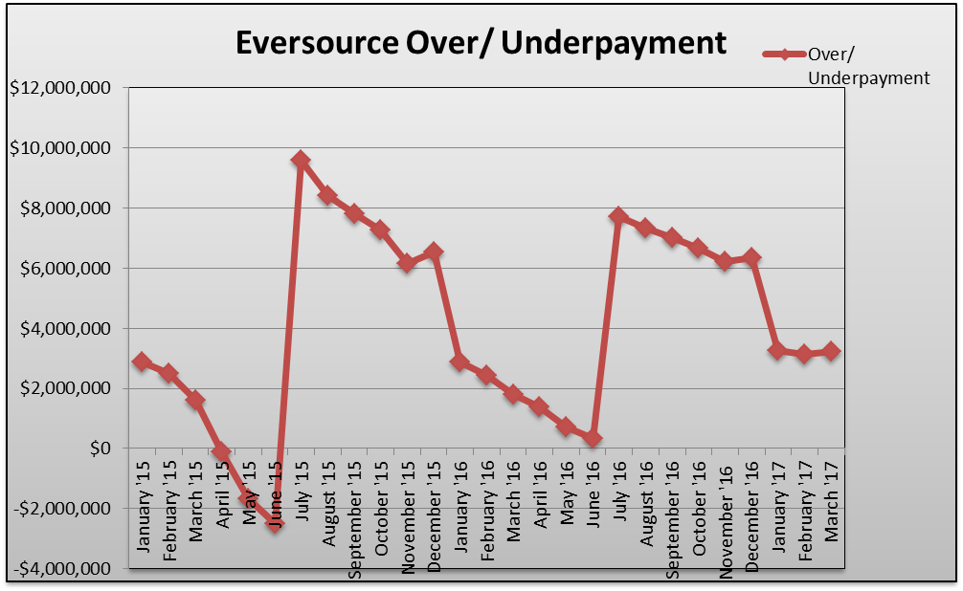
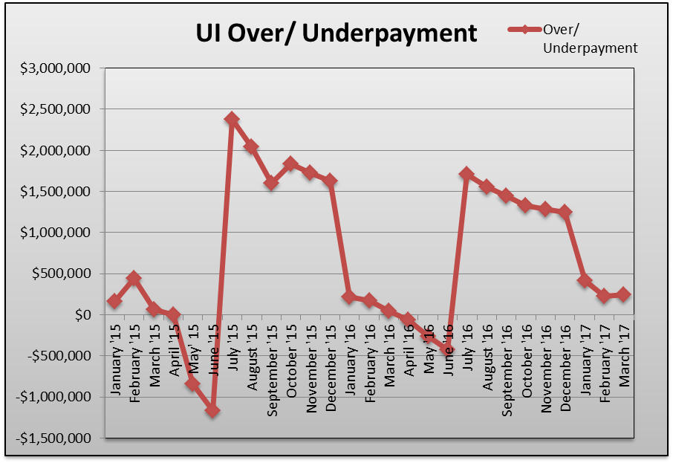
Number Crunching 2016
Seeing a yearly cycle that is trending slightly upward in regard to overpayment/savings

Slide 12
Thank you
Lauren H. Bidra
Staff Attorney
Lauren.Bidra@ct.gov
(860) 827-2904
John Viglione
Economist
John.Viglione@ct.gov
(860) 827-2749
Connecticut Office of Consumer Counsel
10 Franklin Square
New Britain, CT 06051
http://www.ct.gov/occ

