Slide 1
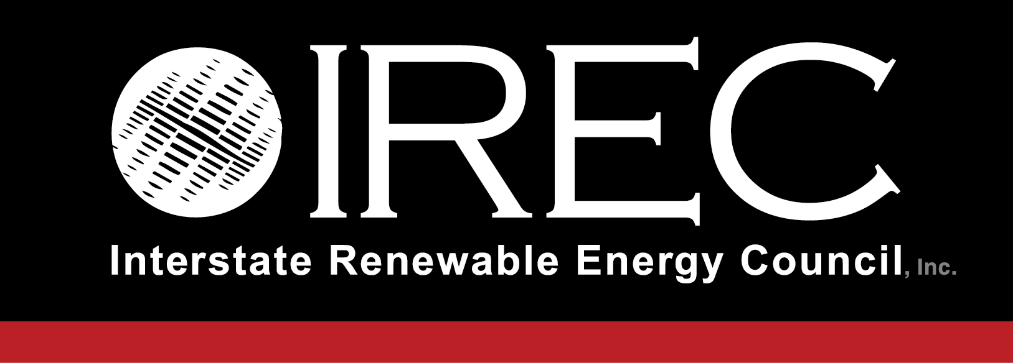
Sara Baldwin Auck Director, Regulatory Program NASUCA Annual Meeting
November 13, 2017

Slide 2
Regulatory Reform
Consumer Empowerment
Quality Workforce

Slide 3
IREC’s Regulatory Program Focus Areas
Access & Equity
Grid Planning
Interconnection
The Consumer Experience

Slide 4
IREC’s Regulatory Activity Through the Years
FERC
DC
Current Engagement (2017-2018)
Recent Activity & Monitoring (2016-2017)
Historic Engagement (2004-2015)
© IREC 2017
Updated November 2017

Slide 6
Navigating today’s energy issues…

Slide 7
…requires new tools and approaches

Slide 8
Tools you can use

Slide 9
Shared/Community Renewables Tools
Download at www.irecusa.org

Slide 10
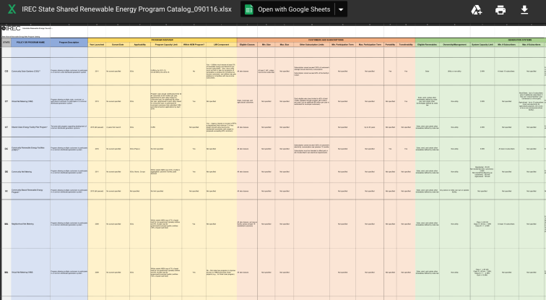
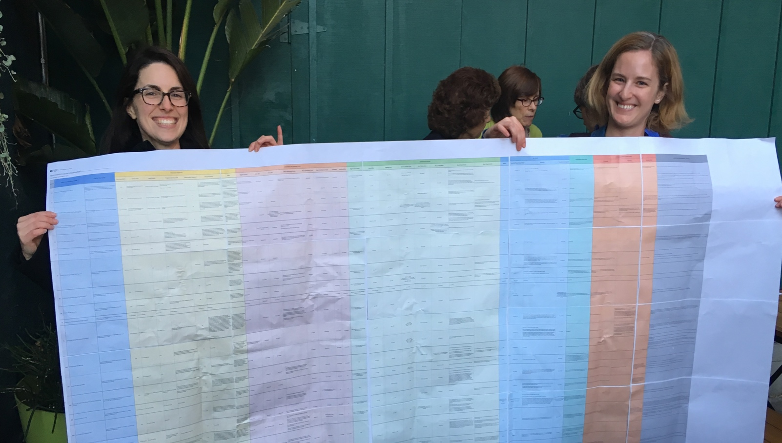
Shared/Community Renewables Tools
State Shared Renewable Energy Program Catalog
Download at www.irecusa.org

Slide 11
Multifamily Housing Access Tools
Apartment Toolkits
Contractor Toolkits
Learn more: https://energycenter.org/solar-market-pathways

Slide 12
Interconnection Tools
IEEE 1547 - Advanced Inverter Standards
WEIB – Interconnection and Reliability Technical Advisory Committee

Slide 13
Energy Storage Tools
DC
Multiple Actions
Plan for Storage
Investigate Storage
Energize the Market
Clarify Existing Rules
Download at www.irecusa.org

Slide 14
Grid Planning Tools
Coming December 2017!

Slide 15
Consumer Tools
Download at www.irecusa.org

Slide 16
Thank you! Let’s stay connected.
Sara Baldwin Auck, Regulatory Director, IREC sarab@irecusa.org
@sarabaldwinauck
@irecusa
@Interstate Renewable Energy Council
Text 22828 for IREC News & Insights
www.irecusa.org

