Slide 1


Slide 2


Slide 3


Slide 4


Slide 5
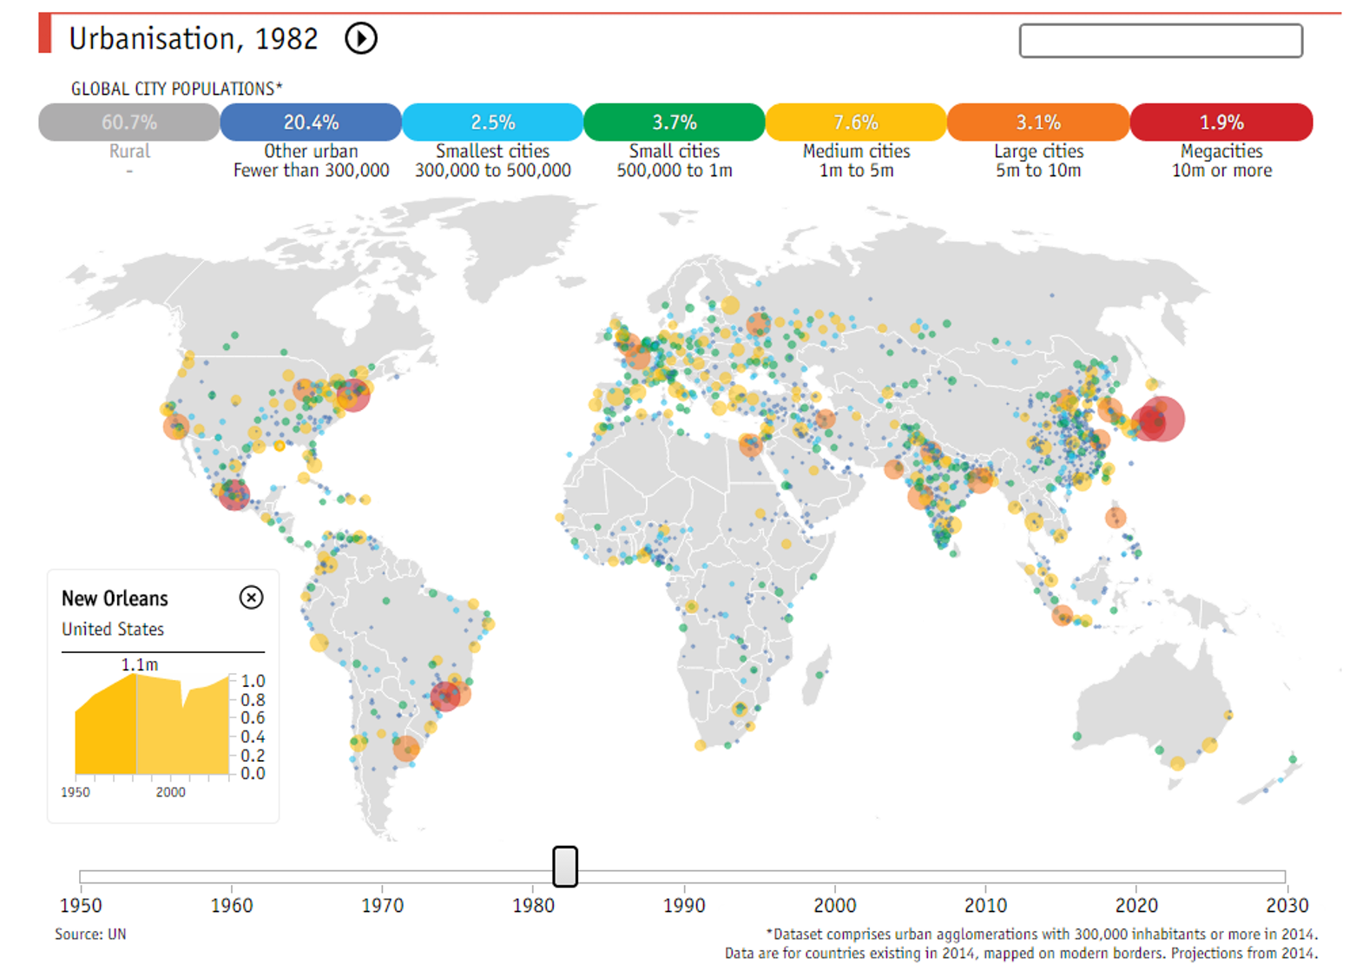

Slide 6
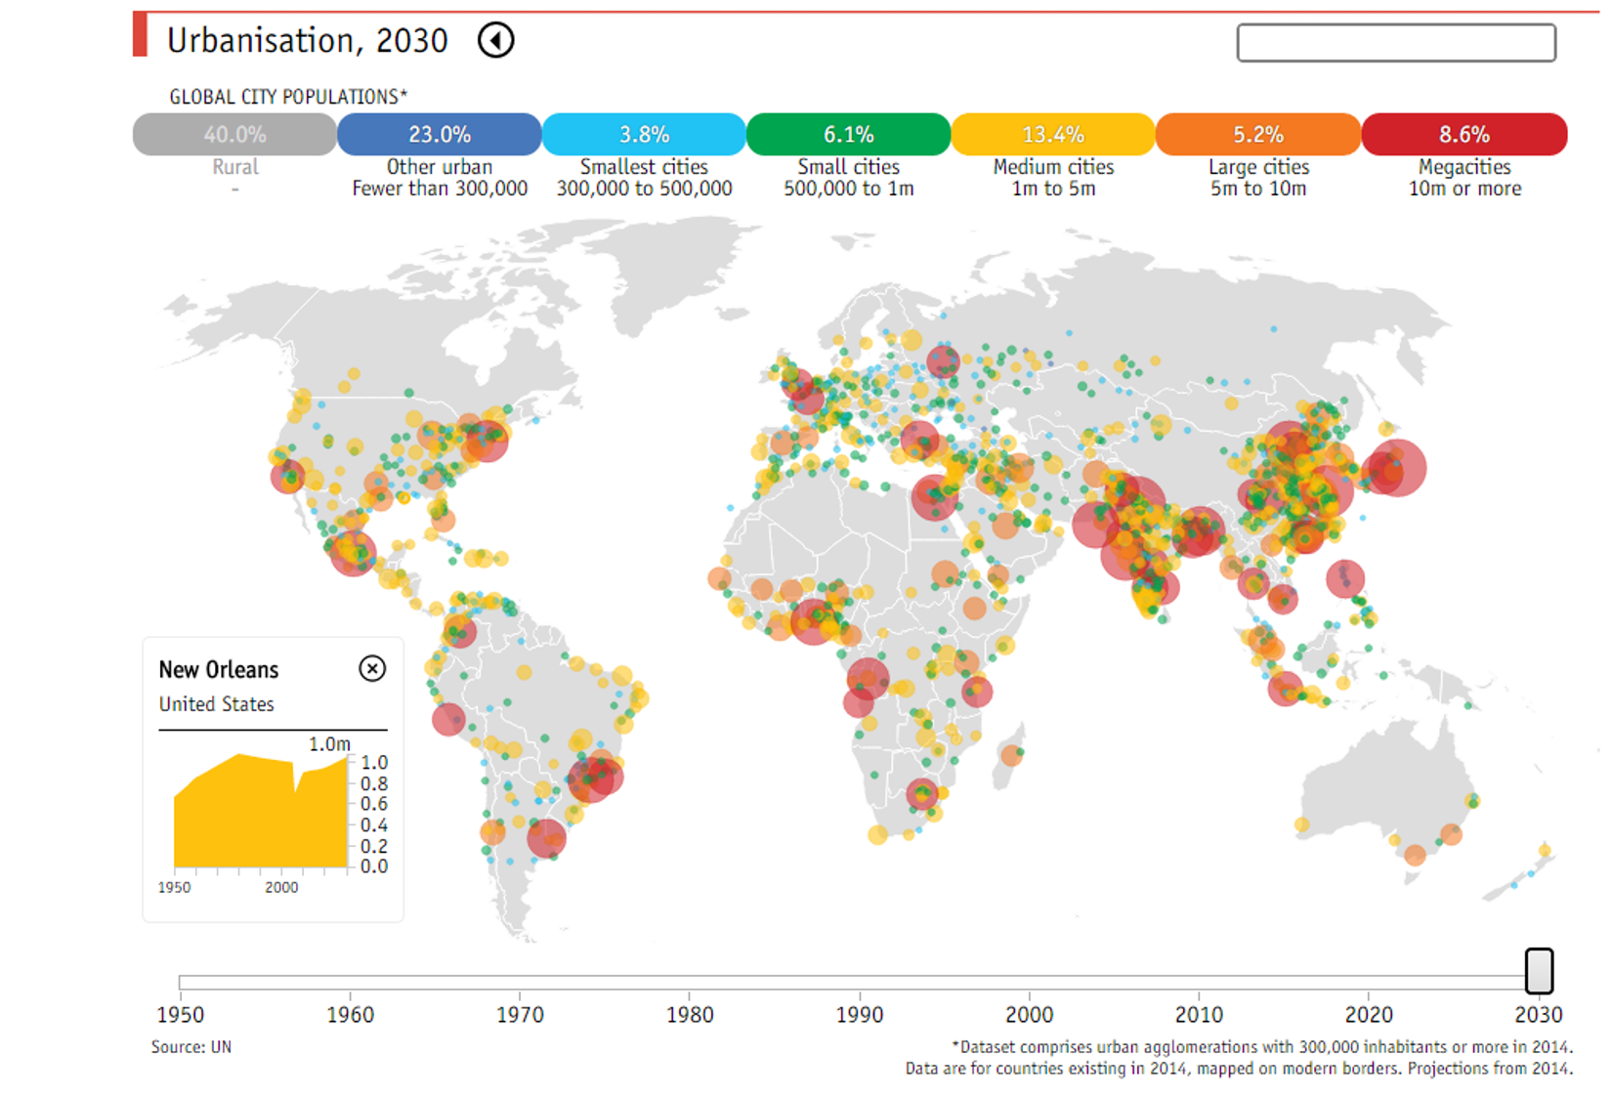

Slide 7
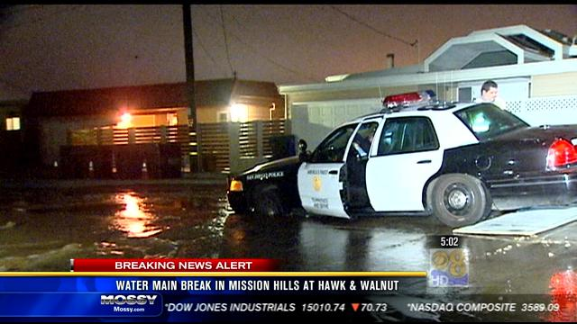

Slide 8
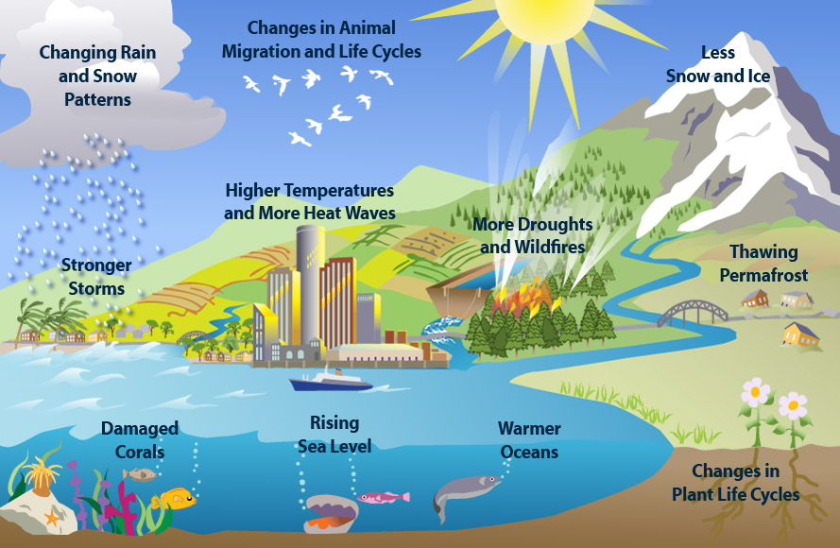

Slide 9
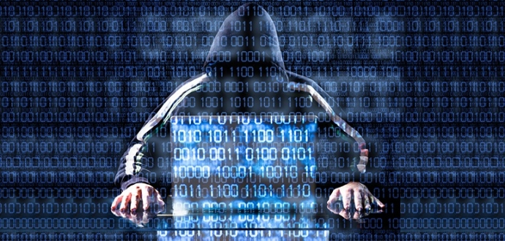

Slide 10
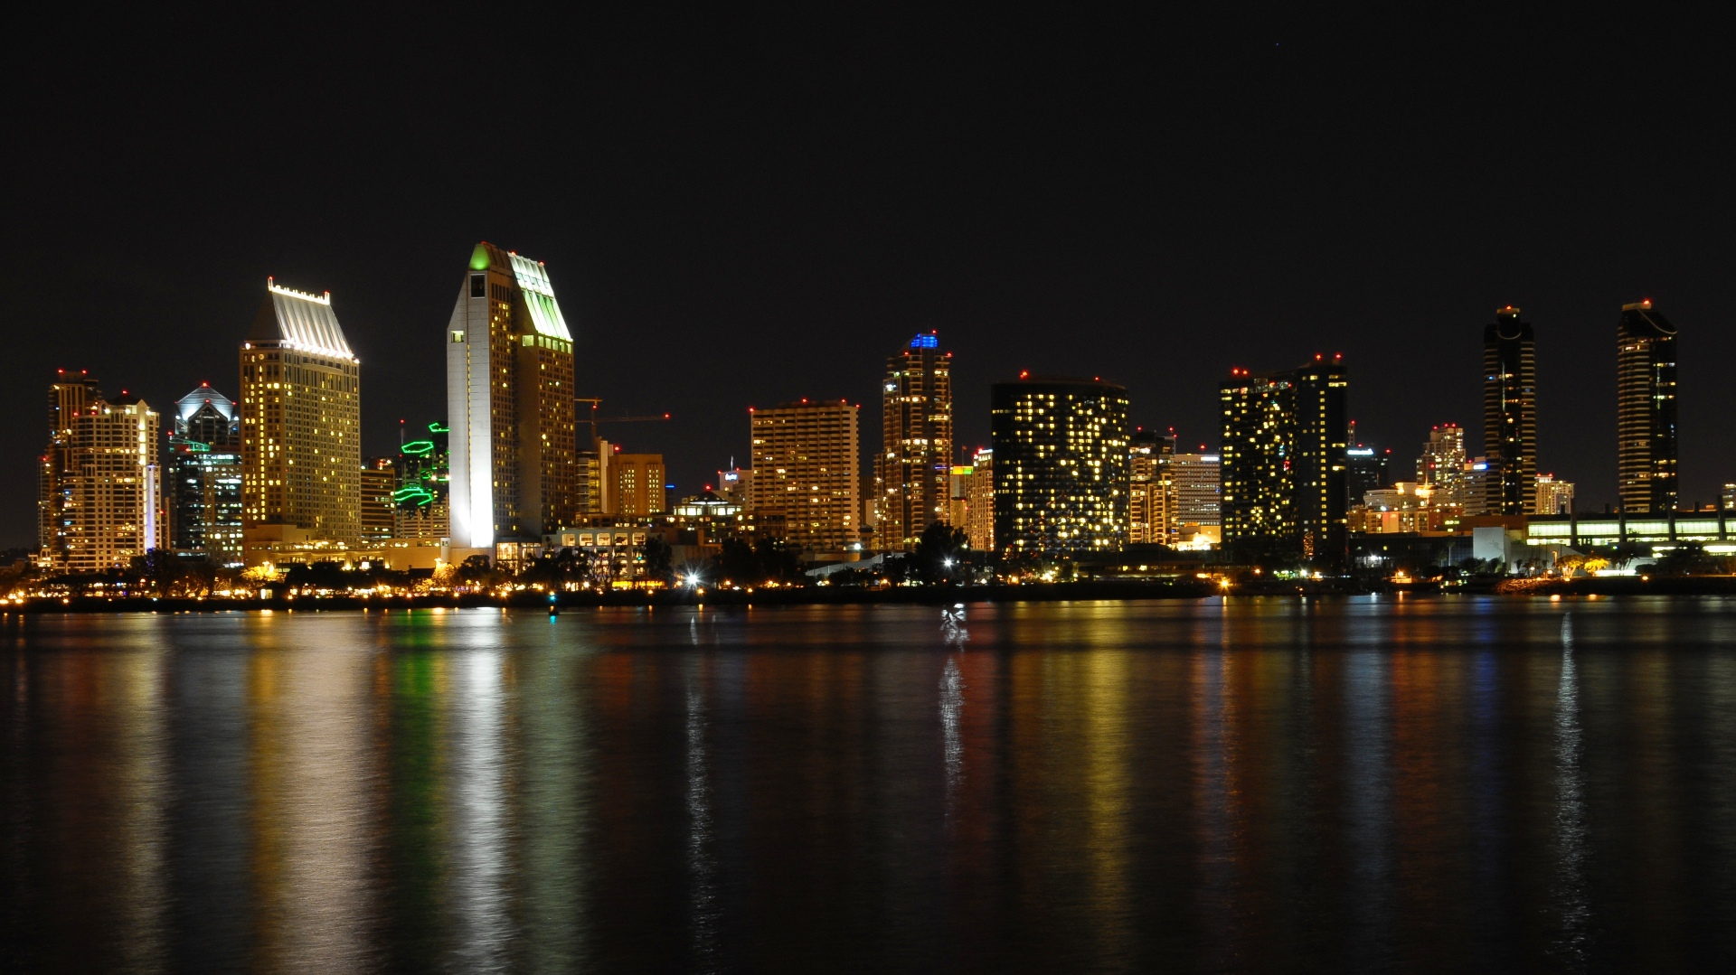
A city can be defined as 'smart' when investments in human and social capital and traditional (transport) and modern (ICT) communication infrastructure fuel sustainable economic development and a high quality of life, with a wise management of natural resources, through participatory action and engagement.“ - Caragliu and Nijkamp 2009
A smart city is one that has digital technology embedded across all city functions. – Smart Cities Council
The effective integration of physical, digital and human systems in the built environment to deliver sustainable, prosperous and inclusive future for its citizens.
– British Standards Institute
Smart cities a process rather than a static outcome, in which increased citizen engagement, hard infrastructure, social capital and digital technologies make cities more liveable, resilient and better able to respond to challenges.
– UK Department for Business, Innovation & Skills
Smart Cities Mission, the objective is to promote cities that provide core infrastructure and give a decent quality of life to its citizens, a clean and sustainable environment and application of ‘Smart’ Solutions. – India Smart Cities

Slide 11


Slide 12


Slide 13
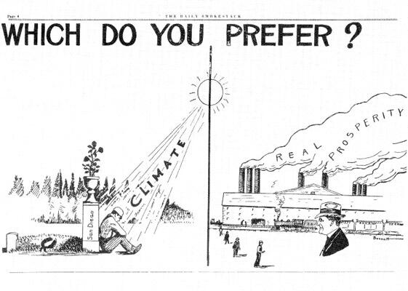

Slide 14
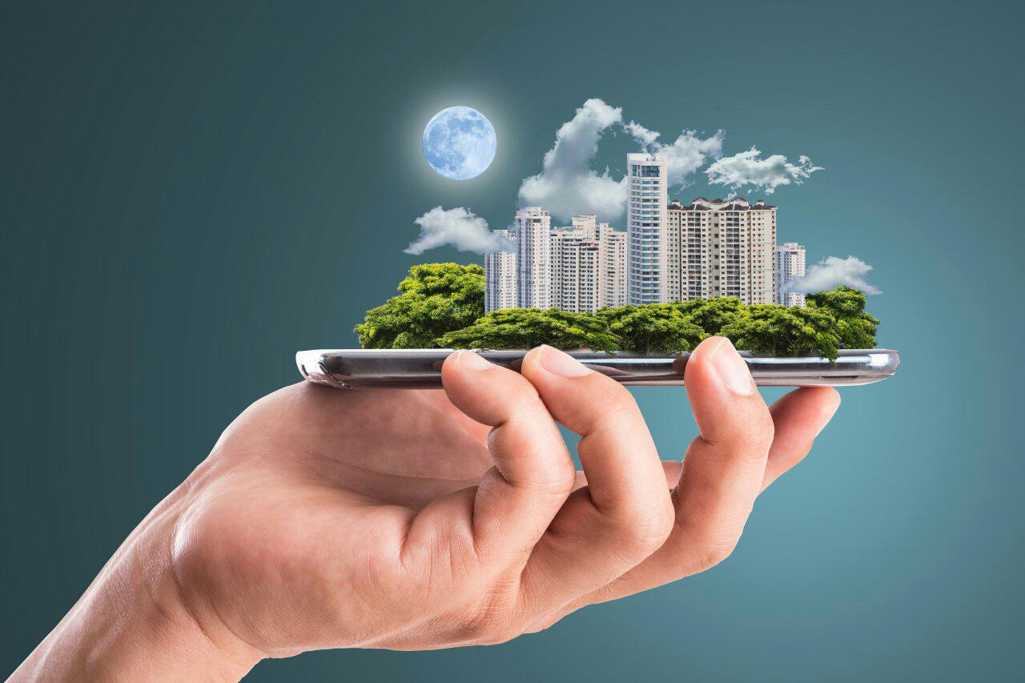
Global smart city revenue is expected to grow from $36.8 billion in 2016 to $88.7 billion by 2025.
- Navigant Research

Slide 15
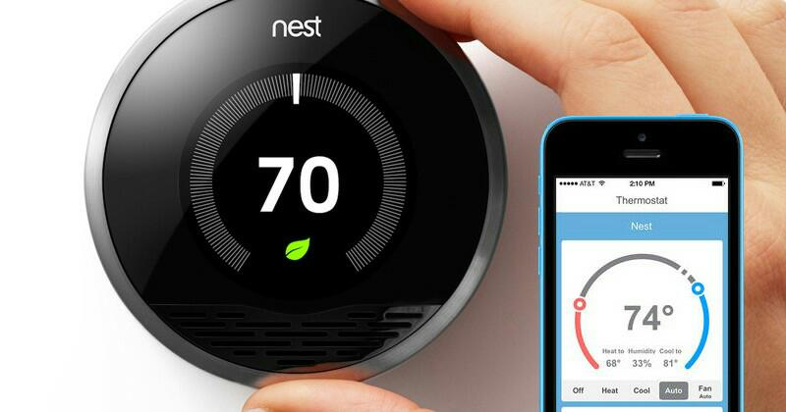

Founded 2011
Sold to
$3.2 Billion

Slide 16


Slide 18
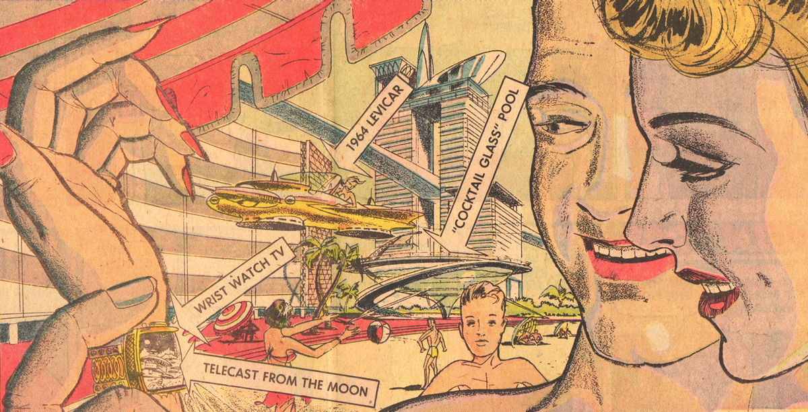

Slide 19
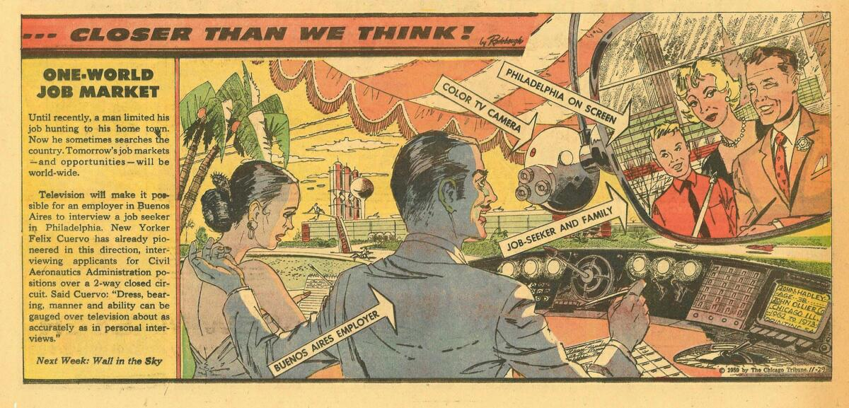

Slide 20
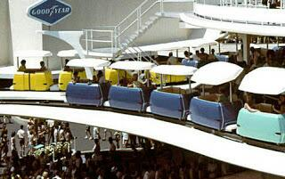

Slide 21
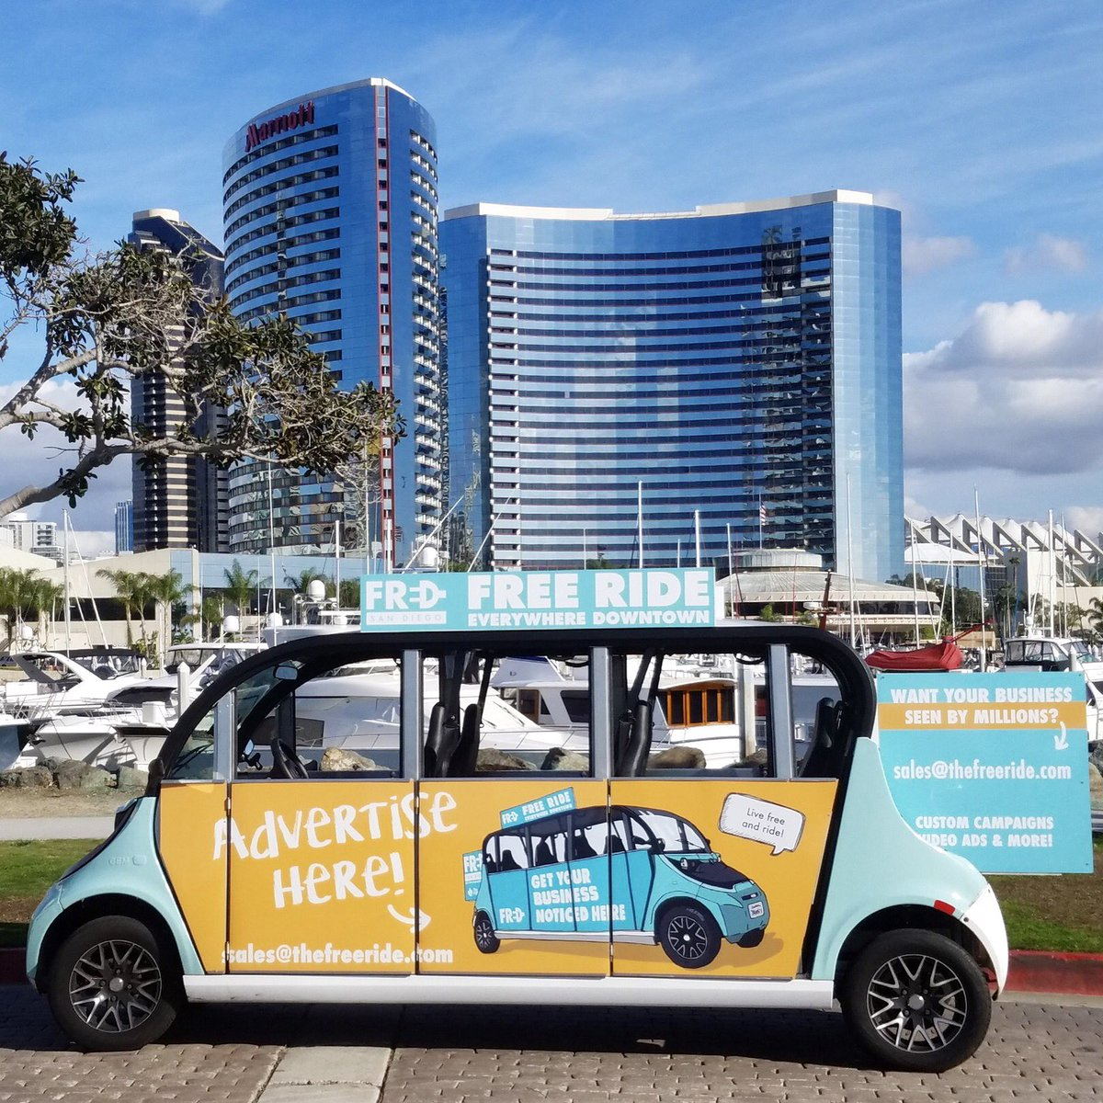

Slide 22
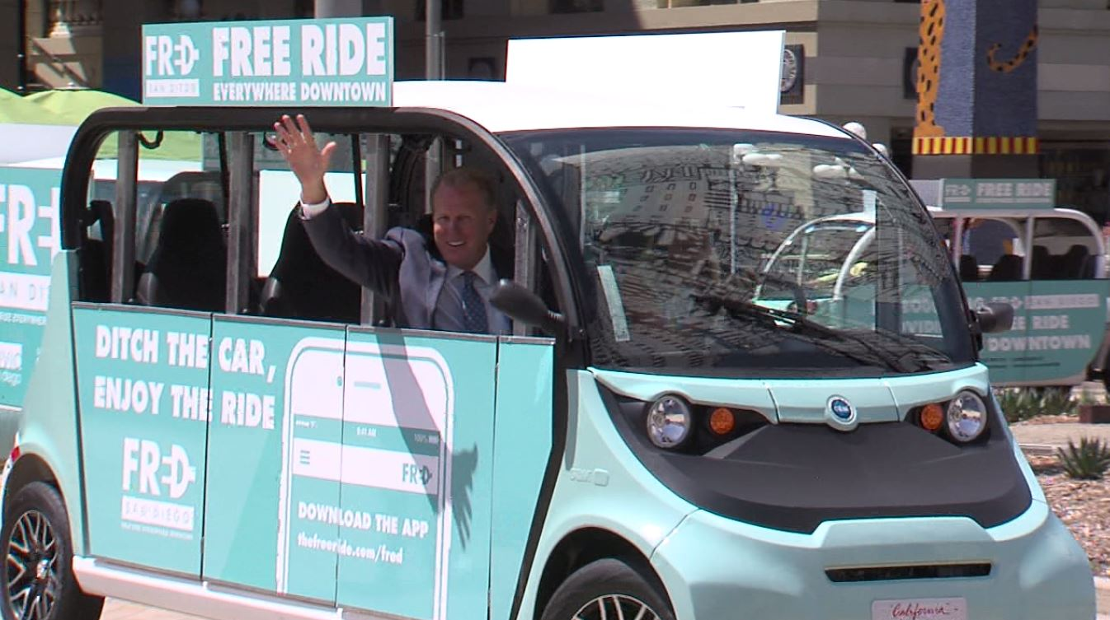

Slide 23
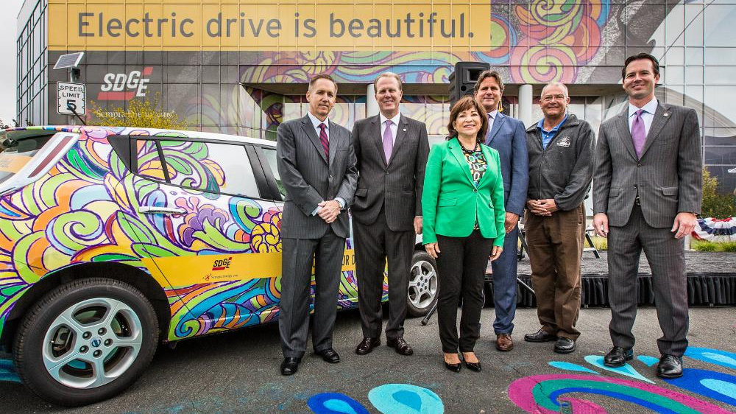

Slide 24
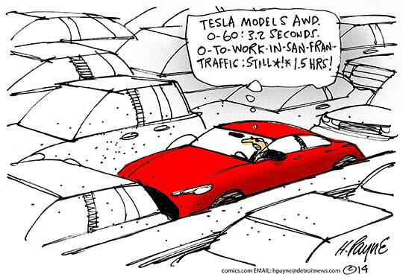

Slide 25
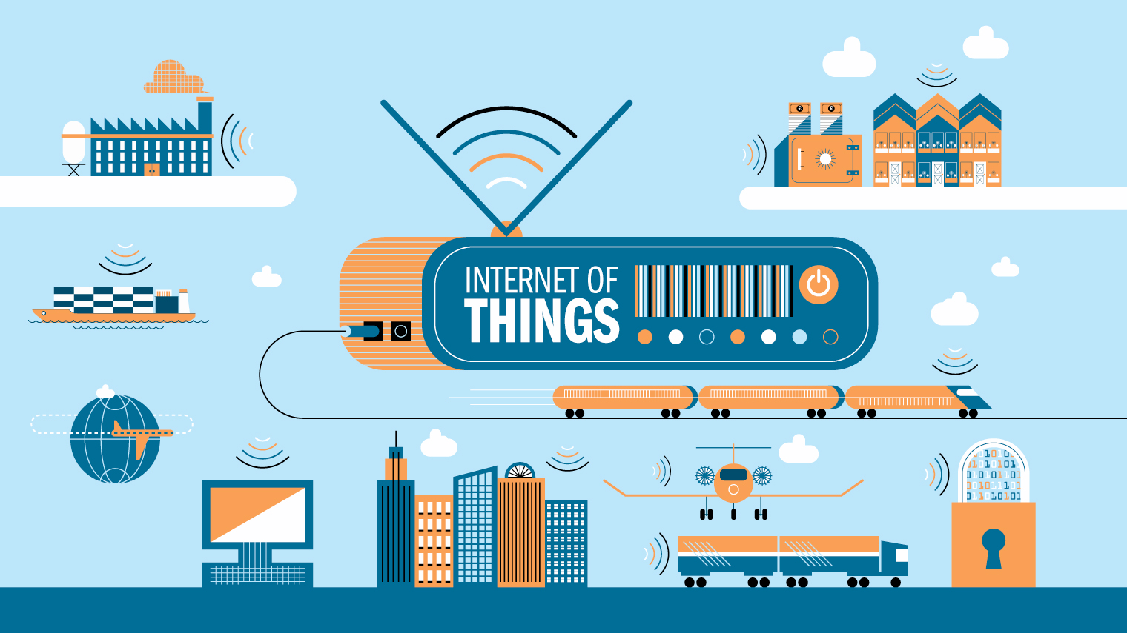

Slide 26


Slide 27
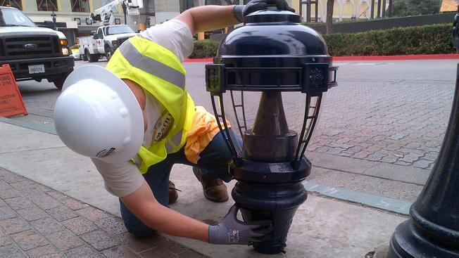

Slide 28
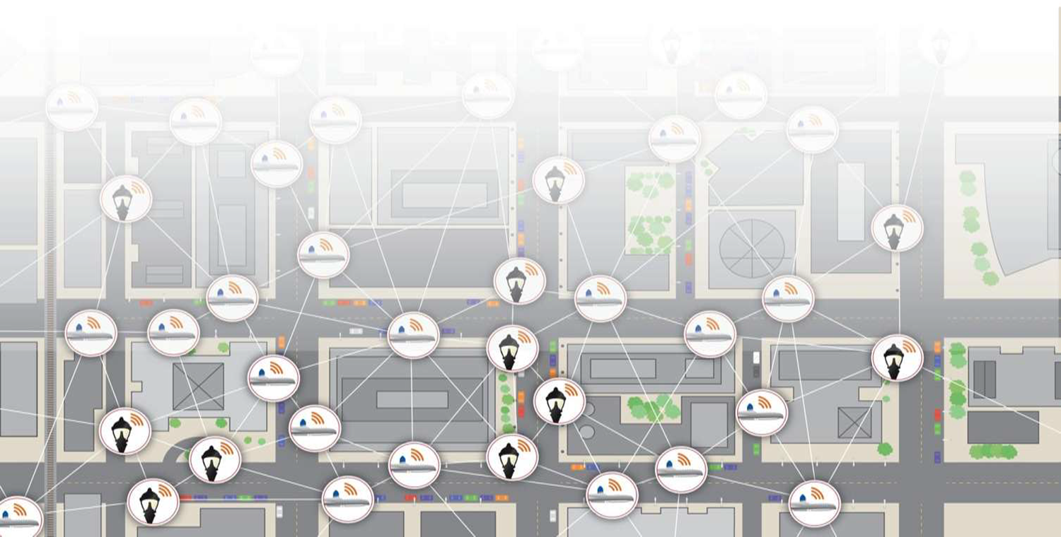

Slide 29
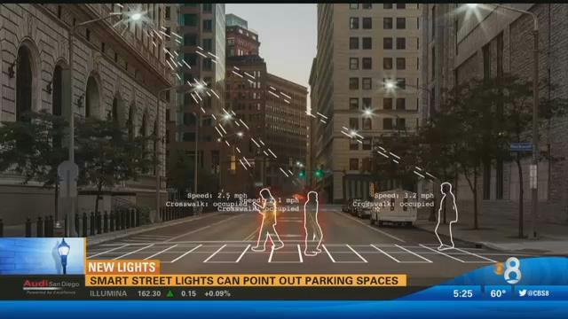

Slide 30
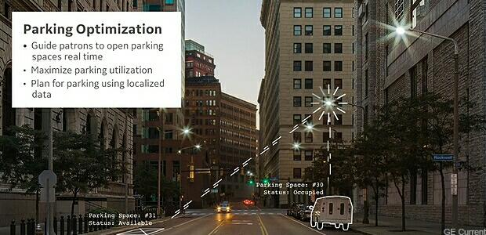

Slide 31
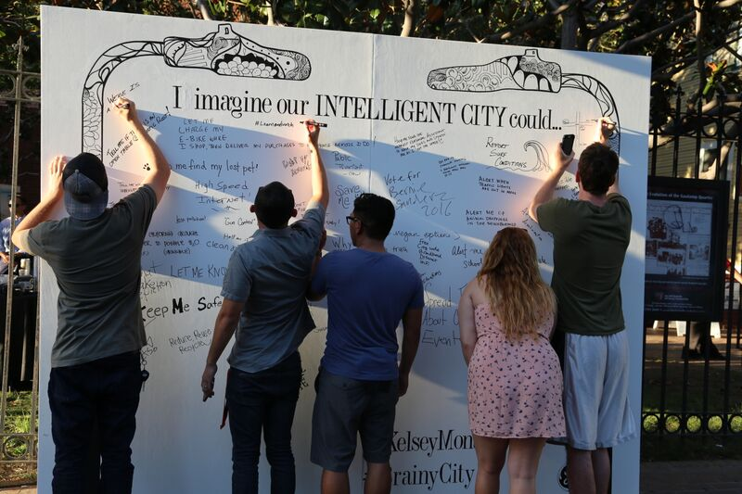

Slide 32
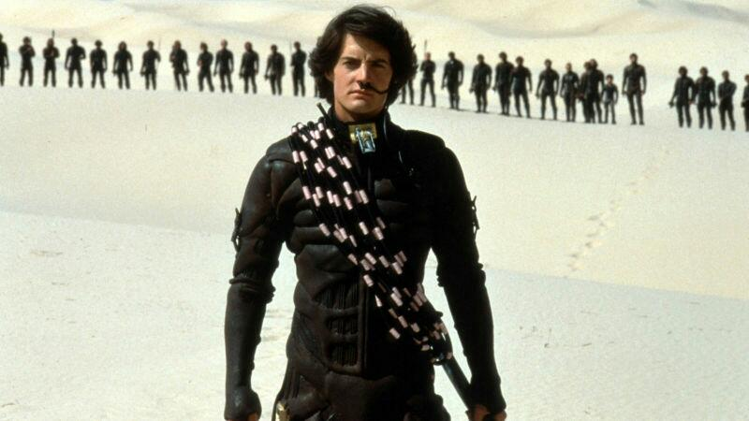

Slide 33
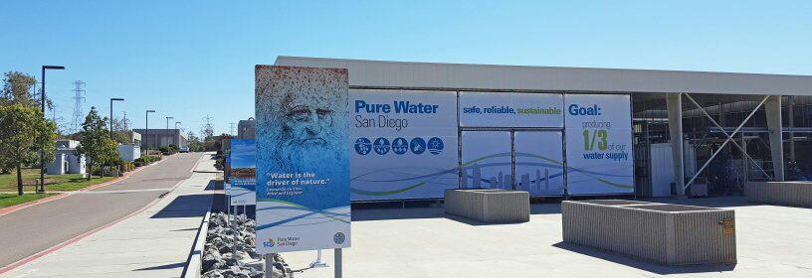

Slide 34
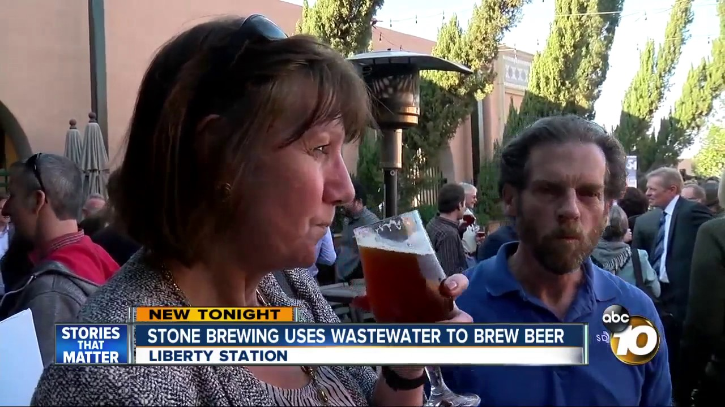

Slide 35
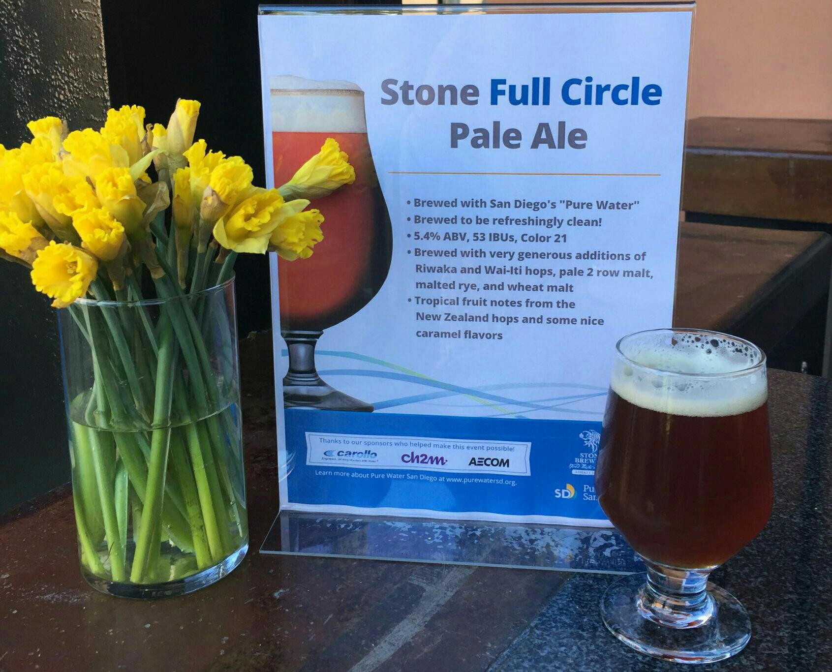

Slide 36
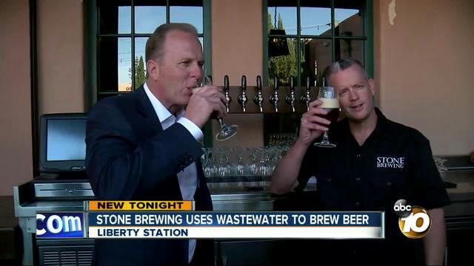

Slide 37
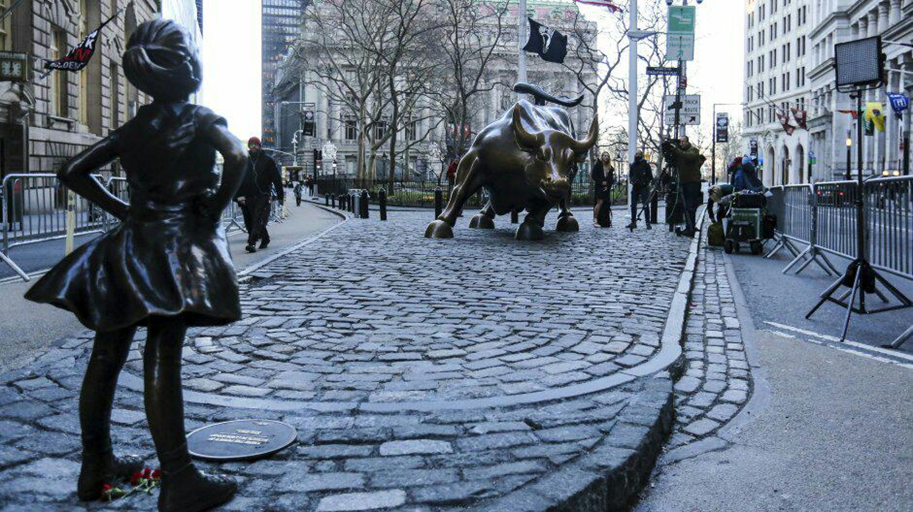

Slide 38
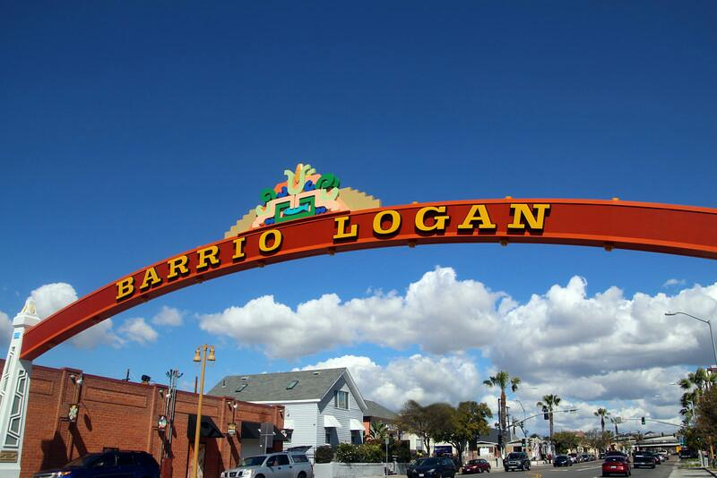

Slide 39
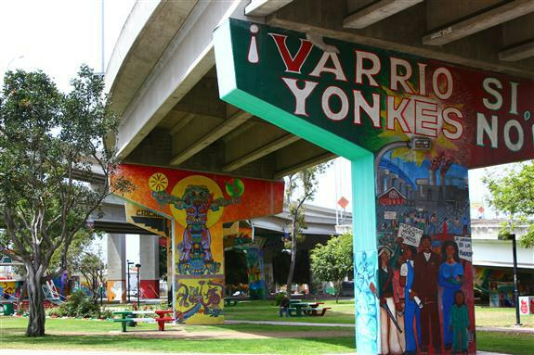

Slide 40
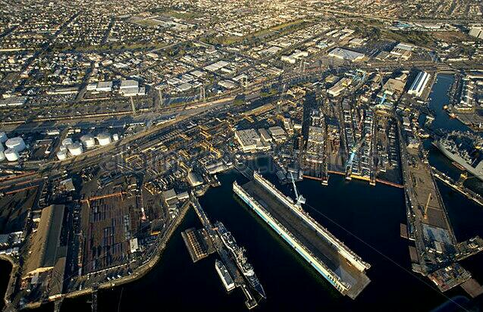

Slide 41
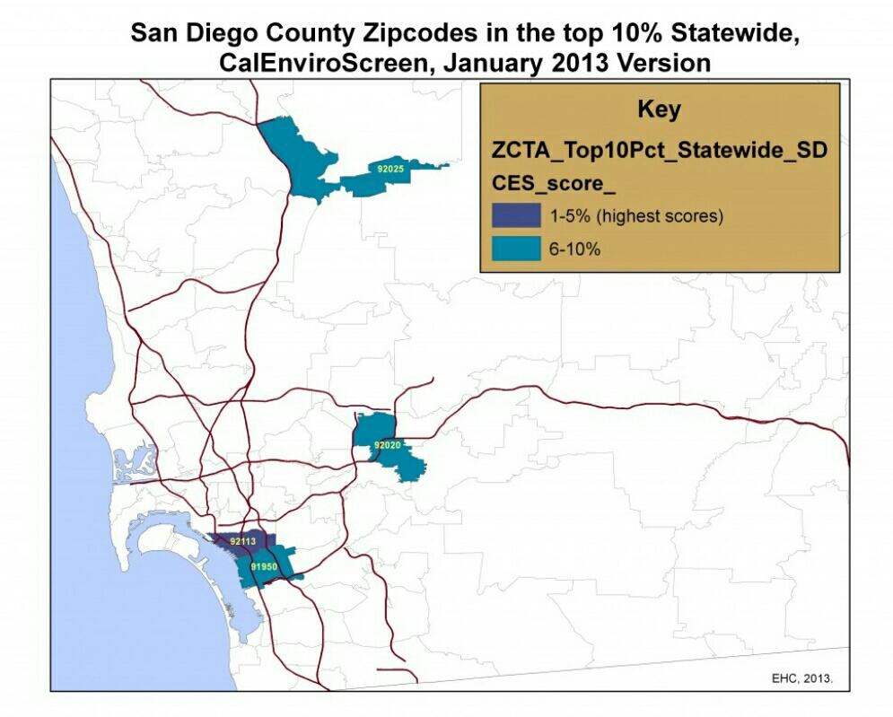

Slide 42
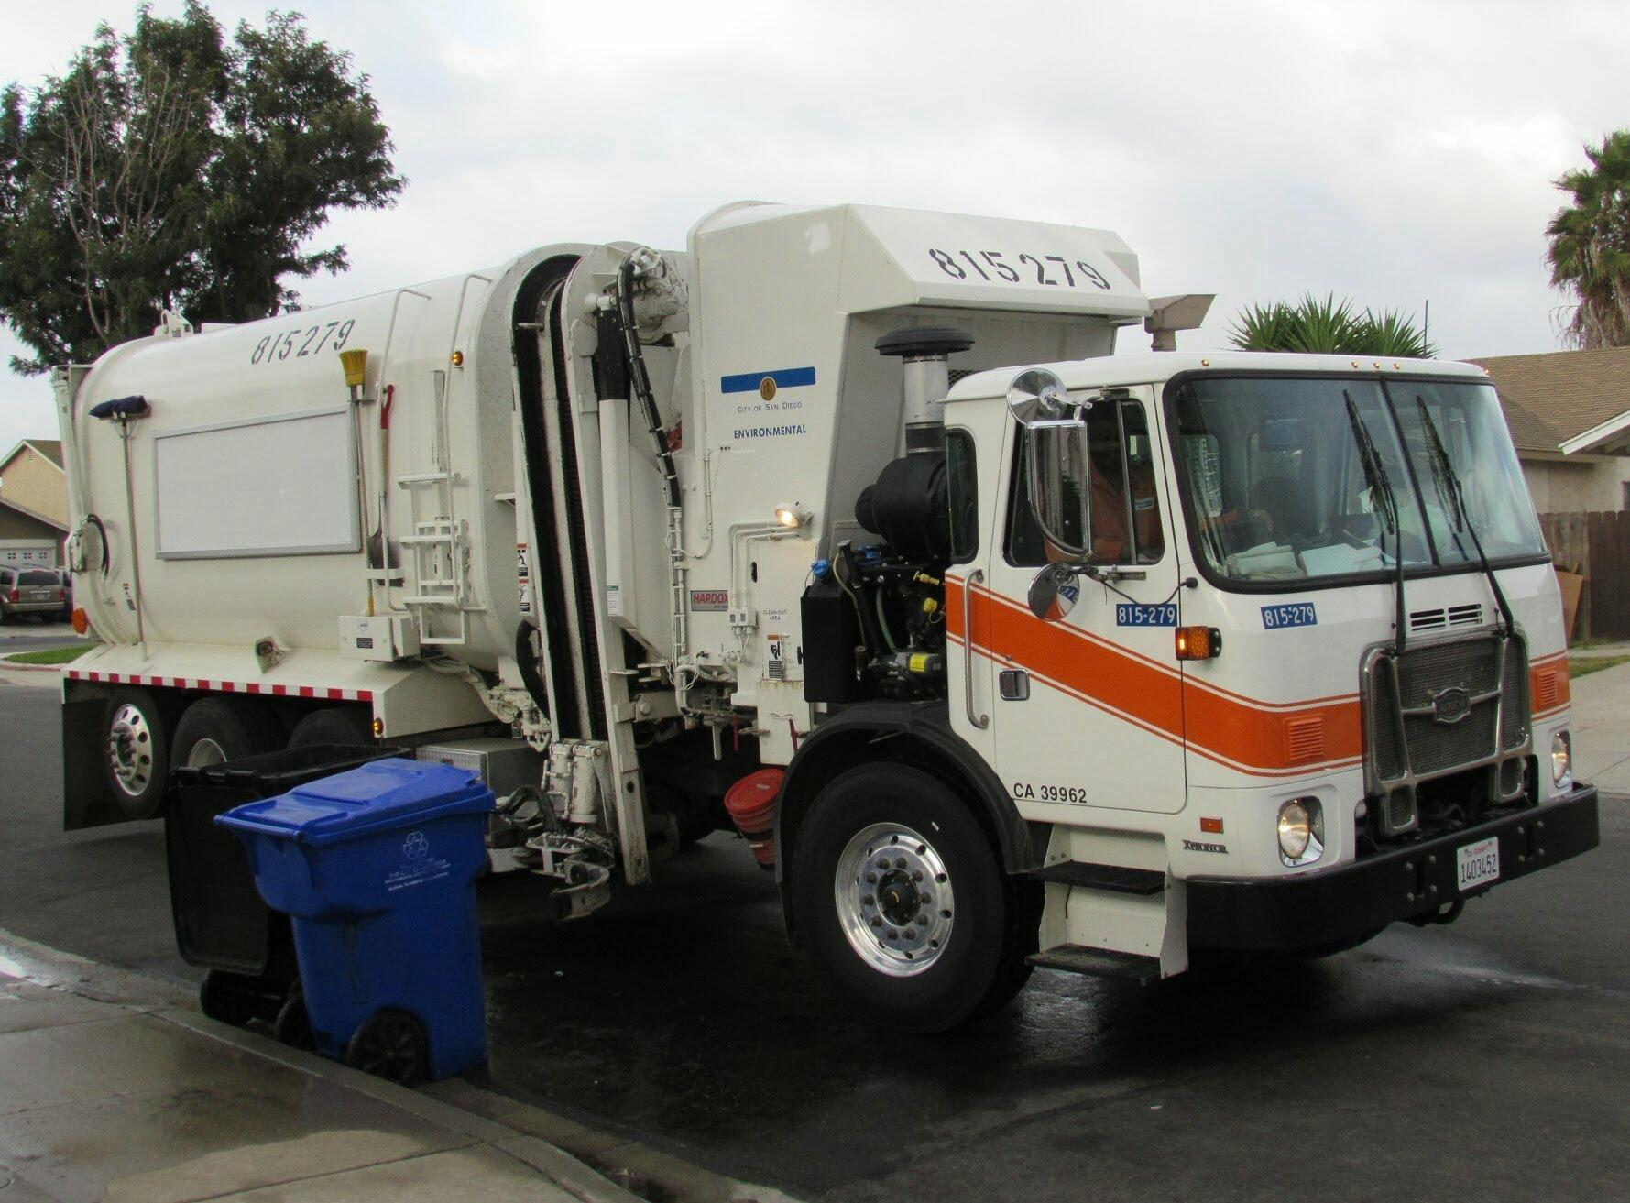

Slide 43
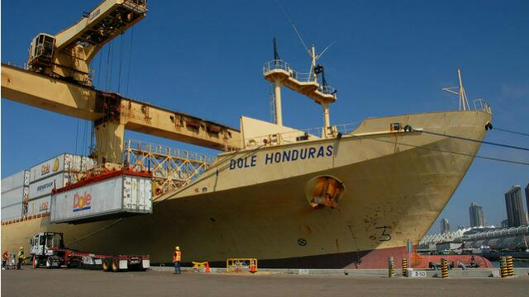

Slide 44
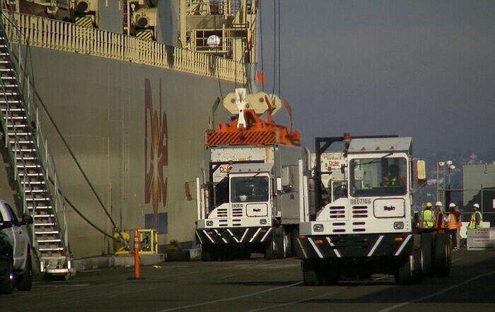

Slide 45
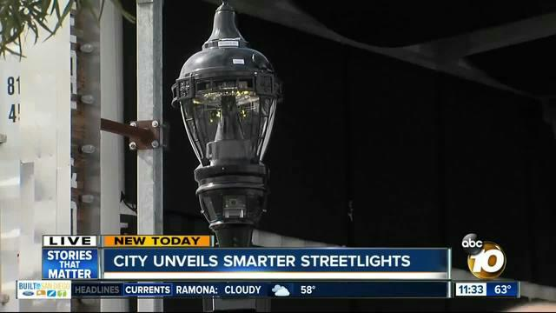

Slide 46
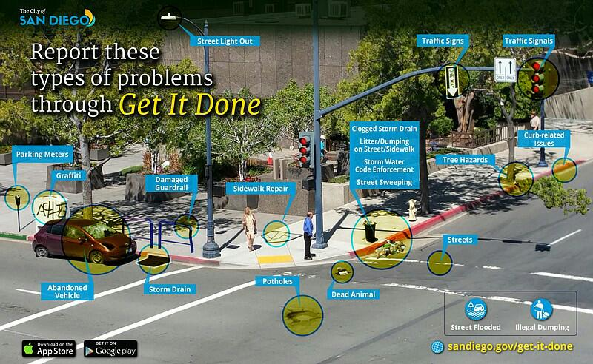

Slide 47
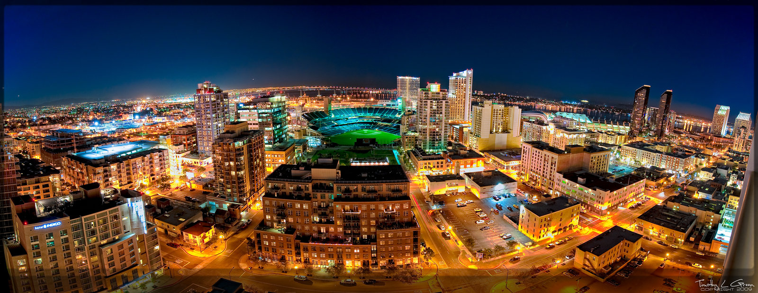
  “Cities have the capability of providing something for everybody, only because, and only when, they are created by everybody.” – Jane Jacobs

Slide 49
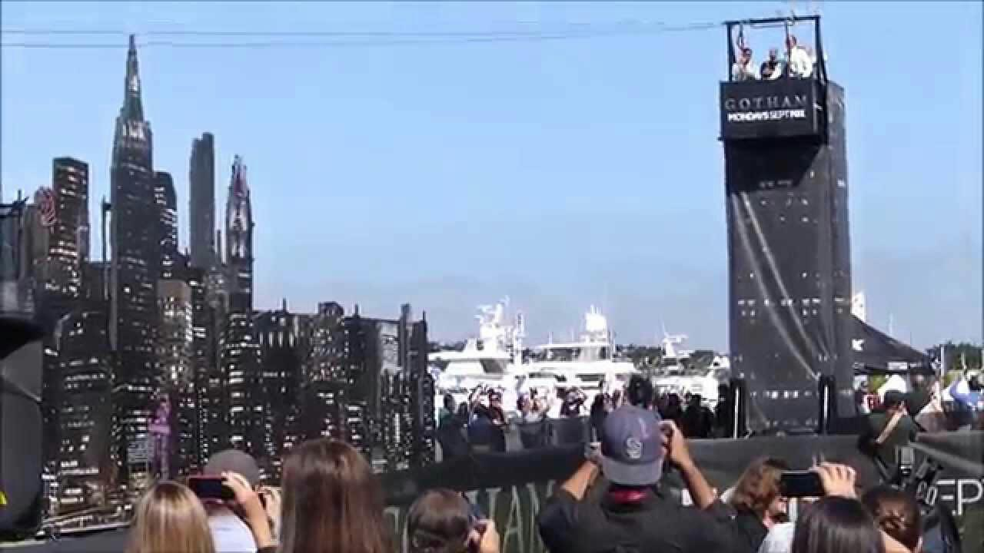

Slide 50
