Slide 1
A Coordinated Approach to Reduce Lead Exposure from Drinking Water
Gary Naumick
Vice President of Engineering and Asset Management
American Water
National Association of State Utility Consumer Advocates
2017 Mid-Year Meeting
June 5, 2017

Slide 2
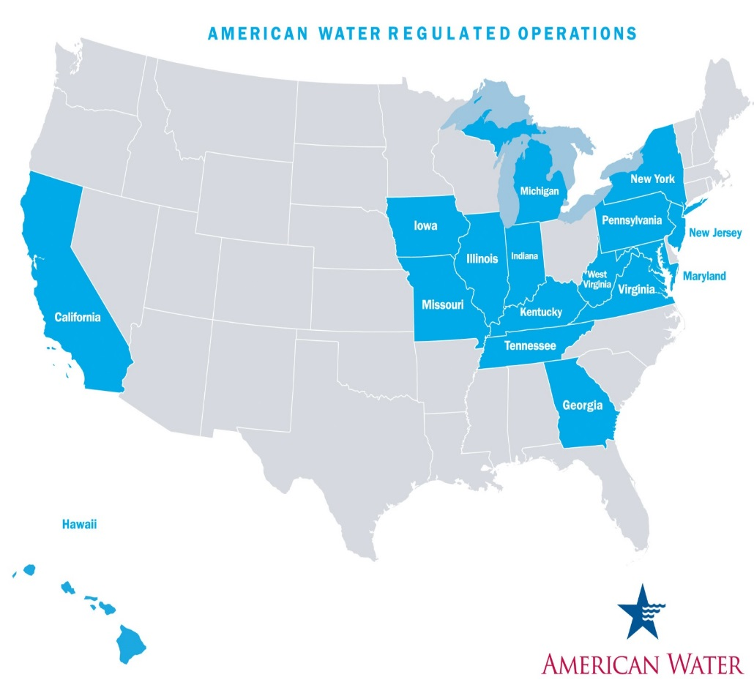
American Water Facts & Figures
We deliver water to over 3 million customers across the country
15 Million people served in 1,600 communities
Every day we operate and manage:
370 individual water systems
48,000 miles of distribution mains
81 surface water treatment plants
500 groundwater treatment plants
1,100 groundwater wells
1,200 treated water storage facilities

Slide 3
Lead In Drinking Water: Its Source
Not from source water
Lead in service lines or solder in plumbing fixtures
Prevalent in service lines in early to mid 1900’s; phase out date varies by location
Occurs in drinking water as result of corrosion
Notes:
1976-1980 median blood level of a child = 15 micrograms per deciliter
Current median B.L. = 1 ug/dL. Reduction due to removal of lead from gasoline & paints, reduction in plumbing fixtures, and reduced drinking water exposure.
Number of large systems with 90th percentile sample over 15 ppb reduced by 90% since LCR in 1991.
2010: 535,000 children had BLL of 5 ug/dL. In 2014, 8.5% of children with high BLL. (Ref.
Health effects – delays in physical and mental development in children, affects hematologic, gastrointestinal, cardiovascular systems. Kidney problems and High blood pressure in adults. Carcinogenic in children and adults.
CDC (Centers for Disease Control and Prevention), and EPA say safe level is ZERO.
1996 – Congress amended SDWA to prohibit lead fittings and fixtures. 2011 Lead Reduction Act reduced lead in fixtures from 8% to 0.25%.

Slide 4
Lead In Drinking Water: Health Effects
Neurotoxicant that can impact all organ systems, especially kidneys, red blood cells, and central nervous system
In children, slows down the development of the central nervous system and brain
NO SAFE LEVEL of childhood exposure to lead.
Notes:
1976-1980 median blood level of a child = 15 micrograms per deciliter
Current median B.L. = 1 ug/dL. Reduction due to removal of lead from gasoline & paints, reduction in plumbing fixtures, and reduced drinking water exposure.
Number of large systems with 90th percentile sample over 15 ppb reduced by 90% since LCR in 1991.
2010: 535,000 children had BLL of 5 ug/dL. In 2014, 8.5% of children with high BLL. (Ref.
Health effects – delays in physical and mental development in children, affects hematologic, gastrointestinal, cardiovascular systems. Kidney problems and High blood pressure in adults. Carcinogenic in children and adults.
CDC (Centers for Disease Control and Prevention), and EPA say safe level is ZERO.
1996 – Congress amended SDWA to prohibit lead fittings and fixtures. 2011 Lead Reduction Act reduced lead in fixtures from 8% to 0.25%.

Slide 5
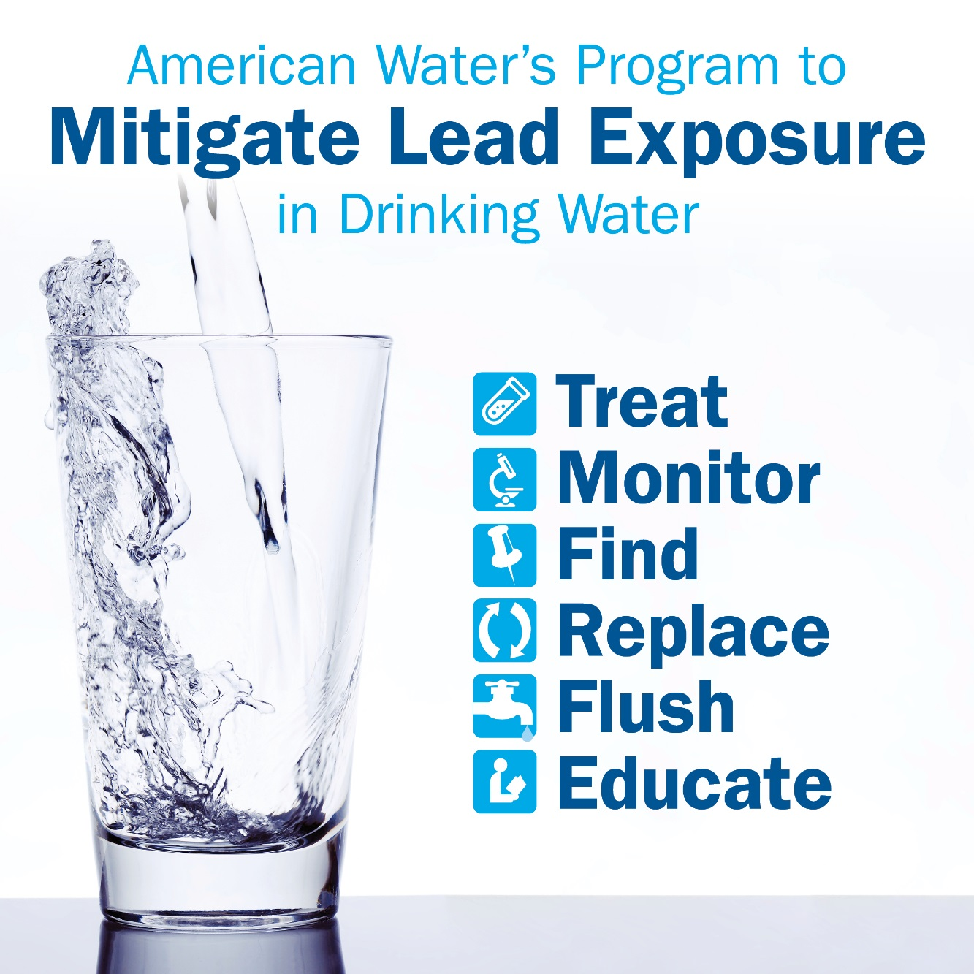

Slide 6
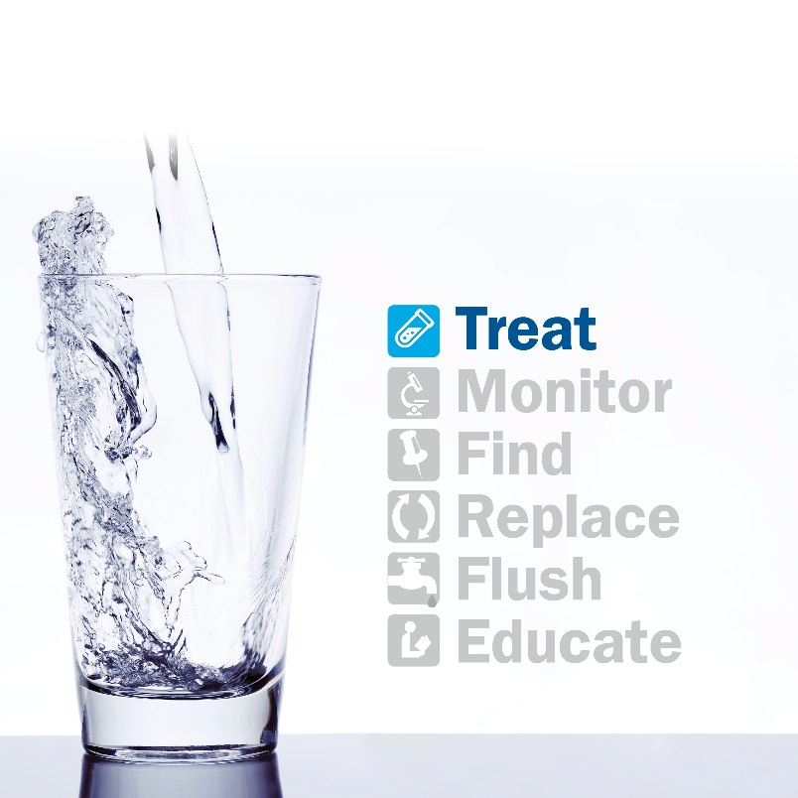
Corrosion control (or water chemistry) can effectively protect against release of lead
Vast majority systems have effectively treated for years
Issues & Challenges
Changes of source or treatment
Water chemistry changes
Disturbances within distribution system
Main breaks,
Infrastructure replacements
Notes:
Changes of source – every time start or stop purchased water (e.g., drought supply)
EPA White Paper: Road construction or maintenance of gas or buried power lines can cause disturbance of LSLs, in some cases introducing high levels of lead into drinking water through the release of lead particulates into the d.w. distribution system.

Slide 7
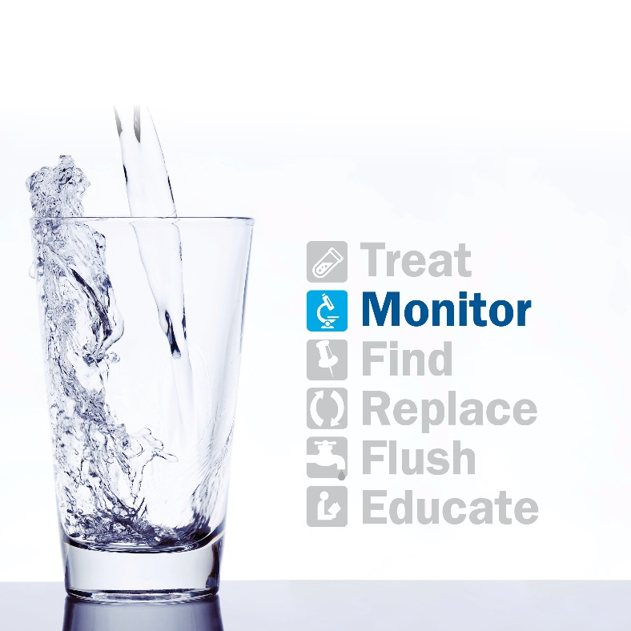
Most systems in compliance with Lead & Copper Rule
Issues & Challenges
LCR does not prevent individual exposures
LCR “Action Level” of 15 ug/L is based on effectiveness of corrosion control, not health effects
Lead concentration can vary
House to house
Time of day
Varies with water usage (flushing)
Notes:
LCR is a treatment rule, not an MCL. Monitors effectiveness of corrosion control, not health effects. Also, 90th percentile allows individual high results.
Water utilities have (unfairly) been accused on “gaming” compliance. It is difficult to find and retain sites meeting proper location, time and protocol of sample collection.

Slide 8
*Note: Pipe ownership limits may vary

Slide 9
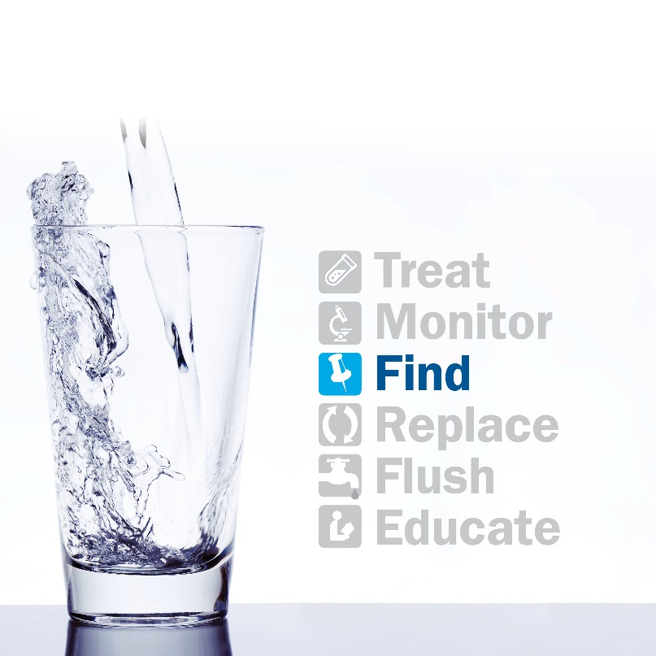
EPA estimates 6 to 10 million homes with Lead Service Lines (LSLs)
Issues & Challenges
Predominantly in older homes
Utility Records are often in paper form or may not exist
May not have record of customer-owned portion of service line
Notes:
EPA White Paper 2016: Estimated 6.5 to 10 million homes have LSLs or PLSLs
LSLs often in poorer urban environments – issue of environmental justice

Slide 10
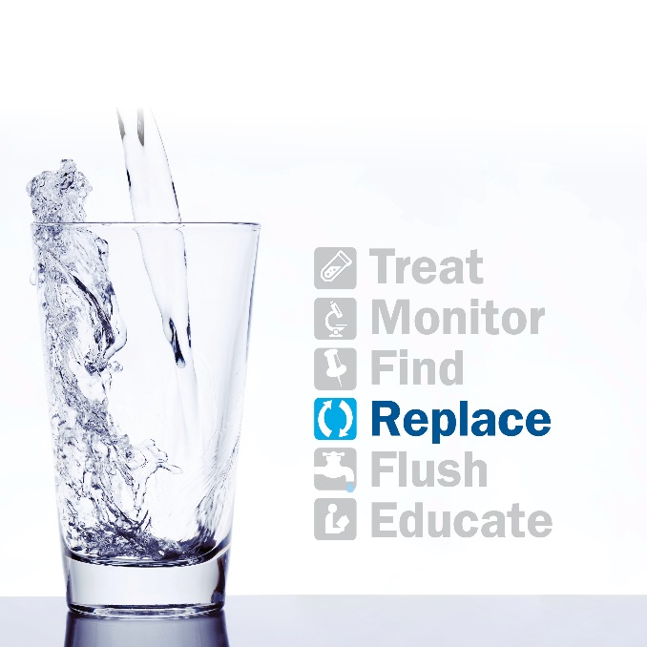
The goal of Full LSL removal endorsed by EPA, NDWAC, AWWA, stakeholders including 40+ child health agencies
Results in greatly reduced potential for exposure over long term
“Our communities will be safer in the long run with no lead pipes in the ground”
– David LaFrance - American Water Works Association, March 11, 2016
Notes:
40 Children’s Health Agencies recommended that Partial LSLRs should be banned (Oct. 2016)
Some cities have completed or are aggressively moving forward w/ full LSLR – Lansing MI; Madison WI; Boston MA.
No estimate available for benefit of reduced d.w. exposure → for lead paint reduction, est. benefit of $17 to $221. (Ref. Environmental Health Perspectives, 2009).

Slide 11
Issues & Challenges - Operational
Partial replacement can cause lead spike
Partial LSLRs discouraged or prohibited
In short term, avoid construction activity impacting LSLs – this is not sustainable long-term
Access / liability for conducting work on customer private property
Need comprehensive customer communication
Flushing, sampling
Electrical grounding
Notes:
Nationwide estimate of LSLs tracks w/AW estimate of 150,000 and cost of $500 to $800 million
Est. national cost of full LSLR = $2,500 to $8,000 per line
Cost recovery → consider customer-side as a restoration cost? E.g., similar to sidewalk repair

Slide 12
Issues & Challenges - Financial
Cost
Nationwide estimate $30 billion
Customer ability to pay for removal of customer-owned portion of LSL
Often lower income residents served by LSLs
Cost recovery
Part of long term infrastructure renewal program
Consider customer-owned LSLR as part of project (i.e., similar to road, sidewalk, landscaping restoration)
Notes:
Nationwide estimate of LSLs tracks w/AW estimate of 150,000 and cost of $500 to $800 million
Est. national cost of full LSLR = $2,500 to $8,000 per line
Cost recovery → consider customer-side as a restoration cost? E.g., similar to sidewalk repair

Slide 13
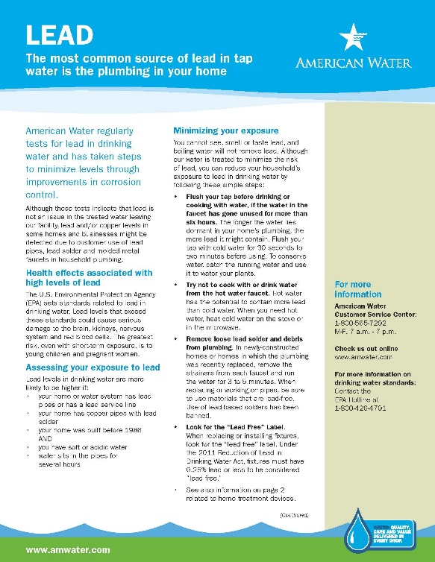
Necessary component of any plan
Customer information
All customers
Before and after construction or LSLR
Schools, child care
& health facilities
Timely, multi-lingual
Notes:
When doing construction, MUST inform customer to flush and protect (don’t drink, use filter, etc.). Especially tough for multi-family

Slide 14
Summary: A Proactive Response is Essential for Our Customers
A variety of stakeholders urge full LSL removal
Removal of LSLs is an expensive but finite problem
Consider as part of infrastructure renewal program
Collaboration and customer education are necessary components
Constructive regulation to enable capital investment can help to mitigate lead exposure
Notes:
To protect public health, we must tackle the infrastructure problem of LSLs.
This is in the long-term best interests of our customers.
Conclusion: Full LSLR should be high priority. If a water system has a capital program, it can be re-prioritized to include LSLR over 10-20 years. Need cost recovery and indemnification for work on private property.
Public health protection is our highest priority.

