Slide 1
Why Should Consumer Advocates Care About Pole Attachment?

Slide 2
Maureen Hopkins
Director, Real Estate, Tilson Technology Management, Inc.
Allen Bell
Distribution Manager, Georgia Power Company
Dave Thomas
Partner, Sheppard Mullen
Joseph A. Rosenthal
Principal Attorney, Connecticut Office of Consumer Counsel

Slide 3
47 U.S.C. § 224(c)

Slide 4
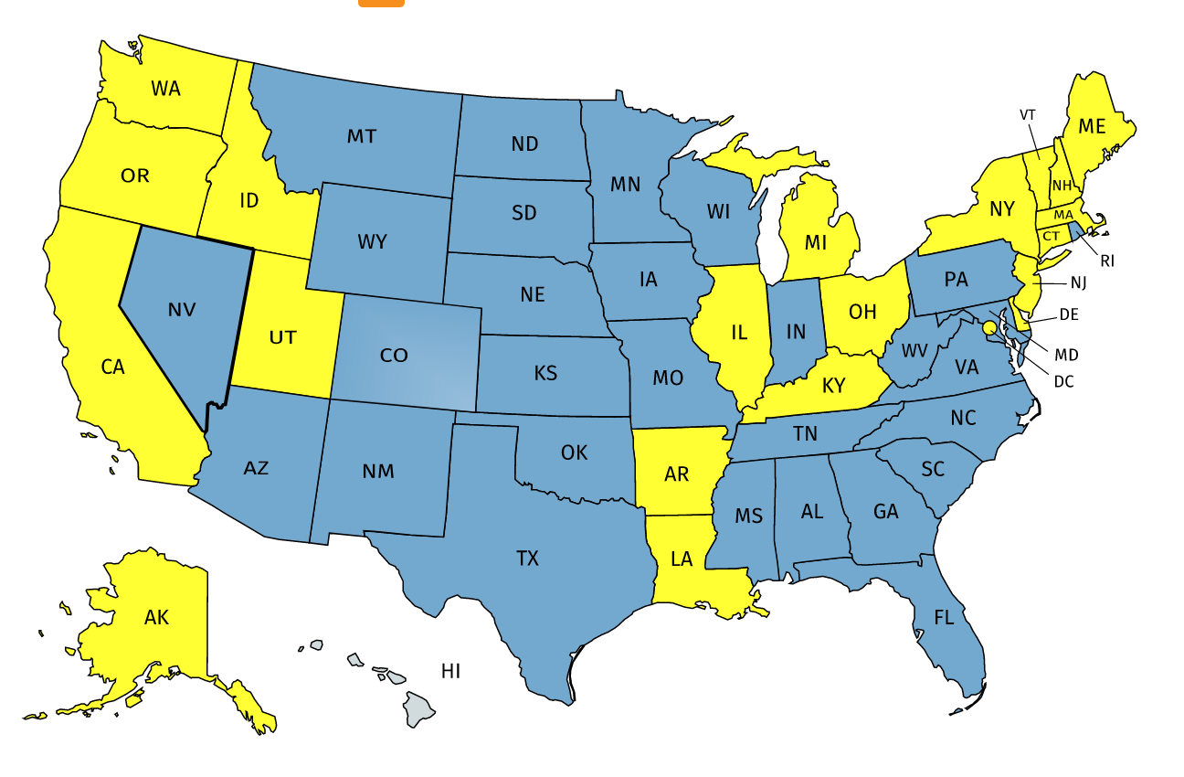

Slide 5
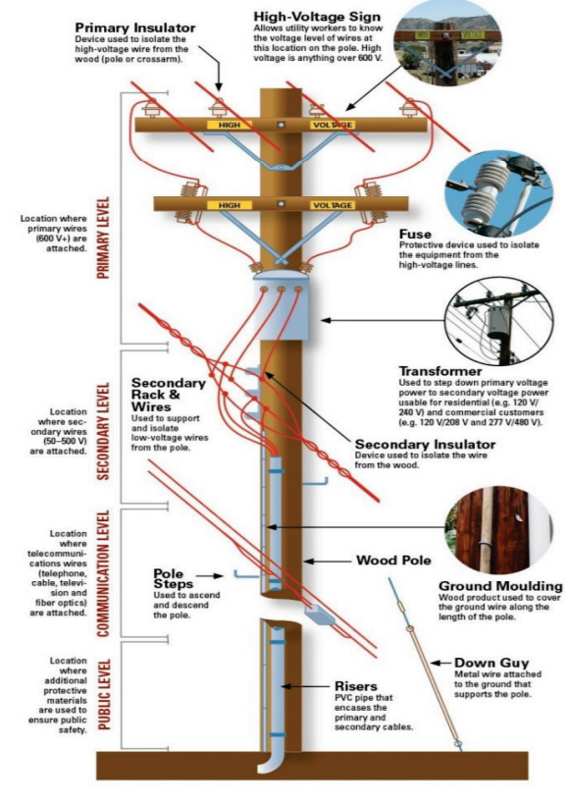

Slide 7
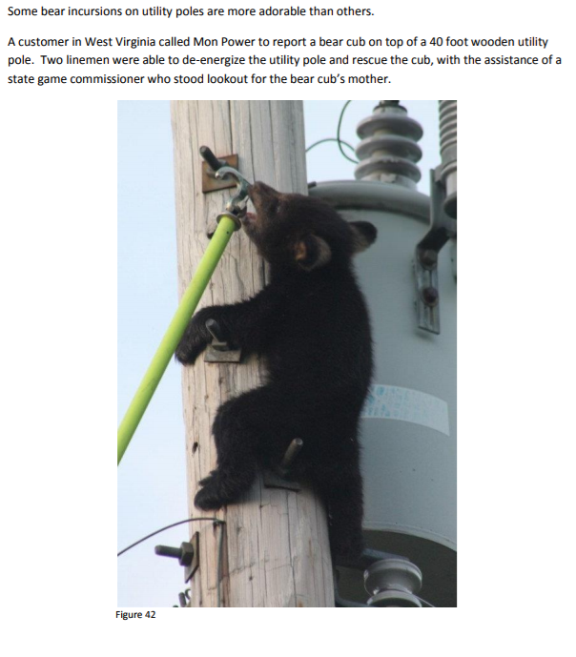

Slide 8
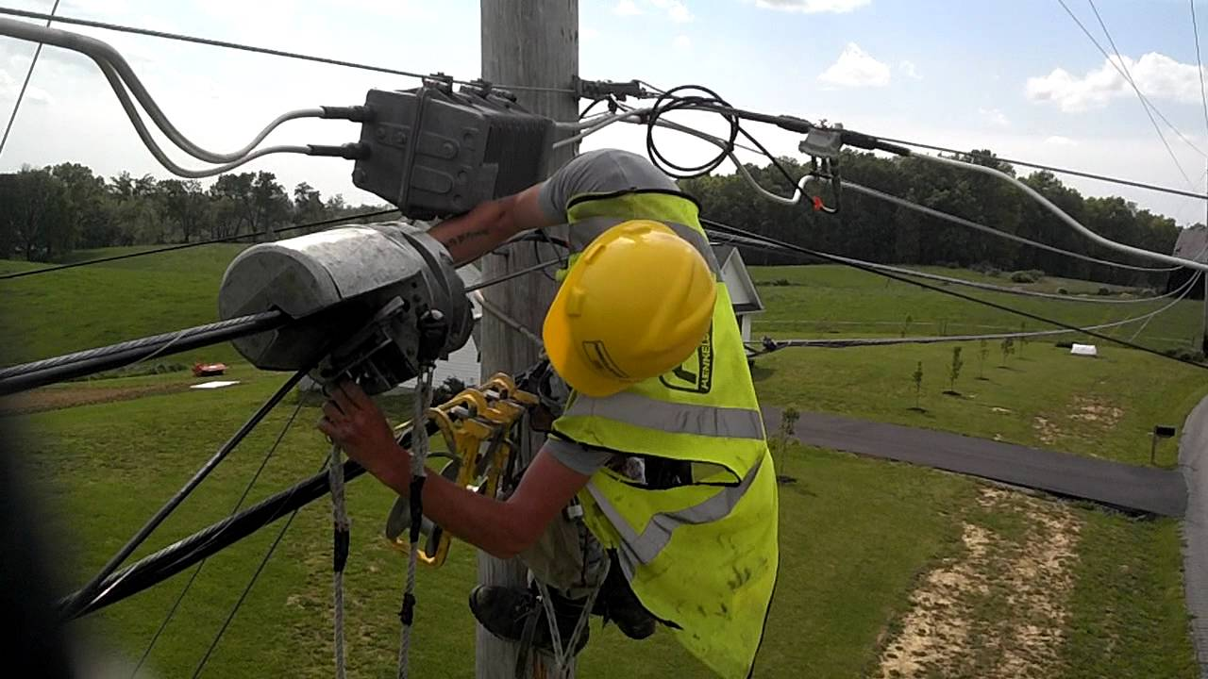

Slide 9
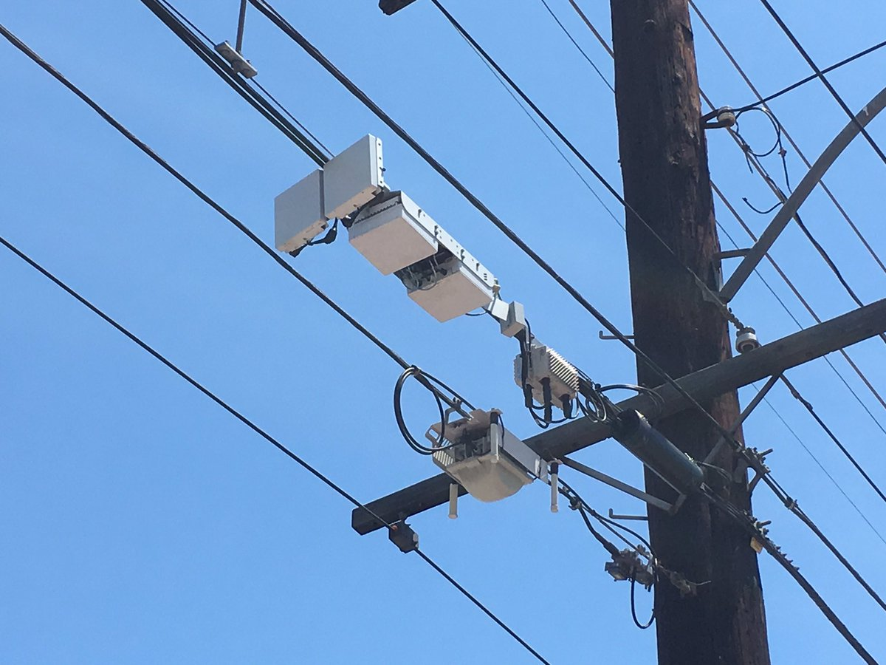

Slide 10
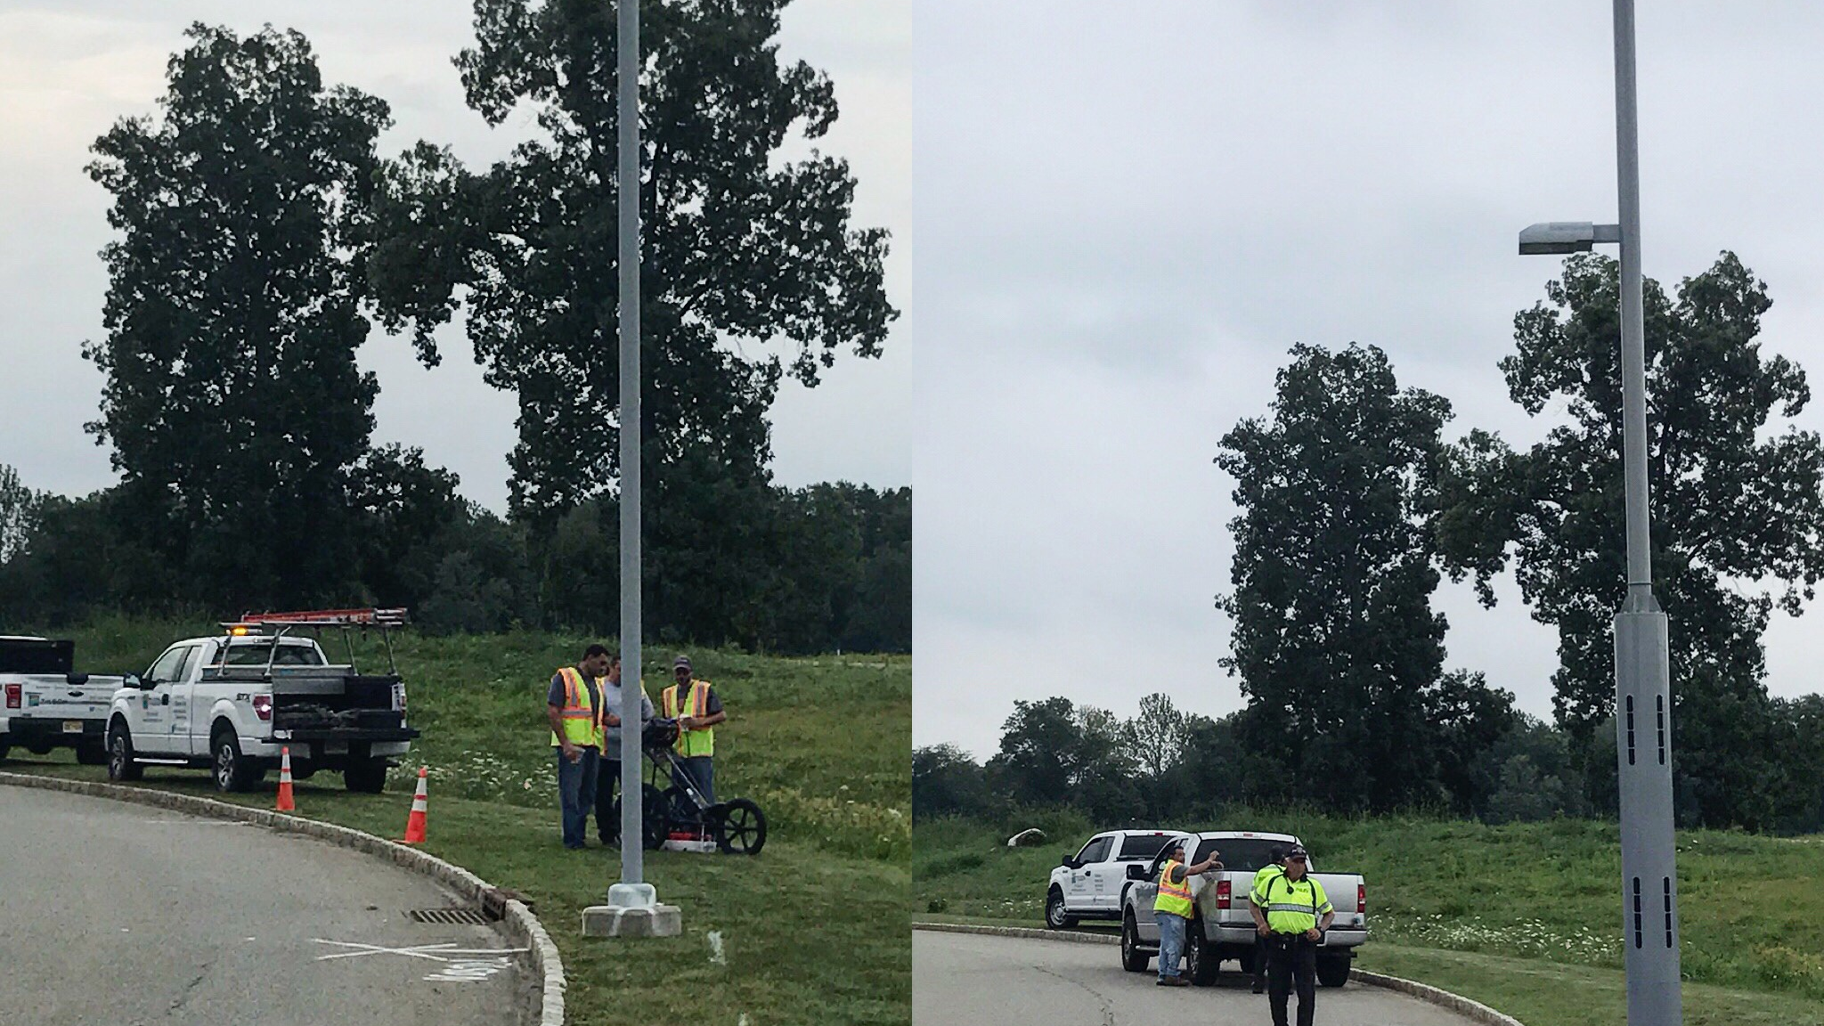

Slide 11
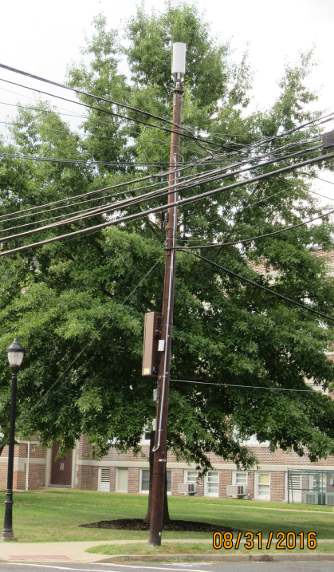

Slide 12
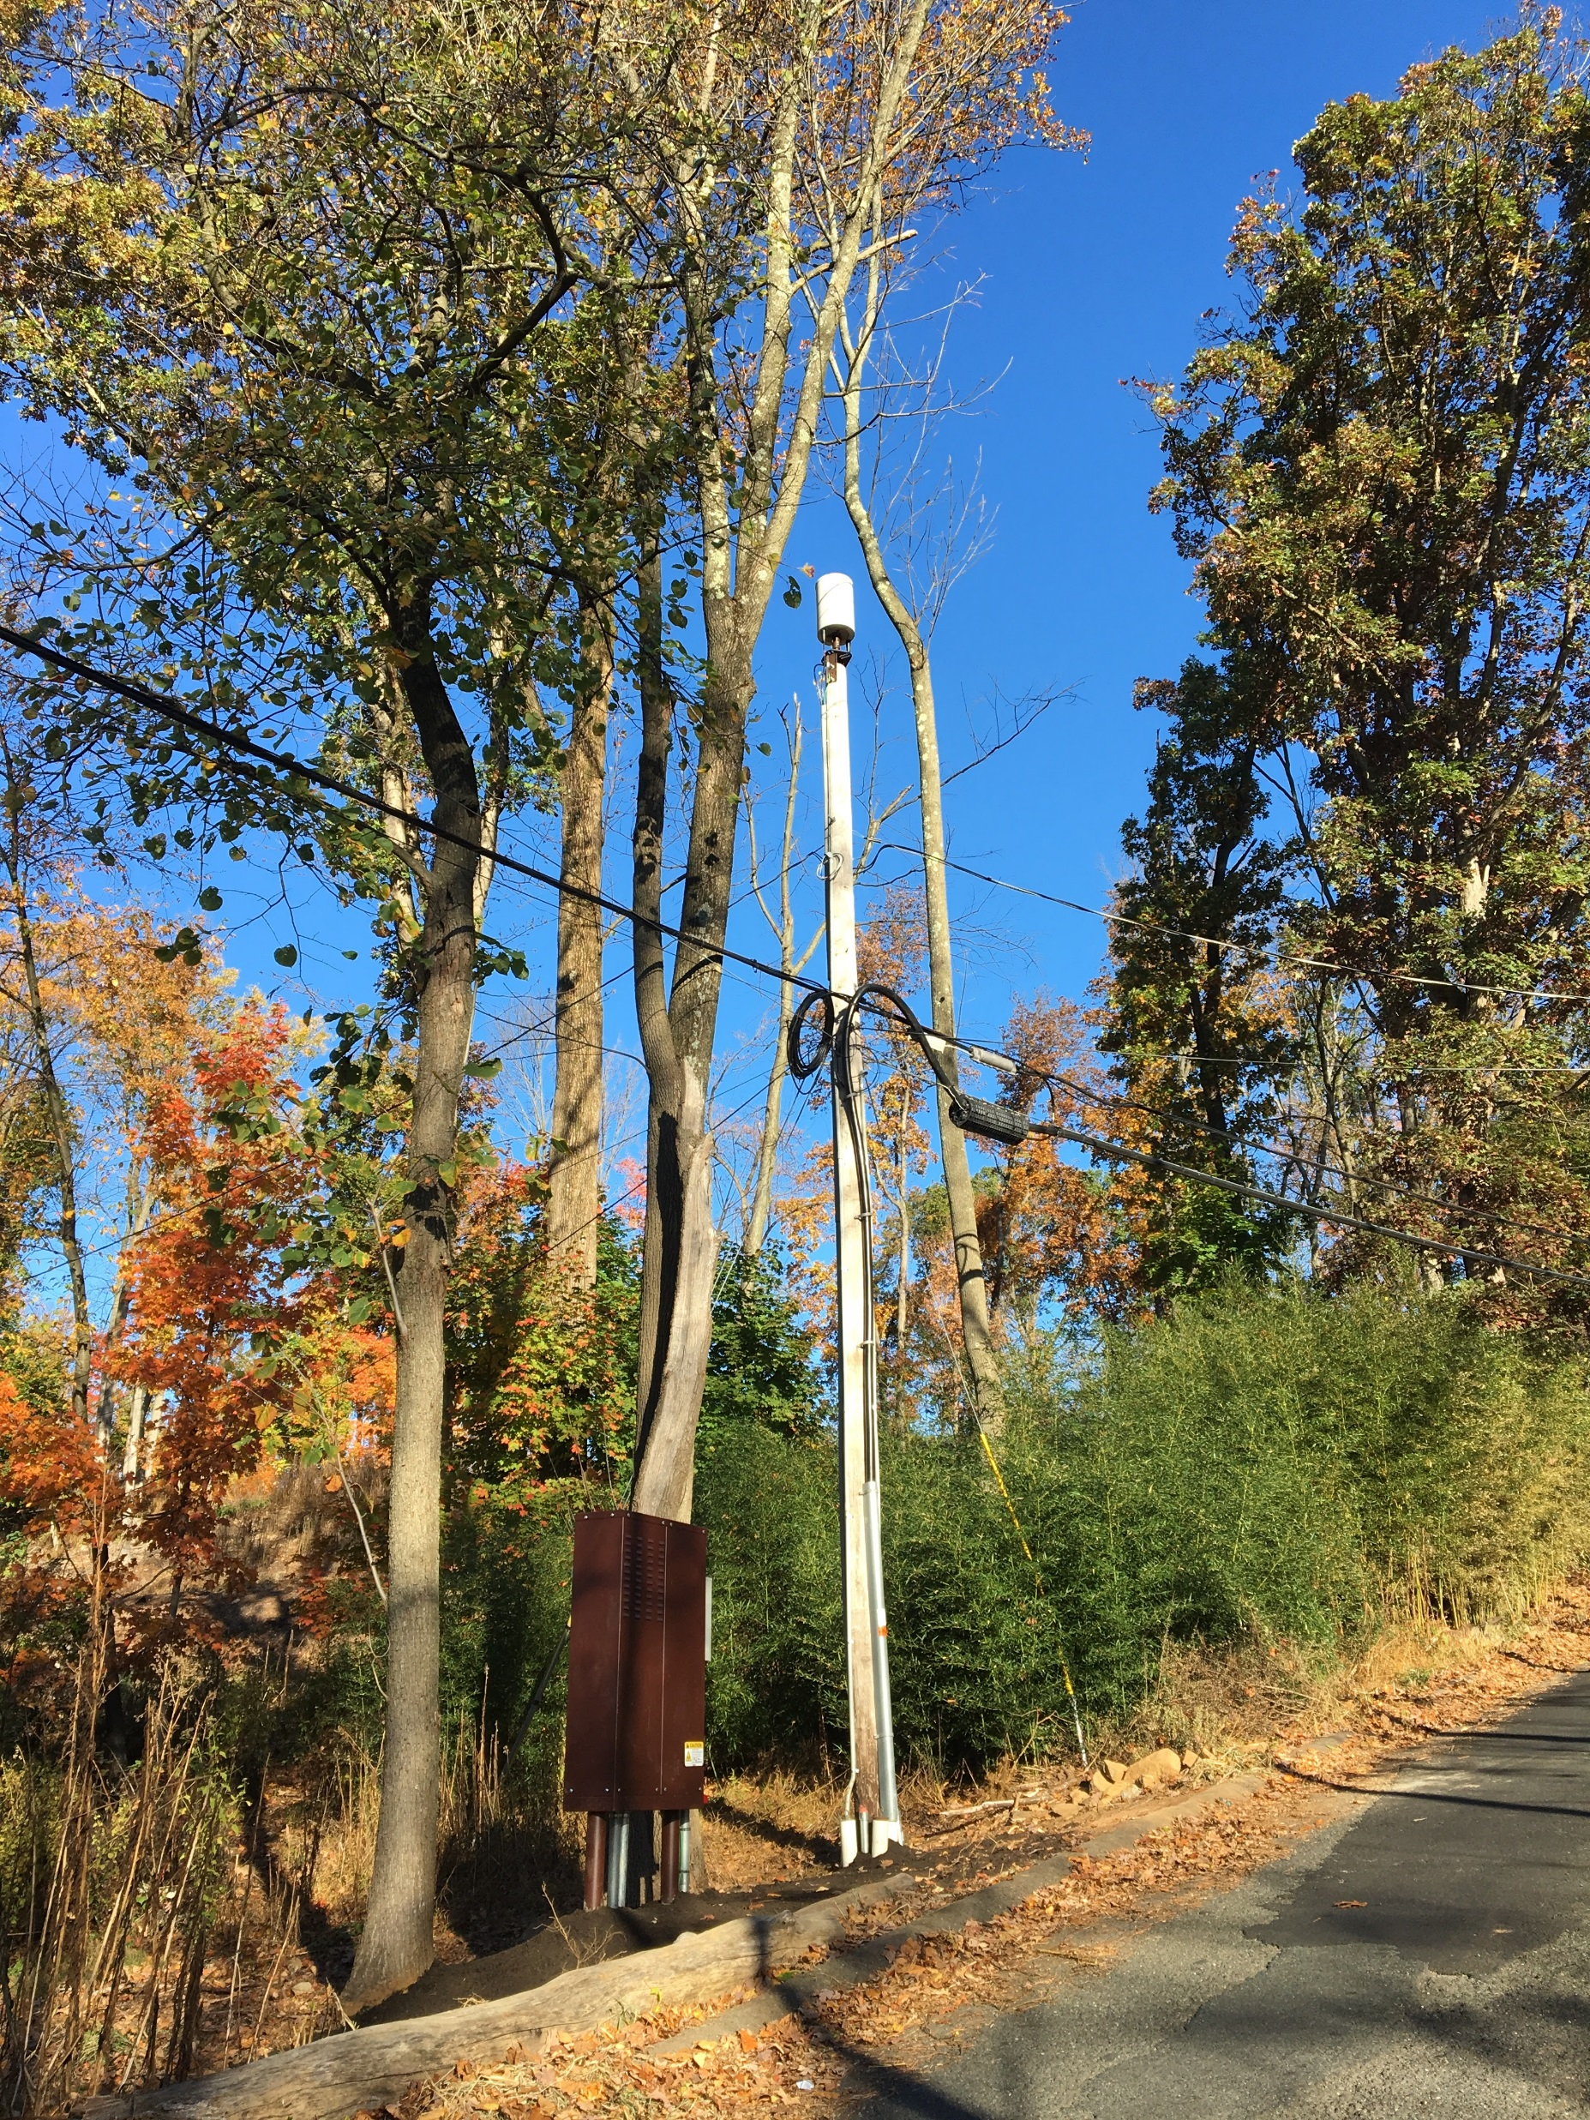

Slide 13
