Slide 1
Hughes v. Talen Energy Mktg., LLC,
136 S.Ct. 1288 (April 19, 2016)
Seth Hollander
Assistant Attorney General ,
Connecticut Office of the Attorney General
* The views expressed here are not necessarily the views of the Connecticut Office of the Attorney General

Slide 2
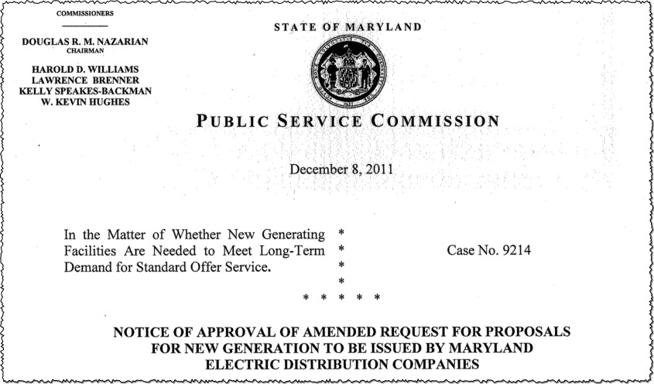
What Was Maryland Up To?

Slide 4
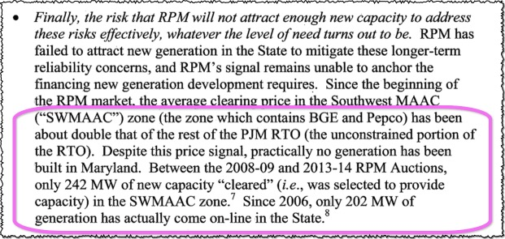

Slide 5
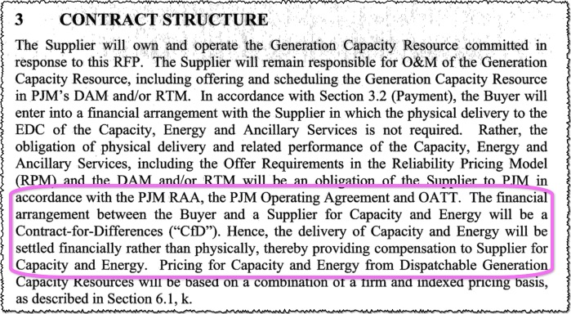

Slide 6
Difference Between Contract Capacity Price
and PJM Capacity Auction Clearing Price
$10/kW Month
Contract Capacity Price
$4.50/kW Month
Capacity Auction Clearing Price
$10 – $4.50 = $5.50
$5.50 * Quantity = Contract Payment from EDC/ratepayers to generator

Slide 7
Difference Between Contract Capacity Price
and PJM Capacity Auction Clearing Price
$10/kW Month
Contract Capacity Price
$7/kW Month
Capacity Auction Clearing Price
$10 – $7 = $3
$3 * Quantity = Contract Payment from EDC/ratepayers to generator

Slide 8
Difference Between Contract Capacity Price
and PJM Capacity Auction Clearing Price
$15/kW Month
Capacity Auction Clearing Price
$10/kW Month
Contract Capacity Price
$10 – $15 = $-5
$-5 * Quantity = Contract Payment from generator to EDC/ratepayers

Slide 9
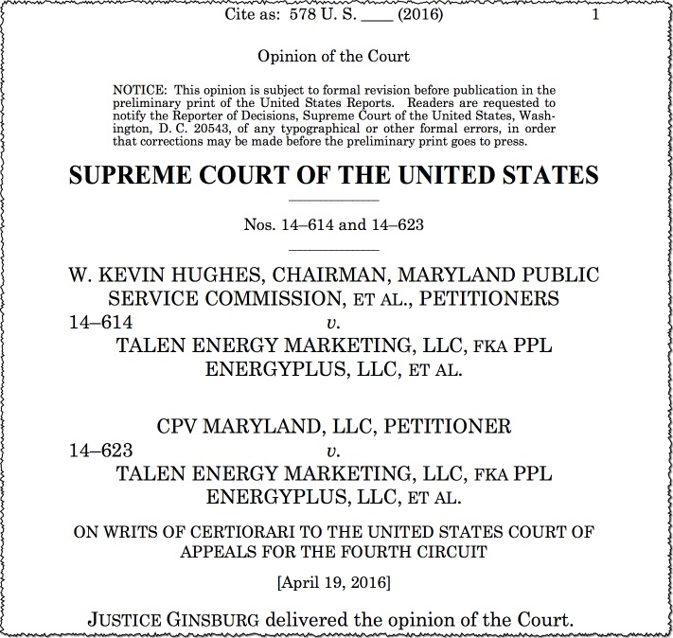

Slide 10
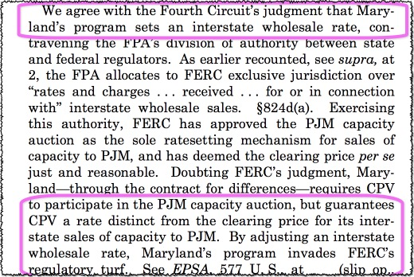
Setting Wholesale Rates

Slide 11
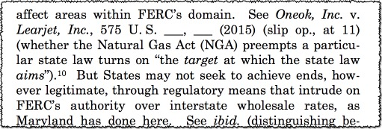
What About State Exercise of Allocated Authority Under the FPA?

Slide 12
Difference Between Bilateral Contracts and Contracts-for-Differences
Solicitor General
Hughes
Court

Slide 13
