Slide 1


The Rooftop Solar Revolution
Implications for Consumer Advocates
Lon Huber
Tim Schneider

Slide 2
Topics
Compensating Distributed Generation
Net Metering
The Cost Shift Debate
Valuing Solar
Classifying Solar
Taxonomy of Policy Proposals

Slide 3
Disclaimer
This section of the presentation attempts to highlight issues some consumer advocates are facing in their respective jurisdictions.
Nothing contained in these slides represents an official position of NASUCA or its member offices.
Notes:
Solar Energy Industries Association, since 2006, costs to install solar have dropped by 73%, and residential solar costs have declined 45% since 2010

Slide 4
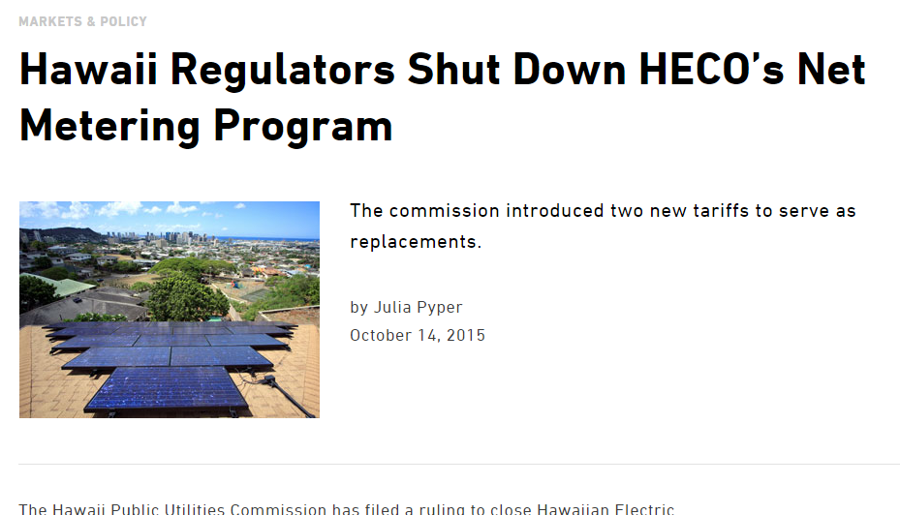
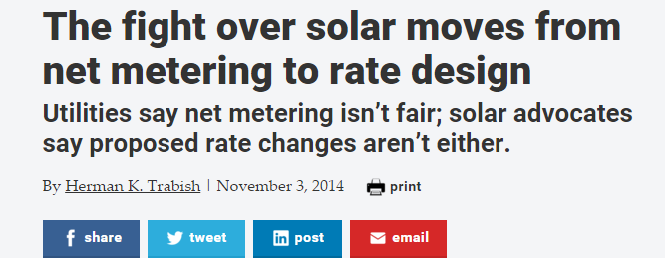
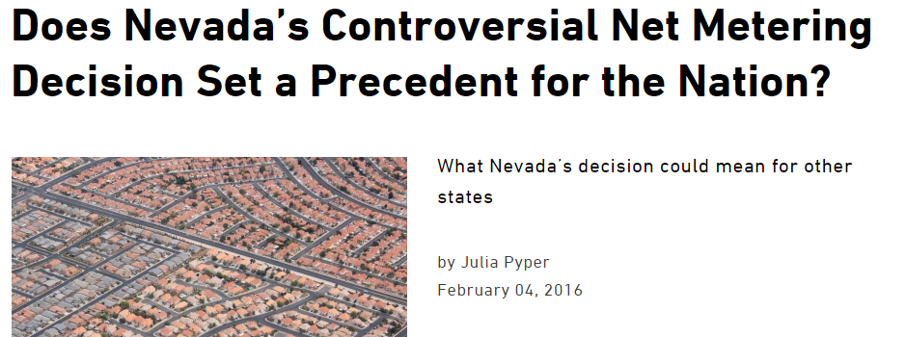
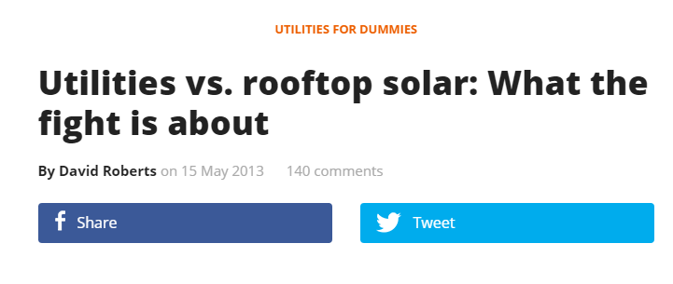
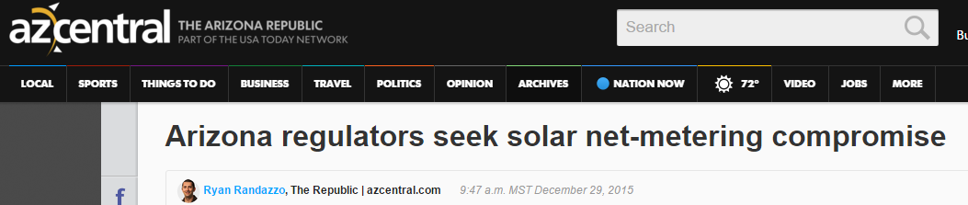
Introduction: Clips from Around the Country
Notes:
Rooftop solar markets are prominently based off of full retail NEM. Which has led to policy fights, uneven roll out of DG within markets, and business uncertainty solar installers.

Slide 5

How is DG being “Compensated”
Three core methods, each with countless variations:
Retail rate offset (think: light LED lightbulb)
Outside retail rate compensation ( think: bill credit)
A mix of both (think: demand response with performance incentives)

Slide 6
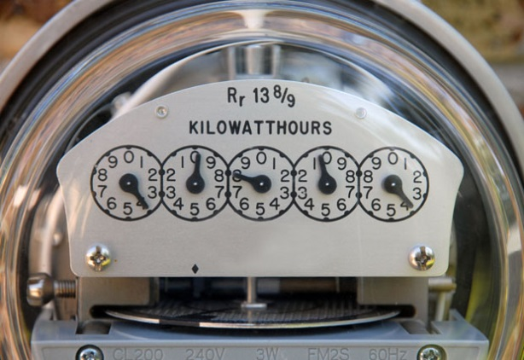
Full Retail Net Metering
For solar, net metering remains the primary compensation mechanism driving growth in the residential sector.
Full Retail Net Metering (NEM): A one-for-one volumetric kWh hour offset, usually with an annual true up.
  There can be variations.
Net metering lays on top of a customer’s rate plan.
  The compensation rate for solar DG relies
  on the underlying kWh charges,
  surcharges, and taxes.
Simple and easy to understand.

Slide 7
Concerns with Full Retail NEM
“Cost shifting” remains primary concern expressed by utilities and net metering opponents, but there are others:
  Limited transparency in allocation of costs & benefits.
  Lack of long-term market certainty for adopters without continual “grandfathering”.
  May not capture all the benefits of solar generation.
  May not take advantage of technology cost declines.
  Absent community solar or “virtual” net metering, may not be available to all customers.

Slide 8
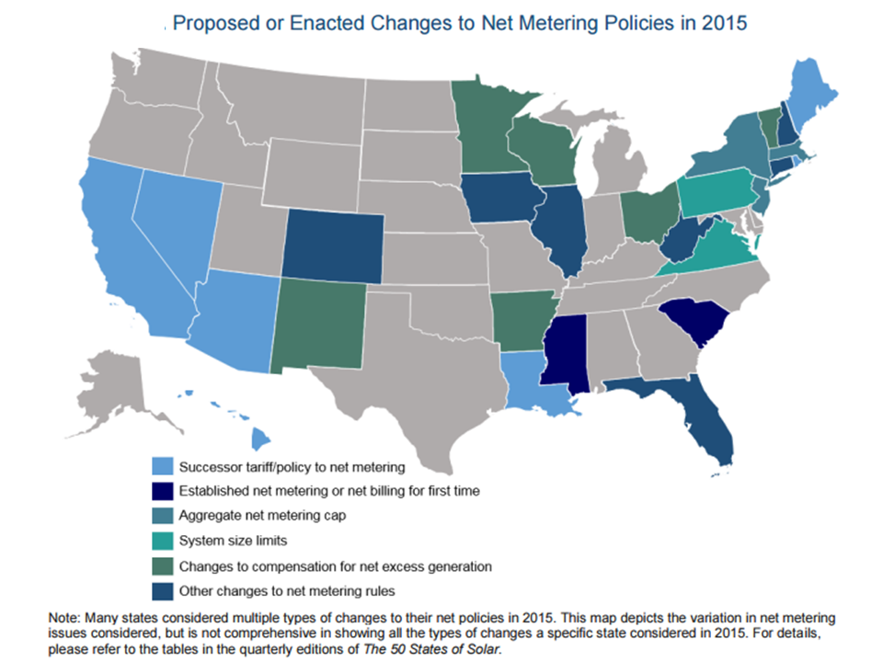
States Considering Changes to Net Metering

Slide 9

The Cost Shift Debate
Revenue requirement shift from adopters to non adopters
  Not necessarily a new problem
Two ways to examine the cost shift:
  Next Day
  Long-term
There is little debate about the “next day” cost shift; however, there is much debate about how to measure the long-term cost shift.
Many studies have been done to ascertain the net cost shift or benefit (value of solar) over different time periods.
  Results can vary sustainability due to:
    The jurisdiction
    Time frame of examination
    The cost and benefit categories being studied

Slide 10
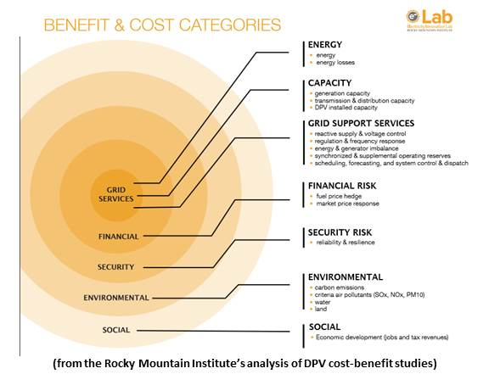
Value of Solar
PUCs, solar companies, utilities, and many others have commissioned “value of solar” studies or tools.
  Like any forward looking forecast, there is much debate around assumptions.
  Some benefits and costs can be very hard to quantify and/or subjective.
  Wide variations in categories and values between studies

Slide 11
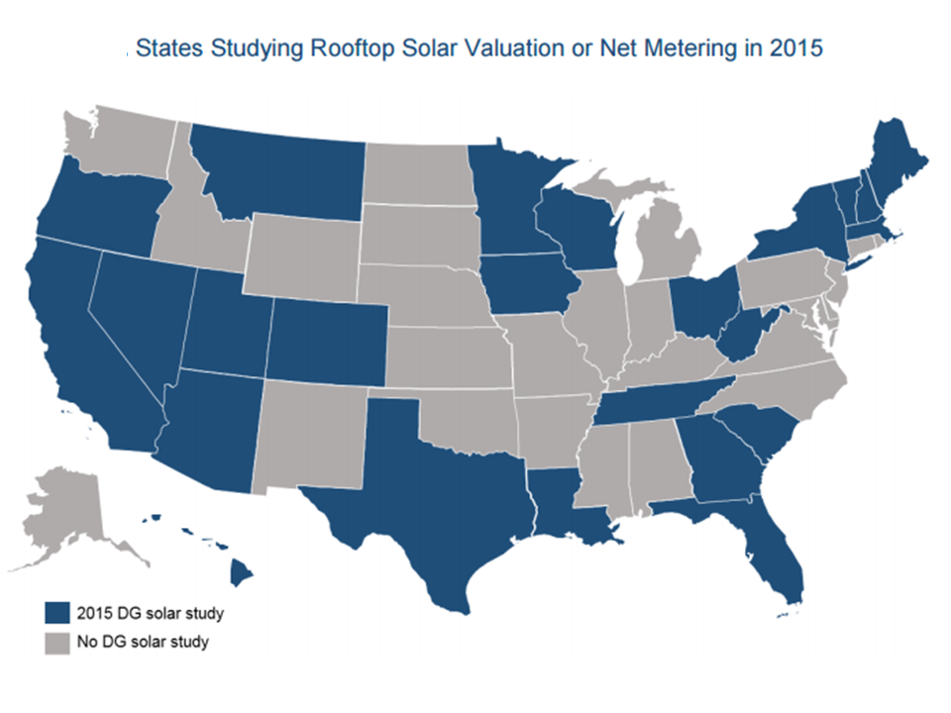
States Studying Value of Solar

Slide 12
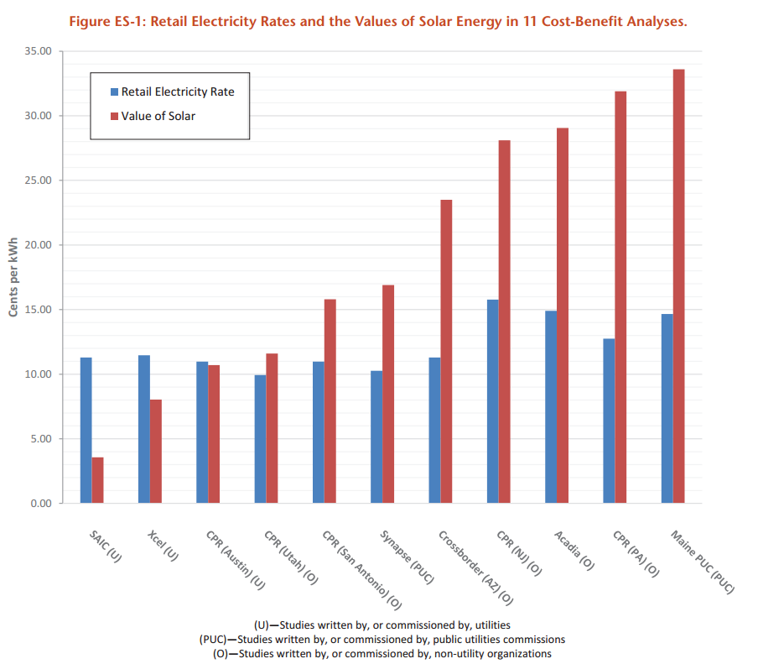
Should Utilities Pay the “Value of Solar”?
Some stakeholders call for payments equal to value under so-called “value of solar tariffs”
  Examples: Minnesota, Austin Power
Paying a fully loaded value rate may yield a net neutral value proposition for non-participants.
To date, value of solar studies have primarily been used to support continuation of retail net metering, by supporting a finding that net metering provides “rough justice”

Slide 13
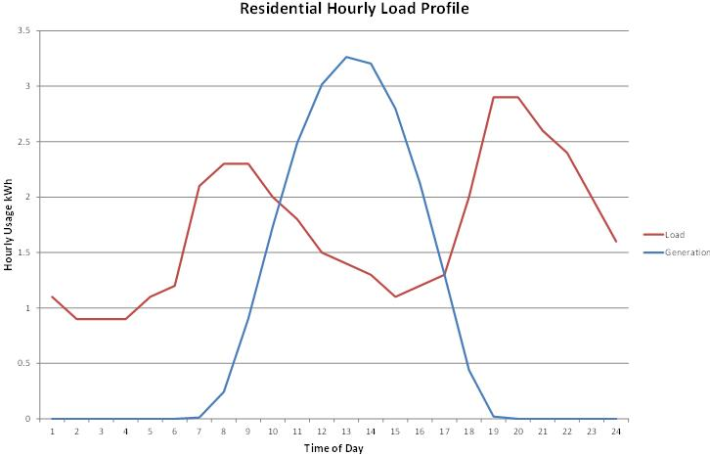
Exports vs. Self Consumption
Illustrative
Illustrative

Slide 14

Solar Self Consumption and Energy Efficiency
Many of the arguments about self consumption of DG may also implicate energy efficiency:
  Self consumption provides the same value to the customer as EE, by offsetting the retail rate.
  Low penetrations of PV can be seen as load reducing to the grid operator.
  A small PV system could “look like” a large energy efficiency retrofit during those periods when it does not export.

Slide 15
Differentiating Solar and Energy Efficiency
There are reasons why regulators may wish to treat EE differently than DG:
  PV is load masking not reducing.
  Benefits are more concentrated and exclusive.
  Less diverse grid impacts than EE.
  Peak demand may stay constant while bill can go to zero.
At a minimum, some strategies to address cost shifting concerns should be evaluated to determine impact on incentives for energy efficiency.

Slide 16
Proposals Responding to Net Metering
Do nothing, current rate designs provide “rough justice”
Treat solar adopters as a unique sub class and assign special tariff or fixed charges.
Solar as a Sub Class
Special Tariff
Demand Charge Based
Fixed Charges
By kW or in Customer Charge
VOST/Bill Credit
Buy All, Sell All

Slide 17
Examples of Solar Only Policy Proposals
Salt River Project
  Special demand charge based rate plan with a higher customer charge
  $32 fixed charge and ~$9 to $30 kW demand charge
Hawaii
  Proposal to increase the minimum bill for solar customers to $25 (up from ~$17 for all residential customers on Oahu). Adopted by PUC
  Replaced net metering with two new price options: Grid Supply (reduced credit rate for exports from retail to wholesale) and Self Supply (no exports permitted).
Nevada
  A phased-in decrease of export rate over 12 years
  $12.75 to $17.90 increase in fixed charge that continues to increase over time up to $38.50

Slide 18
Party Proposals from Across the Country
3. No differentiation between solar adopter and traditional customer: apply policies to address or replace
net metering to all customers
Traditional Customer
Mandatory Rates
Demand Charge Based
Export Policies
Value of solar or a proxy
Higher fixed charges
TOU Rates
At wholesale rate
No export

Slide 19
Examples of Universal Policy Proposals
Many of these proposals involve implementing measures that consumer advocates have expressed concerns about in the past.
  Rarely is solar ever cited as the sole reason for the policy change
Mandatory residential demand charges – UNS Energy and APS
TOU rates – California IOUs
Fixed charges or hybrid approaches:
  National Grid (MA/RI) 2016 Proposal
    Increased, tiered fixed charge for all customers (rejected in RI)
    Introduced per kW “access fee” for standalone solar DG facilities (rejected in RI)
    MA decision pending
  Westar 2015
    Proposed increase in fixed charge for all customers from $12 to $27 per month ($14.50 adopted)
    Two options for solar customers: increased customer charge (~$50/month) or demand rate ($10/kW summer, $3/kW winter, 30 min NCP); ultimately deferred to future
  We Energies 2014 Proposal
    Increased fixed charge for all customers from $9 to $16
    Proposed $3.79/kW charge for solar customers (overturned on appeal)

Slide 20

The Questions Before Us
Can there be a common methodology to approach DG valuations?
  How does the value of larger scale solar influence this?
How should solar production be treated?
  Lessons from EE or partial requirement customers?
To what extent do residential rate designs have to change?
  What if technology keeps advancing and gets cheaper?

Slide 21
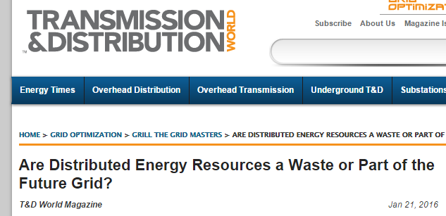
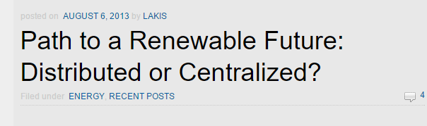
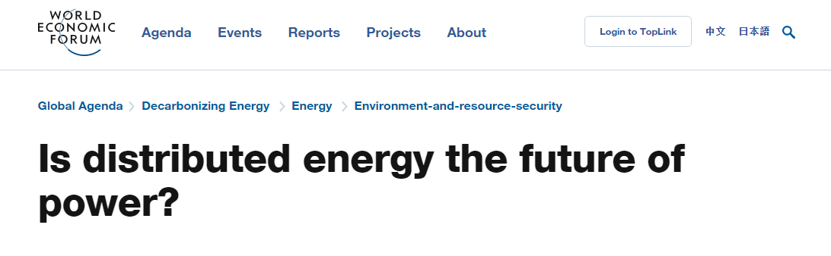
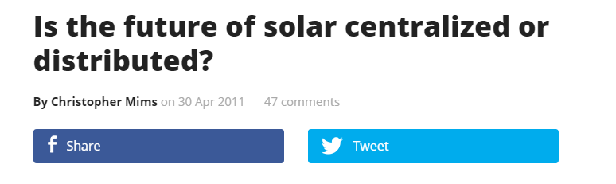


Moving Forward
Notes:
It is unclear how technology will evolve. DG lacks economies of scale but may be able to make up for it with location specific value stacking. The future is likely some combination of both. Which means we have to think about the systems we put in place today.

Slide 22
Questions?

