Slide 1

NASUCA 2016 Mid-Year Meeting
Supplier Enforcement
in Connecticut
Lauren H. Bidra
Staff Attorney
Connecticut Office of Consumer Counsel

Slide 2
Presentation Overview
Promoting Electric Bill Clarity: More Consumer Information on the Bill
Variable Rate Ban
Number Crunching: Data Showing Customers of Electric Suppliers Pay Much More than Standard Service Customers
Regulatory Update: Enforcement Dockets & Civil Penalties

Slide 3
Promoting Electric Bill Clarity
First Page Electric Bill Redesign: ordered by Legislation in 2014, and implemented by a regulatory docket in a two-phase redesign initiative
Purpose to enable consumers to compare pricing and contract terms among electric suppliers
No More Surprises

Slide 4
Promoting Electric Bill Clarity
Some Features of the Redesigned Bill:
The dollar amount the customer would have been billed if the customer were on the EDC Standard Service rate and not with a third-party supplier;
The terms of a customer’s third-party supply rate, including any cancellation fee, and the expiration of that rate;
“Next Month’s Rate”: Any changes to a customer’s third-party supply rate that becomes effective in the next billing cycle; and

Slide 5
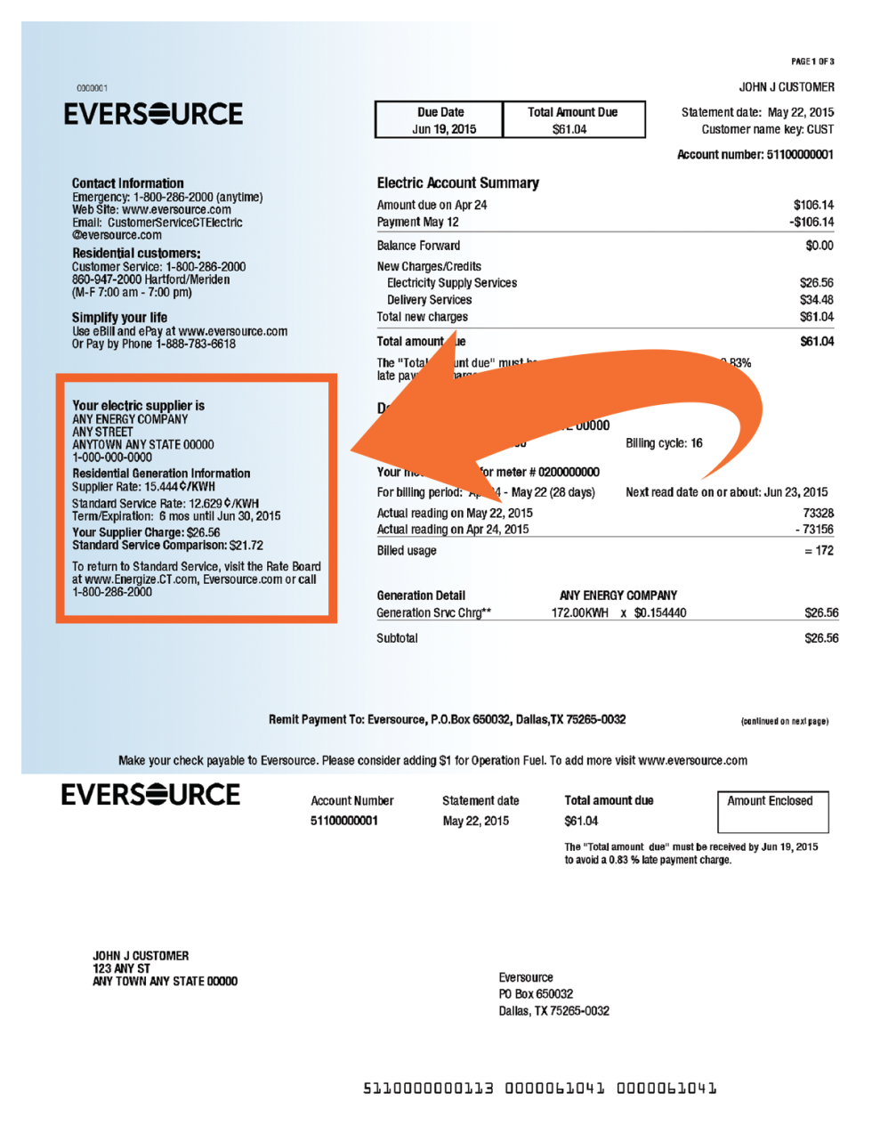
Sample Residential Electric Bill

Slide 6
Variable Rate Ban
Product of 2015 Legislative Session, with regulatory confirmation
Applies to residential customers
Expressly prohibits electric suppliers from entering into a contract for variable rates on or after Oct. 1, 2015
Prohibits suppliers from renewing customers into variable rates on or after Oct. 1, 2015

Slide 7
Variable Rate Ban
Under legislation and PURA ruling, suppliers must offer new customers rates that cannot go up for at least 4 months
Suppliers can only offer renewal terms that cannot go up for at least 4 months

Slide 8
Number Crunching
As a public, monthly compliance filing in a PURA docket, EDCs submit the number of residential customers, at each rate, for each supplier operating in Connecticut
OCC tracks this data on a monthly and annual basis, and posts Facts Sheets on OCC’s website
And the data shows . . .

Slide 9
Number Crunching for 2015
In 2015, Connecticut residential customers of electric suppliers paid approximately $58 Million more than Standard Service customers
  Based on an average monthly usage of 750 kWh
In 2015, retail suppliers served on average 33.55% of Eversource Energy residential customers, and 37.84% of United Illuminating (UI) customers

Slide 10
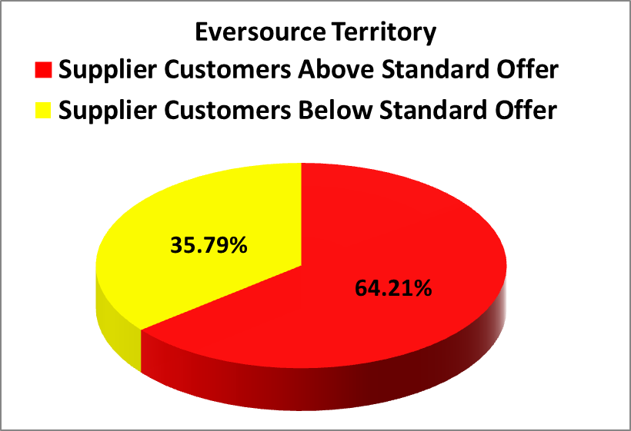
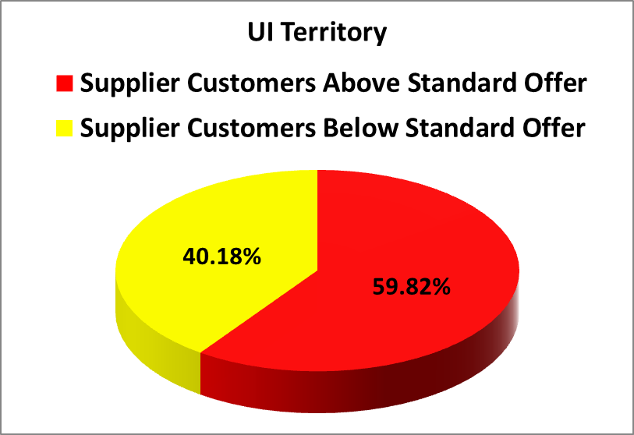
Number Crunching for 2015
During 2015, 64.21% of residential supplier customers paid more than Standard Service on average in Eversource territory, and 59.82% of residential supplier customers paid more than Standard Service on average in UI territory

Slide 11
Number Crunching for 2015

Slide 12
Regulatory Update
2016 PURA Enforcement Actions
$13,000 Civil Penalty against Public Power, Jan. 20, 2016
$60,500 Civil Penalty against Liberty Power, Apr. 13, 2016
$300,000 Assessment of Civil Penalty & Notice of Violation against Choice Energy, May 18, 2016 (Choice requested a hearing)

Slide 13
Regulatory Update
Palmco Power: Pending PURA Enforcement Docket
April 2015: PURA issued a Cease & Desist Order for Palmco’s door-to-door marketing practices, in response to customer complaints of overly aggressive tactics including EDC impersonation and shut-off notices
Palmco charges some of the highest rates, nearly 3X Standard Service for most customers in late 2015
March 2016: PURA ordered Palmco to issue notices to all existing customers advising of current rates and how to switch to Standard Service

Slide 14
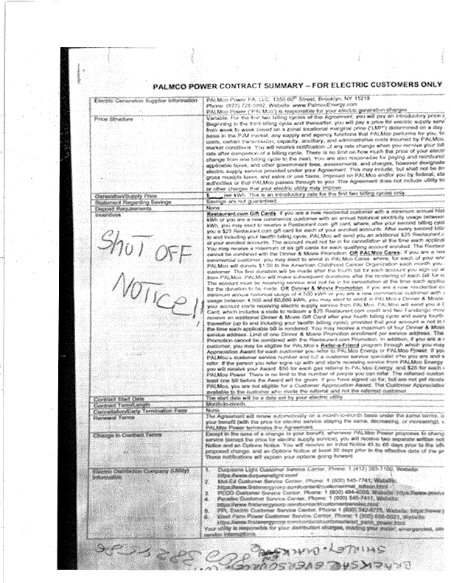

Slide 15
Positive Practices
Supplier Working Group
Working with Allies, including Attorney General’s Office and AARP
Consumer Outreach

Slide 16
Obstacles to Protecting Consumers
Regulatory and legislative reluctance to interfere with the “competitive market” (i.e., caveat emptor)
Can we un-ring the bell of de-regulation?
  Focus on most deceptive practices: door-to-door marketing & telemarketing

Slide 17
Questions?
Thank you.
Lauren H. Bidra
Staff Attorney
Office of Consumer Counsel
10 Franklin Square
New Britain, CT 06051
(860) 827-2904
Lauren.Bidra@ct.gov
http://www.ct.gov/occ

