Slide 1

Gas Hedging
Do low natural gas prices support scaling back hedging programs at local distribution companies?
November 14, 2016

Slide 2

We are Spire
  Spire reflects the growing company we have become
  Our natural gas companies will transition to the Spire name in 2017
  We are about:
  Championing people by delivering energy that inspires
  Bringing people and energy together
  Our transformational journey has been guided by a well-articulated growth strategy
  Over the last three years we have:
  Significantly increased our scale and expanded our geographic footprint
  Added value to our customers and investors alike, through lower costs, enhanced service and investments in reliability

Slide 3
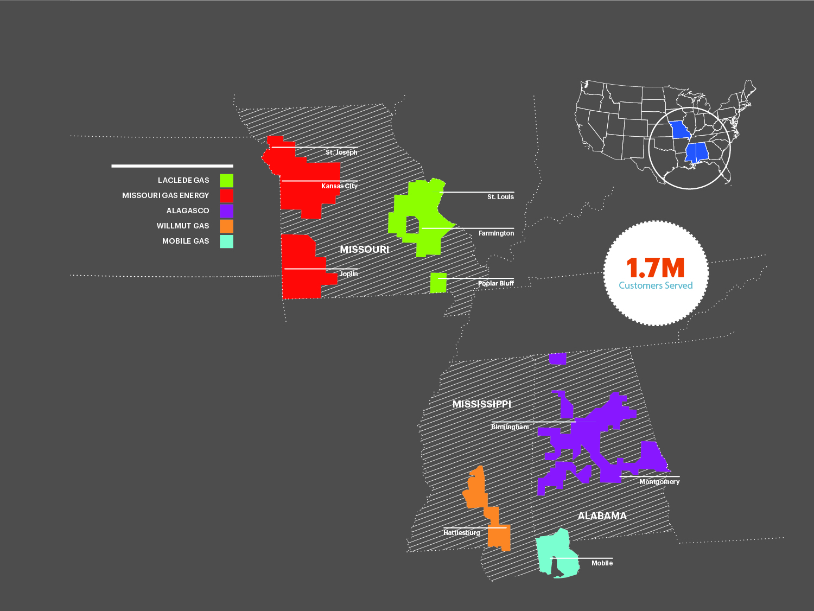
We are a gas company at our core
  Five gas utilities across three states
  Largest gas company in Missouri
  and Alabama
  Focus on safe and reliable service, community development and growth

Slide 4
Gas prices have been volatile…
Historical Henry Hub natural gas prompt month price (nominal) – since 1994
Mean = $6.11/MMBtu
St. Deviation = 40%
Mean = $3.56/MMBtu
St. Deviation = 25%
Mean = $2.18/MMBtu
St. Deviation = 22%
Volatility that caused MO PSC Staff to encourage LDCs to begin hedging
Source: EIA.

Slide 5
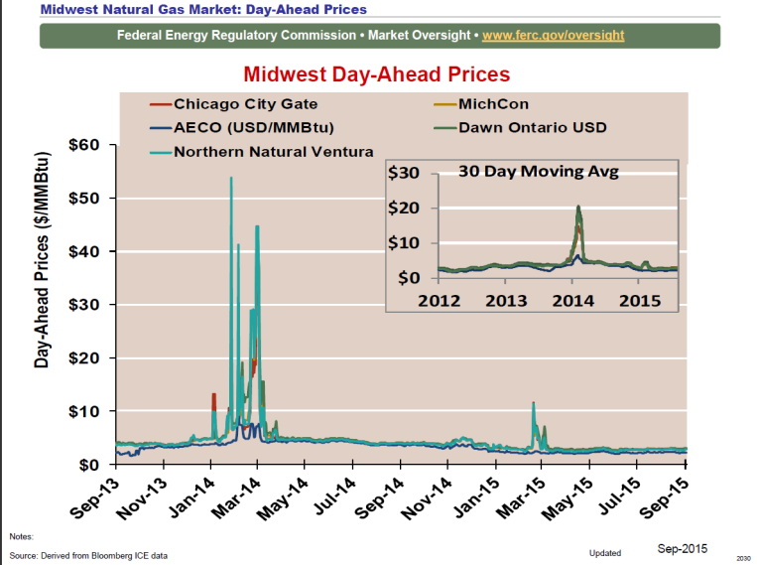
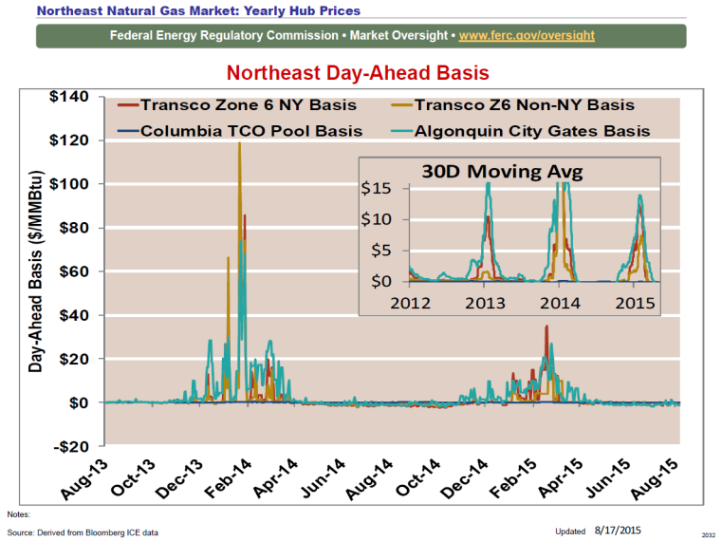
… and event-driven blow-outs can still be massive
Gas shortages during the recent polar vortices drove spot prices
to $20 – $50 – $120 per MMBtu in some regions

Slide 6
Nobody has the fabled “crystal ball”
Gas price projections are just that… no guarantee in any way – nobody knows how much gas markets will move and when
Thus, some level of hedging to protect customers from the unexpected is prudent
Various Henry Hub natural gas projections (2016 Dollars)

Slide 7
Hedging is insurance against the unknown …
Purpose of hedging is not to make money or “beat the market”
Hedging reduces volatility – shields customers from unpredictable spikes and brings stability to their bills
Hedging is like insurance – you pay a small premium to shield yourself from unexpected moves in gas prices
Customers put a premium on the value of stability

Slide 8
… and works, even in low price environments
Hedging has worked and is an useful tool to mitigate volatility
That is why we believe eliminating hedging is not prudent
  Prices are volatile even when low
  Even if one does not see current volatility as material, future is unpredictable and cost of hedging is lower when volatility is low
  One can argue against hedging only with the benefit of hindsight, which is not available when LDCs are planning for the future

Slide 9
Limitations of traditional hedging programs
However, current hedging programs’ limitation is in the long-term:
Financial hedges are a great tool to smooth volatility in the short term…
…but they leave customers 100% exposed to market risk over the long-term

Slide 10
Acquiring gas reserves as a long-term hedge
LDCs can significantly reduce long-term volatility by acquiring gas reserves
When a utility acquires gas reserves, customers get the gas at cost, not market
Producer costs are much more stable over the long-term than market prices
  Market price moves are not necessarily cost-driven, often driven by demand
  This means that when market prices rise, producers get higher profits
If LDCs own gas reserves, those profits are passed on to customers as savings
  Utilities also replace producers’ higher cost of capital with their lower cost of capital
  Cost-based gas prices are more stable than market prices and have a significant probability of being more economic over the long-term

Slide 11
Illustrative benefits of acquiring gas reserves
Hypothetical cost-based vs. market-based gas pricing
Customer savings (if market price at highest projection)
Customer cost (if market price at lowest projection)
Acquiring gas reserves will be more stable and likely more economic for customers

Slide 12
Consumer advocates should continue to support hedging
Hedging brings stability and diversity to customer bills
  Nobody can predict future prices and unanticipated weather, market and system events
  Lower prices and perceived current calm should not lead to complacency
Examination of the benefits of long-term approaches is warranted
  Customers currently bear 100% of long-term price risk, with no means of mitigation
  Investment in gas reserves can bring customers the benefits of stability, diversity and cost savings over the long term
Short or long term, hedging is designed to bring the benefits of stability for gas costs, which generally amount to half of a customers’ bills

Slide 13
Our mission
Answer every challenge, advance every community and enrich every life through the strength of our energy.

