Slide 1
National Association of State Utility Consumer Advocates: Mid-Year Meeting
Lifeline Modernization and Consumers
Michelle Garber, VP Lifeline, USAC
Tuesday, June 7, 2016

Slide 2
Our discussion will cover:
2016 Lifeline Modernization
Changed eligibility programs and rolling recertification
Creation of a National Eligibility Verifier
Broadband, minimum service standards, & port freeze

Slide 3
NOTE: The following will be implemented by 12/1/16!
Near Term Changes
Broadband as a Lifeline supported service
Minimum service standards for voice and broadband offerings
Changes to eligibility criteria for new subscribers
Port freezes on voice and broadband offerings

Slide 4
Changed Eligibility Programs
and Rolling Recertification
USAC l Lifeline Program

Slide 5
Changed Eligibility Programs
Nature of Change | Criteria Affected
Retained | SNAP, SSI, Medicaid, Federal Housing Assistance Tribal Programs: Tribal TANF, Bureau of Indian Affairs General Assistance, Food Distribution Program on Indian Reservations, Head start
Removed | NSLP, TANF, LIHEAP, state identified programs
Added | Veterans Pension and Survivors Benefit Programs
Changed | States may not increase the income threshold of 135% of federal poverty level, as they could previously Income is now equal to IRS gross revenue
New Subscribers: Effective December 1, 2016 or 60 days after PRA approval
Existing subscribers: Effective at next recertification beginning in 2017

Slide 6
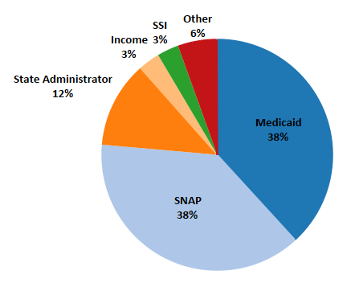
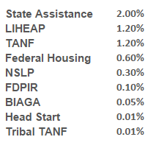
Current Enrollment by Program
Program Breakdown
Lifeline Household Participation Rate - 33% Total Lifeline Subscribers 1Q16 - 12,676,022
Tribal Subscribers 1Q16 - 349,796
USAC l Lifeline Program
Notes:
This can show that the program has low participation from the programs that will be removed and overlapping eligibility between those removed.
*” For example, a LIHEAP recipient who is a child or adult has a 94 percent or 78 percent likelihood of Medicaid eligibility, respectively

Slide 7
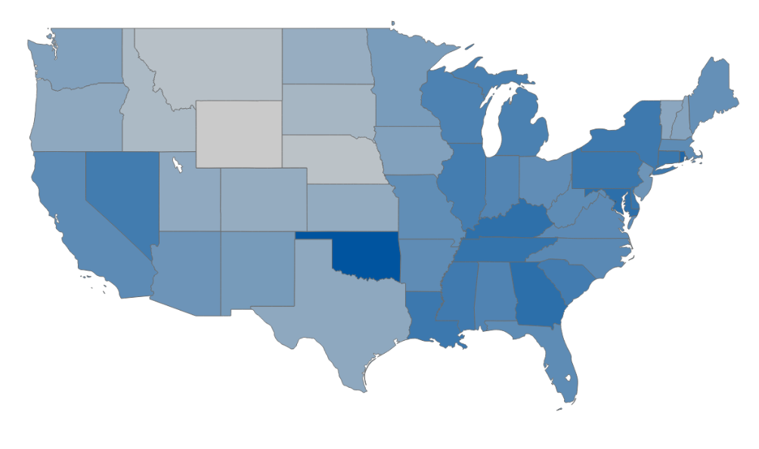
Lifeline Participation
Lifeline Household Participation Rate - 33%
*Numbers derived from data in the 2014 American Community Survey (ACS), U.S. Census Bureau
USAC l Lifeline Program
Notes:
This can show that the program has low participation from the programs that will be removed and overlapping eligibility between those removed.
*” For example, a LIHEAP recipient who is a child or adult has a 94 percent or 78 percent likelihood of Medicaid eligibility, respectively

Slide 8
Rolling Recertification
2016 Recertification Process
Conducted in accordance with current Lifeline practices
2017 Recertification Process
Subscribers will be recertified based on new eligibility programs
Subscribers will be recertified on their enrollment anniversary dates beginning July 1, 2017
Based on February 2016 FCC Form 497 subscribers
Based on existing eligibility programs
Completed by December 31, 2016
Notes:
Topic owner & presenter: Matt
(1) Footnote 427: 47 CFR § 54.409(a). Consistent with the new annual eligibility rules, subscribers already enrolled prior to December 1, 2016 under any of the retired eligibility criteria will be eligible until their next recertification.
This has implications on 2016 recertification process if recertification is not initiated before new programs go into effect because the “next” recertification would be the 2016 recertification and as such subscribers would need to be recertified based on new programs, even though they enrolled prior to December 1, 2016

Slide 9
Consumer Impacts
Some consumers enrolled under eliminated qualifying programs may still be eligible under other programs – need a smooth transition
Consumers need information on rolling recertification, as it will affect when they hear from carriers
If there are challenges updating state databases with new eligibility criteria, carrier eligibility and recertification processes may change

Slide 10
Creation of a
National Eligibility Verifier
USAC l Lifeline Program

Slide 11
National Verifier
Objective:
Facilitating consumer choice and improving the enrollment process
Functions:
Determination of subscriber eligibility
Population of the Lifeline Eligibility Database (LED)
Default basis for determining support payments

Slide 12
National Verifier
Carrier reimbursed based on self-claimed Form 497
Begins delivering discounted service
Carrier verifies consumer eligibility
Current State: Carrier
Carrier reimbursed based on subscribers in LED
Consumer selects Lifeline carrier and begins receiving discounted service
National Verifier verifies consumer eligibility
Future State: National Verifier

Slide 13
National Verifier Phase-in
National Verifier
November 30, 2016
Draft National Verifier Plan
December 31, 2017
Deployed in at least 5 states
December 31, 2018
Deployed in at least 25 states
December 31, 2019
Deployed in all states and territories

Slide 14
Connecting to program data can help us automate eligibility determinations
National Verifier
Eligibility Criteria | Data Source
Federal Public Housing Assistance | Federal Dept. of Housing & Urban Development
Veterans Pension / Survivors Benefit | Federal Dept. of Veterans Affairs
SNAP & Medicaid | State Depts. of Health and Human Services, Social Services, or PUCs
SSI | Social Security Administration
Tribal Eligibility | Research in progress
Income Verification | Research in progress

Slide 15
National Verifier
So far, USAC has spoken with:
6 Federal Agencies
16 individual states, including PUCs and departments of social services
10 vendors in the eligibility space
A number of member organizations that represent our stakeholder community, such as NARUC, NASUCA, and several public interest groups
We are committed to a collaborative approach to working with our federal, state, carrier, and consumer stakeholders

Slide 16
Consumer Impacts
Consumers need to be familiarized with USAC as the National Verifier
Processes must be optimized in ways that work best for consumers
A friendly and streamlined process is needed for eligibility determination disputes

Slide 17
Broadband, Minimum Service Standards, & Port Freeze
USAC l Lifeline Program

Slide 18
Inclusion of Broadband
The Lifeline Program provides a discount of $9.25 per month to eligible low-income subscribers, or up to $34.25 to those living on Tribal lands
Subscribers may receive a discount on either:
Current State | Future State¹
Fixed voice (home phone) | Fixed voice (home phone)
Mobile voice (cell phone) | Mobile voice (cell phone)
 | Fixed broadband
 | Mobile broadband
Bundled voice + broadband
¹Inclusion of broadband is effective on the later of December 1, 2016 or 60 days after PRA approval
USAC l Lifeline Program

Slide 19
Minimum Service Standards
Date | Mobile Voice | Mobile Broadband | Fixed Broadband
12/1/2016 | 500 Minutes | 500 MB 3G | Speed: 10/1 Mbps Usage Allowance: 150 GB
12/1/2017 | 750 Minutes | 1 GB 3G* | Speed: Updating Mechanism Usage Allowance: CAF Standard or Bureau Determination
12/1/2018 | 1000 Minutes | 2 GB 3G* | Speed: Updating Mechanism Usage Allowance: CAF Standard or Bureau Determination
12/1/2019 | 1000 Minutes | Updating Mechanism | Speed: Updating Mechanism Usage Allowance: CAF Standard or Bureau Determination
12/1/2020 | 1000 Minutes | Updating Mechanism | Speed: Updating Mechanism Usage Allowance: CAF Standard or Bureau Determination
12/1/2021 | 1000 Minutes | Updating Mechanism | Speed: Updating Mechanism Usage Allowance: CAF Standard or Bureau Determination
*Subject to review

Slide 20
Minimum Service Standards
Voice-only Phase Down
Date | Voice-Only Service
December 1, 2019 | $7.25
December 1, 2020 | $5.25
December 1, 2021 | 0**
** Except in areas with only one Lifeline provider

Slide 21
Date of Enrollment: Subscriber applies benefit to Lifeline service
Cannot Transfer Lifeline Benefit to New Provider for:
Voice: At Least 60 Days
BIAS: At Least 12 Months
After Port Freeze: Subscriber may transfer Lifeline Benefit at any time
Port Freeze
Exceptions
Subscriber moves their residential address
The provider ceases operations or otherwise fails to provide service
Provider has imposed late fees for non-payment greater than or equal to the monthly end-user charge for the supported service
Provider is found to be in violation of the Commission’s rules during the 12 month period and the subscriber is impacted by such violation
Port freezes are effective on the later of December 1, 2016 or 60 days after PRA approval
Notes:
-Talking point- Port freeze to begin on service initiation date

Slide 22
Consumer Impacts
Consumers should understand the minimum services they are entitled to
Consumers must be aware of port freezes at the time of enrollment, so there are no surprises later
Clear information to consumers is needed for the eventual voice only phase out

Slide 23
Questions for YOU!
What are the best ways to reach consumers to educate about all these changes?
What issues do consumers experience that require USAC support rather than carrier support?
How best can we get input from consumers on ideal process design that will work best for them?
How can USAC and State Consumer Advocates work in partnership to proactively support broadband adoption among low income consumers?
How can USAC partner with State Consumer Advocates during Lifeline Awareness Week this fall?

Slide 24
Questions?
2016 Lifeline Modernization

Slide 25
Thank you!
Contact Us
Next Lifeline webinar is Wednesday, June 8th, 3pm EDT
View “Upcoming Events” at: http://usac.org/li/about/outreach/default.aspx
Please contact LifelineProgram@usac.org if you have additional questions about the Lifeline Program
To sign up for emails about the Lifeline Program including news, updates, and events
Go to www.usac.org and click “subscribe” in the upper-right corner
Notes:
Remind of webinar - the next day, June 8.

