Slide 1
Broadband: What’s a Consumer Advocate to Do?
NASUCA Annual Meeting
La Quinta, CT
Elin Swanson Katz
CT Consumer Counsel
November 14, 2016
1

Slide 2
My guiding principles
Broadband is an essential service in today’s world, bringing access to education, health care, economic opportunities, and the digital economy.
Every citizen should have access to affordable, reliable high-speed broadband.
Government has a role in ensuring that essential services, including broadband, are available to its citizens.

Slide 3
Sec. 16-2a. Office of Consumer Counsel. (a) There shall be an independent Office of Consumer Counsel…to act as the advocate for consumer interests in all matters which may affect Connecticut consumers with respect to public service companies, electric suppliers and certified telecommunications providers, including, but not limited to, rates and related issues, ratepayer-funded programs and matters concerning the reliability, maintenance, operations, infrastructure and quality of service of such companies, suppliers and providers.

Slide 4
Sec. 16-2a. Office of Consumer Counsel….(c) There shall be established an Office of State Broadband within the Office of Consumer Counsel. The Office of State Broadband shall work to facilitate the availability of broadband access to every state citizen and to increase access to and the adoption of ultra-high-speed gigabit capable broadband networks.

Slide 5
High-Tech Manufacturing

Slide 6
Education and the Digital Divide

Slide 7
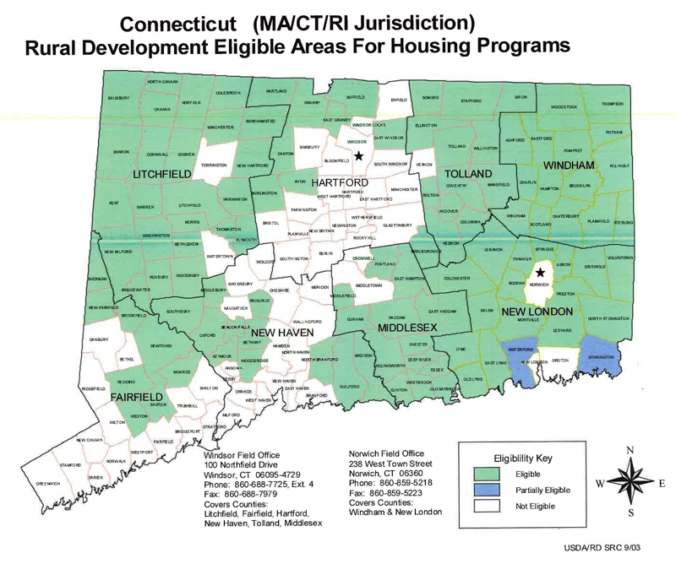
Rural Connecticut

Slide 8
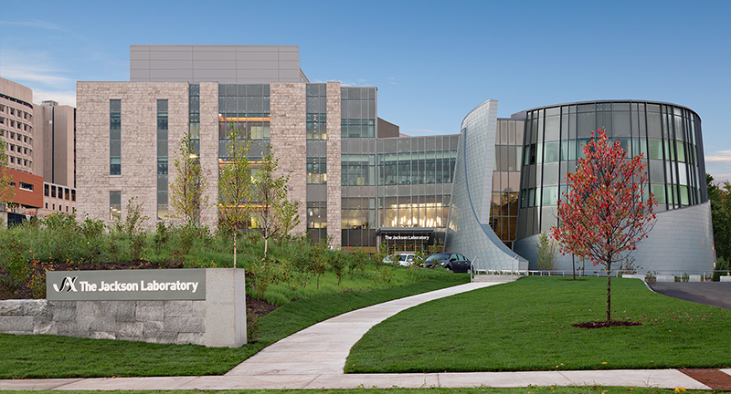
Health Care Data, Bioscience, and Genomic Medicine
$291 million in CT state funding

Slide 9
SB-445 - ESTABLISHING A HEALTH DATA COLLABORATIVE WORKING GROUP. Make recommendations regarding: The digital infrastructure needs of the health care and insurance industries to maximize the potential economic and employment benefits from data analytics collaboration.
9
Notes:
The high tech leaders stated that they don’t operate in a vacuum:
their communities also need broadband to support their business activities:
Teleworking is necessary (live here or there, work anywhere)
CT-based health insurer Aetna: of 35,000 employees, 14,500 do not have a desk at Aetna which cuts real estate costs.
Health care for employees and families
electronic health records and remote monitoring technology increase health and reduce costs;

Slide 11
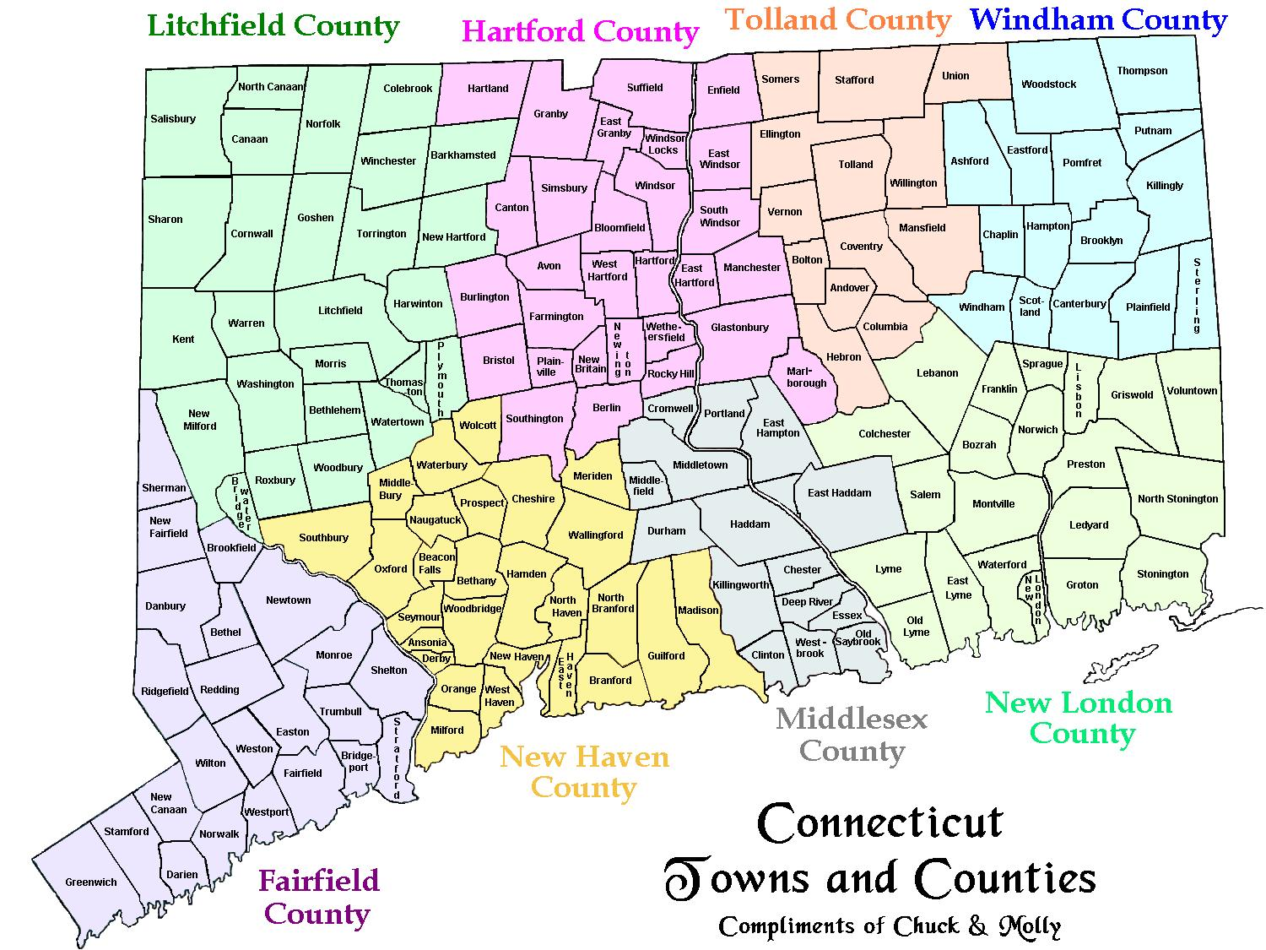

Slide 12
Communities and businesses are demanding better, cheaper, faster broadband because it can be the difference between a successful and vibrant future, or economic decline.
12

