Slide 1
DOE Furnace Rule
L. Craig Dowdy
SVP, External Affairs, Corporate Communications and Marketing
November 2016

Slide 2
Natural Gas Heating
Despite its affordability, efficiency and environmental benefits, new standards by the U.S. Department of Energy could lead to switching away from natural gas to other fuels that could negatively impact consumers and the environment.
Notes:
177 million Americans use abundant natural gas to heat their homes and water and cook their food.
Natural gas is extraordinarily efficient and emits fewer greenhouse gas emissions than other leading energy choices.
These new standards by the U.S. Department of Energy could lead to switching away from natural gas.

Slide 3
New Furnace Standards
    The U.S. Department of Energy (DOE) proposed a rule eliminating non-condensing natural gas furnaces in favor of condensing furnaces
    Natural gas furnaces manufactured must have a 92 percent or higher efficiency rating with an exception for “small” non-condensing furnaces (≥ 55 kBtu input @ 80% efficiency).
        Non-condensing unit adequate only for approximately 10% of homes.
Based on an independent Gas Technology Institute analysis, there is no economic justification for the proposed rule and no “small” furnace input capacity limit provides a net benefit to the low income market segment
Notes:
There is a long history to appliance rulemaking dating back to the Energy Policy and Conservation Act (EPCA) in 1975. While some standards established for consumer products have been controversial over the years, there has been many that have provided significant energy efficiency and savings. However, we have now reached a point in which further stringent standards are now costing consumers more than they will save. The latest proposal for furnace standards is one of those.
The U.S. Department of Energy (DOE) issued a supplemental notice of proposed rulemaking (SNOPR) that proposes a single national standard at a minimum efficiency level of 92% annual fuel utilization efficiency (AFUE) for all mobile home gas furnaces and for non-weatherized gas furnaces (NWGFs) above 55 thousand Btu/hr. (kBtu/h) input capacity.
The DOE is overreaching with this new proposal and has conducted its analysis in a non-transparent manner. Their economic model to justify the rule contains substantial errors that I will explain later in this presentation.
The rule will lessen competition by removing the choice that natural-gas using consumers currently have, and will likely force many consumers to use less efficient, and ultimately more costly, electric alternatives.

Slide 4

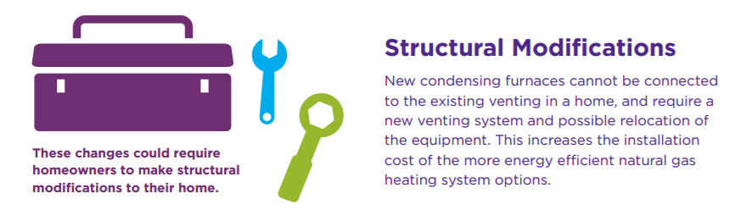
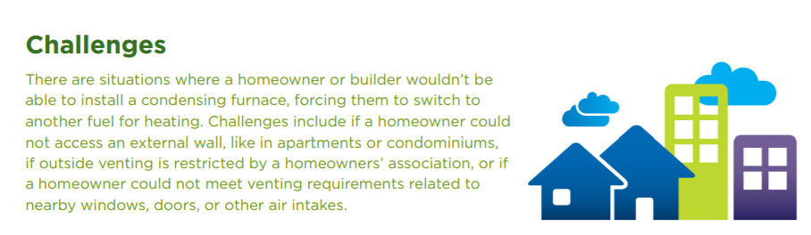
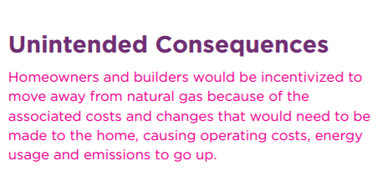
Notes:
Its important to know this rule completely changes how furnaces are vented. Condensing furnaces cannot be connected to the existing venting in a home and will require structural modifications – adding costs.
Many homeowners have finished basements or their equipment is in locations that make the new furnace very difficult to install. Ceiling or walls have to be torn apart. That requires work from more than an HVAC company – carpenters, drywallers, and painters.
Others will find it impossible to install given they live in places where they simply not allowed or cannot get access to an external wall – apartments, condos, or historic areas. There is no choice for these consumers but to install electric equipment.

Slide 5
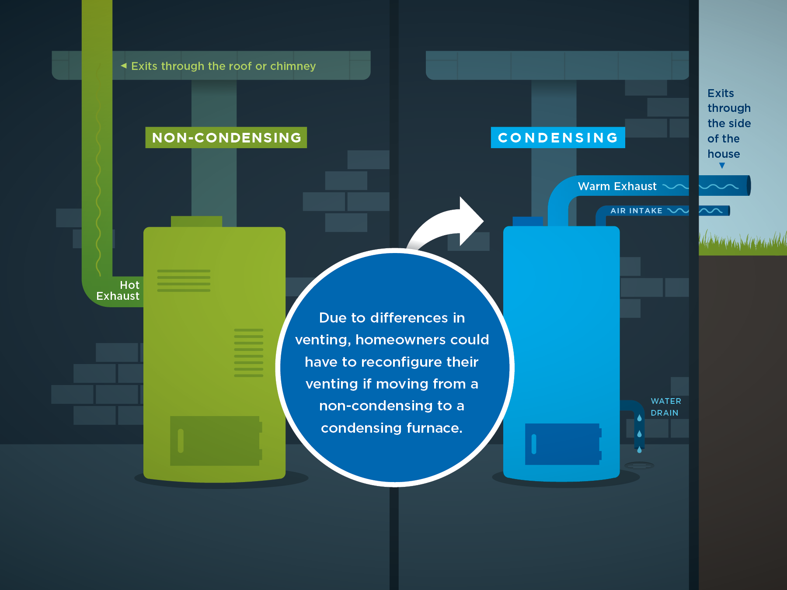
Difference Between Condensing and Non-Condensing
5
Notes:
This illustration shows the fundamental difference between condensing and non-condensing furnaces are typically installed.
Standard efficiency furnaces have efficiencies in the range of 80 percent to 82 percent. The line between mid-efficiency and high-efficiency furnaces is not arbitrary, but marks the division between appliances with distinct operating characteristics. Standard efficiency furnaces are designed to keep flue gases hot enough to avoid any condensation of flue-gas moisture, while high-efficiency furnaces deliberately encourage the condensation of flue-gas moisture.
High-efficiency furnaces (also called condensing furnaces) have AFUE ratings that range from 90 percent to about 97 percent. These furnaces have a secondary heat exchanger where the moisture in the escaping flue gases is condensed. This phase change from water vapor to liquid water releases heat, improving the unit’s efficiency. Condensing furnaces must be hooked up to a drain that can dispose of the liquid condensate.
Most furnaces in the U.S. are non-condensing and vent through the roof or chimney of a home. Condensing appliances vent through the side of the house along with a separate water drain. There are some geographic areas that install furnaces in attics. Moving to condensing furnaces requires expensive retrofits to dispose of the condensate and even insulating attics to avoid it from freezing in the winter – all very costly.
Another very important point is that water heaters and non-condensing furnaces are typically vented together through the roof. When you remove the furnace from the vent, it can result in it being undersized and will be a safety hazard if not corrected – at a high cost – typically about $600 to line the flue.

Slide 6
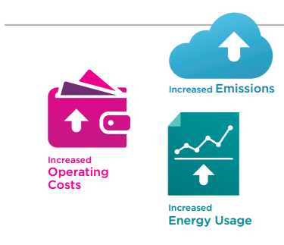
THESE CHANGES COULD IMPOSE SIGNIFICANT COSTS, driving homeowners away from natural gas to alternative fuel heating systems that could be ultimately less efficient and less cost effective
Notes:
Please know, high efficiency furnaces are great products and the right solution for many consumers. Many can install without expensive structural modifications and realize savings and a reasonable payback. That is why we see about 50% of all furnace shipments today already condensing furnaces. It’s the right choice for many consumers – but its at least a choice.
However, there are others that don’t make the choice because its not economic or impossible. The DOE rule will force switching to less efficient home and water heating options.

Slide 7
Burden on Consumers
    There are approximately 47 million homes across the country that have natural gas furnaces. Most furnaces in the U.S. are non-condensing and generally vent through the roof or chimney of a home
    An average homeowner replacing an existing furnace would be forced to pay an additional $350 in unit costs and up to an additional $1,500-$2,200 in installation costs and may opt to switch to electric heating.
    Apartment and condo owners often are restricted from altering their building’s outside venting and forced to electric systems.
    Home builders will avoid added costs and move to lower cost inefficient electric space and water heating systems.
    Water heaters share the same vent as non-condensing furnaces and will often need to be reconfigured, leading to additional costs.
DOE Estimates that consumers would carry a heavy burden
Furnace Cost
Installation Cost
Building modifications
$6 -12 Billion in New Costs
Notes:
As I demonstrated, the installation can be expensive and not right for everyone. Based on an American Gas Association study the average homeowner will pay an average $350 for the furnace and another $1,500 - $2,200 for installation. This can be even higher for those difficult installations.
We already talked about how this impacts apartment and condo owners where it can be physically impossible to install.
Homebuilders are another group that could potentially move to less efficient equipment. Interviews with some of Missouri’s largest builders indicate they would seriously consider what is installed. In fact, a couple builders already made a decision to avoid the cost of building a flue for the water heater and install electric resistant water heaters. Keep in mind that the homebuilding industry is cost conscious and they look for ways to keep housing prices down in order to qualify as many potential buyers as possible.
Even a low incidence of changes in heating system choices would have a negative impact, resulting in increased overall energy costs, primary energy usage and CO2 emissions.

Slide 8
Higher Operating Costs
    Due to the challenges and costs required when moving to a condensing furnace, consumers and builders may be incented to switch to another fuel with higher operating
Electric
Resistance
Furnace
Electric
Heat Pump
Natural Gas
Furnace
DOE NAECA Efficiency Rating:
Energy Cost¹/year
7.7 HSPF
$1,146
99 AFUE
$1,832
80 AFUE
$643
Source: AGA; ¹Energy Cost is based on 2015 DOE representative average unit costs for energy where electric rate is 12.70 cents/kWh; gas rate is $10.03/MMBtu; HSPF=Heating Seasonal Performance Factor, AFUE=Annual Fuel Utilization Efficiency
Notes:
Now that consumers will be forced into other forms of heating where installations are impossible or extremely high in first costs, the long-term operating costs will be higher.

Slide 9
Increased Emissions
    Even a low incidence of fuel switching will have a negative impact on CO2 emissions
    Condensing and non-condensing natural gas furnaces release half the carbon emissions every year compared to an electric resistance furnace.
Electric
Resistance
Furnace
Electric Heat Pump
Natural Gas Furnace
DOE/NAECA Efficiency | 7.7 HSPF | 9.0 HSPF | 99 AFUE | 80 AFUE | 94 AFUE
Full-Fuel-Cycle Energy Use per Year* | 97 MMBtu | 89 MMBtu | 155 MMBtu | 69 MMBtu | 52 MMBtu
CO₂e** Emissions/Yr* | 5.7 Metric Tons | 5.2 Metric Tons | 9.0 Metric Tons | 4.0 Metric Tons | 2.6 Metric Tons
Source AGA; *Excludes A/C operations; ** Includes greenhouse gas impact from unburned methane
Notes:
And the impact on emissions will also be negative. A household with natural gas versus all-electric appliances produce lower greenhouse gas emissions.
Again, it doesn’t take much fuel switching to produce a negative impact on CO2.

Slide 10
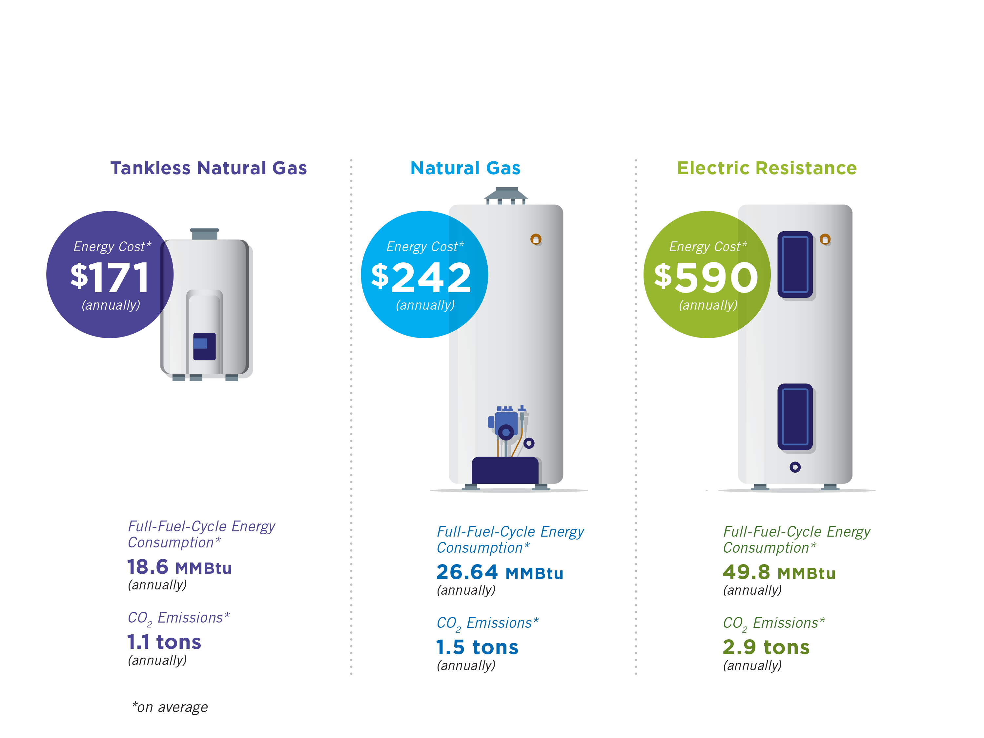
Extraordinarily Efficient
Comparing Residential Water Heater Efficiency*
Source AGA: *On Average

Slide 11
Negative Impact on Low Income Communities
    DOE furnace rule could leave low-income communities out in the cold given the additional costs
    Low-income families and consumers would be the hardest hit, with many bearing higher costs as a direct result of the Proposed Rule
    Real world implications:
      Consumers will continue to use older, potentially unsafe equipment
      Modifications to venting systems will not always be made
      Frequency of non-professional repairs and/or installations will increase
      Low-income customers will turn to unsafe practices (i.e. using cooking appliances to heat, space heaters near combustibles, etc.)
      Could switch to electric space heating
Notes:
The cost burden on low income families is a real concern. DOE even realized the harm in their original rule and changed in the SNOPR to allow a small furnace exception. However, this is way to small and really doesn’t help many consumers.
Real world implications :
-Keep in mind that many homes in this market is thermally inefficient and requires larger
furnaces
-Most low-income customers cannot afford new equipment and will continue to use existing
equipment.
-Many will seek to repair outdated equipment – using a “family member” that is not qualified.
-Others will even divert gas when turned-off for safety reasons. Cold is cold
-Ranges, stove-tops, electric space heaters, and more are often used
Mandating that these customers must now spend even more money for a condensing furnace worsens their already precarious financial situation. Consequently, these customers’ do what they need to. Most need to make a decision – heat, food, medicine......

Slide 12
DOE’s TECHNICAL ANALYSIS CONTAINS CRITICAL FLAWS
Notes:
There are serious technical flaws in the SNOPR analysis that render its rationale for the proposed 92% standard and small furnace exception unacceptable.
But first, a historic review of how we got here may be helpful.

Slide 13
DOE’s Technical Analysis is Flawed
  There are significant flaws in the science and data DOE utilized to economically justify the rule. DOE relies upon faulty analytics and assumptions to support a national standard for residential furnaces.
Non-transparent. DOE analysis relies on methodologies that are proprietary or otherwise outside the public domain
Underestimated equipment costs
Overestimated equipment life
Overestimated savings
Underestimated adverse impacts from fuel switching.
Improper use of discount rates
    Data shows that the furnace market is working properly without a rule. Consumers that should be purchasing condensing furnaces because it makes economic sense for where and how they live.
Notes:
Just the latest SNOPR contains a ludicrous amount of documents to review – almost 8,000 pages (The SNOPR itself is almost 500 pages, the TSD regarding the SNOPR is almost 1200 pages, and the spreadsheets supporting the TSD are over 6000 pages). It is particularly concerning that much of the DOE analysis relies on methodologies that are proprietary or otherwise outside the public domain. DOE has failed to provide sufficient information needed to develop a clear understanding of the technical analysis supporting this rulemaking. In the previous NOPR, gas industry efforts in unraveling DOE’s spreadsheets reportedly cost close to $400,000. And because data was considered proprietary, all the information could still not be understood.
DOE’s analysis contains significant flaws and relies on faulty assumptions. We found that there are carefully selected inputs in order to justify apparently predetermined “energy efficiency” regulatory objectives; or what the Gas Technology Institute (GTI) refers to in its report of DOE’s spreadsheet as preordained for “rule benefit.
DOE uses unexplained and inconsistent installation costs in its Life Cycle Cost analysis. When comparing DOE’s 2011 Life Cycle Cost analysis with the Life Cycle Cost analysis used in the proposed standard, we have identified a large differential in the installed costs of a baseline 80 percent NWGF and the installed cost of condensing NWGFs. These unexplained changes in installed costs have contributed to a claimed improved Life Cycle Cost savings of condensing furnaces which we believe to be unsubstantiated.
DOE overestimates product lifetime. Although industry estimates indicate that the average lifetime of a non-weatherized gas furnace is 15 or 16 years, DOE’s estimate of 21.5 years is significantly longer. DOE’s optimistic assumption has the effect of inflating DOE’s estimates of net economic benefits and energy savings to consumers.
DOE overestimated consumer savings. DOE’s estimates for what is called “marginal monthly natural gas prices” are much higher than actual marginal prices that customers pay as reflected by impacts in energy consumption changes in their utility bills. This vastly overstates the LCC savings.
DOE underestimates adverse impacts from fuel switching. In particular, DOE has failed to properly estimate the economic and energy costs associated with fuel switching from natural gas furnaces to less energy efficient alternatives. The impact of fuel switching cannot be overstated
DOE has overstated the LCC savings by using low average discount rates.
What GTI’s analysis basically concluded is that DOE’s SNOPR predicted energy savings can become negative for DOE’s average consumer and devastating for those most vulnerable. Spire’s has come to similar conclusions. Trying to determine what DOE is doing has proven to be a daunting experience; to put it mildly.

Slide 14

Fuel Switching May Occur
  As consumers are burdened with the challenges and costs to install condensing furnaces, fuel switching will become a consideration for consumers looking to reduce installation costs.
    Spire believes that much more massive gas to electric fuel switching is likely; enough to shift DOE’s cost effectiveness from positive to negative.
    Changing to electric space heating alternatives impacts water heaters that typically share vents with non-condensing furnaces.
    Homebuilders: The nations third largest homebuilder with 17,196 home closing in 2015 has already shifted to electric water heaters (see home sell sheet).
http://www.pulte.com/communities/MO/town-and-country/TheEstatesatTownandCountryCrossin/home-features/682913/Stockton.aspx#.V5YfK2Ao670

Slide 15
Furnace Standard Background
  Appliance standards have a long history starting at state levels and advancing to the national level in the mid 1970’s.
December 2007: Energy Independence and Security Act of 2007 (EISA)
January 2010: “Interested persons” submitted a joint proposal to DOE for expedited energy efficiency standards for furnaces
June 2010: DOE proposed Direct Final Rule (90% AFUE for northern states) and Notice of Proposed Rulemaking (NOPR) for a regional residential furnace standard
October 2011 DOE finalizes DFR despite “adverse comments” from numerous groups
December 2011: American Public Gas Association appealed October 2011 DFR in the DC Circuit
March 2014: Parties settle and vacate DFR and remand back to DOE for NOPR
March 2015: DOE published NOPR for a nationwide 92% standard
June 2015: 145 comments filed, many adverse
September 2016: DOE published a Supplemental Notice of Public Rulemaking (SNOPR) with comments due November 22, 2016
Notes:
The idea of appliance standards as a policy tool to reduce consumption of energy predates the first energy crisis of 1973 (ACEEE). The first standards were enacted at the state level in California in 1974.
At the national level, the Energy Policy and Conservation Act (EPCA) was enacted in 1975, and established a federal program consisting of test procedures, labeling, and energy targets for consumer products.
EPCA was amended in 1979 and directed the Department of Energy (DOE) to establish energy conservation standards for consumer products.
The National Appliance Energy Conservation Act of 1987 established minimum efficiency standards for many common household appliances. Congress set initial federal energy efficiency standards and established schedules for DOE to review and update these standards.
The Energy Policy Act of 1992 (EPAct) added standards for some fluorescent and incandescent reflector lamps, plumbing products, electric motors, commercial water heaters, and heating, ventilation, and air conditioning (HVAC) systems.
In 2005, the Energy Policy Act (EPAct 2005) set new standards for 16 products and directed DOE to set standards via rulemaking for another five. In 2007, Congress passed the Energy Independence and Security Act (EISA 2007), enacting new or updated standards for 13 products.
Energy Independence and Security Act of 2007 (EISA). Allowed “interested persons” that are fairly representative of relevant points of view to petition DOE for more stringent appliance efficiency minimum standards. Section 308 authorized DOE to expedite normal proceedings unless there are any “adverse comments” that DOE considers relevant.

Slide 16
DOE’s Analyses Produced Different Results
  DOE economic model produced massive and unexplained changes in life cycle costs comparing 2011, 2015 and 2016.
    Non-public data; Complex Crystal Ball analytics; Proprietary inputs
Notes: 2011 data from EERE-2011-BT-STD-0011-0010 LCC spreadsheet, summary tab, cells K9:K58, L9:L58 & AI9:AI58
2014 data from EERE-2014-BT-STD-0031-0021 LCC spreadsheet, summary tab, cells O8:O41, AE8:AE41 & AT:AT41
2016 SNOPR data from LCC Results spreadsheet for cases without a kBtu/h threshold for condensing/non-condensing
Notes:
The key outputs from DOE’s 2015 regulatory analysis were so wildly different from the outputs of DOE’s 2011 analysis that it is difficult to believe that the same products were at issue. As the table also shows, the key outputs from the regulatory analysis provided in the SNOPR are again dramatically different than those presented in DOE’s 2015 analysis. Additionally, it appears that the SNOPR analysis inexplicably fails to report key outputs for major customer classes, furnace installations in new construction and replacement installations.
This shortfall in the information provided in support of the SNOPR is reflected in data cells of the table that could not be populated as necessary to compare the results of DOE’s current analysis with the two prior analyses.
Consequently, DOE’s 2015 analysis cannot reasonably be characterized as a refinement of its 2011 analysis: it was a complete overhaul that was seemingly irreconcilable with the prior analysis. Similarly, the analysis presented in the SNOPR does not build upon the 2015 analysis; it is another complete overhaul offered in support of a proposal that “supersedes” DOE’s earlier proposal. The magnitude of the differences between the results of SNOPR analysis (expressed in LCC savings) and that of the results of the two prior analyses necessarily reflects substantial changes in DOE’s regulatory analysis. 81 Fed. Reg. at 65720.

Slide 17
NATURAL GAS IS EFFICIENT
When used directly in homes or businesses, natural gas is extraordinarily efficient and emits fewer greenhouse gas emissions than other leading energy choices

Slide 18

Direct Use of Natural Gas
Is the Clean,
Efficient Choice
The direct use of natural gas in America’s homes and businesses maintains about 92% of its usable energy, and a household with natural gas versus all-electric appliances produces 37% lower greenhouse gas emissions.
Direct use, which can cut carbon emissions nearly in half, refers to natural gas consumed directly in appliances for heating and cooling, water heating, cooking and clothes drying.
Converting to Electricity
Converting natural gas or any other fossil fuel into electricity to power comparable electric end-use products only maintains 32% of usable energy.
Consumers can immediately save on their monthly utility bills through converting their households to natural gas.

Slide 19
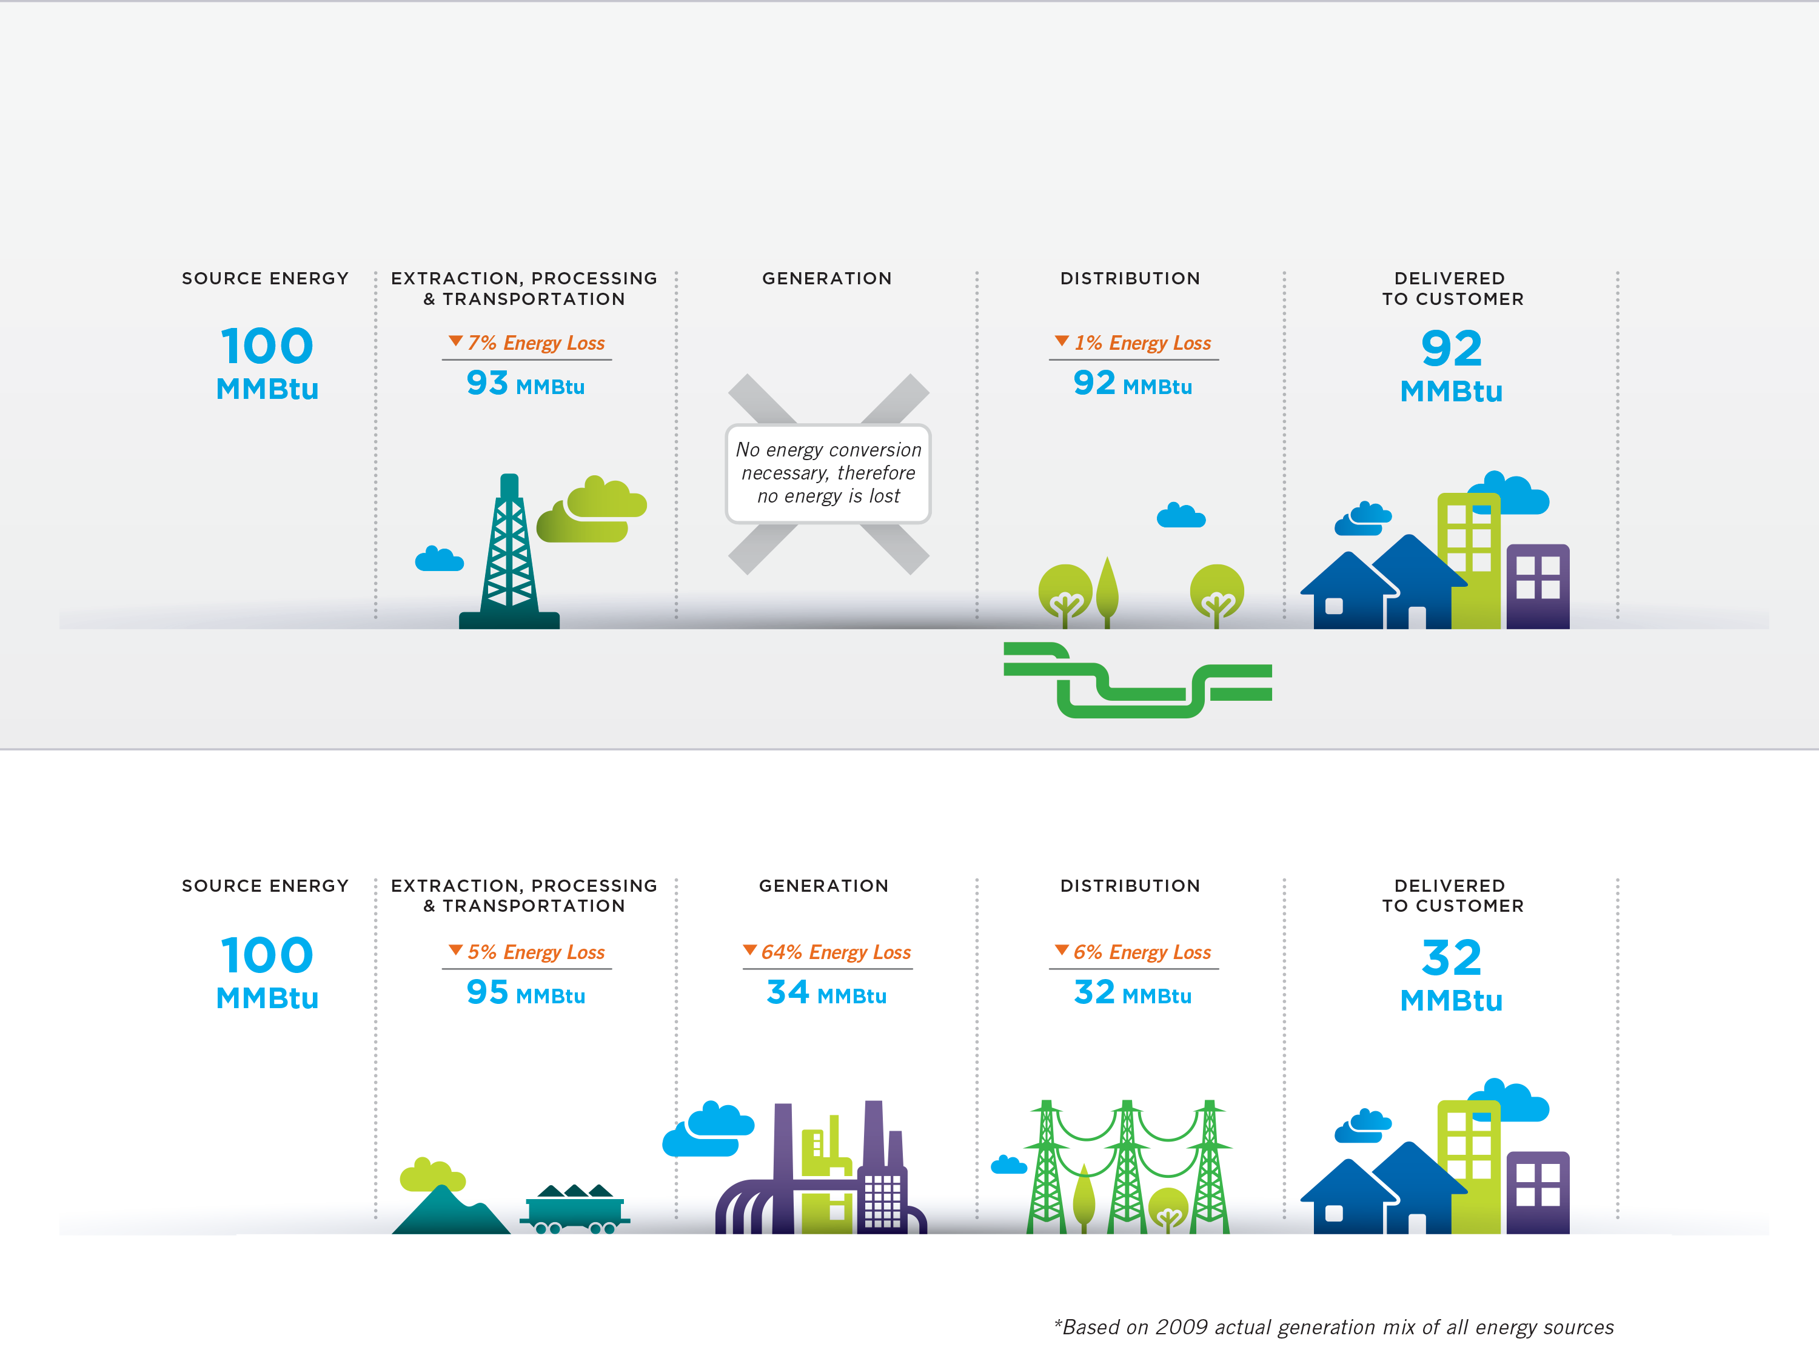
Natural Gas
Electricity

Slide 20
Summary of Points
Data shows that the furnace market is working properly without a rule.
There are significant flaws in the science and data DOE utilized to economically justify the rule.
Correcting for the critical flaws in DOE’s analysis results in net costs than a benefits for many consumers.
Rule forces many consumers to use less efficient, and more costly, electric alternatives.
An average homeowner would be forced to pay an additional $350 in unit costs and up to an additional $1,500-$2,200 in installation costs.
Low income and fixed income households would be the hardest hit.
Even a low incidence of fuel switching will have a negative impact, resulting in increased overall energy costs, primary energy usage and CO2 emissions.

Slide 21
Spire is committed to promoting comprehensive, customer-focused and cost-effective approaches to increasing energy efficiency

