Slide 1
NARUC/NASUCA Panel Time of Use Rates
Jane S Park
VP Regulatory Policy & Strategy
November 15, 2016

Slide 2
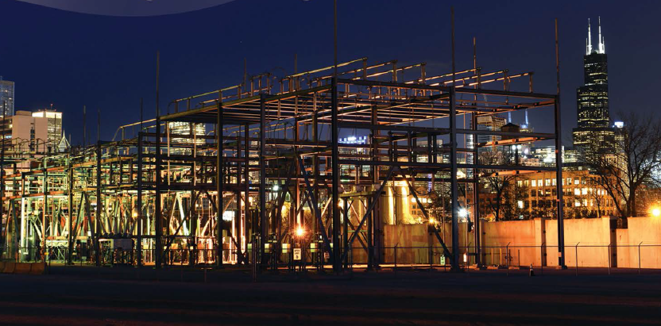
OVERVIEW
ComEd At A Glance; Our Roots in Smart Grid
How TOU Has Been Developing in Illinois
Program Spotlight: Hourly Pricing, Peak Time Savings, Residential Meter Usage Data
(1)

Slide 3
ComEd At A Glance
Our Customers:
• 3.85 million customers in northern Illinois, including the City of Chicago
1.3M or 37.9% take supply service from a RES
Our Company:
• One of six utilities owned by Exelon
• 6,800 Employees
• Service Territory: 11,428 square miles
Our Grid:
• Peak Load: 23,753 MW
• 526,000 distribution transformers
• 5,502 circuit miles of transmission
• Including 2nd largest underground network in the U.S
Over 2 million smart meters installed with completion targeted 2018
(1)

Slide 4
Snapshot of Rates
ComEd Rates (Supply):
ComEd Price to Compare (supply) Summer (June 2016-September 2016): $0.0619/kWh
Price to Compare Non-Summer (October 2016-May 2017): $0.0638/kWh
Class | Customer Charge (per month) | Meter Charge (per month) | Distribution Facilities Charge (per kWh)
SFNSH | $9.89 | $4.33 | $0.03134
MFNSH | $7.00 | $4.33 | $0.03166
SFSH | $11.31 | $4.33 | $0.01860
MFSH | $7.48 | $4.33 | $0.01966

Slide 5
Illinois’ Smart Grid Law: The Foundation
On October 27, 2011, the Illinois General Assembly enacted the Energy Infrastructure Modernization Act (EIMA), setting in motion a $2.6 billion investment by ComEd to strengthen and modernize the state’s electric grid.
Reliability-Related Investments–
5 year program, $1.3B
Smart Grid-Related Investments –
10 year program, $1.3B
Formula Rates

Slide 6
Evolving Discussion on Time Variant Rates
Pre-AMI
AMI Pilot
POST-AMI
TOU Raised As Far Back As 1970s
Concurrent with AMI Pilot, ComEd conducts Customer Applications Program (CAP)
ICC enters Order in 2012 encouraging stakeholder discussion of hourly pricing, TOU, and other dynamic pricing approaches
Experimental Real Time Pricing programs since as early as 2000
CAP seeks to learn how AMI-enabled rate design could incent changes in customer behavior
Smart Grid Advisory Council (SGAC) established; discusses benefits of TOU
ComEd Residential Real Time Pricing (Hourly Program)
8500 participants
TOU in CAP program was market-based; strived for 2:1 pricing value for kwh
ComEd Peak Time Savings Program
Enabling Residential Meter Usage Data (RMUD)

Slide 7
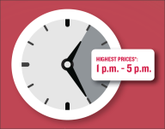
Program Spotlight: ComEd Hourly Pricing Program
Program: Hourly Pricing (formerly Residential Real-Time Pricing)
Description:
This program allows residential customers to pay the hourly market price for the electricity they consume. Prices are based on the ComEd Zone PJM wholesale hourly market price. Average savings thus far in 2016 are 13 percent. Savings since program inception are 15 percent.
Customer Eligibility:
Must take delivery service from ComEd
Must have a smart meter or an AMR meter
Terms & Conditions:
12 month commitment; $0.39/month program participation fee
Number of Customers:
Approximately 11,000 (as of Sept 2016)

Slide 8
Program Spotlight: ComEd Peak Time Savings
Peak Time Savings (PTS) is an opt-in residential demand response program that ComEd offers to all residential customers who have smart meters. PTS pays customers for reducing energy use on select summer Peak Time Savings Afternoons.
Incentive:
$1 per 1 KWh saved
ComEd receives funding through the PJM energy and capacity markets for customer bill credits.
A total of $1.2M of incentives have been provided to PTS customers since the program’s August 2014 inception
Description:
Opt-in residential demand response program that ComEd offers to all residential customers who have smart meters. PTS pays customers for reducing energy use during select Peak Time Savings Hours during the summer.
Required under the Illinois Energy Infrastructure Modernization Act
Customer Eligibility: Enrollment runs annually from October – April. Any customer with an AMI meter is eligible to enroll.
Current Enrollments: 149,000 Residential Customers (2016 Season)

Slide 9
Program Spotlight: ComEd Peak Time Savings & RMUD
Enrollments:
2015: About 404,000 customers were contacted
2015: 56,000 enrolled
2016: Total enrolled 149,000
Since debuting in the summer of 2015, ComEd's Peak Time Savings (PTS) program has delivered participating customers more than $1.2 million in total bill credits for reducing electricity usage.
2015 Operational Results
Three Peak Time Savings Hours were called
Average per participant bill credit was between $8-$9
Total bill credits earned across all events was $386,867
99% of Rebates Calculated with Actual Interval Data (vs. estimated).
Successfully complied with PJM Test Event for the 10 MW of Cleared Capacity
RIDER RMUD: Residential Meter Usage Data
ComEd used the information and feedback from the workshops to design the pilot Rider RMUD – Residential Meter Usage Data (“Rider RMUD”)
ComEd provides interval meter usage data to RESs to allow for TOU and demand response products
RESs can publish their TOU and DR based supply products on Plug-In Illinois website

Slide 10
Next Steps: Future Energy Jobs Bill
Nearly doubling energy efficiency programs, yielding more than $4 billion in energy savings
Provide $1 billion of low-income programs
Accelerate solar and wind energy with up to $220 million annually in funding for renewables
$
Enhance grid security and reliability
Support at risk nuclear plants through a
Zero Emission Standard
Reduce fixed “customer charge” by 50%, giving customers more control
Strengthen and expand Renewable Portfolio Standard
Create tens of thousands of new clean energy jobs through new programs

