Slide 1
The IP Transition – What is it, and why is it important? Prepared for NASUCA Mid-year meeting, New Orleans, LA June 7, 2016
David C. Bergmann
Telecom Policy Consulting for Consumers
tpc4c.net; david.c.bergmann@gmail.com

Slide 2
What is the “IP transition”?
What is usually referred to as the IP transition is multiple interdependent transitions
But specifically, it’s a change from time division multiplexing (TDM) to Internet protocol (IP) transmission on telecom networks; circuit-switched TDM vs. packet switched IP
Not all changes in this transition are IP-related

Slide 3
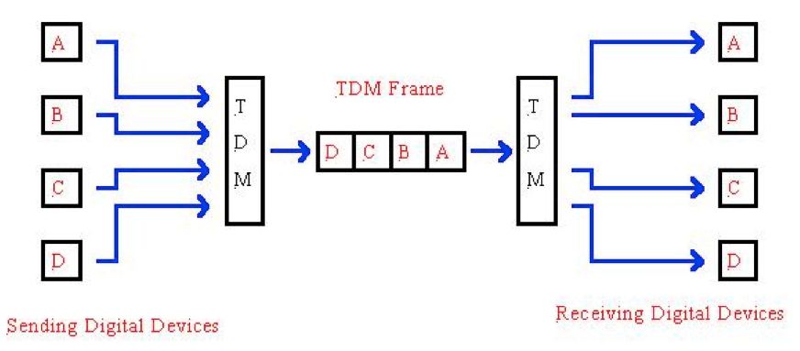
TDM

Slide 4
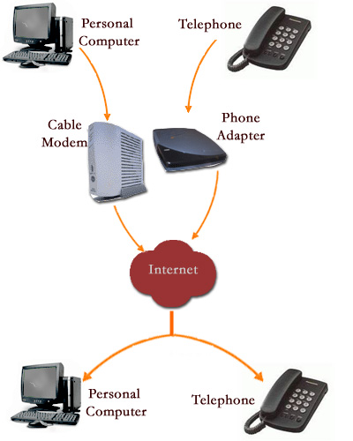
IP
An IP network is multi-use. It can carry video and voice and text. It is thus a “converged” network. It is a more efficient and flatter network – instead of a network of central offices for every neighborhood, and a trunk and branch structure, an IP network can have fewer “meet points” and should have flexible routing.
Thanks, Chris Witteman

Slide 5
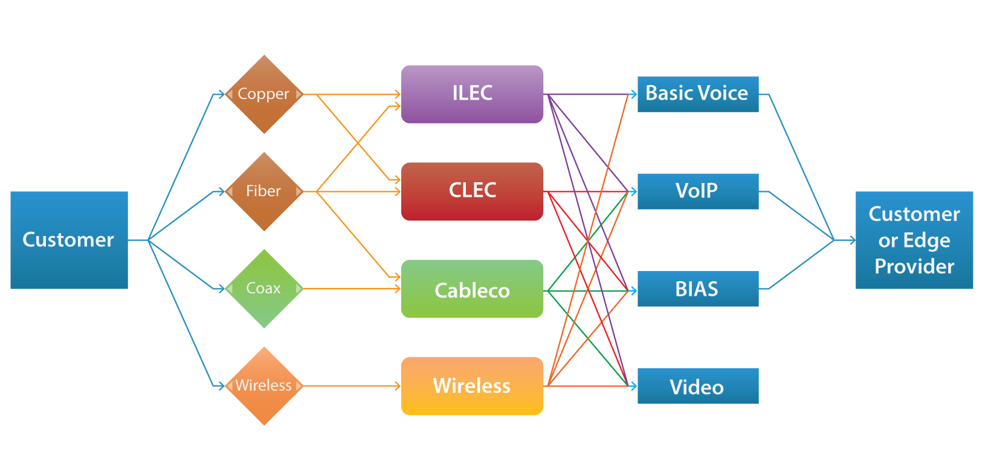
Networks and services

Slide 6
What is the IP Transition NOT?
NOT necessarily a change in network wireline facilities
NOT a change from copper to fiber
Copper can handle IP transmission
NOT an excuse for ILECs to slough off customers
NOT a reason for removing consumer protections
Does NOT require elimination of voice-only service
See posting on my blog, “A Transition to WHAT? And where are we now?”*

Slide 7
The key for customers: The distinction between facilities and/or services
ILECs seek retirement of facilities, i.e., copper lines – with and without ceasing services
AT&T – retiring copper and not replacing it with a wireline service
Verizon – That plus retiring copper in favor of fiber or wireless
Withdrawal of services, esp. of basic service (e.g., OH statute)
Can basic service be offered over fiber? Yes, according to Verizon .
Time Warner Lifeline in NY – basic service over coax
Does it matter whether the facilities are IP-enabled? No.

Slide 8
How can we look at these changes?
Which facilities retirements and service withdrawals are necessary parts of the IP transition?
Which are not necessary parts but instead only part of a particular firm’s business plan?
Does the public interest allow such changes?
AT&T grandfathering
Is the trial working?
Was it a forgone conclusion?
Verizon?
“Customer choice”? Migrate or lose service?

Slide 9
POTENTIAL EFFECTS OF THE IP TRANSITION ON CONSUMERS, COMPETITION, UNIVERSAL SERVICE AND PUBLIC SAFETY
Consumers
Loss of services
Increased cost for basic service; upselling to bundles (triple play +)
Disadvantages to customers on legacy facilities (i.e., neglect)
Excuse for deregulation
Universal service
We’re now talking about TWO essential services: voice and broadband (see Broadband Lifeline Order)
Needs to be ubiquitously available, at reasonable and affordable prices
Consumer protections available to all
§ 254
Public safety
Focus on 911 sunny-day and rainy-day problems with the IP network
E.g., 4/14 multi-state outage caused by oversight
3/16: Erie County NY; Honolulu HI
Competition
Harm to competition is harm to consumers

Slide 10
The § 214(a) protection
In the CAF II Order¹, the FCC forebore from ETC general responsibilities for price cap (large) ILECs where they receive no high-cost support. Did not forbear from Lifeline or for non-price cap (small) ILECs.
But even where there is ETC forbearance, service must continue until a § 214(a) petition has been granted by the FCC
CAF II Order stressed the continuing importance of § 214(a)²
See 13-5 FNPRM (8/7/15)³
AT&T grandfathering proposals in 13-5 (October 30, 2015)⁴
No withdrawal of basic service yet
Note slide in AT&T Report⁵
FCC process; state notice and processes
E.g., OH (burden on customers)
§ 214(a) facilities retirements without service withdrawal
Remember Verizon and basic service
See my blog, “A Relinquishment Briefing”**

Slide 11
Is losing basic service a true loss?
Depends on what replaces it!
Service without obligation to serve
Service without consumer protection
Arbitration clauses?
Service without back-up power
Service without access to medical alerts, alarms, faxes

Slide 12
QUESTIONS? FURTHER DISCUSSION?
Contact info
Telecom Policy Consulting for Consumers
tpc4c.net
david.c.bergmann@gmail.com
(614) 771-5979

Slide 13
Links
* http://tpc4cnotsoquicktakes.wordpress.com/
** Id.
https://apps.fcc.gov/edocs_public/attachmatch/FCC-15-97A2.pdf
https://apps.fcc.gov/edocs_public/attachmatch/FCC-14-190A1.pdf.
https://apps.fcc.gov/edocs_public/attachmatch/FCC-15-97A1.pdf
http://apps.fcc.gov/ecfs/document/view?id=60001331668
5. http://apps.fcc.gov/ecfs/document/view?id=60001326674.

