Slide 1
NASUCA Annual Meeting Austin, Texas November 10, 2015
Moving Toward Demand-Based Residential Rates
Scott J. Rubin, Attorney + Consultant
333 Oak Lane + Bloomsburg, PA 17815
Office: (570) 387-1893 + Cell: (570) 850-9317
scott.j.rubin@gmail.com

Slide 2
Bonbright’s Rate Design Principles
Practicality (simple, understandable, ability to implement, and acceptable to the public)
Clarity in its interpretation
Effectiveness in yielding the total revenue requirement
Stability in revenues from year to year
Continuity of rates, including the concept of gradualism
Fairness in relation to the cost of serving different types of customers
Avoidance of undue discrimination among similarly situated customers
Encouragement of efficient consumption practices

Slide 3
One Thing …
with apologies to Jack Palance and Billy Crystal
Curly: Do you know what the
secret of rate design is?
Curly: This.
Mitch: Your finger?
Curly: One thing. Just one thing. You stick to that and the rest don't mean shit.
Mitch: But, what is the "one thing?"
Curly: Customers. You must analyze the impact on real customers.

Slide 4
The Problem
For electricity and gas distribution service, essentially all costs are either customer-related or demand-related
Most existing residential rate designs have two components: customer charge and usage charge
Neither of those is precisely equal to (or proportional to) a customer’s demand
Annual usage is correlated with demand, but the correlation may be weak (especially for high off-season use, like electric space heating)
Collecting demand-related costs in the customer charge (same amount per customer) is not consistent with cost causation
Is there a better way to design residential rates consistent with cost causation?

Slide 5
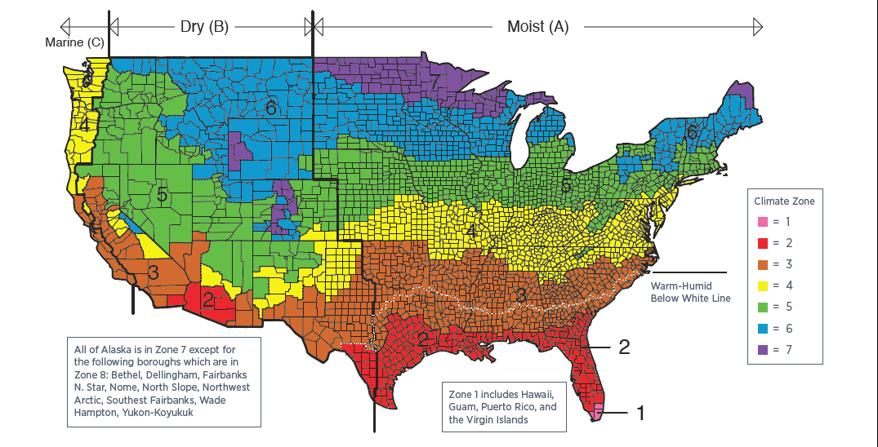
Some examples based on real data
Actual data for 77,000 residential electricity customers in Climate Zone 5 (green area): summer cooling load and some electric space heating
Data set has monthly kWh and annual coincident peak kW
Monthly demands estimated from DOE residential demand curves

Slide 6
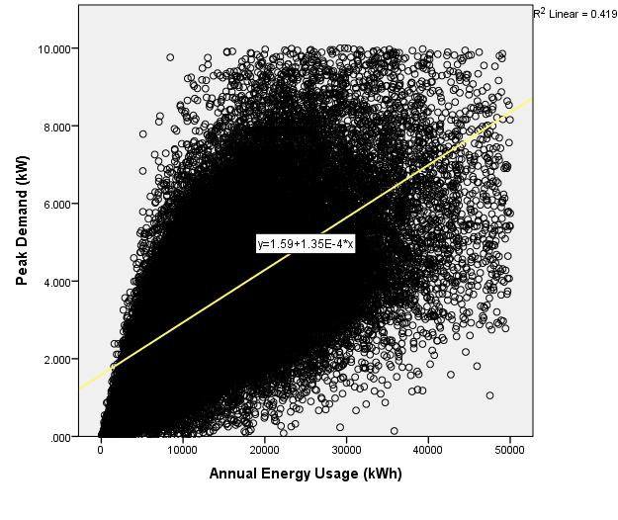
Relationship Between Annual Peak Demand and Annual Energy Consumption
There is a positive, but weak, correlation between annual energy usage and contribution to the annual system peak
R² = 0.419
ρ < 0.001

Slide 7
Some Rate Design Options for Collecting Demand-Related Distribution Costs
All options include a customer charge for customer-related costs (metering, billing, call center, etc.)
Uniform per-kWh charge (“All kWh”)
Split between fixed charge (60%) and per-kWh charge (40%) (“Split”)
Demand charge based on previous year’s annual peak (“Annual Demand”)
Demand charge based on monthly (billing) demand (“Billing Demand”)
Seasonal per-kWh rates (higher rates in peak season) (“Seasonal” and “All Summer”)

Slide 8
Evaluation of Options
Rates and revenue requirement are hypothetical
Assume that the Annual Demand option represents the actual allocated cost of serving each customer
Evaluate other options against that measure of cost
Closer R² is to 1.0, closer the option comes to matching each customer’s revenues with its cost of service
Real world will be more complex
COSS may include multiple measures of demand for different types of costs (4 CP, NCP, etc.)
Concerns with specific customer segments (e.g., low-income, electric space heating)

Slide 9
How Well Does Each Rate Design Track Each Customer’s Cost of Service?
Option | R-Squared
All kWh | 0.419
Split | 0.419
Billing Demand | 0.426
Seasonal | 0.550
All Summer | 0.846
(All are statistically significant (ρ < 0.001)

Slide 10
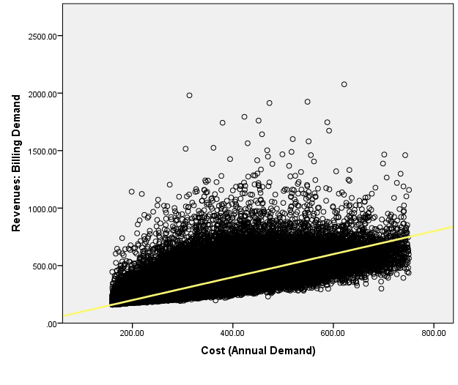
“Billing Demand” Revenues Compared to Cost of Service
R² = 0.426
Many bills greatly above cost
Line is revenue = cost

Slide 11
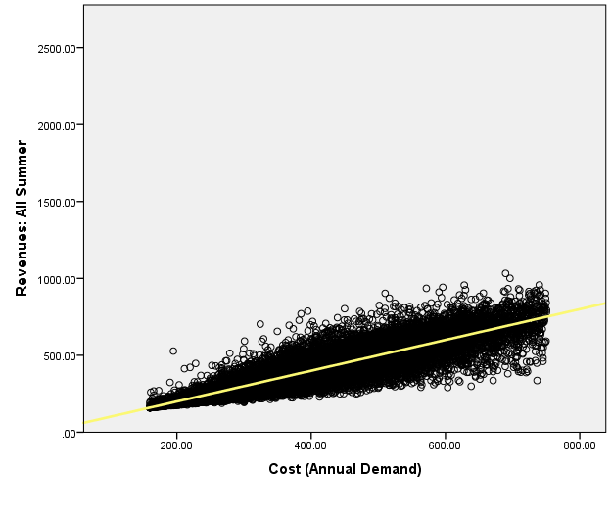
“All Summer” Revenues Compared to Cost of Service
R² = 0.846
Much closer match between revenues and costs
Line is revenue = cost

Slide 12
What are the Impacts on Customers’ Bills?
Option | Average % Change | Min / Max % Change | 10th / 90th Percentile | % of Bills that Increase
Annual Demand | 4.4% | -76% / +162% | -29% / +32% | 62%
Billing Demand | 0.6% | -40% / +183% | -14% / +16% | 43%
Split | 4.6% | -25% / +49% | -14% / +24% | 60%
All Summer | 3.0% | -76% / +74% | -26% / +26% | 63%
Seasonal | 0.7% | -19% / +18% | -6% / +6% | 61%
It is assumed that existing rate structure is the “All kWh” structure. Each customer’s bill under each rate option is compared to the “existing” bill under the All kWh structure.

Slide 13
Bill Impacts: Billing (Monthly) Demand
In this data set, rates based on billing demand cause significant bill changes, but almost no improvement in ability to track cost causation (R² of 0.426 vs. 0.419 under All kWh rate)

Slide 14
Bill Impacts: Seasonal kWh Rate
In this data set, seasonal kWh rates (summer rate that is twice the winter rate) improves the relationship of rates to cost (R² of 0.550 vs. 0.419 under All kWh rate) without causing extreme bill impacts

Slide 15
Conclusions
Actual customer data must be analyzed to evaluate the impact of different rate design options
Rate impacts might surprise you (in this analysis, for example, essentially no improvement in cost relationship when move to rates based on billing demand)
Goal is to move toward a rate design that improves the relationship to cost without causing drastic changes in annual bills
Remember the One Thing: Customers. Get data for each customer and analyze the actual bill impacts (and relationship to cost) of different rates design options

Slide 16
Read More About It
Paper forthcoming in The Electricity Journal:
Moving Toward Demand-Based Residential Rates, by Scott J. Rubin
http://dx.doi.org/10.1016/j.tej.2015.09.021

