Slide 1
Consumer Engagement in an Advanced Grid
November 8
Joseph Paladino
NASUCA 2015 Annual Meeting
Austin, TX
November 8 – 11, 2015

Slide 2
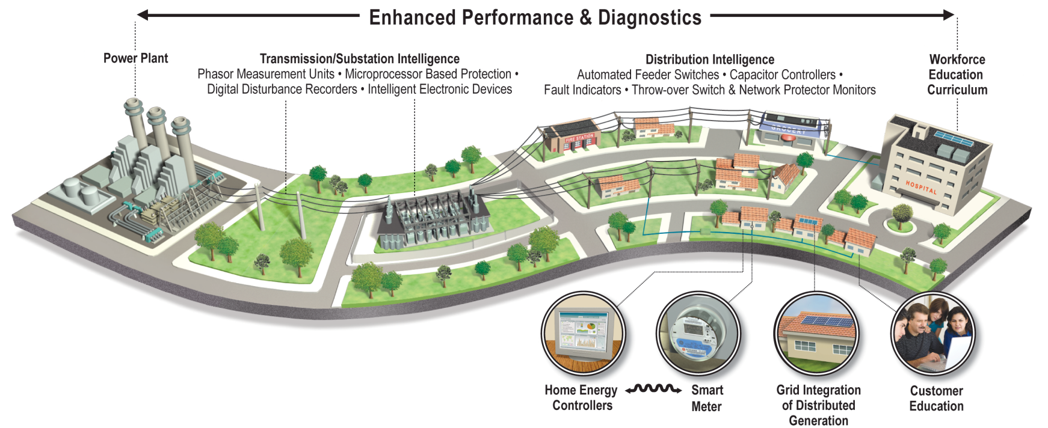
Smart Grid Today
A smarter grid applies digital technologies with communications and IT infrastructure to improve the reliability, security, efficiency, and flexibility of the electric system.
Image used courtesy of Florida Power and Light

Slide 3
SMUD Consumer Behavior Study
Rate Period | Price Level (¢/kWh)
 | Flat w/CPP | TOU | TOU w/CPP
Base/Off-Peak <700 kWh | 8.5 | 8.5 | 7.2
Base/Off-Peak >700 kWh | 16.7 | 16.6 | 14.1
Peak | n/a | 27.0 | 27.0
Critical Event | 75.0 | n/a | 75.0
Scenario | Benefit/Cost Ratio | 10 Year NPV ($ millions)
 |  | Benefits | Costs | Net Benefits
Default TOU, no IHD | 4.48 | $66.9 | $15.0 | $52.0
  DOE/LBNL developed rigorous methodology and supported a Technical Advisory Group for each project to assist in project design and evaluation
  Survey results indicate 59% of customers preferred some type of time-based pricing design (TOU or CPP) over the existing tiered rate structure and preferred TOU over CPP pricing by roughly 2 to 1
  Due to the study’s results, SMUD (and CA) are planning to institute TOU in 2018 (Rulemaking 12-06-013; 4/21/2015)
    "Many parties have discussed SMUD's SmartPricing Options (SPO) pilot as a landmark study due to its scientific rigor and use of experimental design."
Notes:
Sources:
SMUD (2013). SmartPricing Options Interim Evaluation. Sacramento Municipal Utility District and Freeman, Sullivan & Co.: October 2013.
“Provide SmartPricing Options Pilot Final Evaluation Results”. Board Policy Committee, Agenda Item #1. June 17, 2014.
Notes:
SMUD has 600,000 customers
$308 million total project cost; $10 million for the pricing study (SmartPricing Options)
Approx 5000 customers enrolled in the study

Slide 4
Value-Based Reliability Planning
Iberdrola (CMP) and Ameren have applied the ICE Calculator in the filings to their regulators; NY and other states are interested in measuring societal benefits in benefit-cost analysis
July 5, 2012 Derecho in Chattanooga
Avoided customer outage minutes are translated into avoided customer costs by the Interruption Cost Estimation (ICE) Calculator
(www.icecalculator.com)
Automated feeder switching technology:
Equipment cost $51 million
In this storm, avoided $23 million in damages to customers, eliminated 500 truck rolls, and reduced restoration costs to the utility by $1.4 million by restoring 1.5 days early
Number of customers experiencing sustained outages
Time (hours)
Notes:
Chattanooga example demonstrates use of Smart Grid Technologies and application of the ICE Calculator damage estimation tool
An outstanding example of how smart grid technology has avoided costs to customers and utilities by millions of dollars is in the July 2012 storm (derecho) response in Chattanooga, TN.
EPB of Chattanooga estimated that power outages resulted in an annual cost of $100 million to the community.
With an SGIG grant, EPB deployed a city-wide fiber optic system to support grid and other city operations, as well as automated feeder switches and smart meters.
The July 5, 2012 wind storm was the same derecho that hit the East Coast. Although, 80,000 customers were affected, the installed automated feeder switches restored power to 40,000 customers within 1-2 seconds.
Also, the utility was able to restore power 1.5 days earlier as a result of the smart grid technology saving the utility approx $1.4 million.
We can apply the Interruption Cost Estimation (ICE) Calculator to determine the avoided costs or damages to customers based on the avoided outage hours and understanding the make-up of the customer population where outage duration was reduced.
The ICE Calculator applies customer damage information obtained from 24 utility surveys conducted from 1998 – present (data for residential, commercial and industrial customer types).
With help from utilities, DOE will continue to gather information on customer damages from “blue-sky” reliability events, as well as from major, high-impact events.
Also, DOE will work with utilities to gather information that correlates infrastructure upgrades (e.g., asset hardening, smart grid deployment, and DER deployment, including microgrids) with reliability/resiliency improvement.
Currently, working with several utilities to develop case studies to show costs/benefits from specific types of infrastructure upgrades.
Also working with EPRI and IEEE in this area.
The objective is to advance cost/benefit analysis methodology that can help utilities choose an optimum set of infrastructure upgrades given constrained resources.

Slide 5
Conservation Voltage Reduction
Conservation voltage reduction (CVR) reduces customer voltages along a distribution feeder for lowering peak demands and overall energy consumption
OG&E:
Control algorithm set voltage levels at the substation
  Applying smart meter data
  Capability turned on when power price exceeds $0.22/kWh
Achieved 8 MW reduction from application of VVC technology on 50 circuits during Summer 2011
Goal – 74 MW reduction over 400 circuits by 2017 (SGIG contributes to 16 MW)
“CVR-off”
Voltage
“CVR-on”
Distance along circuit
PNNL 2010 GRID-LAB-D Analysis:
National deployment of CVR can provide a 3.0% reduction in annual energy consumption for the electricity sector. 80% of this benefit can be achieved from 40% of feeders.
CVR Study (due January 2016):
Report on technology applications, impacts and institutional hurdles. Seeing energy reductions ranging from 0.75 – 3.0% and peak reductions from 0.84 – 7.0%.
5
Notes:
Studies dating back to the 1980s have shown that small reductions in distribution voltage can reduce electricity demand from customer equipment and save energy. This has become known as “conservation voltage reduction (CVR)”.
Recent utility pilot programs have demonstrated that lowering distribution voltage by 1% can reduce demand and energy consumption by 1% or more.
In addition:
25 SGIG projects are deploying advanced VVC:
11 are applying conservation voltage reduction (CVR) to reduce peak load –
Up to 200 MW reduction for one utility (over 100’s of circuits)
7 are using CVR to reduce energy consumption
Many are improving ability for reactive power compensation
Multitude of equipment integration and control schemes –
Many are applying distributed management systems
Some are using smart meter data

Slide 6
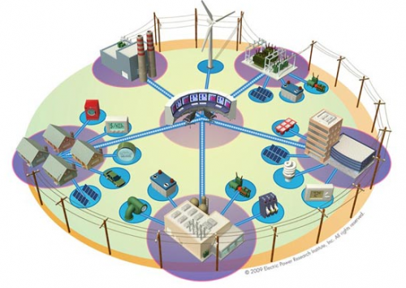
Smart Grid Tomorrow
Integration of renewable and distributed resources (electric cars, smart buildings, PV, energy storage, microgrids, community energy)
Shared ownership and responsibility of the electric grid planning and operations
Multi-directional flow of energy, information and money
Evolved model for the utility business and how it is regulated to ensure reliability, efficiency, affordability, security and innovation
Value creation through integrated networks and convergence (smart cities)

Slide 7
Distribution System Evolution
Focus of Regulation and Advocacy
Distribution as an enabling platform
Expanding customer services
Reforming regulation
E21 Initiative – Utility 2.0
REV Proceeding
DPU 12-76-A
Microgrid Initiative
AB 327 Implementation
Utility 2.0 Initiative
IOU Solar PV Ownership
Order No. 32053
Regulatory Proceeding/s
Governor Initiative
Potential Regulatory Action

Slide 8
High Levels of DERs
Balancing Authority/ Transmission System Operator
NY State Energy Plan – By 2030 achieve 40% reduction in greenhouse gases and 50% electricity from renewable sources
FERC
State Regulator:
Applies policies for efficiency, reliability, affordability
Rate design (volumetric vs fixed)
Utility business model
Performance incentives (innovation)
Microgrid
DSO
Merchant DER
Distribution System Operator:
Probabilistic forecasting of DER penetration
Value determination of DERs (asset deferral and grid services)
Distribution resources plan
Pricing mechanisms for DERs (contracts, tariffs, spot markets)
Transparency in planning to DER providers
Integrated planning with TSO and DERs
Manage markets and operations
End-use Customers & behind-the-meter DER
Adapted from L. Kristov and P. De Martini

Slide 9
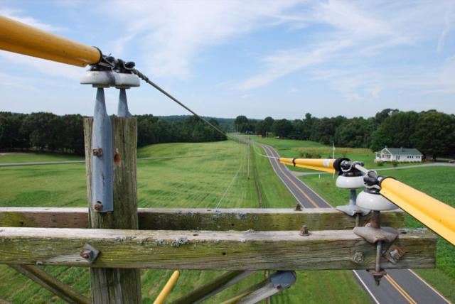
Contact Information
Joe Paladino
202-586-6916
joseph.paladino@hq.doe.gov
www.smartgrid.gov
9

