Slide 1
Clean Power Plan Handbook
For the National Association of State Utility Consumer Advocates
November 10, 2015
Elizabeth A. Stanton, PhD
Sarah Jackson

Slide 2
Synapse Energy Economics
Research and consulting firm specializing in energy, economic, and environmental topics
Leader for public interest and government clients in providing rigorous analysis of the electric power sector
Services include economic and technical analyses, regulatory support, research and report writing, policy analysis and development, representation in stakeholder committees, facilitation, trainings, and expert witness services
Develops resources such as the Synapse Clean Power Plan Toolkit to promote transparent decision-making
All non-confidential publications and open-source tools available for free at www.synapse-energy.com

Slide 3
Why We Are Here Today
Synapse was funded by the Energy Foundation to assist consumer advocates in reviewing EPA’s final Clean Power Plan
The culmination of this work is our Clean Power Plan Handbook: A Consumer Advocate’s Guide to Understanding the Final Rule, which we are presenting today
To date, we have also hosted two webinars exclusively for NASUCA members in which we:
provided an in-depth overview of the final Clean Power Plan, and
received feedback from NASUCA members on an early draft of the Handbook

Slide 4
Clean Power Plan Handbook: A Consumer Advocate’s Guide to Understanding the Final Rule

Slide 5
Overview of the Clean Power Plan Handbook
Executive Summary
Section 1: Introduction
Section 2: Evolution of the Clean Power Plan
Section 3: Notable changes to the final rule
Section 4: Target setting
Section 5: State compliance planning
Section 6: Demonstrating compliance
Section 7: EPA estimates of Clean Power Plan costs and benefits
Section 8: Key issues for consumer advocates

Slide 6
Overview of the Clean Power Plan Handbook
Executive Summary
Section 1: Introduction
Section 2: Evolution of the Clean Power Plan
Section 3: Notable changes to the final rule
Section 4: Target setting
Section 5: State compliance planning
Section 6: Demonstrating compliance
Section 7: EPA estimates of Clean Power Plan costs and benefits
Section 8: Key issues for consumer advocates

Slide 7
Section 3: Notable Changes to the Final Rule

Slide 8
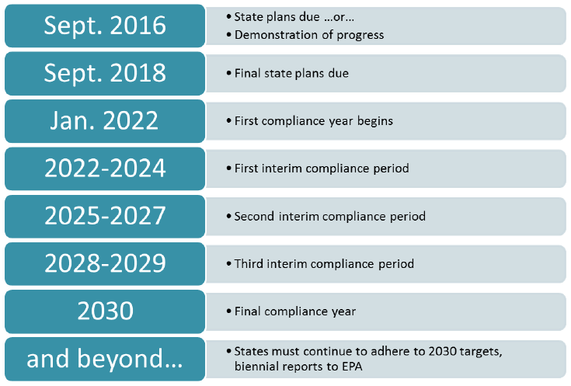
Timeline for Compliance
First date for compliance pushed back from 2020 to 2022
Two additional years to complete final State Plans
States still expected to demonstrate progress during an interim period through 2029 and must meet the final compliance targets by 2030

Slide 9
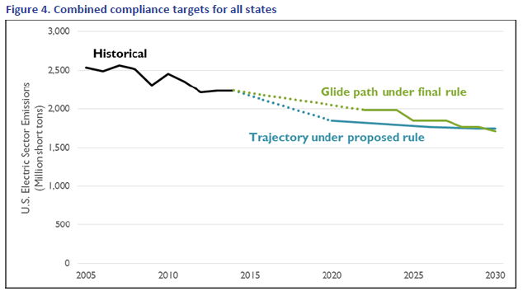
Glide Path
Final rule establishes a “glide path” that gradually steps down each state’s compliance target over the course of three interim compliance periods
This helps smooth out the “compliance cliff” of concern in some states where significant reductions would have been needed at the beginning of the compliance period

Slide 10
New Target Calculations
Targets now based on emission performance rates established for two subcategories of emitters: fossil steam units (e.g., coal and oil generators) and stationary combustion turbines (e.g., natural gas combined cycle units)
Heat rate improvements at coal units have been reduced and differ according to where power plants are located
Natural gas combined cycle (NGCC) re-dispatch now calculated based on summer peak generating capacity, rather than nameplate, and an assumption that they can operate at a 75 percent capacity factor level, rather than at 70 percent; phased in over the compliance period
Renewable energy is now based on EPA’s estimate of potential availability, rather than on regional renewable portfolio standards
The target calculation itself is now largely done at the interconnect level

Slide 11
Displacement Now Considered in Target Setting
The final Clean Power Plan targets account for generation and emissions displaced by new renewable energy generation
This means that for every MWh produced by renewables, an equivalent amount of generation and associated emissions are subtracted from the calculation

Slide 12
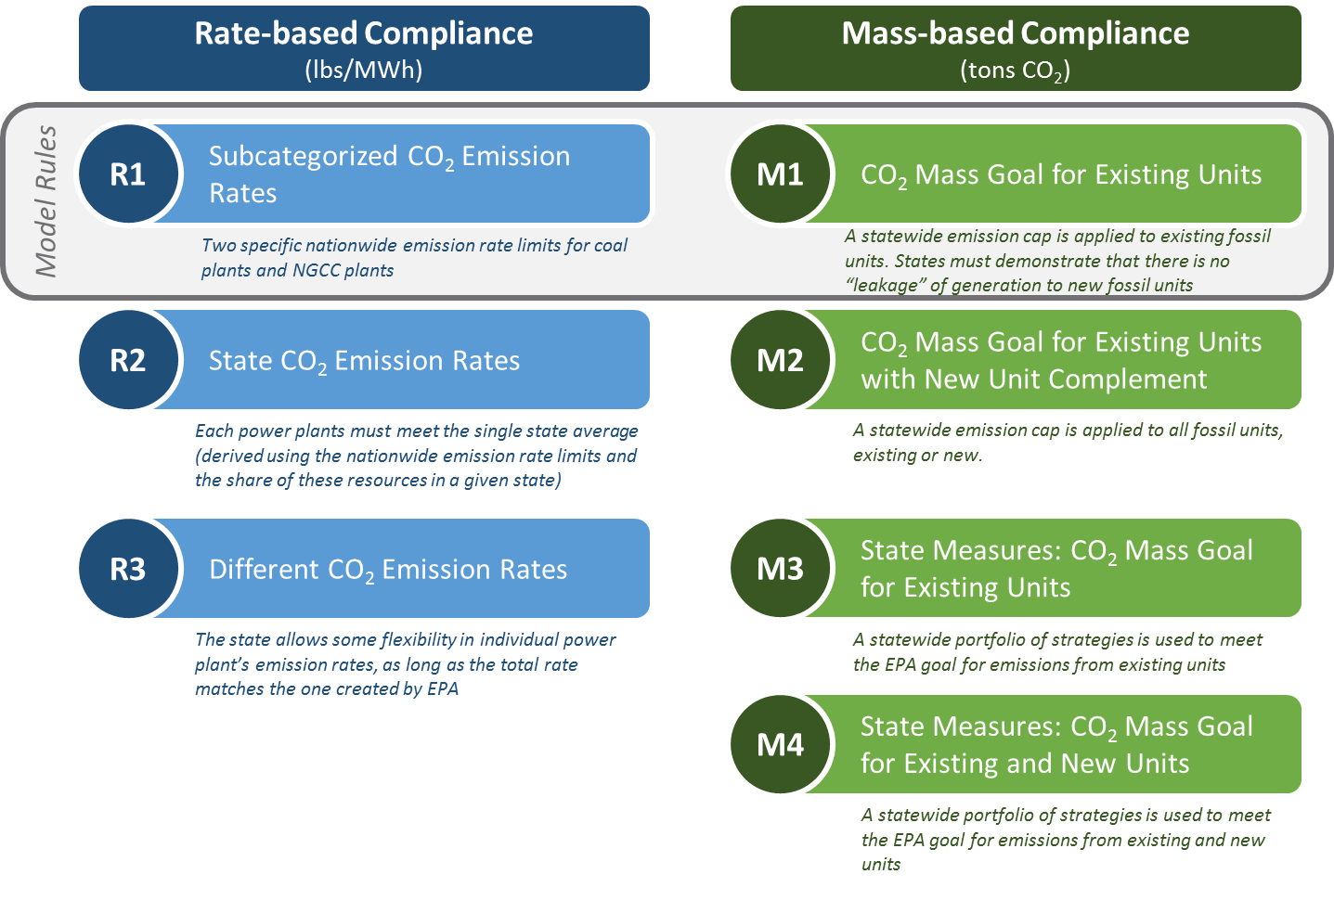
New Pathways for Compliance

Slide 13
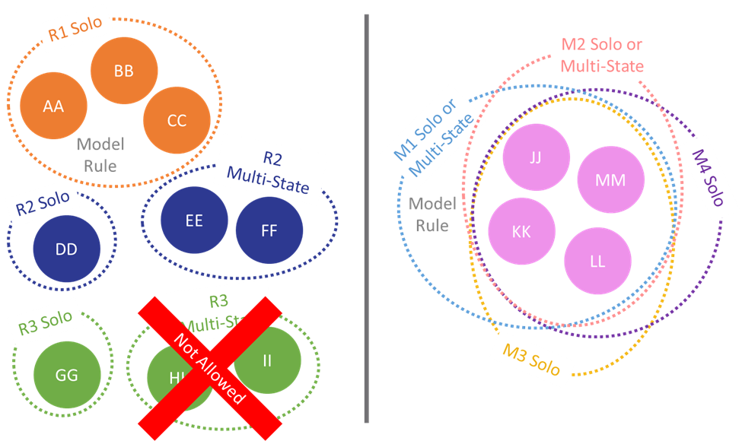
Emphasis on emissions trading
Rate-based trading: uses Emissions Rate Credits (ERCs) measured in MWh representing (in most cases) one MWh of zero-emission generation
Mass-based trading: uses
allowances measured in short tons
of CO₂

Slide 14
Reliability
States must demonstrate that they have considered reliability in developing their state plans
EPA has included a temporary “reliability safety valve” in case unforeseen emergencies arise that would impact reliability
Safety valve is only available under state plans; no safety valve is available under a federal plan

Slide 15
Incentives for Early Action
Clean Energy Incentive Program encourages and rewards early installers of certain types of renewable energy and energy efficiency measures
Wind and solar resources and low-income energy efficiency measures can earn credits for generation or savings that occur in 2020 and 2021
These “early action” credits can be sold to fossil generators for use during the compliance period
EPA is currently taking comment on the design of this program

Slide 16
Community and Environmental Justice Concerns
Under CEIP, EPA matches ERCs 1:1 for energy efficiency programs in low-income communities
EPA also outlines a series of critical deadlines related to community and environmental justice issues during state plan development and final plan submittal (discussed in more detail later in presentation)

Slide 17
Section 8: Key Issues for Consumer Advocates

Slide 18
Key Issues for Consumer Advocates
Intrastate coordination
States will benefit from early and comprehensive internal coordination among departments of environmental protection, air quality agencies, state energy offices, public utility commissions, and consumer advocate offices
Public process requirements: states must provide opportunity for public review and comment on draft plans and must hold at least one public hearing before submitting plans to EPA
Multi-state coordination
Consider the benefits of coordinating with other states to maximize opportunities for low-cost compliance options
Designing compatible interstate trading programs, either through multi-state plan development or through ready-for-interstate-trading plans, is one key way to maximize opportunities
Coordination with ISOs/RTOs is important

Slide 19
Key Issues for Consumer Advocates (Cont.)
Least-cost planning
EPA did not use least-cost planning in developing targets
States will need to undertake least-cost planning in order to determine the right combination of options for reducing electric sector CO₂ emissions
Wholesale price of energy
Depending on its design, the price instrument necessary to shift dispatch from high-emitting coal and oil plants to lower-emitting gas plants can have either a strongly inflating effect or a neutral effect on the wholesale price of energy
Inflated wholesale market prices would mean more money for existing low-emission resources and higher costs to consumers
Looking to existing carbon markets (e.g., RGGI, California’s AB32 program) will provide useful insights into effective program design

Slide 20
Key Issues for Consumer Advocates (Cont.)
Mass- versus rate-based compliance
States will need to evaluate which approach is right for them
EPA has performed the rate-to-mass translation, accounting for potential load growth in that translation process
A rate-based approach may be beneficial for states anticipating greater-than-expected demand growth or states building large new nuclear units
A mass-based approach is likely the easier, more cost-effective approach for most other states, including coal-heavy states anticipating the retirement of coal units regardless of the Clean Power Plan
Emissions from new sources
States should consider the inclusion of new fossil generating units—those covered by Section 111(b) of the Clean Air Act—in mass-based compliance plans
Plans using this approach may be presumptively approvable way to address leakage concerns

Slide 21
Key Issues for Consumer Advocates (Cont.)
Coal retirement
States should monitor opportunities for retirement of uneconomic fossil plants as a means of compliance with the Clean Power Plan
States should evaluate under which approach—mass- or rate-based—such retirements would provide the most benefit
Enforceability
All measures included in any of the rate-based compliance planning approaches would become federally enforceable
States that would like to include state measures (e.g., RPS or EERS) to reduce emissions can avoid having their state policies become federally enforceable by choosing the “State Measures” approach under a mass-based compliance pathway
Nuclear challenges and opportunities
Nuclear generation has been dropped from the target setting process but can still be used to comply with state targets
Consumer advocates should consider the risks and opportunities associated with new and uprated nuclear facilities

Slide 22
Key Issues for Consumer Advocates (Cont.)
Efficiency measurement
Energy efficiency is no longer included in the target setting process but can still be a valuable, low-cost compliance tool
The more standardized the rules for measuring and verifying efficiency measures are across the country, the easier it will be for states to coordinate for compliance purposes
Rate and bill impacts
Synapse analysis demonstrates that compliance with the Clean Power Plan will result in higher rates but lower bills for energy efficiency participants in most states
Based on EPA expectations that energy efficiency will still play a large role in compliance, a growing number of consumers participating in energy efficiency programs would be expected to see the benefit of lower bills
On the other hand, customers not participating in efficiency programs will not share in benefits and will face higher costs

Slide 23
Key Issues for Consumer Advocates (Cont.)
Clean Energy Incentive Program - States need to decide whether to participate in the CEIP:
Provides incentives for early action
Provides incentives for low-income EE programs
Helps counter any perceived incentive to delay planned installations or adoption of state programs encouraging EE/RE
Value of early action credits will be determined by the market for credits during the compliance period

Slide 24
Key Issues for Consumer Advocates (Cont.)
Community and environmental justice considerations
During initial plan submittal: States are required to provide information about community engagement and their plans to include vulnerable communities in finalization of the state plan
If requesting two-year extension: States must demonstrate meaningful engagement with vulnerable communities in a public participation process
During submittal of the final state plan: States must include an overview of the public hearings conducted and information about how the hearings they held were accessible to vulnerable communities
During the implementation phase of the rule: EPA plans to conduct its own assessments on emission reduction and potential negative localized impacts in the states, but encourages states to begin conducting their own community impact studies prior to implementation to uncover any immediate issues
Equity
Wide participation in efficiency programs is an important consideration to ensure that the allocation of costs and benefits among different customer types is equitable and does not unfairly burden any one group of customers (such as low-income households)

Slide 25
Questions?

Slide 26
Contact Information
Elizabeth A. Stanton: eastanton@synapse-energy.com
Sarah Jackson: sjackson@synapse-energy.com

Slide 27
Resources

Slide 28
Synapse Resources
Publications (www.synapse-energy.com/search-view)
Coming soon: Clean Power Plan Handbook: A Guide for Consumer Advocates
Best Practices in Planning for Clean Power Plan Compliance: A Guide for Consumer Advocates
Implications of EPA's Proposed Clean Power Plan: Analyzing Consumer Impacts of the Draft Rule
Consumer cost analysis (www.synapse-energy.com/project/consumer-costs-low-emissions-futures)
Webinars (www.synapse-energy.com/synapse-projects-and-webinars-related-clean-power-plan)
Updates to Synapse's CP3T – September 16, 2015
Recordings of past webinars available at the above link
Open-source tools (www.synapse-energy.com/tools)
Clean Power Plan Toolkit
Clean Power Plan Planning Tool (CP3T)
Coal Asset Valuation Tool (CAVT)

