Slide 1
CPP Compliance Options: Reliability, Affordability, and Sustainability NASUCA Mid-Year Meeting June 7, 2015

Slide 2
About NASEO and State Energy Offices
NASEO represents the 56 governor-designated energy offices from each state and territory. State Energy Directors:
Advise governors, legislatures, and regulators
Advance practical energy policies and support energy technology research, demonstration, and deployment
Partner with the private sector to accelerate energy-related economic development and enhance environmental quality
Engage in the development of state energy policies and the oversight of billions of dollars in state-based energy funding
Lead state energy policy planning in most states

Slide 3
NASEO’s Affiliates
A robust and engaged network of +60 private-sector partners, including representatives from business, trade associations, nonprofit organizations, educational institutions, laboratories, and government.

Slide 4
NASEO CPP Approach
NASEO has not taken a position on 111(d)
Support inter- and intra- State Energy Office, Air Agency, and Utility Commission discussions
If CPP moves forward NASEO seeks to:
maintain electricity system reliability and affordability
ensure maximum compliance flexibility for states
enable least cost compliance (e.g., EE – supply and demand, distributed resources, voluntary actions)
EPA should provide states the opportunity to use both state-overseen ratepayer efficiency programs and public and private non-ratepayer approaches (e.g., ESPC, Superior Energy Performance, CHP, building energy codes, ENERGY STAR, C-PACE, Weatherization)

Slide 5
NASEO’s Key CPP Takeaways
Recognize the electricity system is changing rapidly and already faces multiple challenges (technology disruption, environmental quality, economic sustainability), and must also deliver reliable, affordable power to support state economic goals
Advance options for states that leverage private existing energy efficiency (demand and supply) and distributed energy investments to provide least cost approaches that support system reliability, generation fuel diversity, and affordability
Ensure that efficiency program EM&V is as streamlined as possible (i.e., don’t let perfect be the enemy of the good) while providing environmental agencies verifiable emissions reductions
Assist states in working with the private sector to accelerate “no-regrets” efficiency actions (ESPC, codes, EE financing)
Continue State Energy Office, State Air Agency, and State Utility Commission collaboration through inter-state, multi-state, and the 3Ns. Energy and air issues are complex and need all of our ideas, efforts, and solutions … goes beyond 3Ns

Slide 6
NASEO CPP Activities
Ongoing cooperation with the National Association of Clean Air Agencies (NACAA) and National Association of Regulatory Utility Commissioners (NARUC) to coordinate state assistance efforts
Hosted “3N” consensus process “Energy Efficiency Principles”: http://www.naseo.org/Data/Sites/1/principles_3n_2014.pdf
(e.g., reliability, national energy efficiency registry, credit for early action)
3N Efficiency Case Studies Meeting: December 2015
3N Efficiency Plan Language Meetings: March 2015
Engage States, Utilities, Energy Industry, advocacy groups, federal agencies on reliability, cost and EE compliance (ongoing)
111(d) planning sessions at NASEO Annual Meeting September 2015
State 111(d) Resource Hub: www.111d.naseo.org/

Slide 7
Energy Efficiency Opportunities – “No Regrets” Actions
Utility ratepayer EE programs ~$7B billion annually (portion of project costs)
Public facilities retrofits and ESPC ~$6B of private investment annually (total project cost)
NASEO developed multi-state ESPC tracking project (e.g., VA, GA, KY) to leverage broad energy, economic, environmental benefits
Building Energy Code Compliance
NASEO-led pilot code compliance program (e.g., TX)
Private industrial efficiency (e.g., Superior Energy Performance / ISO 50001; CHP)
Energy financing programs (e.g., WHEEL, C-PACE) (States oversee >$5B in EE and RE financing programs)
Statewide comprehensive energy planning that supports, for example, evolving utility business model policies, distributed generation, storage, micro-grids

Slide 8
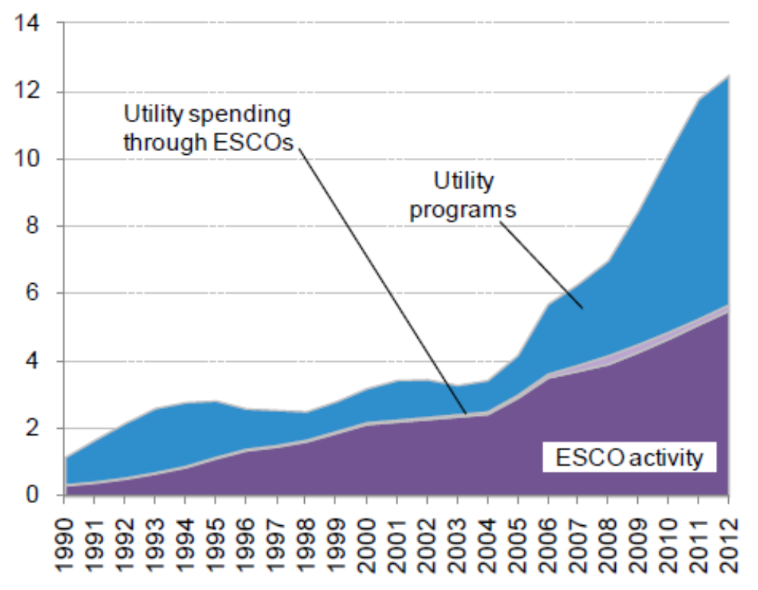
Privately-Delivered Energy Efficiency
Investment in Energy Efficiency Through ESPC 1993-2012
($ billion)
ESPC doesn’t rely on taxpayer or ratepayer investment
~$7B+ U.S. market investment annually
Projected to grow to $10-15 billion by 2020
Scalable for CPP compliance
Slide Source: RAP; Bloomberg New Energy Finance

Slide 9
NASEO Ongoing/Upcoming CPP Activities
Ongoing cooperation with NACAA and NARUC to coordinate state assistance efforts
Create EE compliance case studies and plan language for state consideration and submission to EPA (Summer 2015)—codes, ESPC, CHP, Sup Energy Perf…
Advance voluntary national energy efficiency registry concept (e.g., 3N comments 2014; engage states and industry 2015)
Support multi-state collaboration proposing work with the Climate Registry and NASEO to create a national energy efficiency registry to use for existing and future state and federal air rules and energy planning (2015 – pending funding)
Promote multi-state and intra-state dialogue among State Energy Offices, air agencies, and utility commissions
NASEO will provide increased assistance and support to State Energy Offices in plan input and analysis (Sept. 2015 - ongoing)
NASEO multistate meetings with EPA regional officials (Sept. 2015 - ongoing)
Establish a CPP energy efficiency compliance coordination calls (various DC and regional groups) and NASEO State Energy Office task force (2015)
State 111(d) Resource Hub: www.111d.naseo.org/

Slide 10
Next Steps . . .
1. Continue work with States, NARUC and NACAA, as well as NASUCA, ECOS, utilities, trade associations…
2. Complete Efficiency Pathways/Cases – NASEO is working with private sector partners (JCI, Honeywell, Schneider Electric, NEMA, AGA, NAIMA, USGBC) in developing case studies on programs for consideration by States and submission to EPA:
State, local and federal public facility retrofits – ESPC
Building energy codes (residential and commercial)
CHP and Industrial EE / Superior Energy Performance
Other Areas: C-Pace, Multifamily, Supply Side EE
3. Work with TCR and states to create a National Energy Efficiency Registry - broad energy/air program value
4. Support State-Industry CPP Coordination meetings/calls
5. Provide assistance to states on EE and reliability issues and support multi-state efforts

Slide 11
Contact Information
David Terry, Executive Director
Jeff Genzer, General Counsel
Donna Brown, Director, Finance and Accounting
Charles Clinton, Senior Advisor, Regional Program
Sandy Fazeli, Program Director, Financing
Stephen Goss, Program Manager, Fuels and Grid Integration
Brian Henderson, Senior Advisor, Buildings
Maurice Kaya, Senior Advisor, Grid Integration
Bill Nesmith, Senior Advisor, China-US Eco-Partnerships
Garth Otto, Manager, Operations and Accounting
Jeff Pillon, Director, Energy Assurance
Cassie Powers, Program Manager, Transportation
Melissa Savage, Senior Program Director, State Policy
Todd Sims, Program Manager, Buildings Programs
Rod Sobin, Senior Program Director, Energy-Air Policy
Shemika Spencer, Program Director, Energy Assurance
2107 Wilson Blvd
Suite 850
Arlington, VA 22201
Phone: 703.299.8800
www.naseo.org

