Slide 1
Making 111(d) Decisions
National Association of State Utility Consumer Advocates
June 9, 2015
Franz T. Litz
Litz Energy
Strategies

Slide 2
Blank Sheet of Paper

Slide 3
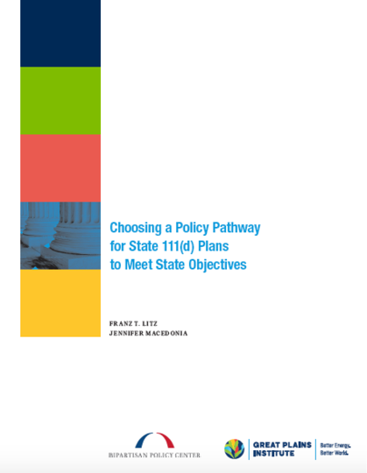

Slide 4
Putting Pen to Paper
What are our objectives for a 111(d) plan?
Cost effective
Maintain reliability
Achieve the environmental goal
Flexibility for regulated entities
Regulatory certainty
(for regulated entities and economic regulators)
Simplicity and ease of implementation
Limit federal involvement in state energy decisions
Maintain fuel diversity
Recognize unique state circumstances
Capture reductions from all activities
Preserve the option to connect to other states
Consistency with electricity system

Slide 5
Threshold Decisions
Rate- or mass-based approach?
What entities are to be regulated?
How much flexibility?
Trading or no trading?
Allow power plant owners to use
allowances or credits from other states?

Slide 6
Cross-Cutting Issue
Self-correcting plan?
Self-correcting plan achieves
goal with certainty
Non-self-correcting plan
requires assessment at
milestones and corrective measures

Slide 7
Overview of Policy Pathways

Slide 8
Regulated Entities? | Rate-based | Mass-based
Covered Power Plants & Other Entities | State Portfolio/Commitment Approach | State Portfolio/Commitment Approach
Utilities | Utility Rate Approach | Utility Budget Approach
 | Utility Rate Approach w/ Optional Trading | Utility Budget Approach w/ Optional Trading
Plant/Unit Level | Full Rate-based Trading | Full Mass-based Trading
Notes:
Recall we said that once a state and its stakeholders decide what it wants to accomplish with its 111(d) plan, there are threshold decisions, including rate-based or mass-based? Who is regulated? How much flexibility? Preserve ability to use allowances or credits from another state? All of these questions are imbedded in this table that we’ll examine here in a minute.

Slide 9
Regulated Entities? | Rate-based | Mass-based
Covered Power Plants & Other Entities | State Portfolio/Commitment Approach | State Portfolio/Commitment Approach
Utilities | Utility Rate Approach | Utility Budget Approach
 | Utility Rate Approach w/ Optional Trading | Utility Budget Approach w/ Optional Trading
Plant/Unit Level | Full Rate-based Trading | Full Mass-based Trading

Slide 10
Making an Individual State Plan “Trading Ready”
The Idea:
Power plant owners can use (mass-based) tons or (rate-based) credits from other states without the states filing a joint plan, and without the need for (much) coordination between the states.
How?
By making the plans compatible— to both EPA and the other states.

Slide 11
Minimum Compatibility Requirements
EPA establishes a few basic rules.
Utility in a state that meets the minimum compatibility requirements has the option use tons or credits from another state that meets the requirements.
Each state also decides which other states have compatible programs, and allows tons or credits to come from those states.

Slide 12
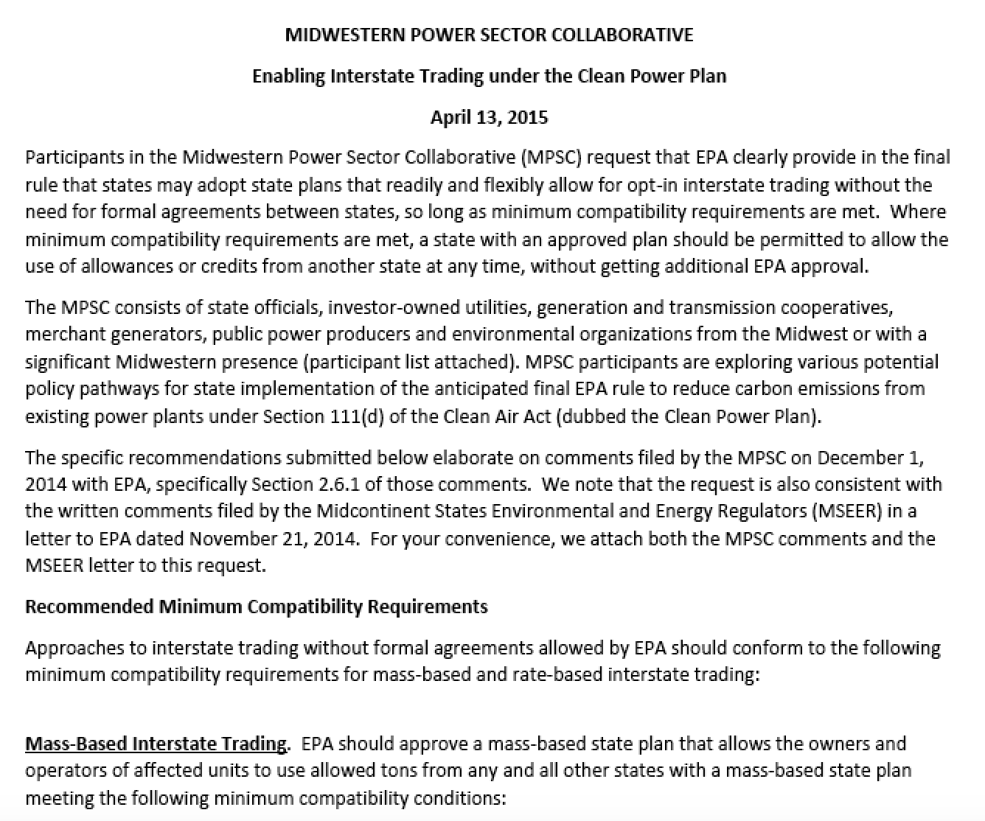

Slide 13
Regulated Entities? | Rate-based | Mass-based
Covered Power Plants & Other Entities | State Portfolio/Commitment Approach | State Portfolio/Commitment Approach
Utilities | Utility Rate Approach | Utility Budget Approach
 | Utility Rate Approach w/ Optional Trading | Utility Budget Approach w/ Optional Trading
Plant/Unit Level | Full Rate-based Trading | Full Mass-based Trading

Slide 14
A Compatible Mass-based Plan
Step 1. Establish mass budget
Step 2. Decide utility level or plant level
Step 3. Allocate shares of budget
Steps 4, 5 & 6. Rulemaking language, tracking system & emissions reporting
Step 7. Finalize rulemaking & administer
To administer: administer tracking system, undertake compliance assessments, & enforce

Slide 15
What makes it compatible?
Hypothetical two states:
EPA-approved budget is firm.
Every affected unit has to cover every ton of emissions with an allowance.
Nothing about the program would allow the “printing” of additional tons or lift the requirement to cover emissions with tons.
Tracking system has integrity.

Slide 16
Could this work for rate-based trading?
Maybe.
EPA would have to drop the requirement that states average their goals together.
EPA—and state—would have to decide that credits are the “same” even though they come from states with different rates, and different crediting reqts.
Tracking system has integrity.

Slide 17
Franz T. Litz
franz@litzstrategies.com
Litz Energy
Strategies

